Slide 1
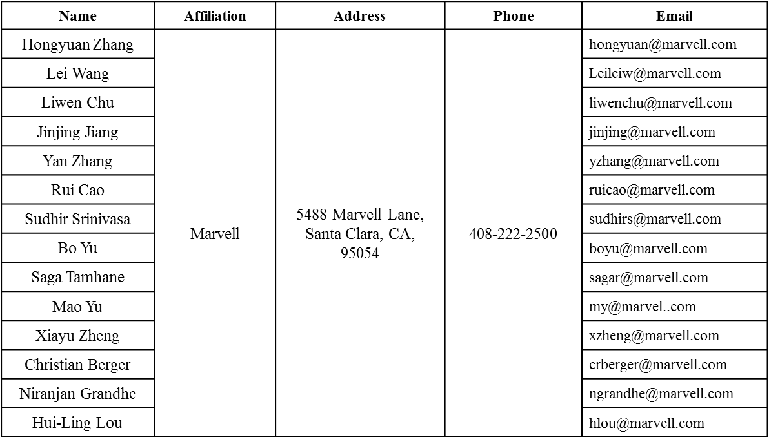
BW Field in HE-MU Format
Date: 2016-07-25
Authors:

Slide 2
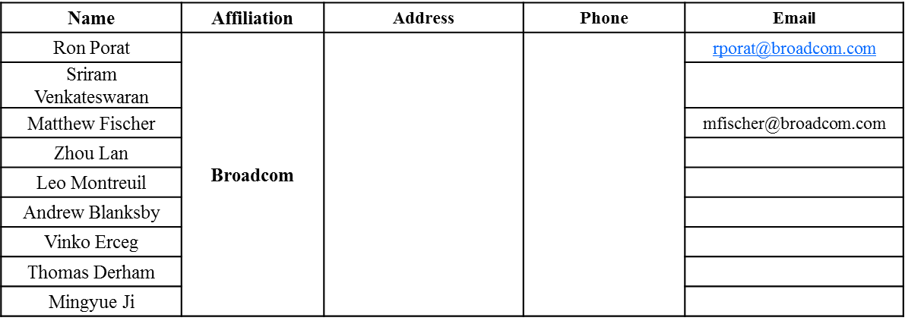
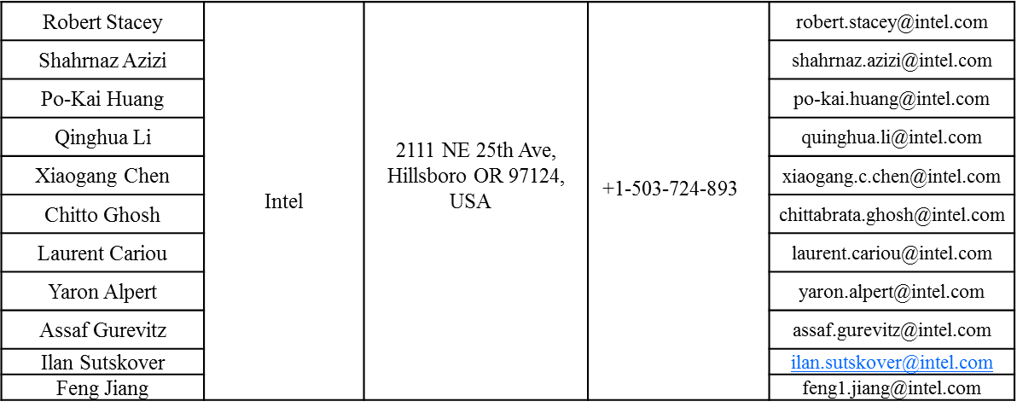
Authors (continued)

Slide 3
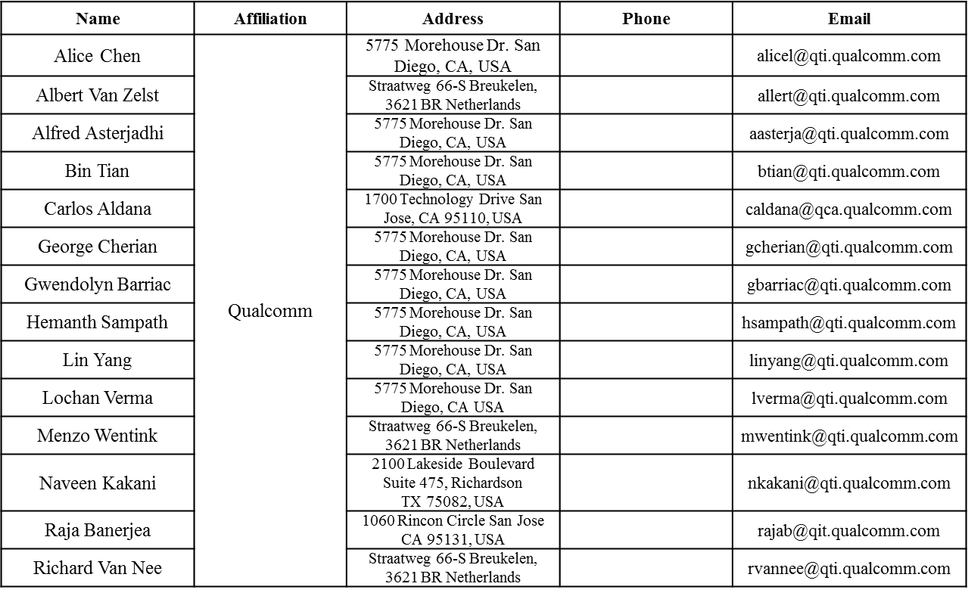
Authors (continued)

Slide 4
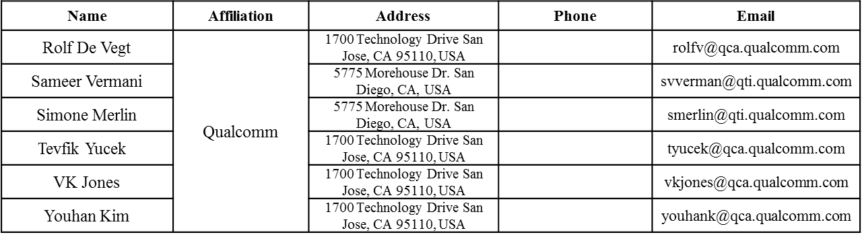
Authors (continued)

Slide 5
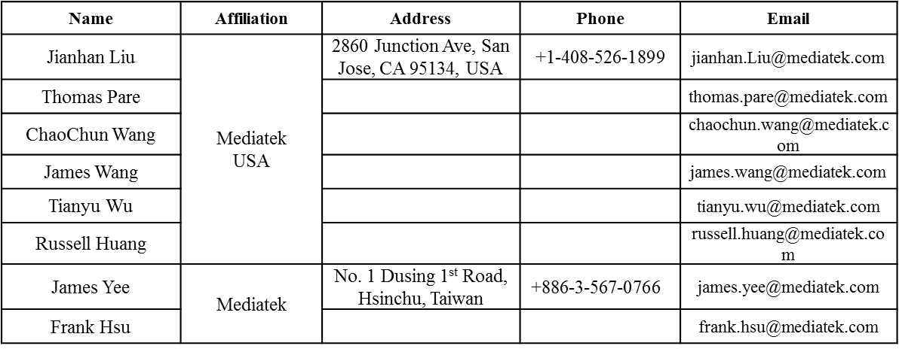
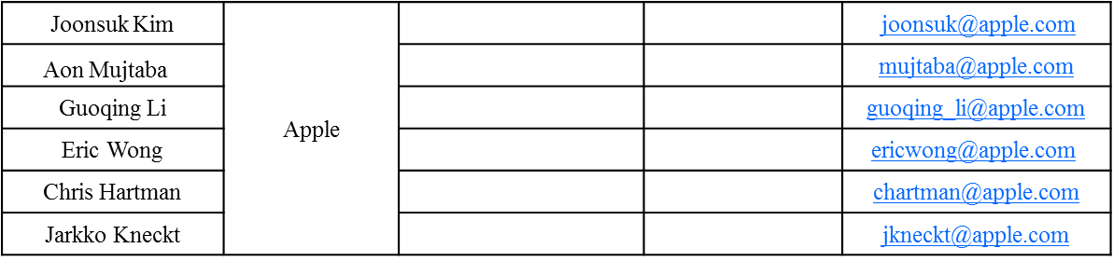
Authors (continued)
Authors (continued)

Slide 6
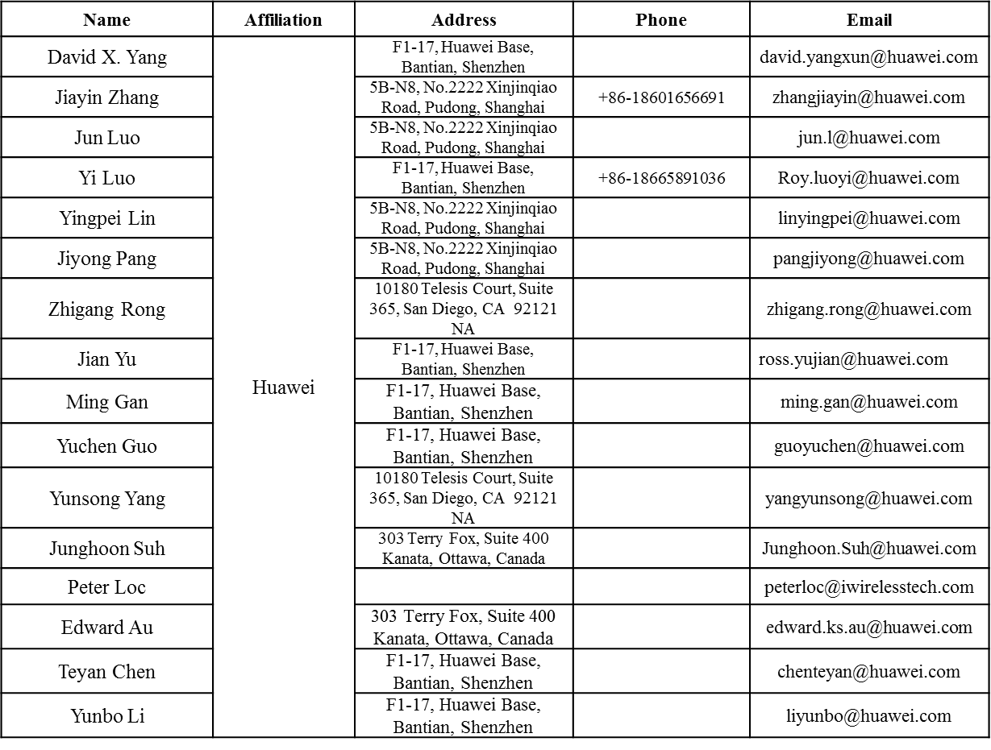
Authors (continued)

Slide 7
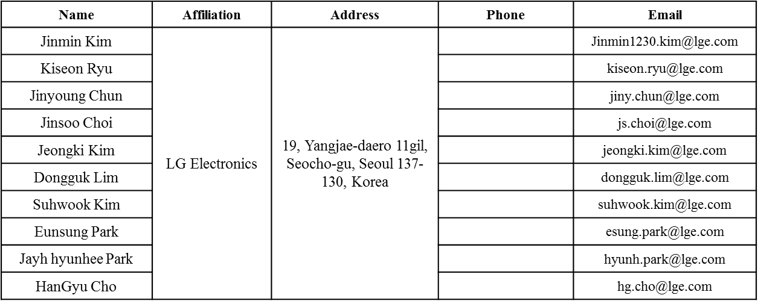
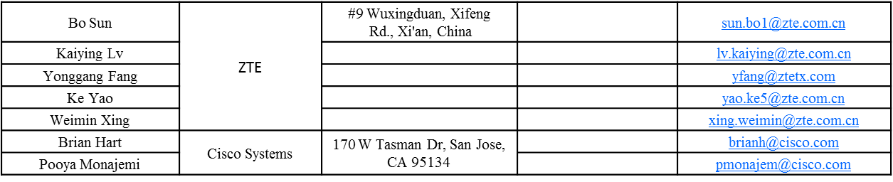
Authors (continued)

Slide 8
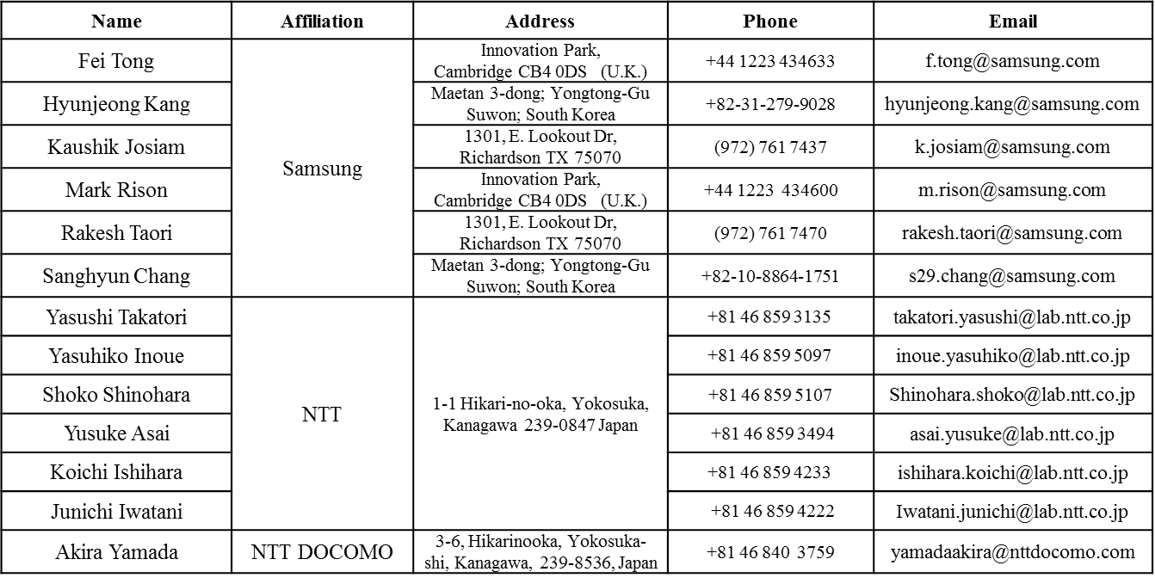
Authors (continued)

Slide 9
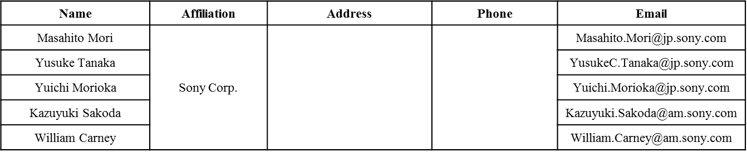
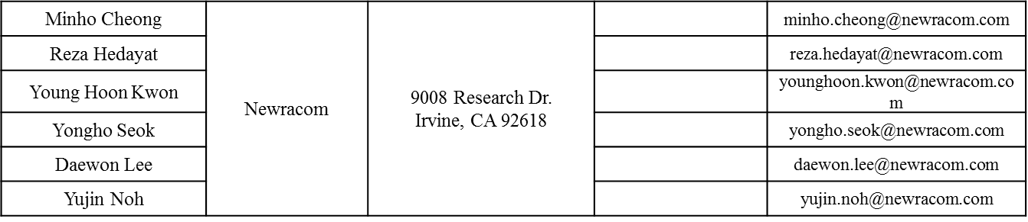
Authors (continued)

Slide 10
Authors (continued)

Slide 11
Overview
Non-Contiguous Channel bonding was adopted by 11ax [1].
The bandwidth field in HE-SIG-A of a HE MU format has 3 bits to signal the corresponding puncturing modes in the preamble [2].
  Excluding the 4 basic BW modes (20/40/80/160(80+80)), 4 additional modes may be indicated by BW field.

Slide 12
On the Name “Non-Contiguous Channel Bonding”
The name “bonding” is not very accurate, because we are not doing carrier aggregation but actually digitally puncturing tones.
  There will be non-negligible spectral leakage in the continuous frequency points in the punctured 20MHz channels that is not in the exact subcarrier locations.
With or without this “bonding”, the spectral mask should be identical as defined for the full BW (20/40/80/160(80+80) masks).
Proposals:
  Change the term “Non-contiguous channel bonding” to “channel puncturing”.
  The BW field in HE-SIG-A of HE-MU format indicates “preamble puncturing”.

Slide 13
Criteria for Preamble Puncturing—1
Preamble puncturing happens only for 80MHz and 160MHz, therefore in the primary 80MHz without puncturing, there are two 20MHz subchannels carrying the HE-SIG-B content channels 1 and 2 respectively.
For receiver implementation simplicity (i.e. to reduce the SIGB decoding variations), it is desirable to have at least one instance of the 1st SIG-B content channel and one instance of the 2nd SIG-B content channel being present in primary 80 MHz.

Slide 14
Criteria for Preamble Puncturing—2
The following puncturing mode for 80MHz are possible:
Preamble Puncturing
Mode 1:
P20
S20
S40
In 11ac, S20 CCA busy leads to 20MHz Tx, ~3x Throughput over 11ac
Receiver is able to decode SIGB-C1 and SIGB-C2 from the known puncturing landscape
Preamble Puncturing
Mode 2:
P20
S20
S40-L
S40-R
OR
P20
S20
S40-L
S40-R
Receiver is able to decode SIGB-C1 and SIGB-C2 from P40

Slide 15
Criteria for Preamble Puncturing—3
The following puncturing mode for 160MHz (or 80+80MHz) are possible:
Preamble Puncturing
Mode 3:
P20
S20
S40
S80
In 11ac, S20 CCA busy leads to 20MHz Tx, up to ~7x Throughput of 11ac!
Receiver is able to decode SIGB-C1 and SIGB-C2 from the known puncturing landscape
Preamble Puncturing
Mode 4:
P20
S20
S40-L
S40-R
S80
OR
P20
S20
S40-L
S40-R
S80
OR
P20
S20
S40-L
S40-R
S80
Puncturing may happen in S80, but not need to be signaled by SIGA, because typically SIGB decoding won’t use S80.
In 11ac, S40 CCA busy leads to 40MHz Tx, up to ~3.5x Throughput of 11ac!
Receiver is able to decode SIGB-C1 and SIGB-C2 from the P40.

Slide 16
Proposals
Propose to limit preamble puncturing in P80 only to the above mentioned 4 modes.
  SIGB content channels 1 and 2 are both present in primary 80MHz, therefore no need to change the current SIGB encoding structure and content (“[1 2 1 2]” structure).
Capability: propose to define 4-bit capability on these 4 additional CB modes.
In the above mentioned preamble puncturing modes 2 and 4, SIGB RU allocation may further signal which 20MHz sub-channel the in secondary 40MHz is punctured
In the above mentioned preamble puncturing modes 3 and 4, SIGB RU allocation may further signal which 20MHz sub-channel the in secondary 80MHz is punctured
Spectral Mask: propose no spectral mask change with channel puncturing.
  i.e. in channel puncturing modes, the transmitted waveforms only need to conform to the original 80MHz or 160MHz masks.

Slide 17
Straw Poll 1
Do you agree with the following definition of the BW field in HE-SIG-A of HE_MU format?
  The 3-bit BW field in HE-SIG-A of HE-MU format is defined as:
    0: Full 20MHz
    1: Full 40MHz
    2: Full 80MHz
    3: Full 160/80+80 MHz
    4: 80MHz with Preamble Puncturing: in the preamble, only the secondary 20MHz is punctured
    5: 80MHz with Preamble Puncturing: in the preamble, only one of the two 20MHz subchannels in secondary 40MHz is punctured
    6: 160/80+80MHz with Preamble Puncturing: in the primary 80MHz of the preamble, only the secondary 20MHz is punctured.
    7: 160/80+80MHz with Preamble Puncturing: in the primary 80MHz of the preamble, the primary 40MHz is present
  Furthermore:
    In Mode 5, HE-SIG-B RU allocation may signal which 20MHz sub-channel the in secondary 40MHz is punctured
    In Mode 6 and Mode 7, HE-SIG-B RU allocation may signal additional puncturing in secondary 80MHz.
    In Mode 7, HE-SIG-B RU allocation may signal additional puncturing in secondary 40MHz.
    Modes 4~7 are optional for STA to receive, each with a capability bit
    In the Preamble Puncturing modes (Modes 4~7), the spectral mask is the same as those defined for the total bandwidth.
    Regardless of Preamble Puncturing modes, the structure of HE-SIG-B is the same, i.e. the HE-SIG-B structure is solely dependent on the total BW

Slide 18
Straw Poll 2
Do you agree to adopt the spec text changes as shown in doc 11/16-0899r0 (reflects the content of SP1)?

Slide 19
References
[1] 11-16-0059-01-00ax-non-contiguous-channel-bonding-in-11ax
[2] 11-16-0635-02-00ax-bw-indication-for-non-contiguous-channel-bonding

