Slide 1
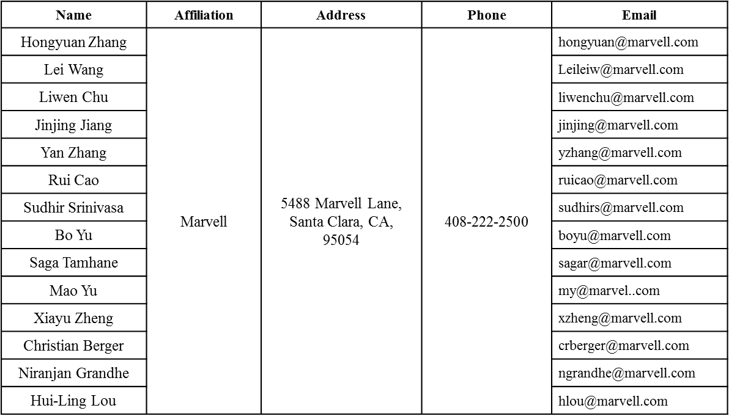
11ax Beamformee Capabilities
Date: 2016-07-25
Authors:

Slide 2
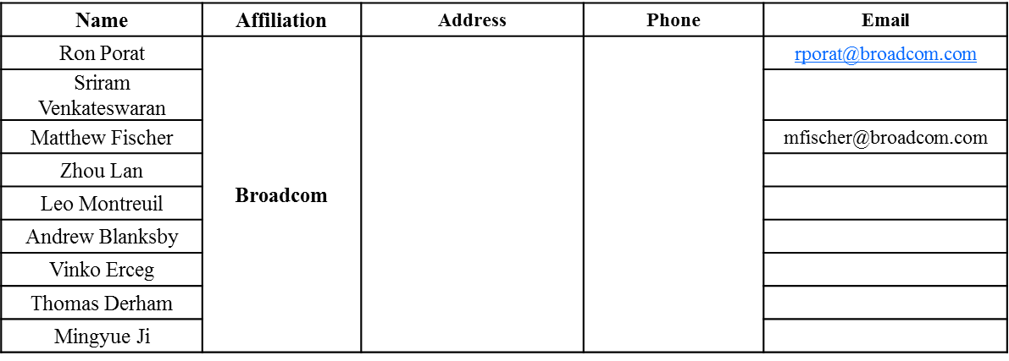
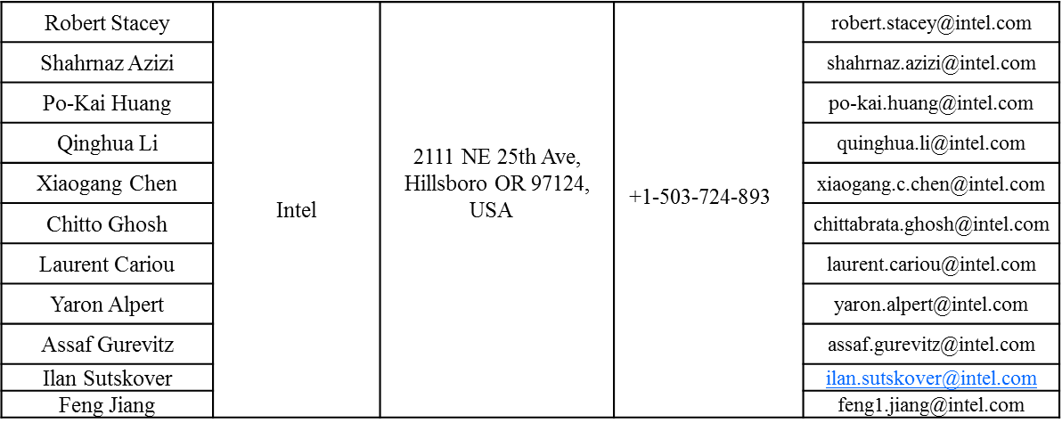
Authors (continued)

Slide 3
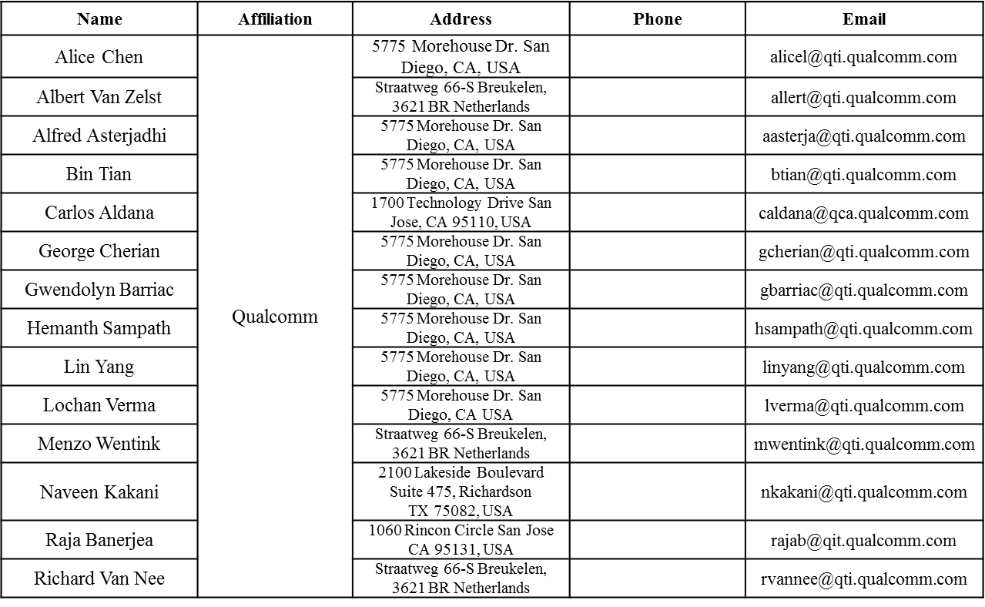
Authors (continued)

Slide 4
Authors (continued)

Slide 5
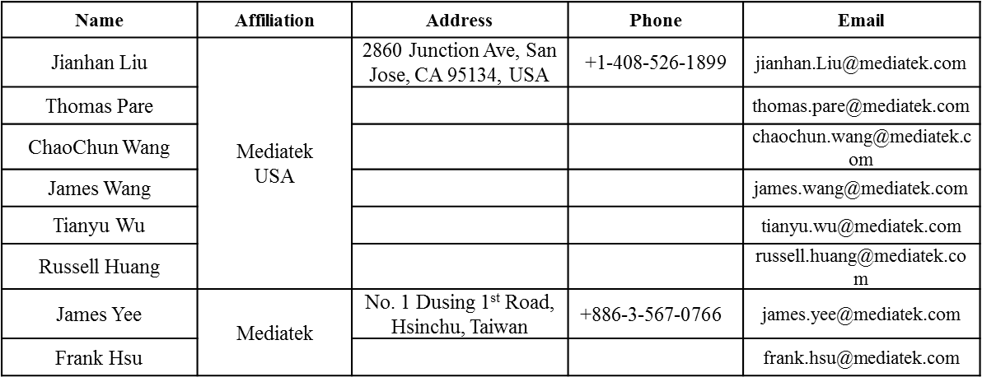
Authors (continued)
Authors (continued)

Slide 6
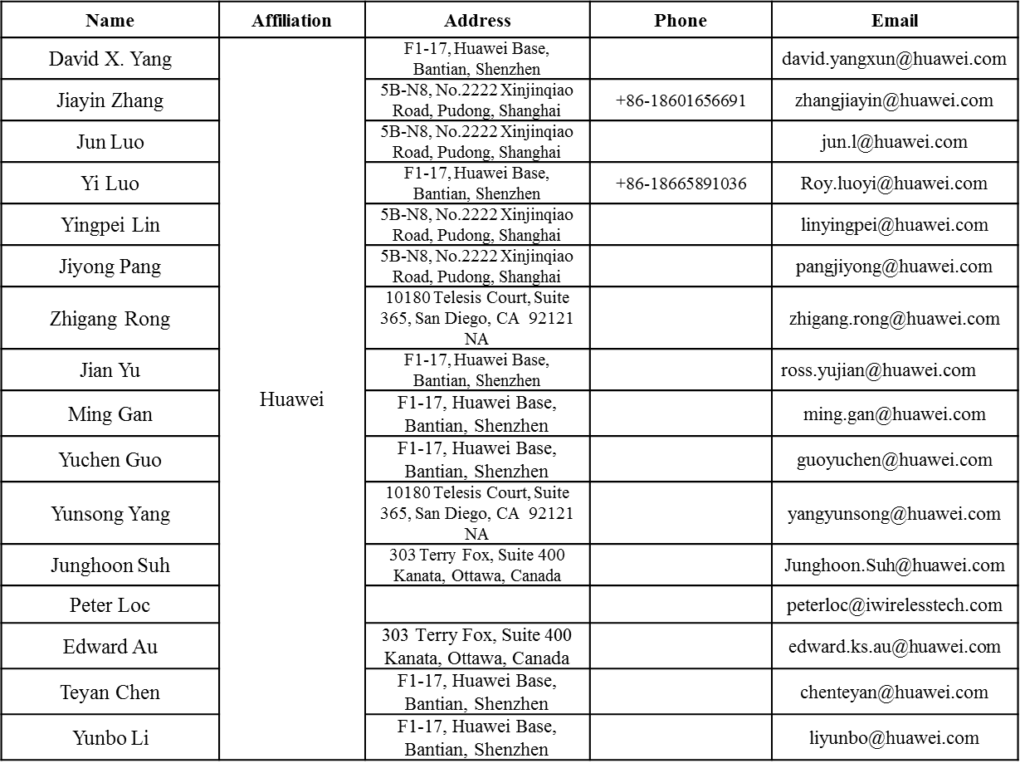
Authors (continued)

Slide 7
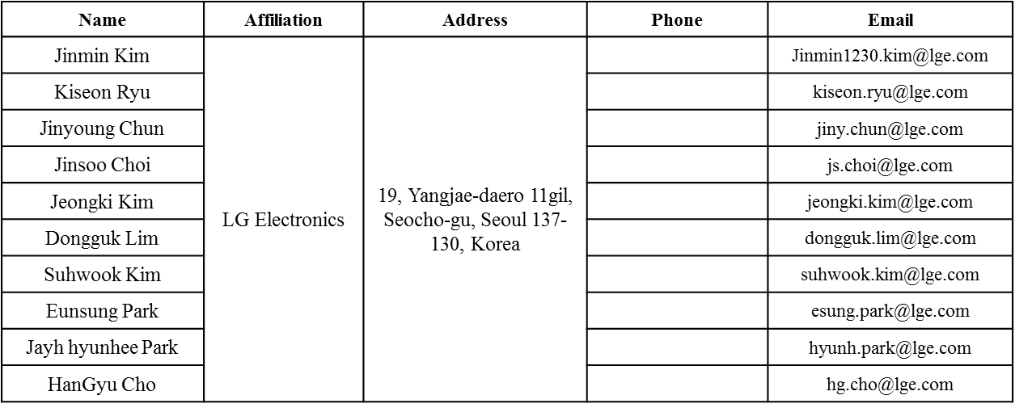
Authors (continued)

Slide 8
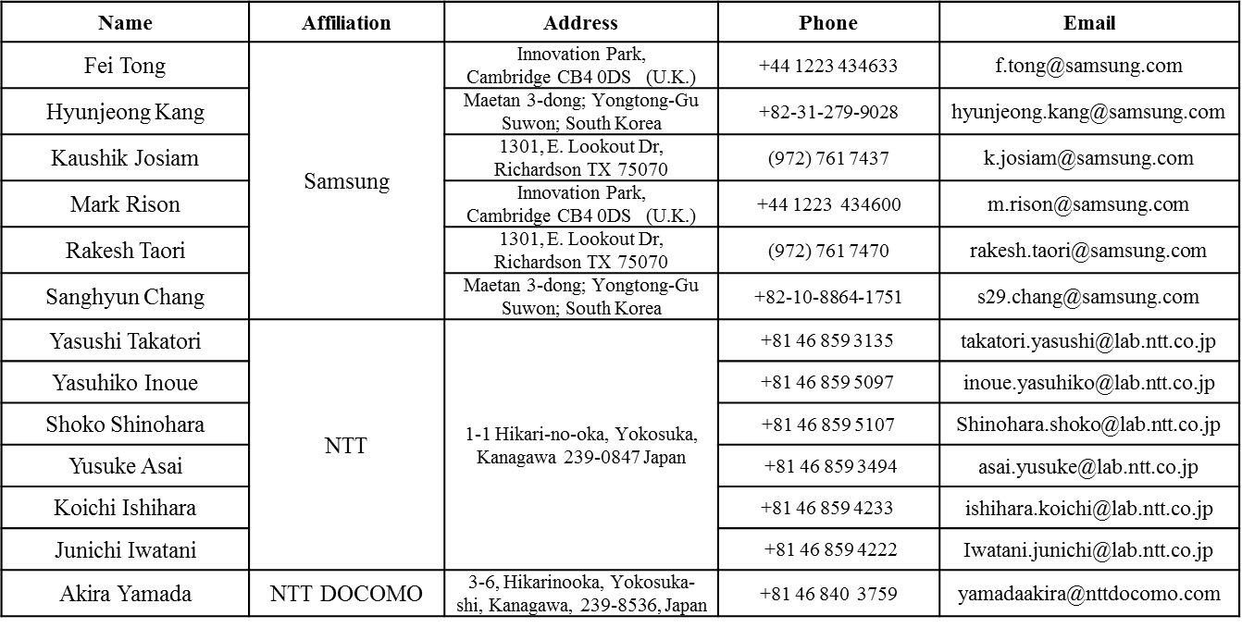
Authors (continued)

Slide 9
Authors (continued)

Slide 10
Authors (continued)

Slide 11
On the Feedback Parameters
Current Spec Allows the following:
Ng: Ng=4 or 16
CB Size: (9,7) (7,5) for MU-Type; (6,4) (4,2) for SU-Type
Prefer to reduce the number of choices at STA:
Ng=16 is optional at beamformee for both SU-type and MU-type feedbacks, define a capability bit for Ng=16 feedback capable for MU-type and SU-type feedbacks respectively.
CB size (7,5) for MU-type feedback and CB size (4,2) for SU-type feedback are optional at beamformee, define a capability bit for these two cases respectively.

Slide 12
Discussions
Ng=16 is almost not usable for MU-Type feedback due to poor performance;
While Ng=16 performs ok for SU-type.
Typically vendors will do larger CB size to guarantee the best performances in different scenarios

Slide 13
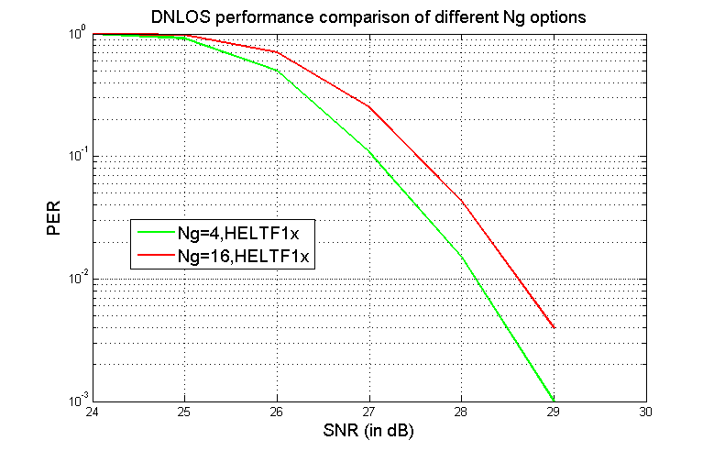
Ng for SU (80MHz, 4x2-2SS, MCS9)

Slide 14
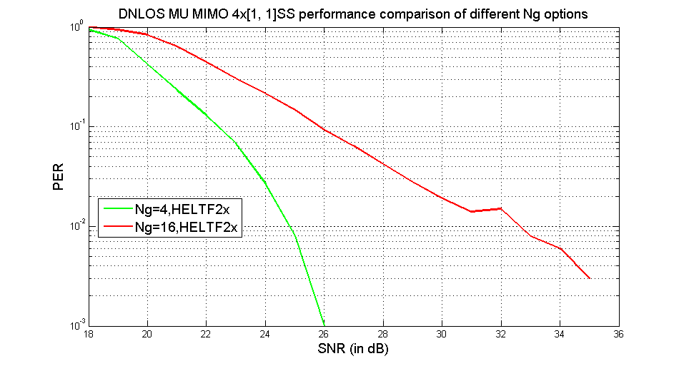
Ng for MU (80MHz, 4x[1,1]SS, MCS7)

Slide 15
Proposal
Propose the following statements on Ng and CB size in 11ax sounding feedbacks.
Ng=16 is optional at beamformee for both SU-type and MU-type feedbacks, define a capability bit for Ng=16 feedback capable in MU-type, and a capability bit for Ng=16 feedback capable in SU-type.
CB size (7,5) for MU-type feedback and CB size (4,2) for SU-type feedback are optional at beamformee, define a capability bit for CB (7,5) for MU-type feedback, and a capability bit for SU-type feedback.

Slide 16
Straw Poll 1
Do you agree to adopt the spec text changes as shown in doc 11/16-0897r1?

