Slide 1
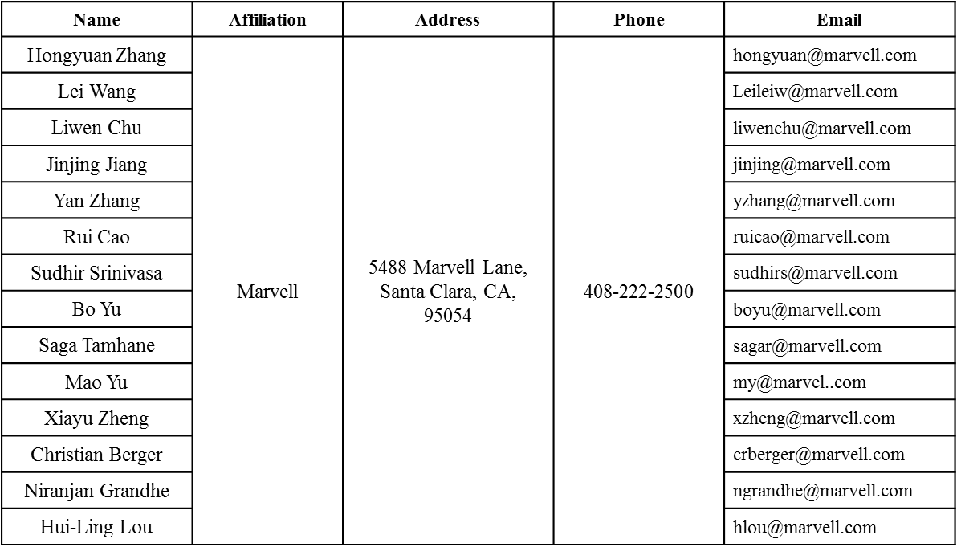
HE-LTF Capabilities
Date: 2016-07-25
Authors:

Slide 2
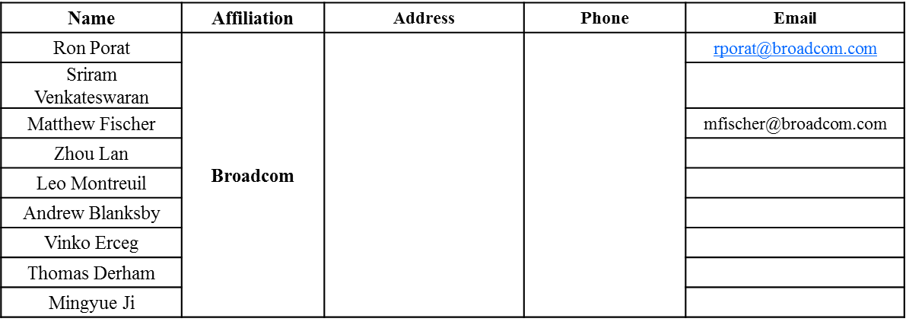
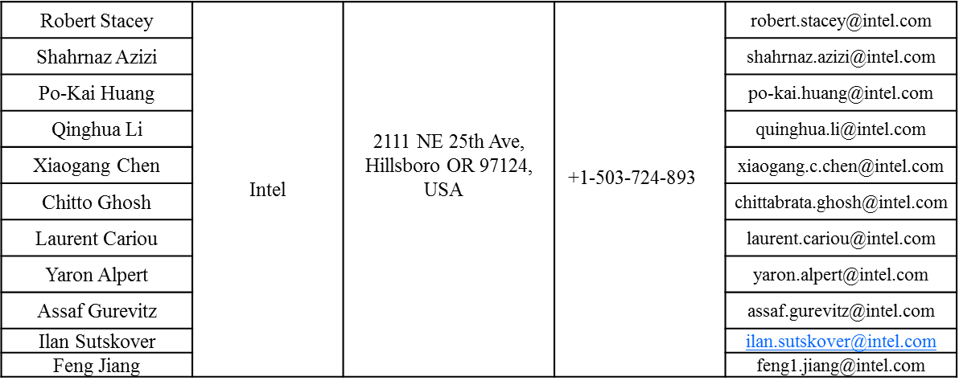
Authors (continued)

Slide 3
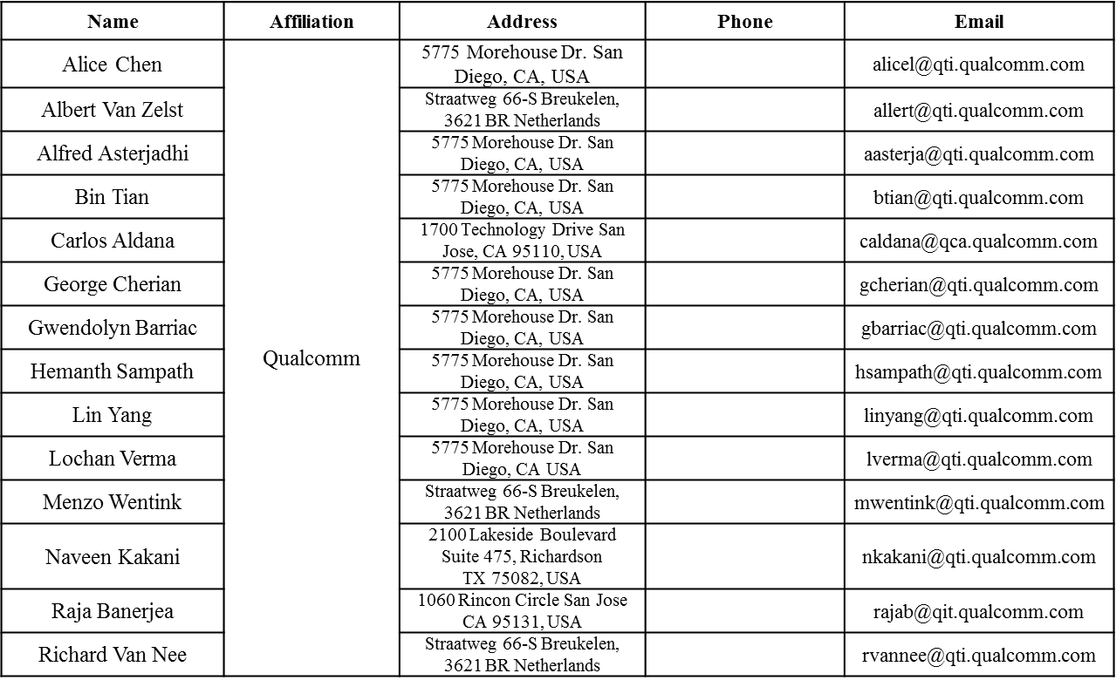
Authors (continued)

Slide 4
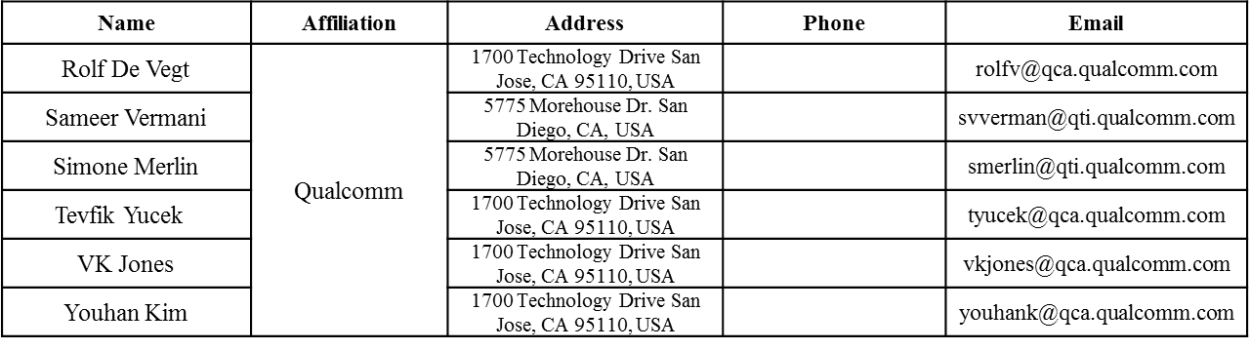
Authors (continued)

Slide 5
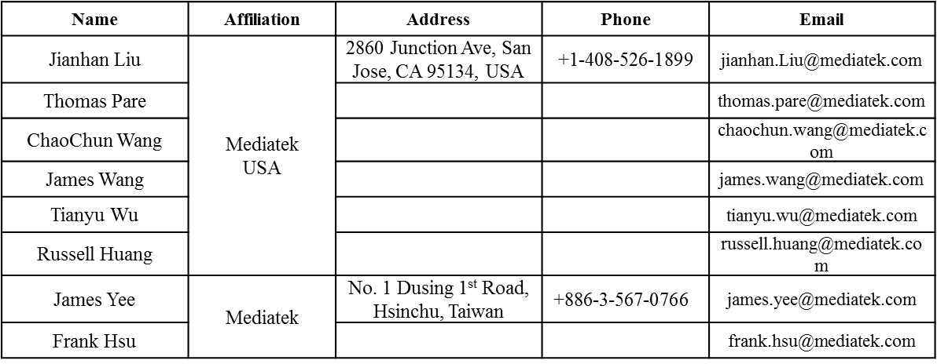
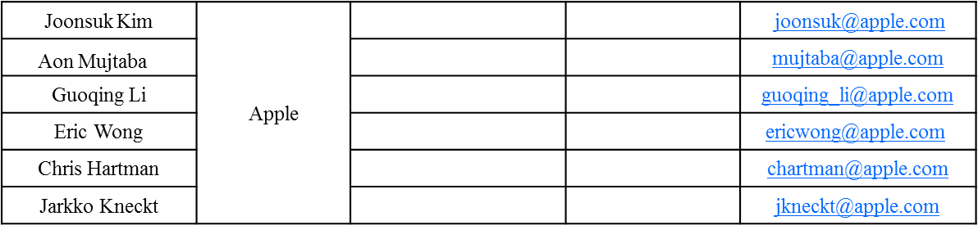
Authors (continued)
Authors (continued)

Slide 6
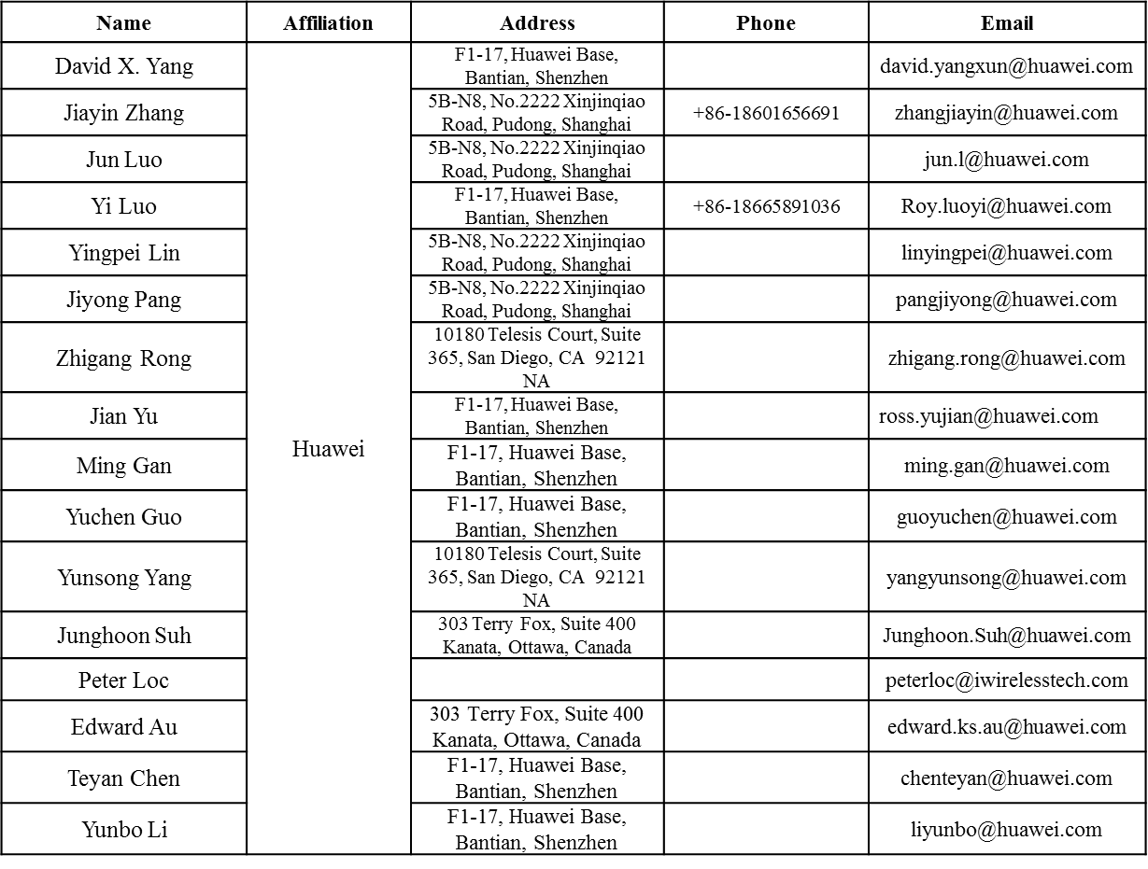
Authors (continued)

Slide 7
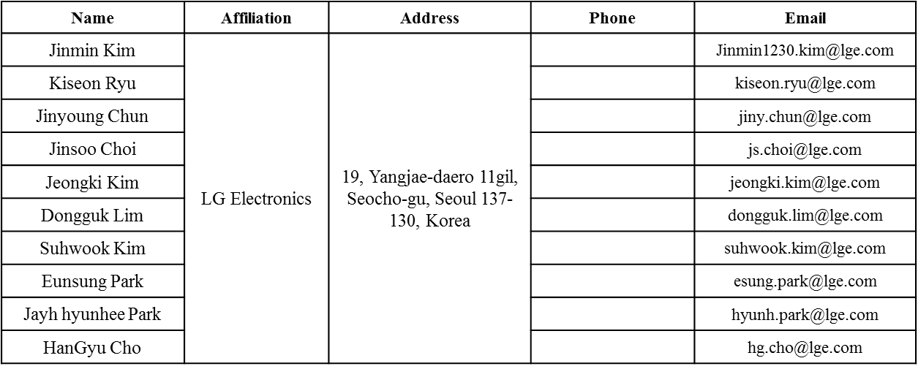
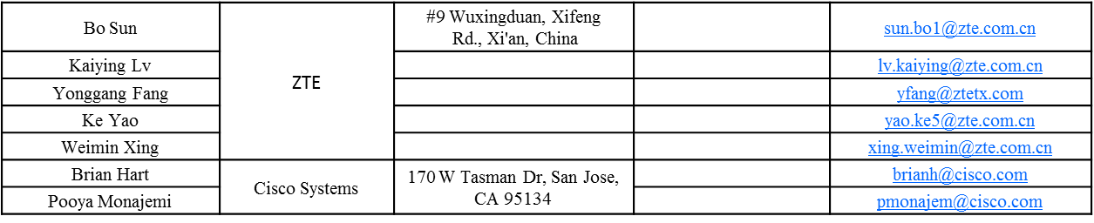
Authors (continued)

Slide 8
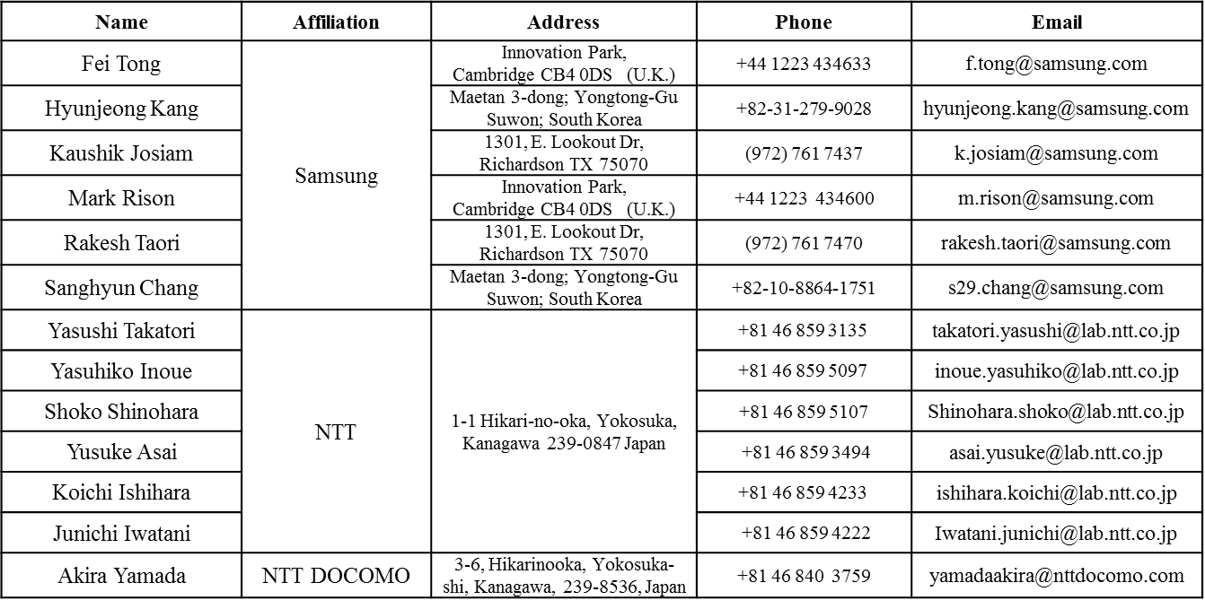
Authors (continued)

Slide 9
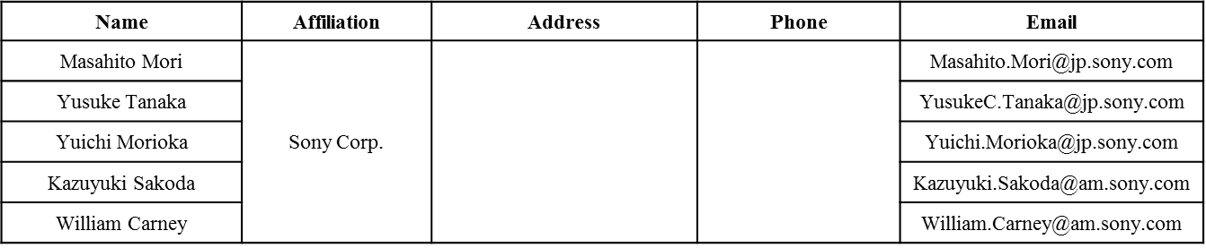
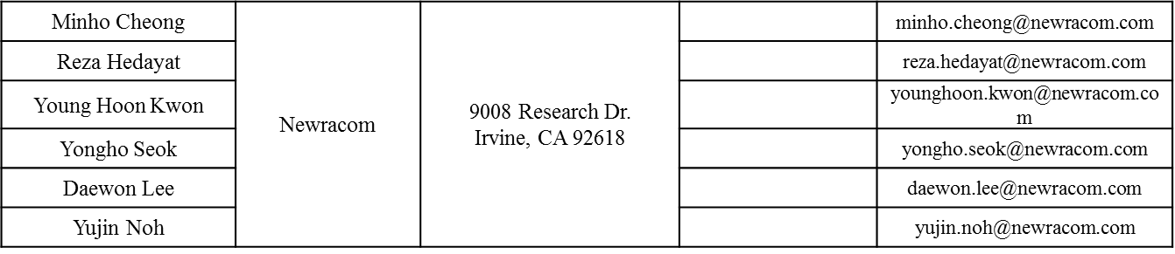
Authors (continued)

Slide 10
Authors (continued)

Slide 11
Outline
NSTS.total to NHE-LTF mapping
1x HE-LTF usage

Slide 12
I. NSTS.total to NHE-LTF Mapping
In D0.2, the text on NHE-LTF is “In an HE MU PPDU and HE trigger-based PPDU, NHE-LTF is selected to be not smaller than the maximum value of the functions for each NSTS,r,total.”
  Meaning NHE-LTF may be larger than 11ac mapping.
  E.g, if max(NSTS.total.r) = 2, NHE-LTF may be 4, 6, 8.
Note that if the “HE-MU PPDU” is a DL-MUMIMO PPDU over the full BW, or a single user PPDU (single RU), the 11ac counter part has a strict one-to-one mapping per “Table 21-13—Number of VHT-LTFs required for different numbers of space-time streams” (Revmc D6.0).

Slide 13
Cont’d
Prefer not to change this mapping for DL-MUMIMO over the full BW, and for single user PPDU sent in HE-MU format.
  One to Multiple choice mapping will significantly increase the number of modes at receiver/transmitter implementation, making the implementation, verification and interop tests much more complex.
  Example: for DL-MUMIMO Nsts_total = 2, in 11ac there is only one case; now in 11ax there could be up to 8 cases (2x HE-LTF NHELTF = 2/4/6/8; and 4x HE-LTF, NHELTF=2/4/6/8)!
    In DL-MUMIMO, the performance is usually determined by SIR, instead of SNR.

Slide 14
II. 1x HE-LTF usage
For ULMUMIMO (full BW), 1x HE-LTF has the advantage of minimal phase shift over HE-LTFs in the case of UL-MUMIMO over the full-BW.
  May get away from phase compensation during HE-LTFs without much performance penalty—results refer to [1].
Propose that 1x HE-LTF is mandatory for transmit at a STA participating UL-MUMIMO over the full BW.
  The complexity at STA is very minor (Tx only).

Slide 15
1x HE-LTF for DL-MUMIMO
For DL-MUMIMO, 1x HE-LTF may perform similar to 2x HE-LTF (based on our simulations). However, to reduce the number of modes, we propose to DISALLOW 1x HELTF for DLMUMIMO.

Slide 16
Straw Poll 1
Do you agree that for DL-MUMIMO over the full BW, or for a HE-MU PPDU format sent to a single user, the mapping from NSTS, total to NHE-LTF is as in Table 21-13 (Number of VHT-LTFs required for different numbers of space-time streams) in clause 21.3.8.3.5 (VHT-LTF definition), i.e. the same as in 11ac?

Slide 17
Straw Poll 2
Do you agree that 1x HE-LTF is mandatory to transmit in UL-MUMIMO PPDUs over the full BW, for a STA that supports UL-MUMIMO?

Slide 18
Straw Poll 3
Do you agree with the followings?
  1x HE-LTF is disallowed in any DL-MUMIMO PPDU over the full BW.

Slide 19
Straw Poll 4
Do you agree to adopt the spec text changes as shown in doc 11/16-0895r0, which reflects Straw Polls 1~3?

Slide 20
References
[1] 11-16-0033-00-00ax 1x HE-LTF for UL-MUMIMO

