Slide 1
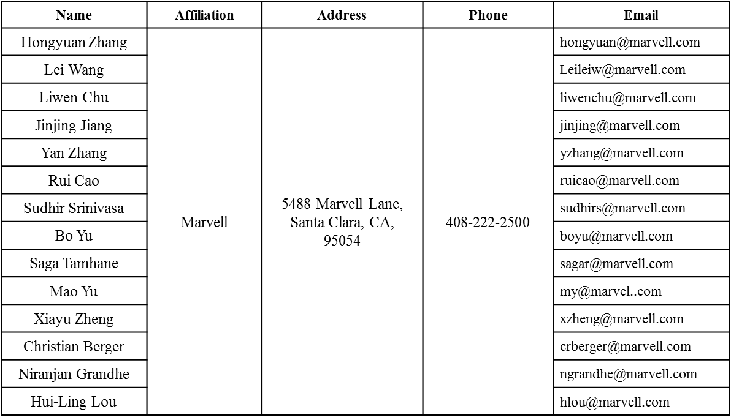
LDPC for 1024QAM
Date: 2016-07-25
Authors:

Slide 2
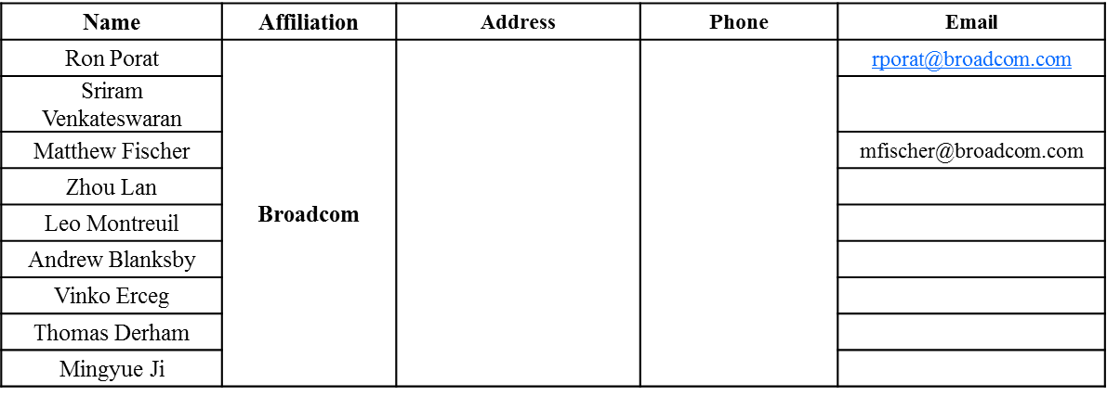
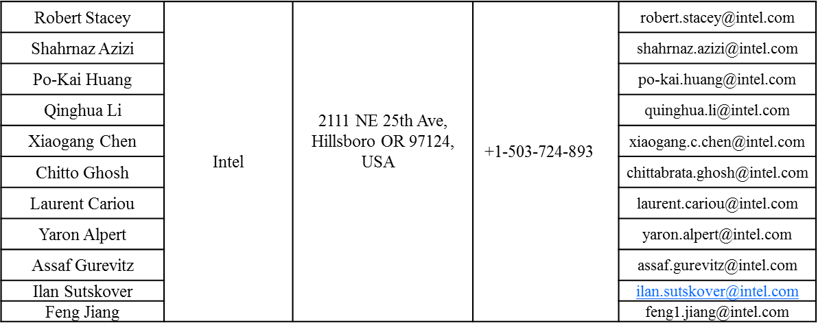
Authors (continued)

Slide 3
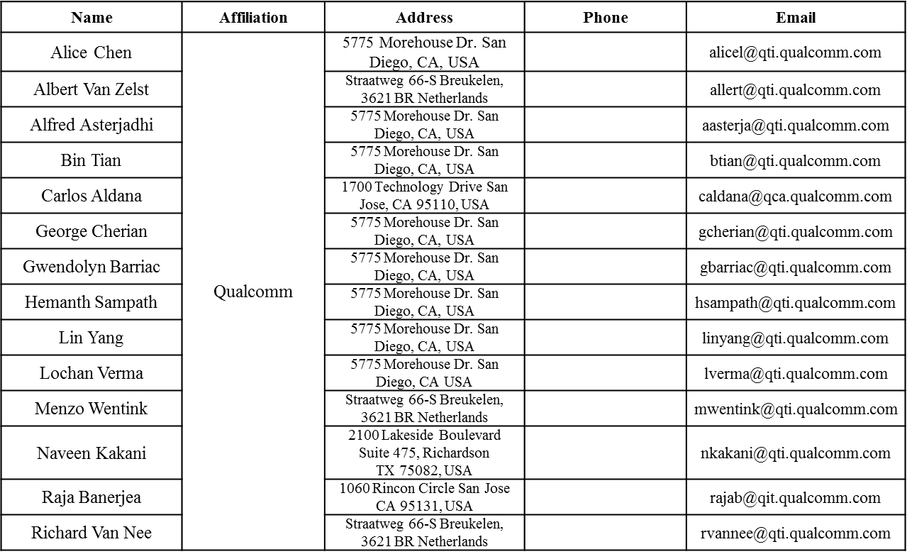
Authors (continued)

Slide 4
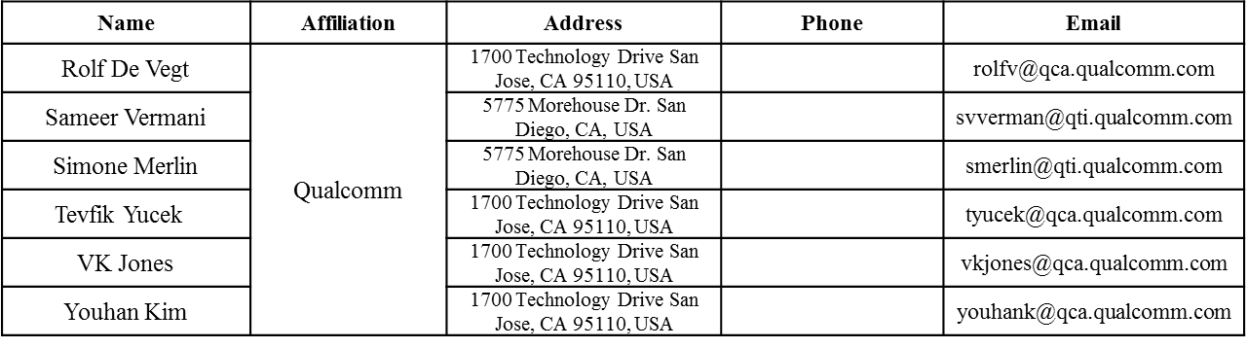
Authors (continued)

Slide 5
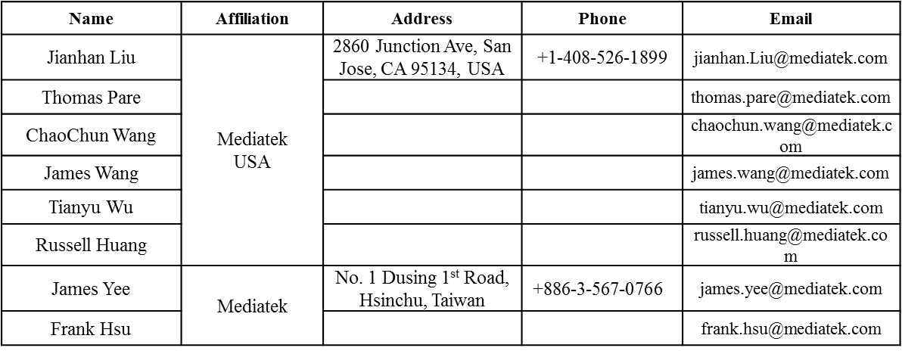
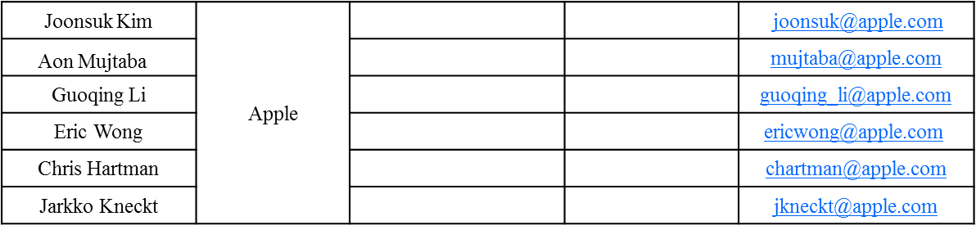
Authors (continued)
Authors (continued)

Slide 6
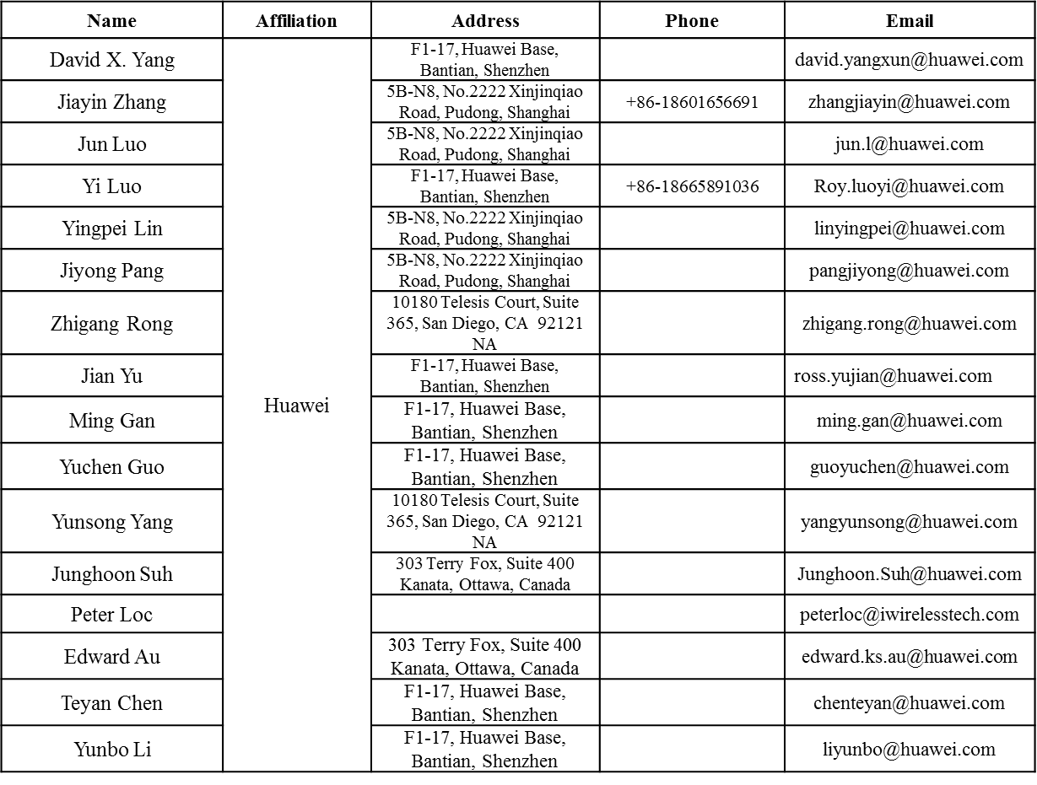
Authors (continued)

Slide 7
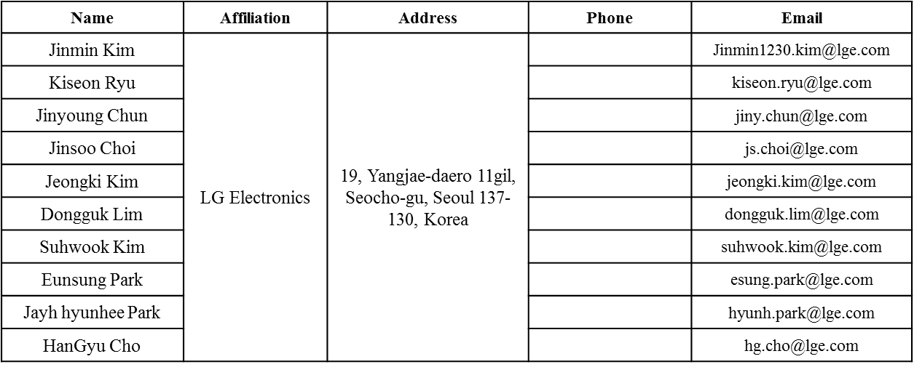
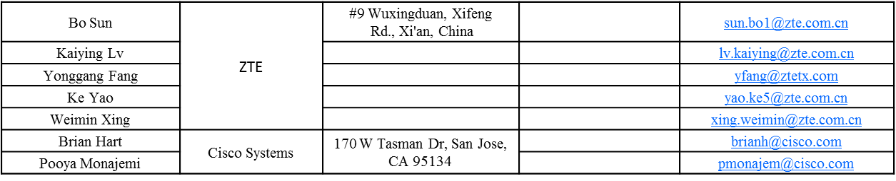
Authors (continued)

Slide 8
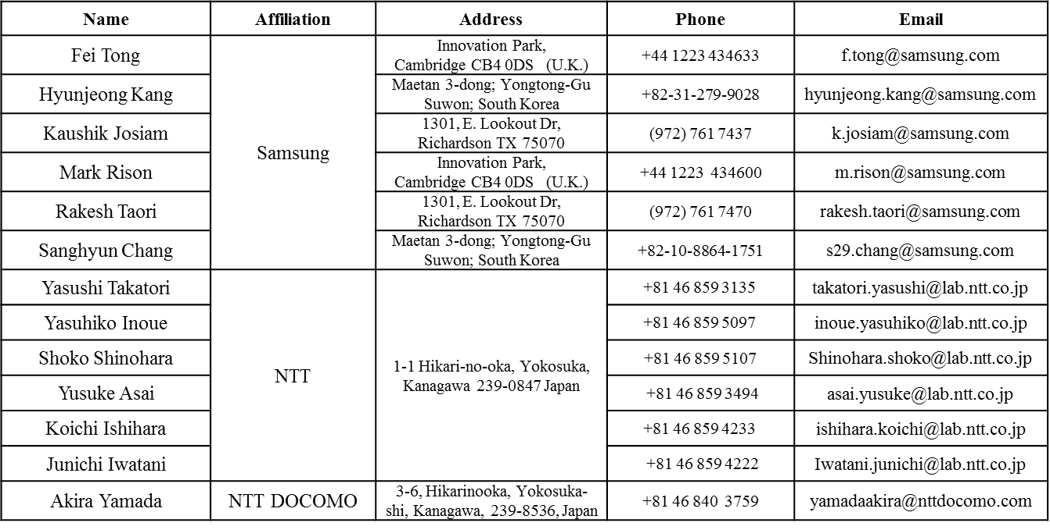
Authors (continued)

Slide 9
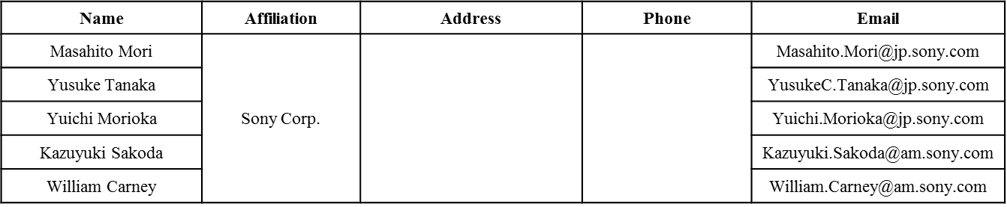
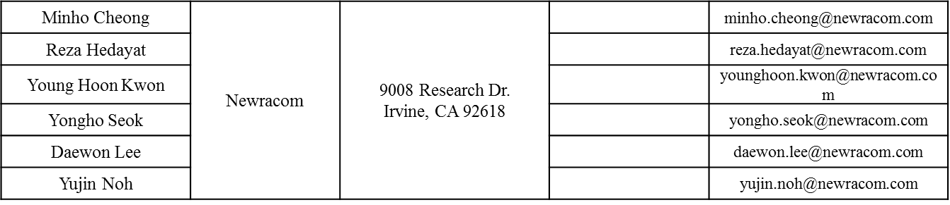
Authors (continued)

Slide 10
Authors (continued)

Slide 11
Discussions
Currently 1024 QAM is allowed for 242-RU or above.
Currently BCC is mandatory for 242-RU or below, NSS≤4.
Question: do we need to define BCC for 1024QAM in 242-RU?
Prefer that 1024-QAM is only with LDPC for all allowed RU sizes.
  No need to expand the BCC deinterleaver in 11ac for 234 tones.
  LDPC is mostly required to achieve the link budget for 1024QAM

Slide 12
Proposal
Only LDPC is allowed for MCS10 and MCS11 for 242-RU or larger RU sizes.
  If an 11ax STA claims MCS10 and MCS11 capable, then LDPC is mandatory.
The corresponding text change is as shown in doc. 11/16-0892.

Slide 13
Straw Poll 1
Do you agree to adopt the spec text change as shown in doc 11/16-0892r0?

