Slide 1
Issue of Buffer Status reporting
Date: 2016-07-26
Authors:
Name | Affiliation | Address | Email
Stéphane BARON | Canon | Cesson-Sevigné, France | stephane.baron@crf.canon.fr
Patrice NEZOU |  |  | patrice.nezou@crf.canon.fr
Romain GUIGNARD |  |  | romain.guignard@crf.canon.fr
Pascal VIGER |  |  | pascal.viger@crf.canon.fr

Slide 2
Introduction
One of the main features introduced in 11ax is UL MU operation
  AP allocates UL resources used by multiple STAs to transmit their data
For an efficient allocation the AP needs to know UL buffer status (BS) of its STAs. The BS knowledge allows the AP to:
  Allocate resources to those STAs that have something to transmit in UL
  Calculate correctly the UL resources needed by the STAs.
In this contribution, we suggest addressing the unmanaged P2P flows in order to increase efficiency of buffer status reporting.
This contribution is linked with two CIDS: #178, #1066.

Slide 3
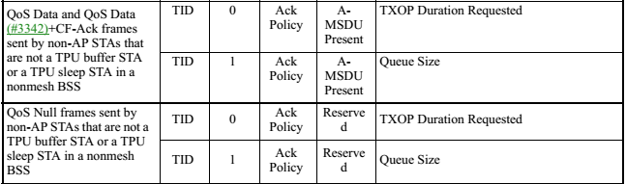
QoS Control field
QoS Control field ([4] table 9-6)
  BS information is only related to the TID of the current data frame.
  “The Queue Size subfield… indicates the amount of buffered traffic at the STA sending this frame.”
BSR A-Control, in HE Control field [2]
  Used to allow HE STA to send a buffer status information for multiple TIDs/ACs
“BS Report”
Control ID: 3
Buffer Status Report
TBD

Slide 4
Problem Statement
P2P transmissions in between non-AP STAs :
  Example protocols: Direct Link (DLS), or Tunneled Direct Link Setup (TDLS), or WiFi-Miracast
  Wireless Display scenario, from Evaluation Methodology Document [3]:
    typically low-compressed video, which requires huge bandwidth (from 1080p60 HD up to 8K UHD).
Issue :
  Even if such flows are not numerous, the amount of data per flow is huge.
  At the minimum, the AP, which is the central control entity for UL MU allocation, should not be misinformed by such amount of data waiting in STA queue(s).
  Otherwise, AP grants UL resources to a STA … which finally is not able to use the offered resource ! (because its pending data is not uplink data)

Slide 5
Proposal (1/2)
Specify that a HE STA avoids counting P2P traffic for its Buffer Status Report
Add into Draft spec 0.2:
  25.5.2.5 HE buffer status feedback operation for UL MU :
    The Buffer Status Report of HE STA shall only indicate the amount of buffered data that the HE STA needs to transmit to the AP it is registered with.
    For example, this report does not include transmissions from HE STA to a peer non-AP STA once a direct link transmission is established in between.
[ST#1]

Slide 6
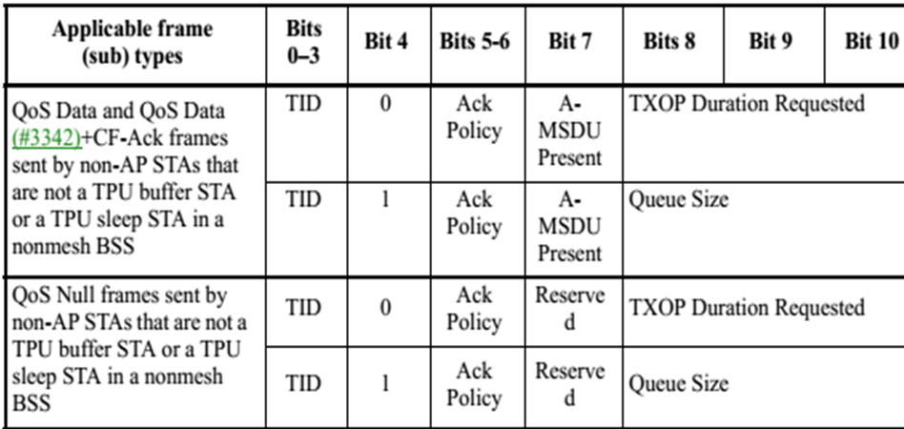
Proposal (2/2)
“QoS Control field” usage for HE STA :
  Legacy BSR inside QoS Data/Null frames
Add into Draft spec 0.2:
  clause 9.2.4.5.6 : Queue Size subfield
    Note: for MU operation, a HE STA shall only indicate the amount of buffered data that the HE STA needs to transmit to the AP it is registered with (refer to 25.5.2.5).
  clause 9.2.4.5.7 : TXOP Duration Requested subfield
    “TXOP Duration Requested” is used by a STA to indicate its need for its next SU TXOP.
    TXOP Duration is useless for the AP for UL MU since it cannot determine the associated amount of buffered data.
    Proposal: forbid usage of “TXOP Duration” format for HE STA for UL MU (in favor of only using the “queue size” format).
[ST#2]
[ST#3]

Slide 7
Conclusion
We note that a HE STA should build a buffer status information only with regards to uplink transmissions (that is to say, directed towards or relayed by the AP).
The direct link transmissions (also called unmanaged P2P) must not be considered in BSR once the direct link session is established.

Slide 8
Straw Poll 1
Do You agree to add to the 802.11ax draft specification v0.2 the following text :
  25.5.2.5 HE buffer status feedback operation for UL MU :
  {end of chapter}
  The Buffer Status Report of HE STA shall only indicate the amount of buffered data that the HE STA needs to transmit to the AP it is registered with.
  For example, this report does not include transmissions from HE STA to a peer non-AP STA once a direct link transmission is established in between.
Y/N/A

Slide 9
Straw Poll 2
Do You agree to add the following note to the 802.11ax draft specification v0.2:
  9.2.4.5.6 Queue Size subfield:
  Note for HE STA :
  For MU operation, a HE STA shall only indicate the amount of buffered data that the HE STA needs to transmit to the AP it is registered with (refer to 25.5.2.5).
Y/N/A

Slide 10
Straw Poll 3
Do You agree to add the following note to the 802.11ax draft specification v0.2:
  9.2.4.5.7 TXOP Duration Requested subfield
  Note for HE STA:
  The “TXOP Duration Requested” subfield format in QoS Data frames shall only be used for SU operations, and shall not be used for UL MU operations (refer to HE buffer status feedback operation 25.5.2.5).
Y/N/A

Slide 11
References
[1] 11-15/0132r15 “Tgax Specification Framework”,
[2] 11-16/0628r1 “Buffer Status Report in HE Control field”
[3] 11-14/0571r10 “Evaluation Methodology Document”, Appendix 2 – Traffic model descriptions
[4] IEEE P802.11-REVmc/D5.3

