Slide 1
Multipath Component Tracking and
Channel Model for Lecture Room
Date: 2016-07
Authors:
Name | Affiliations | Address | Phone | email
David Lai | NIST | Gaithersburg, MD, USA | +1 (301) 975-6797 | chiehping.lai@nist.gov
Jian Wang | NIST | Gaithersburg, MD, USA | +1 (301) 975-8012 | jian.wang@nist.gov
Camillo Gentile | NIST | Gaithersburg, MD, USA | +1 (301) 975-3685 | camillo.gentile@nist.gov
Peter Papazian | NIST | Boulder, CO, USA | +1 (303) 497-7078 | peter.papazian@nist.gov
Jae-Kark Choi | NIST | Gaithersburg, MD, USA | +1 (301) 975-6049 | jae-kark.choi@nist.gov
Jelena Senic | NIST | Boulder, CO, USA | +1 (303) 497-6166 | jelena.senic@nist.gov
Nada Golmie | NIST | Gaithersburg, MD, USA | +1 (301) 975-4190 | nada.golmie@nist.gov
Kate Remley | NIST | Boulder, CO, USA | +1 (303) 497-3652 | kate.remley@nist.gov

Slide 2
Abstract
This document presents results from tracking measured MultiPath Components (MPCs) in a lecture room, the resultant Quasi-deterministic (Q-D) channel model at 83 GHz, and preliminary measurements at 60 GHz

Slide 3
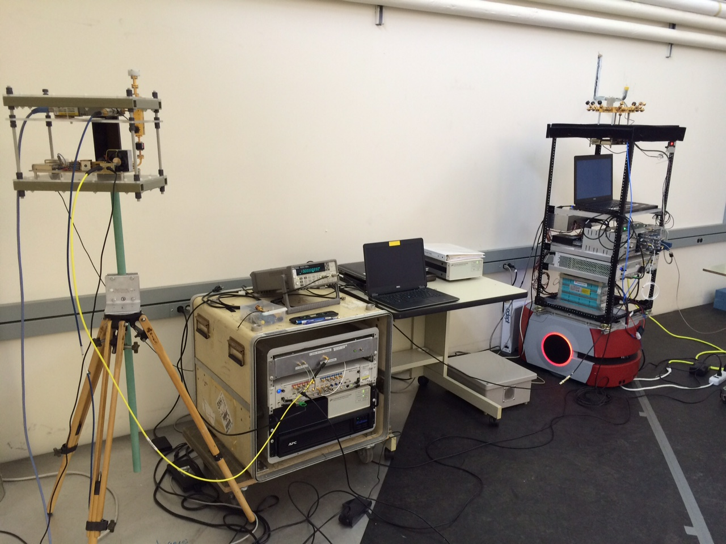
83 GHz Channel Sounder
1 TX antenna
  Omnidirectional in azimuth and 45º beamwidth in elevation
  4 dBi gain
16-antenna RX array
  45º beamwidth in azimuth / elevation
  Each horn has 12.2 dBi gain
  Can extract AZ AoA and EL AoA
2 GHz null-to-null bandwidth
Robot-guided navigational system
  Can collect hundreds of GB of data in just minutes
Can support use cases with high mobility
  Complete channel measurement sweep in 65.5 μs
  Untethered synchronization through rubidium clocks
Tx RF section
Rx array
Notes:
This slide has been presented in the past
It’s shown here again for completeness
You can briefly go over the main points

Slide 4
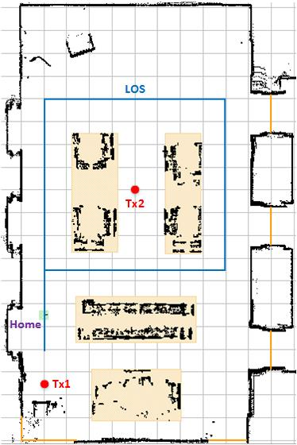
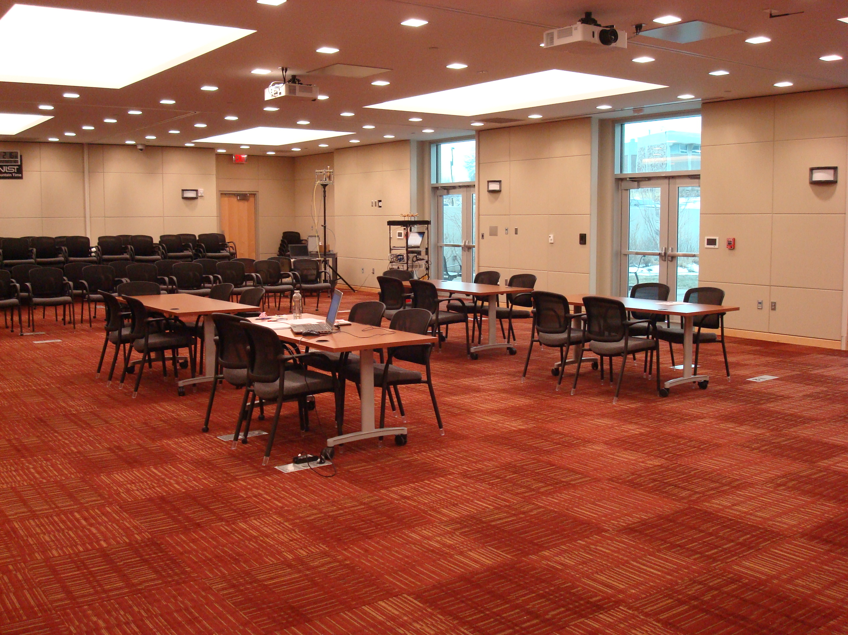
Lecture Room Environment
87
61
Tx1
100
Rx
Rx
1
25
Photograph
Floorplan
Tx1 mounted on tripod at 2.5 m height in corner of room
Rx mounted at 1.6 m height on robot which moved along blue trajectory in direction of arrows, collecting measurements at 100 locations (about every 30 cm)

Slide 5
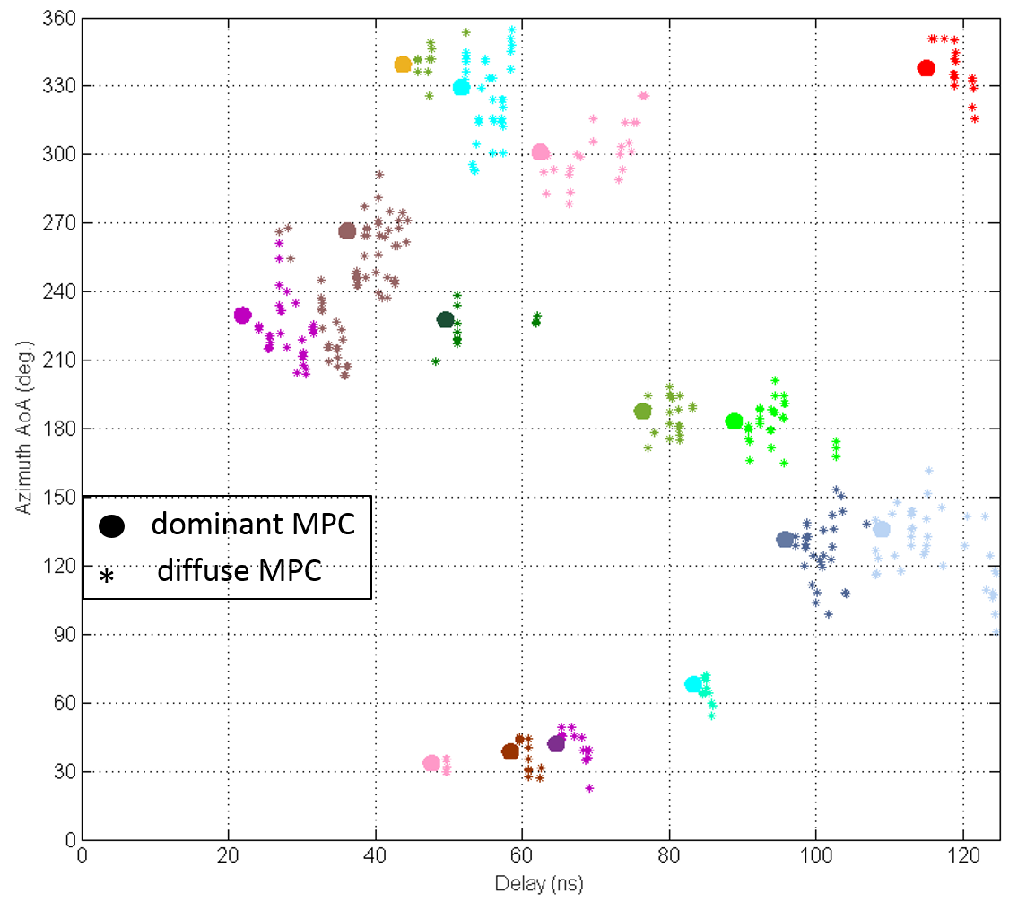
MPC Clustering
  At each location, channel MPCs were extracted from measurements and indexed according to pathloss, delay, AZ AoA, and EL AoA (shown in AZ AoA vs. delay)
  Based on a similarity metric across the four-dimensional indices, the MPCs were grouped into different clusters
  For each cluster, the dominant MPC was identified and the remaining dismissed as diffuse MPCs

Slide 6
Dominant MPC Tracking
Dominant MPCs were automatically tracked from location to location along robot’s trajectory
Each track was labeled according to the first and last locations at which it was detected
Notes:
The direct path is detected for all robot locations and so its track is labeled from 1 -100
As explained before, because the system has finite dynamic range, the 1st-order and 2nd-order wall reflections are not detected at all robot locations, therefore their tracks are shorter and labeled according to first / last location at which detected
They are not shorter only because of the finite dynamic range, but also because unmodeled clutter (tables, chairs, podium) block the paths and create broken tracks

Slide 7
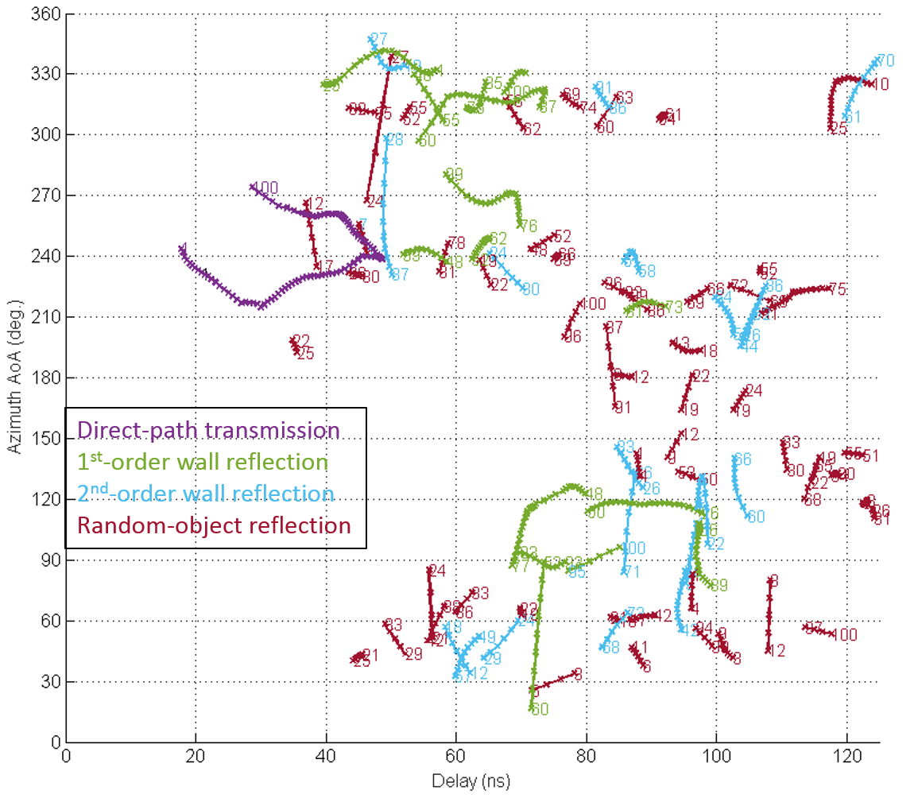
Dominant MPC Classification
Raytracing was implemented to identify the path type of the dominant MPCs
Measured MPC tracks were compared against the raytraced MPC tracks to classify the former into four path types
Of total Rx power over the robot’s trajectory,
- direct transmission accounts for 83.5%
- 1st-order wall reflections account for 14.4%
- 2nd-order wall reflections account for 0.6%
- random-object reflections account for 1.45%
Notes:
The direct path is detected for all robot locations and so its track is labeled from 1 -100
As explained before, because the system has finite dynamic range, the 1st-order and 2nd-order wall reflections are not detected at all robot locations, therefore their tracks are shorter and labeled according to first / last location at which detected
They are not shorter only because of the finite dynamic range, but also because unmodeled clutter (tables, chairs, podium) block the paths and create broken tracks

Slide 8
Direct Path
90
180
0
Measured MPC
Raytraced MPC
270
AZ AoA
87
61
100
Rx
1
25
In magenta is illustrated the measured MPC track of the direct path
LOS conditions are maintained throughout, hence direct path always detected from location 1 – 100
In green is illustrated the raytraced MPC track of the direct path
Even though measured MPC parameters will have errors, good match-up observed between measured and raytraced
Notes:
I put in a magenta ray to show the AZ AoA, which is roughly between 210 and 270 in reference to the AZ legend in the upper left corner

Slide 9
Reflection from Backwall
90
Measured MPC
Raytraced MPC
180
0
270
87
61
AZ AoA
Rx
broken
track
100
1
25
Missing
track
broken
track
For reflected paths, match-up between measured and raytraced MPCs not as good because in reality…
  …shape of the room is irregular (not cyan 3D box used in raytracing)
  …unmodeled clutter creates blockage and in turn broken tracks
    E.g. podium in upper corner of floor plan creates blockage, so 4 tracks are detected instead of 1
  …system has finite dynamic range so raytraced MPCs cannot be detected everywhere in the room
    E.g. track 1 – 25, farthest from backwall, weakest and so missing
Notes:
Here we are showing how we track the measured MPC reflected from the backwall
An example ray originating from Tx1, reflected from the backwall, and hitting the Rx is shown in magenta
The measured magenta curve deviates from the modeled green curve for many reasons:
The system error makes the measurement wrong
The simplified geometry makes the modeled wrong
The unmodeled clutter creates blockage along the ray pay at points, e.g. shown for podium
System has finite dynamic range: that is why segment 1-25 along trajectory is missing: points along that segment are farthest from the reflection
Also here you can see the AZ AoA of the ray in magenta, which is roughly between 120 and 90

Slide 10
Reflection from Random Objects
podium
90
door
180
0
270
AZ AoA
87
61
chair
chair
podium
100
Rx
1
25
Measured MPC
door
chair
Through visual inspection of delay, AoA, and location index, random objects can be identified (examples shown)

Slide 11

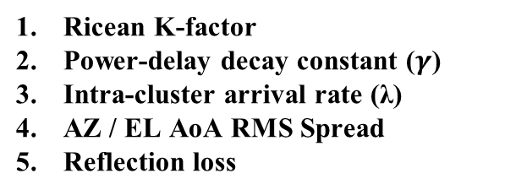


Reduction of Q-D* Cluster Parameters
dominant
component
RMS spread
Power (dB)
1/$γ$
diffuse
components
Power (dB)
$$1/λ$$
delay (ns)
AoA (deg.)
Ricean K-factor
Power-delay decay constant ($γ$)
Intra-cluster arrival rate (λ)
AZ / EL AoA RMS Spread
Reflection loss
K-factor = $\frac{dominant power}{total diffuse power}$
Reflection loss
*“Quasi-deterministic Approach to mmWave Channel Modeling in a Non-stationary Environment,” Maltsev, Pudeyev, Karls,
Bolotin, Morozov, Weiler, Peter, Keusgen, Globecom 2014.

Slide 12
Summary of Parameter Extraction
  CLUSTERING:
    Measured MPCs at each location are clustered and dominant path of each cluster is identified
  TRACKING:
    Dominant MPCs are automatically tracked from location to location along robot’s trajectory
  CLASSIFICATION:
    Measured MPC tracks compared to raytraced MPC tracks in order to classify path-type (direct, 1st-, 2nd-, or random-object reflected)
  REDUCTION:
  Q-D parameters of each cluster at each location reduced
  5. AGGREGATION:
    Clusters are assigned path-type associated of their dominant MPC and their statistics aggregated accordingly
Over 1000 clusters used to aggregate data

Slide 13
Ricean K-factor
Direct transmission
1st-order wall reflection
2nd-order wall reflection
Random-object reflection
      Mean values 14.1 dB for direct, 7.3 dB for 1st-order, and 5.4 dB for 2nd-order, and 7.1 dB for random-object
K-factor decreases with path-type order, meaning dominant component becomes smaller and smaller compared to diffuse components, as expected
Random-object path-type comparable to 1st-order reflection
Notes:
What are tracked are only the dominant paths, i.e. the direct, 1st-order wall reflected, 2nd-order wall reflected, and random-object reflected
In reality, each dominant path has associated diffuse paths which are clustered to it
The channel model consists of characterizing the diffuse paths because the dominant paths can be predicted (assuming some model for the distribution of random objects)
The K-factor represents the strength of the dominant path with respect to the diffuse paths in the same cluster

Slide 14

Power-delay Decay Constant ($γ$)
Direct transmission
1st-order wall reflection
2nd-order wall reflection
Random-object reflection
The mean values are 2.1 ns for direct, 3.5 ns for 1st-order, and 3.6 ns for 2nd-order, and 3.7 ns for random-object
As path-order increases, power decays less rapidly because the reflected component becomes smaller and smaller compared to scattered component (smaller K-factor)
Random path-type comparable to 1nd-order and 2nd-order

Slide 15
Azimuth / Elevation AoA RMS Spread
      Azimuth
      Elevation
Direct transmission
1st-order wall reflection
2nd-order wall reflection
Random-object reflection
      Mean values 2.2º / 1.4º for direct, 6.5º/ 3.8º for 1st-order, and 8.0º / 4.7º for 2nd-order, and 6.6º / 4.5º from random-object
Angular spread increases with path-type order because there is more and more scattering
Random-object type comparable to 1st-order

Slide 16
Reflection Loss
1st-order wall reflection
2nd-order wall reflection
Random-object reflection
      Mean values are 8.0 dB for 1st-order, 11.9 dB for 2nd-order*, and 13.0 dB for random-object
      Sidewalls are made from fabric panels over sheetrock and ceiling made from acoustic tiles under sheetrock
      2nd-order reflections are often combination of reflection from sidewall and reflection from ceiling
      - This explains why mean value of 2nd-order reflection is not twice mean value of 1st-order reflections
      Reflection loss from random objects are larger than 1st-order wall reflections
      - May be due to more complex shape of objects compared to walls
* Reflection loss for 2nd-order means combined loss over both reflections

Slide 17
Complete Q-D Channel Model Parameters
Manual
 | Ricean K-factor |  | γ, Power-delay decay constant |  | λ, Inter-cluster arrival rate |  | Azimuth AoA RMS spread |  | Elevation AoA RMS spread |  | Reflection loss
 | (dB) |  | (ns) |  | (1/ns) |  | (deg.) |  | (deg.) |  | (dB)
Path type | µ | σ | µ | Σ | µ | σ | µ | σ | µ | σ | µ | σ
Direct | 14.1 | 6.3 | 2.1 | 3.7 | 0.60 | 0.18 | 2.2 | 1.9 | 1.4 | 0.8
1st-order | 7.3 | 5.0 | 3.5 | 4.6 | 0.44 | 0.16 | 6.5 | 4.1 | 3.8 | 1.7 | 8.0 | 4.5
2nd-order | 5.4 | 3.6 | 3.6 | 3.1 | 0.42 | 0.19 | 8.0 | 4.0 | 4.6 | 1.5 | 11.9 | 6.6
Random | 7.0 | 3.9 | 3.7 | 4.2 | 0.41 | 0.20 | 6.6 | 2.8 | 4.5 | 1.6 | 13.0 | 7.2

Slide 18
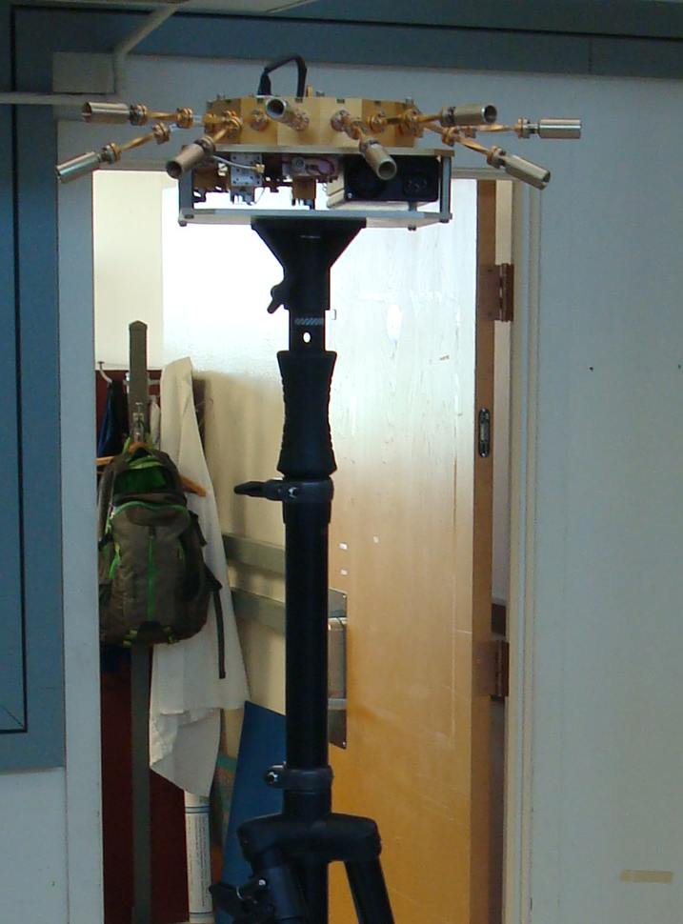
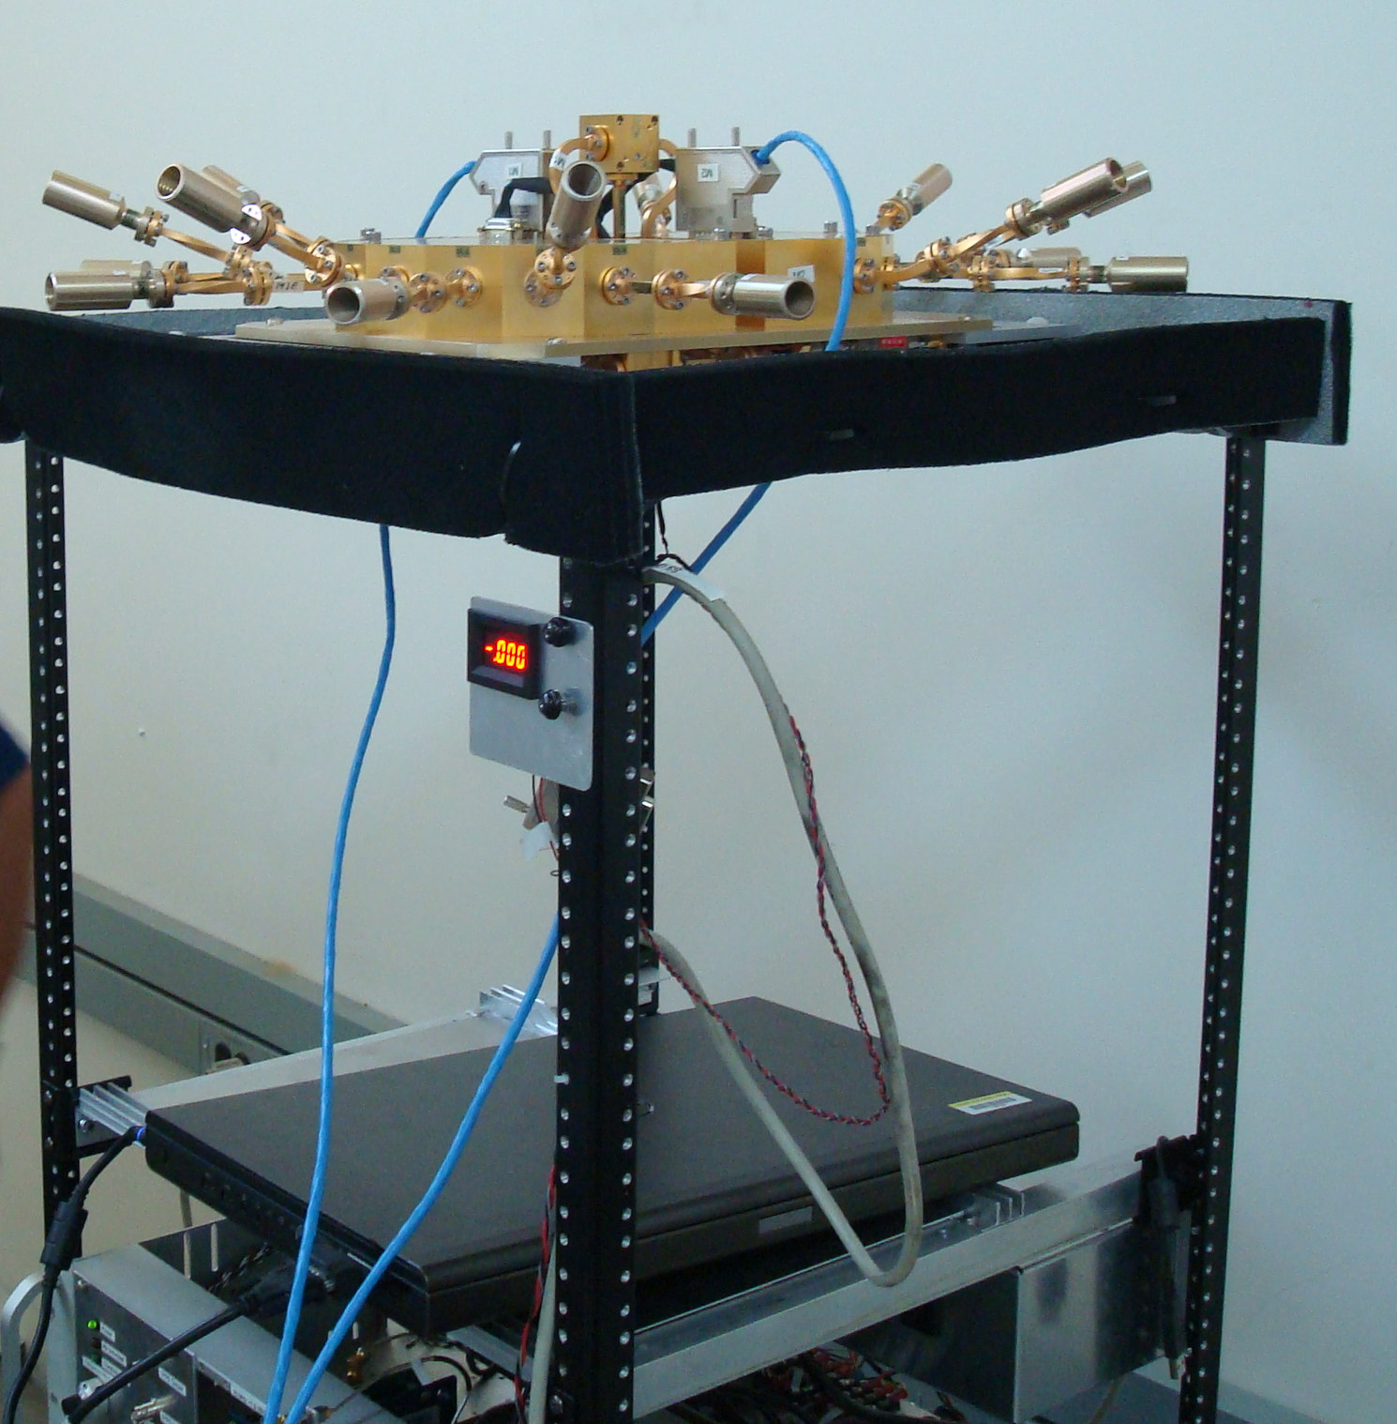
60 GHz Channel Sounder
TX array mounted on tripod
RX array mounted on robot
Tx array: 8 antennas, Tx power (per antenna) = 22.3 dBm , Tx gain = 25 dBi, Tx beamwidth = 22.5º
Rx array: 16 antennas, Rx gain = 18 dBi, Rx beamwidth =22.5º
One measurement over all 8 Tx antennas x 16 Rx antennas takes 262 µs to sweep
Can extract three-dimensional AoD and AoA
4 GHz bandwidth

Slide 19
Angle Estimation Error
mean abs(error) = 2.5 deg.
location index
location index
location index
location index
location index
location index
In initial lab tests over more than 80 robot locations, mean estimation error of AZ AoD, EL AoD, AZ AoA, and EL AoA for direct path between 2.1º and 2.5º

Slide 20
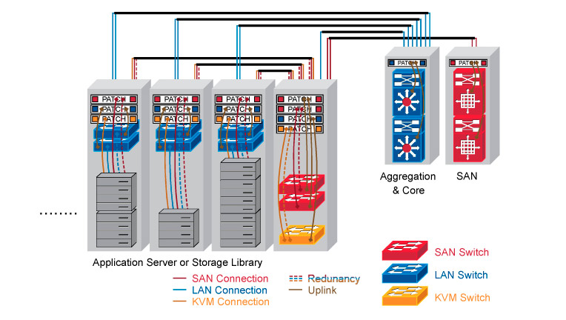
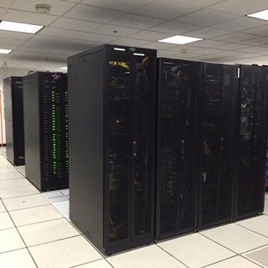
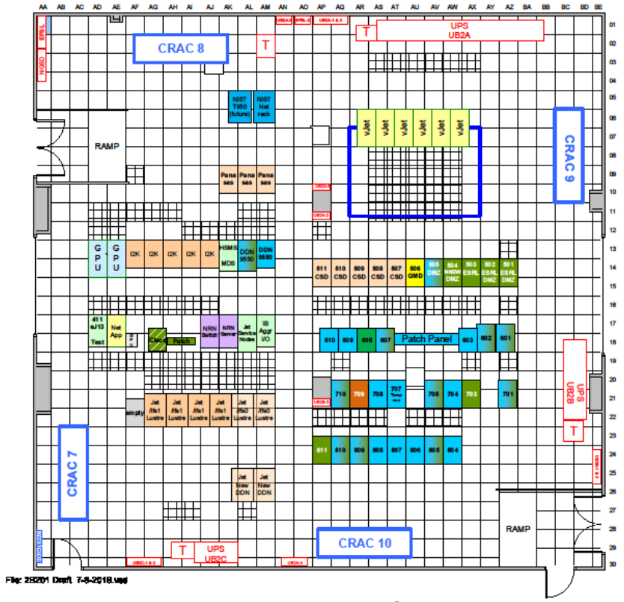
Measurements for Usage Model 4: Data Center
Dimensions of server room:18 m x 18 m
Height of room: 4.0 m
Height of racks: 2.0 m
Tx and Rx will be placed on top of rack,
both down the row and across the row
from each other to get range diversity
60 GHz server-room measurements taking place this week
Topology (Doc. 802.11-2015/0625-03)
Photograph of server room
Floorplan of server room

