Slide 1
1st Vice Chair Report – July 2016 - Waikoloa
Date: 2016-07-25
Authors:

Slide 2
Abstract
Agenda Items for 1st Vice Chair -
M3.3 II Other WG meeting plans
M3.4 II Meeting room locations
M3.5 II Next meeting reminder
M3.6 II Meeting registration
M3.7 II Recording attendance
M3.8 II File server
M3.9 II Breakfast, breaks, Social logistics
Friday:
F3.1.1 II Straw Poll of membership regarding this meeting location
F3.1.2 DT Future venues status and discussion

Slide 3
Monday– 802.11 Opening Plenary
802.11 First Vice Chair Report

Slide 4
M3.3 Other WG meeting plans
802.11 802.15 802.16 802.18 802.19 802.21 802.24
Treasurer Report:
Patent policy (in IEEE-SA bylaws), patent policy (slide set), and antitrust guidelines

Slide 5
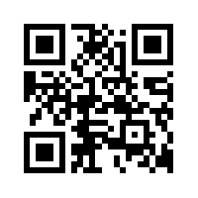
M3.4 Meeting room locations
MOBILE DEVICE SCHEDULE
http://802world.org/attendee

Slide 6
Online Calendar
This session’s meetings are also shown on the 802.11 calendar on the 802.11 home page (http://www.ieee802.org/11).
This is a Google calendar “802_11_calendar@ieee.org”
There are multiple ways of accessing this information, for example from a cell-phone, or as a remote calendar.
Note: the schedule on this calendar will be updated as will IMAT.

Slide 7
M3.5 Next meeting reminder
802 Plenary: 6-11 November 2016
Grand Hyatt San Antonio , San Antonio, TX, USA
Registration to Open Sept 1
Early-Bird Meeting Registration Deadline: 30 Sept 2016

Slide 8
M3.5 Next Meeting Reminder (Cont)
2016 Sept 11-16 802 Wireless Interim:
Marriott Warsaw, Warsaw, Poland
Session Information Registration Hotel Booking

Slide 9
M3.6 Meeting registration
IEEE 802 Plenary Session - July 24-29, 2016 Registration Report by Working Group
Working Group | Number
802.11 | 332
802.3 | 277
802.15 | 66
802.1 | 57
802.xx | 29
none | 11
802.21 | 9
802.19 | 7
802.16 | 6
802.18 | 4
802.24 | 1
Updated 2016-07-24

Slide 10
M3.7 Recording attendance
It is a requirement that attendees record their participation at an 802.11 session and declare their affiliation. This record is usually made using the IMAT attendance system.
If you wish to participate without recording attendance, send an email per session to the WG 2nd vice chair declaring your participation and affiliation. You cannot gain or maintain 802.11 voting membership using this method.
You must record 75% attendance of required 802.11 slots in a session for that session to count towards gaining or maintaining 802.11 voting membership
You need a single IEEE-SA web account
The IEEE SA web account requires a working email address
do not remove your email address from the account
Use the email address associated with that web account when registering attendance
If you change email addresses, update the web account, don’t create a new web account, or your membership status may not be calculated properly
Record attendance using this URL: IMAT.IEEE.ORG/

Slide 11
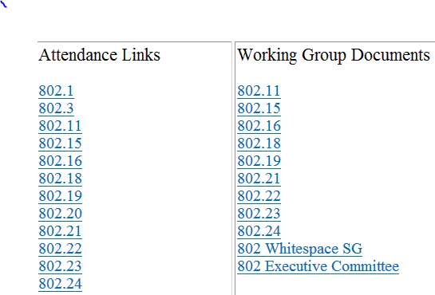
M3.8 Local File Document Server information
Local FTP server: ftp://griffin.events.ieee.org (anonymous)
External Document Server https://mentor.ieee.org/802.11/documents

Slide 12
M3.09 FOOD & BEVERAGE
Breakfast: 07:30 to 09:00
Morning Coffee/Tea 10:00 to 11:00
Afternoon Coffee/Tea/Snacks 15:00 to 16:00
802.3 & 802.1 at 3 PM
Wireless Groups at 3:30 PM
Served at Palm Foyer
For Registered Attendees Only

Slide 13
TECHNICALLY FUNNY IEEE 802 SOCIAL
Wednesday 6:30 – 9:30 pm
Seaport ABC @ Grand Hyatt Manchester
Networking reception with entertainment by acclaimed tech industry comedian
Don McMillan.
Attendee & Guest Tickets $US 24.99 each
(not included with registration)
Ticket Purchase Online at http://802world.org/plenary/social/
Tickets are transferrable but not refundable.
6:30 – 9:30 pm Bar Open
6:30 – 8pm Reception with Casual Menu
8 – 9pm Technically Funny Don McMillan
DON’T MISS THE LAUGHS PURCHASE YOUR TICKET TODAY

Slide 14
M3.9 Social Event
Casual Network Reception with Comedic Entertainment by acclaimed tech industry entertainer Don McMillian.
Date: Wednesday July 27, 2016
Time: 6:30 PM – 8:30 PM
Place: Grand Hyatt Manchester (Room TBC)
SOCIAL TICKET PRICE: $US 24.99 each – Deadline Tues 1:30pm
Tickets are non refundable, but are transferable.
SOCIAL TICKET PURCHASE WEBSITE
Tickets may be purchased online at: http://802world.org/plenary/social/
SOCIAL TICKET PICK UP
Tickets may be picked up at the IEEE 802 Plenary Registration Desk
Ticket Receipt and Photo ID Required.

Slide 15
802.11 Mid-Week Plenary
Agenda Items:
2.5 – Announcements
5.1 – Room Change Reports

Slide 16
W2.5 II Announcements
Reminder about Social Tonight
Networking reception with entertainment by acclaimed tech industry comedian Don McMillan.
Remember to Bring Your Ticket
(not included with registration)
Tickets are transferrable but not refundable.
TICKET PICK UP
At the July 2016 IEEE 802 Plenary Registration/Information Desk
Tickets available until 1:00 PM Wednesday July 27, 2016.
Photo ID is required to pick up ticket.
6:30 – 9:30 pm Bar Open
6:30 – 8pm Reception with Casual Menu
8 – 9pm Technically Funny Don McMillan

Slide 17
W5.1 Room Change Requests

Slide 18
802.11 WG Closing Plenary
Agenda Items:
3.1.1 – Straw Poll
3.1.2 -- Future venues status and discussion

Slide 19
F3.1.1 -Straw Poll of membership regarding this meeting location
Straw Poll:
How many people would like to come back to this venue?
Yes -
No –

Slide 20
F3.1.2: Future Venue Insight
Future 802 Wireless Interims:
Sept 2016 Warsaw Marriott, Poland
Jan 2017 Hyatt Regency Atlanta May 2017 Daejeon Convention Center, Korea Sept 2017 Hilton Waikoloa
Jan 2018 Hotel Irvine
May 2018 TBD Sept 2018 Hilton Waikoloa

Slide 21
F3.1.2: Future Venue Insight
Future 802 Plenary Sessions:
Nov 2016 Grand Hyatt San Antonio
March 2017 Hyatt Regency/Fairmont – Vancouver
July 2017 Estrel Hotel – Berlin
Nov 2017 Caribe Hotel and Convention Center – Orlando
March 2018 Hyatt Regency O’Hare – Rosemont, IL
July 2018 Manchester Grand Hyatt – San Diego
Nov 2018 Suzhou, China - TBC
(New facility, pricing model being negotiated, Sponsor capability investigation)

Slide 22
References
https://mentor.ieee.org/802-ec/dcn/12/ec-12-0040-11-00EC-802-plenary-future-venue-contract-status.xlsx

