Slide 1
802.11 July 2016 Closing Reports
Date: 2016-07-28
Authors:

Slide 2
Abstract
This document is a digest of the closing reports of all 802.11 sub-groups for presentation at the July 2016 closing plenary meeting. Attendance information and liaison reports (including liaison reports from the mid-week plenary) are also included.
R1 Adds JTC1 closing report

Slide 3
Attendance

Slide 4
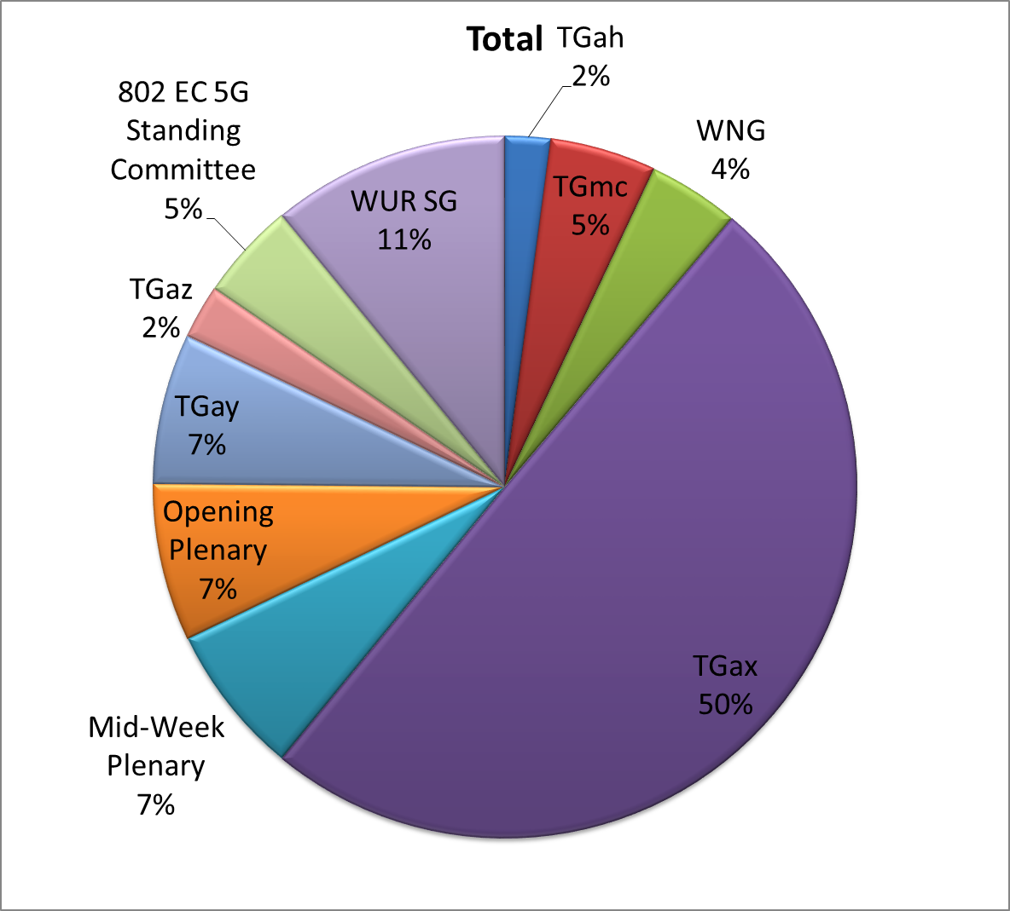
Attendance Total

Slide 5
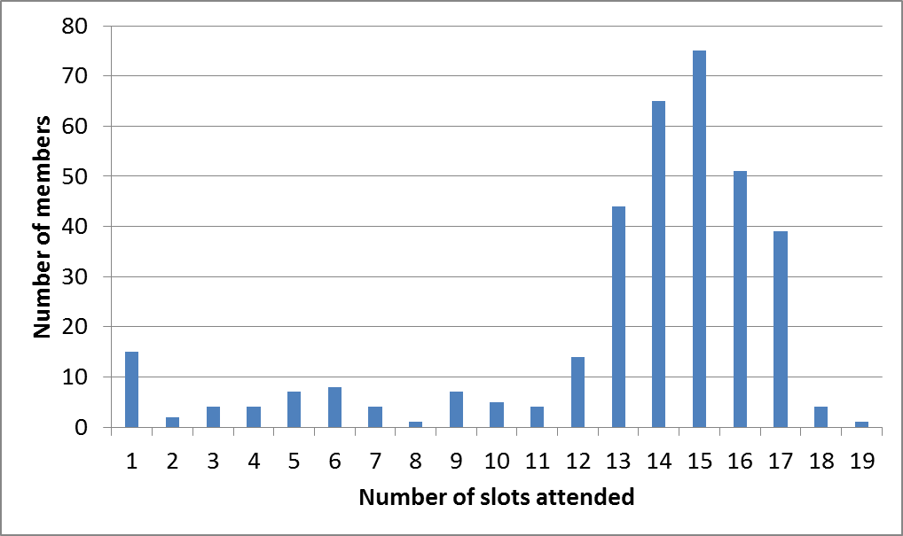
Attendance Histogram (Thu)

Slide 6
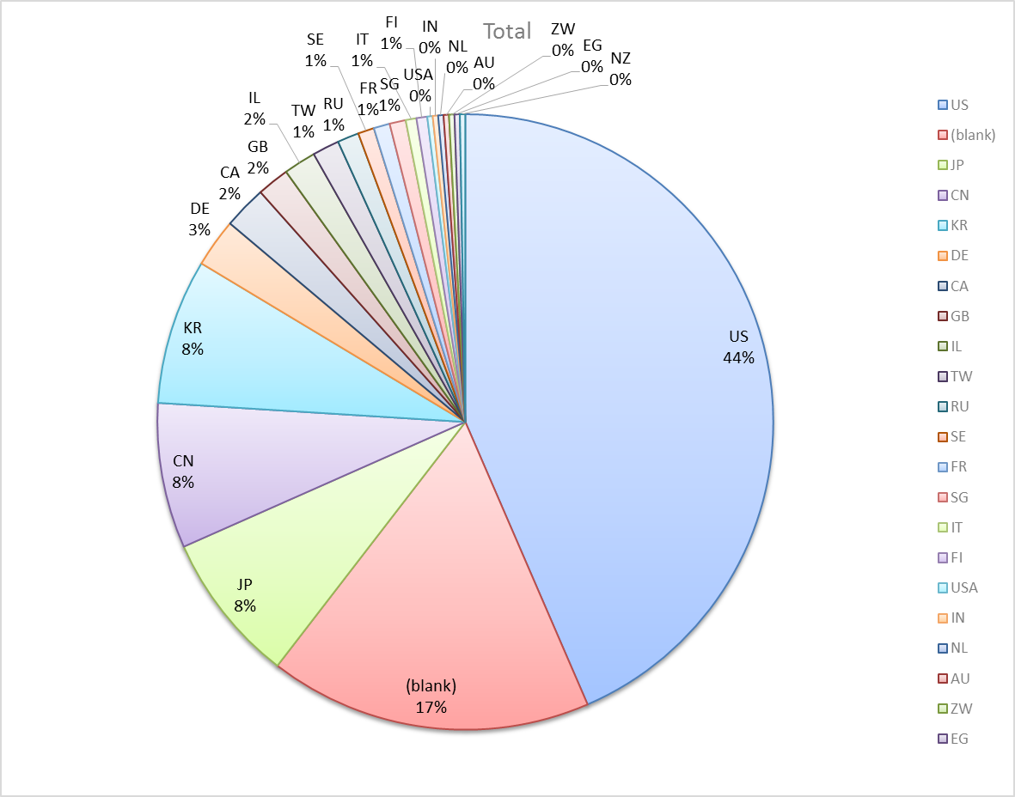
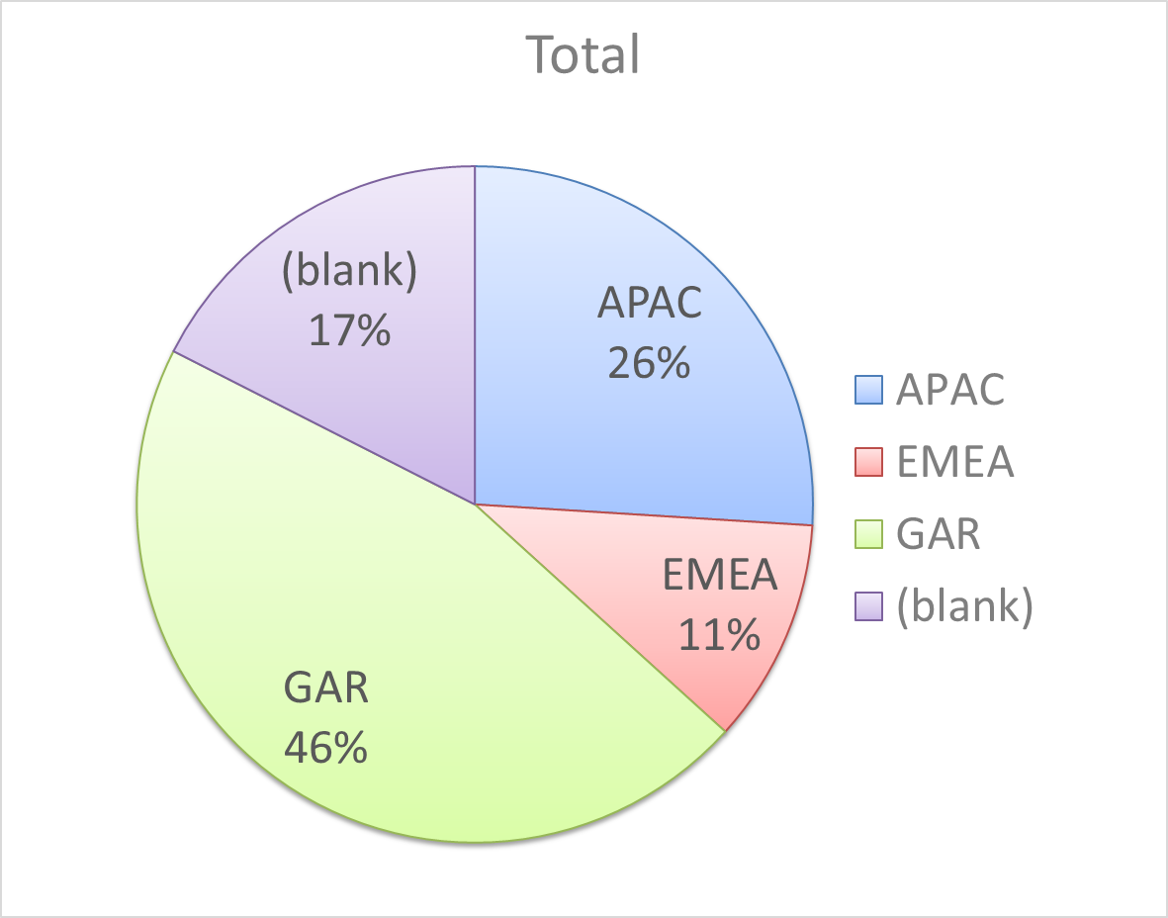
Attendance by Country

Slide 7
Doc Revision uploads by meeting (month #)

Slide 8
802.11 WG Editor’s Meeting (July ‘16)
Date: 2016-07-24
Authors:
from slide 1/6 of 11-16-0934 by Peter Ecclesine (Cisco Systems)
Notes:
July 2007

Slide 9
Volunteer Editor Contacts
TGmc – Adrian Stephens – adrian.p.stephens@intel.com, Edward Au – edward.ks.au@huawei.com, Emily Qi – emily.h.qi@intel.com
TGah – Yongho Seok yongho.seok@gmail.com, Alfred Asterjadhi – aasterja@qti.qualcomm.com
TGai – Lee Armstrong – LRA@tiac.net, Ping FANG Ping.FANG@huawei.com
TGaj – Jiamin CHEN – jiamin.chen@mail01.huawei.com , Shiwen He – shiwenhe@seu.edu.cn
TGak – Donald Eastlake – d3e3e3@gmail.com, Norm Finn – nfinn@cisco.com
TGaq – Lee Armstrong – LRA@tiac.net
  TGax – Robert Stacey – robert.stacey@intel.com
  TGay – Carlos Cordeiro – carlos.cordeiro@intel.com
  TGaz – Chao Chun Wang – chaochun.wang@mediatek.com
  Editors Emeritus:
  TGaa – Alex Ashley – alex.ashley@hotmail.co.uk
  TGac – Robert Stacey – robert.stacey@intel.com
  TGad – Carlos Cordeiro – carlos.cordeiro@intel.com
  TGae – Henry Ptasinski – henry@LOGOUT.COM
  TGaf – Peter Ecclesine – pecclesi@cisco.com
  TGaq – Dan Gal – ddrgal@gmail.com
from slide 2/6 of 11-16-0934 by Peter Ecclesine (Cisco Systems)
Notes:
July 2007

Slide 10
802.11 Style Guide
See 11-09-1034-11-0000-wg11-style-guide.doc
  We updated 802.11 WG Style Guide based on 2012 IEEE Standards Style Manual and consistency changes in final publication of the 802.11 standard
Editor’s responsibility includes checking the 2014 IEEE Standards Style Manual when creating or updating drafts. https://development.standards.ieee.org/myproject/Public/mytools/draft/styleman.pdf
Submissions with draft text should conform to both the WG11 Style Guide and IEEE Standards Style Manual
Note that the Style Guide evolves with our practice, expect a revision in March
from slide 3/6 of 11-16-0934 by Peter Ecclesine (Cisco Systems)

Slide 11
Editor Amendment Ordering
Data as of July 2016
See http://grouper.ieee.org/groups/802/11/Reports/802.11_Timelines.htm
In July 2016, Editors changed the running order and will revisit in Mar 2017, maintaining this order in the interim
Amendment Number | Task Group | Projected REVCOM Date
802.11REVmc | TGmc - 3650 | Jan 2017
802.11-2016 Amendment 1 | TGai - 170 | Jan 2017
802.11-2016 Amendment 2 | TGah - 627 | Jan 2017
802.11-2016 Amendment 3 | TGaq - 34 | Mar 2017
802.11-2016 Amendment 4 | TGaj - 288 | Jun 2017
802.11-2016 Amendment 5 | TGak - 86 | Sep 2017
802.11-2016 Amendment 6 | TGax - 209 | Mar 2019
802.11-2016 Amendment 7 | TGay | Dec 2019
802.11-2016 Amendment 8 | TGaz | Mar 2020
Amendment numbering is editorial! No need to make ballot comments on these dynamic numbers!
from slide 4/6 of 11-16-0934 by Peter Ecclesine (Cisco Systems)
Notes:
July 2007

Slide 12
Draft Development Snapshot
July 2016
TG | Published or Draft Baseline Documents |  |  |  |  |  |  |  |  |  | Source | MDR | Style Guide | Editor | Snapshot Date
 | Published | mc | ai | ah | aq | ak | aj | ax | ay | az
mc | Y | 5.4 |  |  |  |  |  |  |  |  | Frame 12.0 | Yes | 2012 | Adrian Stephens Edward Au, Emily Qi | 26-Jul
ai | N | 5.0 | 8.0 |  |  |  |  |  |  |  | Frame 12.0 | Yes | 2012 | Lee Armstrong Ping FANG | 25-Jul
ah | N | 5.0 |  | 8.0 |  |  |  |  |  |  | Frame 11.0 | Yes | 2012 | Yongho Seok Alfred Asterjadhi | 26-Jul
aq | N | 5.0 |  |  | 5.0 |  |  |  |  |  | Frame 12.0 | No | 2012 | Lee Armstrong | 25-Jul
ak | N | 5.0 | 6.0 | 5.0 | 1.2 | 2.3 |  |  |  |  | Word | No | 2012 | Donald Eastlake Norm Finn | 25-Jul
aj | N | 5.4 | 6.2 | 5.0 | 3.0 | 1.3 | 2.0 |  |  |  | Frame 10.0 | No | 2012 | Jiamin Chen Shiwen He | 27-Jul
ax | N | 5.0 | 6.0 | 5.0 | 3.0 | 1.0 | 1.0 | 0.2 |  |  | Frame 12.0 | No | 2012 | Robert Stacey | 26-Jul
ay |  |  |  |  |  |  |  |  |  |  |  | No | 2012 | Carlos Cordeiro | 26-Jul
az |  |  |  |  |  |  |  |  |  |  |  |  |  | Chao Chun Wang | 26-Jul
Changes from last report shown in red.
Most current doc shaded green.
from slide 5/6 of 11-16-0934 by Peter Ecclesine (Cisco Systems)
Notes:
July 2009
July 2007
Peter Ecclesine (Cisco Systems)
Page 12

Slide 13
MIB style, Visio and Frame practices
I’m going to suggest going forward we use a single style with appropriately set tabs, and use leading Tabs to distinguish the syntax and description parts. (Adrian Stephens Feb 9, 2010)
Two ways to format a figure & its caption in frame:
  Insert a table. Insert anchored frame inside table cell to hold graphics. Use table caption as figure caption.
  Insert an anchored frame. Insert caption inside a text frame inside the anchored frame. Insert graphics inside the anchored frame.
Keep embedded figures using visio as long as possible
  Near the end of sponsor ballot, turn these all into .wmf (windows meta file) format files (you can do this from visio using “save as”). Keep separate files for the .vsd source and the .wmf file that is linked to from frame. There is likelihood we should use .emf
Frame templates for 11aa, 11ac, 11af
from slide 6/6 of 11-16-0934 by Peter Ecclesine (Cisco Systems)

Slide 14
ARC Closing Report
Date: 2016-07-28
Authors:
from slide 1/8 of 11-16-1038 by Mark Hamilton (Ruckus Wireless)

Slide 15
Abstract
This document is the closing report for ARC SC,
July 2016 Meeting in San Diego, California, USA
from slide 2/8 of 11-16-1038 by Mark Hamilton (Ruckus Wireless)

Slide 16
Work Completed
Agenda is here: https://mentor.ieee.org/802.11/dcn/16/11-16-0793-02-0arc-arc-sc-agenda-july-2016.pptx
Noted status of “802.11 as a component/5G/IMT-2020”
  Being handled in EC SC 5G. EC SC 5G is planning to wrap up their work this week, and had evening meetings planned to discuss. No action needed.
Noted status of IEEE 1588 mapping to IEEE 802.11
  No changes. No action needed.
  Noted that the Society of Motion Pictures is developing a standard based on IEEE 1588, but that would need to do timing on multicast traffic over 802.11, which we do not current cover. We might get a request to add extensions to cover this.
from slide 3/8 of 11-16-1038 by Mark Hamilton (Ruckus Wireless)

Slide 17
Work Completed (cont)
Noted status of IETF/802 Coordination
  No known action needed.
Noted status of 802.1AC revision
  Yet another Sponsor Ballot closed to clean up all changes and open issues, but still waiting for the RAC to assign an EtherType.
Status of joint topics with TGak (General Links)
  TGak is still struggling with what an ESS means in their context. ARC SC can help with this. Covered later in the agenda.
from slide 4/8 of 11-16-1038 by Mark Hamilton (Ruckus Wireless)

Slide 18
Work Completed (cont)
MIB Design Pattern work item
  Discussed.
  No real progress recently. Have missed our target to complete a version we can include in the MDR process, out of the May meeting.
  At this point, we need to put focus and emphasis on this, to get a recommendation done that can the basis for REVmd and related amendments.
YANG/NETCONF
  Reported on comments from the 802.3 Study Group working on this. If we agree that SNMP has outlived value, we may find the start of REVmd as a good window to consider changing to YANG/NETCONF.
The above topics are likely to interrelate.
from slide 5/8 of 11-16-1038 by Mark Hamilton (Ruckus Wireless)

Slide 19
Work Completed (cont)
What is an ESS?
  Long discussion. No consensus, yet.
  Proposal for a new view/definition, that includes all the “black boxes” (like DS, Bridges, even Authentication Service, etc.), that would be “everything needed to provide an end-to-end service that hides mobility/location/topology”
  Some things can clearly be different within an ESS, like channel. How about band? MTU size? What do we do with client-identity-specific or location-specific policies; do they imply multiple ESSs?
  Not comfortable with this significant a change, yet. Will continue discussion. Also need to consider what changing this definition will really affect.
Joint meeting with TGak
  11ak comment resolution; ARC contributed occasional opinions.
from slide 6/8 of 11-16-1038 by Mark Hamilton (Ruckus Wireless)

Slide 20
Teleconference(s)
None planned
May schedule with 10 days notice
from slide 7/8 of 11-16-1038 by Mark Hamilton (Ruckus Wireless)

Slide 21
September 2016 Plans
Two standalone meeting slots planned:
  Update on 802.11 as a component/5G/IMT2020
    Monitor activities arising from 802 EC SC work
    Note that actions would come to WGs, including 802.11, and ARC SC is likely to be tapped for something
  Design Pattern for MIB attribute use
  Consider use of YANG/NETCONF by 802.11
  DS/AP/Portal architecture discussions, and “what is an ESS?”
  Status of IETF work, IEEE 1588 work
One joint session with TGak
  802.11ak architecture discussions
from slide 8/8 of 11-16-1038 by Mark Hamilton (Ruckus Wireless)

Slide 22
PAR Review - Meeting Agenda and Comment slides - San Diego 2016
Date: 2016-07-18
Authors:
from slide 1/12 of 11-16-0248 by Jon Rosdahl, (Qualcomm)

Slide 23
Abstract-Snapshot
July 24-29, 2016, San Diego, California
PARs under consideration:
  802.3cb - Amendment: 2.5Gb/s and 5 Gb/s Operation over Backplane, PAR Modification and CSD
  802.3.2 (802.3cf)- Standard: Ethernet YANG data, PAR and CSD
Meeting times: Monday PM2, Tuesday AM2, Thursday AM2
from slide 2/12 of 11-16-0248 by Jon Rosdahl, (Qualcomm)

Slide 24
PAR Review SC – July 2016
Chair: Jon Rosdahl
Draft Agenda:
Monday Agenda:
  Welcome
  Approve Previous Minutes
  Determine order of review
  Review PARs/CSD posted for review this week.
  Recess
Tuesday Agenda:
  Complete review of PARs/CSD and post comments to 802 WGs
  Recess
Thursday Agenda:
  Review Response to Comments
  Prepare Report for 802.11 WG closing plenary
  Adjourn
from slide 3/12 of 11-16-0248 by Jon Rosdahl, (Qualcomm)

Slide 25
Motion to Approve Previous Minutes
Move to approve doc 11-16/423r0 as the minutes for PAR Review SC from March 2016 Plenary in Macau
Moved: Michael Montemurro 2nd: Menzo Wentink
No Objection – Passed without objection – motion passes.
from slide 4/12 of 11-16-0248 by Jon Rosdahl, (Qualcomm)

Slide 26
Par Review Comments
from slide 5/12 of 11-16-0248 by Jon Rosdahl, (Qualcomm)

Slide 27
  802.3cb - Amendment: 2.5Gb/s and 5 Gb/s Operation over Backplane, PAR Modification and CSD
Section 8.1 – An Explanation should be put in 8.1 to explain what was modified.
CSD has a “(CU4HDD)” which is not defined, is it necessary? Suggest remove.
CSD – Footer indicates “March 2016” suggest update as this CSD is being updated and should be documented as such.
from slide 6/12 of 11-16-0248 by Jon Rosdahl, (Qualcomm)

Slide 28
802.3.2 (802.3cf)- Standard: Ethernet YANG data, PAR and CSD
5.5 – Expand NETCONF acronym for the first time use.
CSD – update page 1 “Ad Hoc Draft Edit Copy” should this be removed?
from slide 7/12 of 11-16-0248 by Jon Rosdahl, (Qualcomm)

Slide 29
Responses From 802 WGs
from slide 8/12 of 11-16-0248 by Jon Rosdahl, (Qualcomm)

Slide 30
  802.3cb - Amendment: 2.5Gb/s and 5 Gb/s Operation over Backplane, PAR Modification and CSD
Section 8.1 – An Explanation should be put in 8.1 to explain what was modified.
RESPONSE: ACCEPTED: Explanatory text added to item 8.1.
CSD has a “(CU4HDD)” which is not defined, is it necessary? Suggest remove.
RESPONSE: ACCEPTED: (CU4HDD) is removed as suggested.
CSD – Footer indicates “March 2016” suggest update as this CSD is being updated and should be documented as such.
RESPONSE: ACCEPTED: Footer updated.
Updated IEEE P802.3.2 IEEE P802.3cb draft PAR modification request: <https://mentor.ieee.org/802-ec/dcn/16/ec-16-0124-00-00EC-ieee-p802-3cb-draft-par-modification-request.pdf>
Updated IEEE P802.3.2 IEEE P802.3cb draft CSD modification request: <https://mentor.ieee.org/802-ec/dcn/16/ec-16-0125-00-00EC-ieee-p802-3cb-draft-csd-modification-request.pdf>
from slide 9/12 of 11-16-0248 by Jon Rosdahl, (Qualcomm)

Slide 31
802.3.2 (802.3cf)- Standard: Ethernet YANG data, PAR and CSD
5.5 – Expand NETCONF acronym for the first time use.
Response:
• We have changed the text to “...NETCONF
(NETwork CONFiguration, IETF RFC 6241)...”
CSD – update page 1 “Ad Hoc Draft Edit Copy” should this be removed?
Response:
Thank you and we have made the change.
.. Comments and responses: <https://mentor.ieee.org/802-ec/dcn/16/ec-16-0123-00-00EC-responses-to-ieee-p802-3-2-ieee-802-3cf-par-and-csd-comments.pdf>
Updated IEEE P802.3.2 (IEEE 802.3cf) draft PAR: <https://mentor.ieee.org/802-ec/dcn/16/ec-16-0121-00-00EC-ieee-p802-3-2-ieee-802-3cf-draft-par.pdf>
Updated IEEE P802.3.2 (IEEE 802.3cf) draft CSD: <https://mentor.ieee.org/802-ec/dcn/16/ec-16-0122-00-00EC-ieee-p802-3-2-ieee-802-3cf-draft-csd.pdf>
from slide 10/12 of 11-16-0248 by Jon Rosdahl, (Qualcomm)

Slide 32
Motion To Approve Report
Move to accept 11-16/248r2 as the report from PAR Review SC for the July 2016 plenary.
Moved: Marc EMMELMANN
2nd: Michael MONTEMURRO
Results: 4-0-0 Motion passes.
from slide 11/12 of 11-16-0248 by Jon Rosdahl, (Qualcomm)

Slide 33
References
IEEE 802 PARs Under consideration Webpage:
  http://grouper.ieee.org/groups/802/PARs.shtml
Minutes:
11-16/986r0 < https://mentor.ieee.org/802.11/dcn/16/11-16-0986-00-0PAR-minutes-july-2016-session.docx >
from slide 12/12 of 11-16-0248 by Jon Rosdahl, (Qualcomm)

Slide 34
IEEE 802.11/15 Regulatory SC
San Diego Closing Report
Date: 2016-07-29
Authors:
from slide 1/6 of 11-16-0848 by Rich Kennedy, Hewlett Packard Enterprise

Slide 35
Abstract
This presentation is the closing report for the July 2016 IEEE 802.11/15 Regulatory Standing Committee meeting in San Diego.
from slide 2/6 of 11-16-0848 by Rich Kennedy, Hewlett Packard Enterprise

Slide 36
Agenda
Administrative items
Introduction
Approve Waikoloa minutes
Discussion items
  Regulatory work in progress
  Status of completed work
Actions required
  FCC 16-89 mmWave FNPRM
  India Public Wi-Fi consultation
AOB and Adjourn
from slide 3/6 of 11-16-0848 by Rich Kennedy, Hewlett Packard Enterprise

Slide 37
Regulatory Updates
Ofcom 5 GHz Consultation
  Submitted Thursday, July 21st
FCC 5.9 GHz band Public Notice
  FCC getting started testing DSRC interference mitigation
FCC 16-89 mmWave R&O
  FCC opened 64-71 GHz to add to 57-64 GHz
ETSI BRAN and ERM TG11 updates
  EN 300 328 in final approval stage
  EN 301 893 hoping for September completion
  EN 301 598 to be completed in time for June deadline
from slide 4/6 of 11-16-0848 by Rich Kennedy, Hewlett Packard Enterprise

Slide 38
Input for 802.18
Liaison to ITU-R to consider WAS/RLANs in 57-76 GHz
FCC 16-89 mmWave FNPRM
  Due September 30, 2016
  Ask for
    71-76 GHz and 81-86 GHz
    No conducted power limit (only EIRP)
    Higher EIRP limit
    Enable use on aircraft
from slide 5/6 of 11-16-0848 by Rich Kennedy, Hewlett Packard Enterprise

Slide 39
Teleconferences, etc.
No more Regulatory SC teleconferences
We will continue with SC meetings for two more meetings, until the transition to 802.18 is shown to be effective
I will continue to act as Chair until the end
from slide 6/6 of 11-16-0848 by Rich Kennedy, Hewlett Packard Enterprise

Slide 40
Closing Report
Date: 2016-07-29
Authors:
from slide 1/3 of 11-16-1050 by Jim Lansford, Chair (Qualcomm)

Slide 41
Abstract
Closing report for WNG SC for July 2016 in San Diego, California (USA)
from slide 2/3 of 11-16-1050 by Jim Lansford, Chair (Qualcomm)

Slide 42
Final Agenda
https://mentor.ieee.org/802.11/dcn/16/11-16-0797-02-0wng-agenda-for-wng-2016-07.ppt
Presentations at July 2016 meeting
    “P802.1CM Time-Sensitive Networking for Fronthaul” - János Farkas (Ericsson)
      https://mentor.ieee.org/802.11/dcn/16/11-16-1003-00-0wng-p802-1cm-time-sensitive-networking-for-fronthaul.pptx
    “History and Implementation of the IEEE 802 Security Architecture”, Meareg Abreha (Addis Ababa University – IEEE 802 student paper award winner)
      https://mentor.ieee.org/802.11/dcn/16/11-16-0940-01-0wng-history-and-implementation-of-the-ieee-802-security-architecture.pptx
    Introduction to SOMA” Junghoon Suh (Huawei)
      https://mentor.ieee.org/802.11/dcn/16/11-16-0943-00-0wng-introduction-to-soma.pptx
    “Student Measurements of 802.11 behavior in different environments”, Jim Lansford (Qualcomm/University of Colorado - Boulder)
      https://mentor.ieee.org/802.11/dcn/16/11-16-0977-00-0wng-measurements-of-802-11-behavior-in-different-environments.ppt
Minutes
  11-16-0985r0
Plans for September 2016
  TBD
from slide 3/3 of 11-16-1050 by Jim Lansford, Chair (Qualcomm)

Slide 43
IEEE 802 JTC1 SC closing report
(Jul 2016)
Date: 2016-07-26
Authors:
from slide 1/4 of 11-16-0481 by Andrew Myles, Cisco

Slide 44
Abstract
Closing report for IEEE 802 JTC1 SC
for July 2016 in San Diego
from slide 2/4 of 11-16-0481 by Andrew Myles, Cisco

Slide 45
The SC did not have a great deal of work this week and only one session was required
Reviewed status of PSDO pipeline
  IEEE 802 has pushed 20 standards completely through the PSDO ratification process
  IEEE 802 has 37 standards in or planned to go into the PSDO ratification process
    802.11 has 3 standards liaised (802.11ah, 802.11ai, 802,11mc)
    802.11 has 6 standards planned for liaising
  SC reviewed replies to comments for multiple groups
    802.1Qbv, 802.1AB, 802.1Qca, 802.3, 802.22a, 802.22b
Reviewed SC6 activities
  Responded to SC6 liaison, telling them that we are unlikely to attend SC6 meetings but will provide information via teleconference
from slide 3/4 of 11-16-0481 by Andrew Myles, Cisco

Slide 46
The SC will focus in Warsaw on executing PSDO processes
Continue executing PSDO processes
Discuss any new material from SC6
from slide 4/4 of 11-16-0481 by Andrew Myles, Cisco

Slide 47
IEEE 802.11mc Closing Report for
July 2016
Date: 2016-07-28
Authors:
from slide 1/6 of 11-16-1049 by Dorothy Stanley, HP Enterprise

Slide 48
Abstract
This document contains the TGmc closing report for July 2016.
from slide 2/6 of 11-16-1049 by Dorothy Stanley, HP Enterprise

Slide 49
Status
Sponsor Ballot Comment resolution
  334 comments received and resolved (second recirc SB, 93% approval) on P802.11REVmc D6.0.
  Approved motion for SB recirculation on D7.0
Agenda, includes motions
  https://mentor.ieee.org/802.11/dcn/16/11-16-0785-11-000m-tgmc-agenda-july-2016.pptx
Comment resolution spreadsheet
  11-15-532
from slide 3/6 of 11-16-1049 by Dorothy Stanley, HP Enterprise

Slide 50
TGmc Plan of Record - modified
20 July 2012 – 12 Sept 2012 – Call for Comment/Input
29-30 Aug 2012 – NesCom, SASB PAR Approval
Sept 2012 – Begin to process CC input, 11aa, 11ae integration
Dec 2012 – March/May 2013 – 11ad integration
Jan 2013 – First WG Letter ballot - without 11ad – on D1.0
Sept 2013 – Letter ballot on D2.0
Dec 2013 – May 2014 – 11ac, 11af integration – D3.0 in May 2014
July 2014 – Mandatory Draft Review
Jan 2015 – D4.0 Recirculation
Form Sponsor Pool: Open Dec 15th or so, close Feb 20, 2015 –good for 6 months (end of July 2015)
D4.0 Initial Sponsor Ballot 2015-03-27 through 2015-04-26
D5.0 Jan 2016 Initial SB recirculation
D6.0 Second Recirculation 2016-06-07 through 2016-06-30
D7.0 August/September Third/Fourth (unchanged) Recirculation
October 2016 – WG/EC Final Approval Oct 4th telecon
December 2016 – RevCom/SASB Approval
Slide 50
from slide 4/6 of 11-16-1049 by Dorothy Stanley, HP Enterprise
Notes:
doc.: IEEE 802.11-10/0503r4
May 2010
Michael Montemurro, Research in Motion
Page 50

Slide 51
TGmc SB Planning
June 2016
  2rd recirculation D6.0 2016-06-07 to 2016-06-30
July 2016
  Comment resolution on D6.0
August/Sept 2016
  July 30 – Aug 15 editing and review of editing
  3th recirculation D7.0 August 15-25
  On or before Sept 9: Complete comment resolution (goal: unchanged draft)
  4th recirculation D7.0 unchanged Sept 10 - 20: 10 day recirculation of unchanged draft
October 4th: EC teleconference approval – request unconditional approval for TGmc
  October 17th deadline for submission to Revcom
December 2016 – RevCom/SASB Approval
Slide 51
from slide 5/6 of 11-16-1049 by Dorothy Stanley, HP Enterprise
Notes:
doc.: IEEE 802.11-10/0503r4
May 2010
Michael Montemurro, Research in Motion
Page 51

Slide 52
July – September 2016 Meeting Planning
Objectives:
  Complete 3rd Sponsor Ballot comment resolution, Initiate 4th recirculation
  Prepare Report to EC for Unconditional approval (Oct 4th teleconference),
  Sept 2016 WG approval for proceeding to RevCom
Conference calls 10am Eastern 2 hours
  August 12, 2 hours if needed; other calls scheduled with 10 day notice
Ballot Resolution Committee meeting –
  None currently scheduled
Availability of 11mc in the IEEE store
  D6.0 is available (add D7.0 after SB approval), see http://www.techstreet.com/ieee/products/1867583
Forward to ISO JTC1/SC6 WG1
  D5.0 forwarded; D6.0 & D7.0 will be forwarded upon SB approval
from slide 6/6 of 11-16-1049 by Dorothy Stanley, HP Enterprise

Slide 53
IEEE 802.11ah Closing Report for
July 2016
Date: 2016-07-28
Authors:
from slide 1/6 of 11-16-1039 by Yongho Seok (NEWRACOM)

Slide 54
Abstract
This presentation is the closing report for the San Diego meeting of the IEEE 802.11 TGah.
from slide 2/6 of 11-16-1039 by Yongho Seok (NEWRACOM)

Slide 55
Activity in TGah
The last Sponsor Ballot for TGah Draft 8.0 (closed May 17th) satisfied the requirement for forwarding the draft to REVCOM
But, TGah are pending a next step until our base specs (P802.11mc and P802.11ai are ready to forward their draft to REVCOM
On July meeting,
  Review P802.11ah EC Report
  PAR extension request
  Timeline Update
  Agenda: https://mentor.ieee.org/802.11/dcn/16/11-16-0781-02-00ah-july-2016-agenda.pptx
from slide 3/6 of 11-16-1039 by Yongho Seok (NEWRACOM)

Slide 56
Going forward
Update TGah Draft to D9.0 incorporating some editorial changes from P802.11mc Draft 7.0
  Expect that P802.11mc Draft 7.0 will be available on a mid August
Start 4th Sponsor Recirculation Ballot for Draft 9.0
from slide 4/6 of 11-16-1039 by Yongho Seok (NEWRACOM)

Slide 57
Teleconference
Two teleconferences on Teleconferences on August 16th and September 6th
  Tuesday 8PM ET for 2.5 hours
from slide 5/6 of 11-16-1039 by Yongho Seok (NEWRACOM)

Slide 58
TGah Timeline – Updates
Internal Task Group Ballot : May 2013
Initial Letter Ballot : September 2013
Initial Recirculation Letter Ballot : September 2014
Initial Sponsor Ballot : October 2015
Initial Recirculation Sponsor Ballot : January 2016
EC Approval : July September 2016
Revcom Approval : September December 2016
from slide 6/6 of 11-16-1039 by Yongho Seok (NEWRACOM)

Slide 59
IEEE 802.11TGai
Closing Report
July 2016
Date: 2016-07-28
Authors:
Name | Company | Address | Phone | email
Hiroshi MANO | Koden Techno Info K.K. | Fuji Blg 28 2F, 2-7-26 Kita-Aoyama, Minato-ku, Tokyo, 107-0061, Japan | +81-3-6890-0594 | mano@koden-ti.com hiroshi@manosan.org
from slide 1/14 of 11-16-1034 by Hiroshi Mano (KDTI)

Slide 60
Abstract
This presentation is the closing report for the San Diego meeting of the IEEE 802.11 TGai.
from slide 2/14 of 11-16-1034 by Hiroshi Mano (KDTI)

Slide 61
IEEE 802.11 FILS TGai – July 2016 San Diego
Goals for the Meeting:
  Approve minutes of past meeting and teleconference
  Continue on comment resolution
  Approve to forward the 3rd recirc sponsor LB
  Approve Timeline (with PAR extention)
  Approve Teleconference schedule
  Approve plan for Sep
from slide 3/14 of 11-16-1034 by Hiroshi Mano (KDTI)

Slide 62
Accomplishments TGai 1/2
2 regular slots
Approve TGai Meeting Minutes for the IEEE 802.11 Waikoloa meeting:
  16-0743r0
  https://mentor.ieee.org/802.11/dcn/16/11-16-0743-00-00ai-may-2016-waikoloa-sesssion-minutes.doc
Approve TGai teleconference meeting minutes of Waikoloa to SanDiego meeting.
  16-0800r2
  https://mentor.ieee.org/802.11/dcn/16/11-16-0800-00-02ai-may-july-teleconference-minutes.doc
from slide 4/14 of 11-16-1034 by Hiroshi Mano (KDTI)

Slide 63
Accomplishments TGai 2/2
Received 6 comments by2nd recirc SB
  Resolved all of comment
Approve to forward the 3rd recirc sponsor LB
Approve Timeline (with PAR extention)
Approve Teleconference schedule
Approve plan for Sep
from slide 5/14 of 11-16-1034 by Hiroshi Mano (KDTI)

Slide 64
Motion
(Re-approval of 5C)
Believing that the Five Criteria contained in the document referenced below meets IEEE 802 guidelines,
Request that the Five Criteria contained in 11-10/1153r0 be posted to the IEEE 802 Executive Committee (EC) agenda for WG 802 preview and EC approval.
Moved: Ping Fang
Seconded:Hitoshi Morioka
Result:7/0/0
from slide 6/14 of 11-16-1034 by Hiroshi Mano (KDTI)

Slide 65
Motion
(approval of PAR extension)
Believing that the PAR extension contained in the document referenced below meets IEEE-SA guidelines,
Request that the PAR extension contained in 11-16/0991r0 be posted to the IEEE 802 Executive Committee (EC) agenda for approval to submit to NesCom.
Moved:Ping Fang
Seconded:George Calcev
Result y/n/a :8/0/0
from slide 7/14 of 11-16-1034 by Hiroshi Mano (KDTI)

Slide 66
Timeline
  PAR Approved, Modified, or Extended 2010-12-08
  WG Letter Ballots Initial / Recirc Mar14/Sep14/Jan15/
  Mar15/Jul15/Aug15
  MEC Done Nov14
  Form Sponsor Ballot Pool / Reform Mar15
  IEEE-SA Sponsor Ballots Initial / Recirc Sep 15/Mar 16/Aug 16
  Sep 16/Oct 16
  Final 802.11 WG Approval Sep 16
  final or Conditional 802 EC Approval Oct 4th, 2016 (telco)
  RevCom & Standards Board Final or
  Continuous Process Approval Dec 16
from slide 8/14 of 11-16-1034 by Hiroshi Mano (KDTI)
Notes:
Need to be in SB on Oct 17 final SB on draft unchanged.
Note: Aug16 recirc to make final technical changes (D9.0) based on comment resolutions this week
Sep 16 (D10.0) only changes due to merging REVmc
Oct 16 (D10.0-unchanged) recirc of unchanged draft

Slide 67
Teleconference Schedule
July 2016
Motion:
  Approve the following schedule of weekly teleconferences between Aug 16 to Nov 1st.
  Tuesdays 10:00 ET
  Duration 1.5 Hour
  Using WEB-EX that will be provided by Task Group Chair
  Moved: Marc Emelmann
  Second: George Calcev
Approved by unanimous consent
from slide 9/14 of 11-16-1034 by Hiroshi Mano (KDTI)

Slide 68
Plan for Sep
Goals for the Sep Meeting:
  Approve minutes of past meeting and teleconference
  Approve to forward Conditional EC Apporval
  Approve Timeline
  Approve Teleconference schedule
  Approve plan for Nov
from slide 10/14 of 11-16-1034 by Hiroshi Mano (KDTI)

Slide 69
Motion to go to recirc:
July 2016
Move to
Having approved comment resolutions for all of the comments received from the 2nd Recirculation Sponsor Ballot on P802.11ai D8.0 as contained in document https://mentor.ieee.org/802.11/dcn/16/11-16-0852-02-00ai-tgai-comments-from-sb-2nd-recirc.xlsx.
Instruct the editor to prepare Draft 9.0 incorporating these resolutions and,
Approve a 10 day Sponsor Recirculation Ballot asking the question “Should P802.11ai D9.0 be forwarded to RevCom?”
Moved: Jouni Malinen
Seconded:Ping Fang
Result:9/0/0
from slide 11/14 of 11-16-1034 by Hiroshi Mano (KDTI)

Slide 70
3rd Sponsor Ballot has been opened.
BALLOT OPENS: 27-Jul-2016
BALLOT CLOSES: 06-Aug-2016
Don’t forget your Vote!
from slide 12/14 of 11-16-1034 by Hiroshi Mano (KDTI)

Slide 71
Reference
TGai-Motion-deck (11-13-1186/46)
  https://mentor.ieee.org/802.11/dcn/13/11-13-1186-46-00ai-tgai-motion-deck.pptx
Comments from 2nd recirc SB (11-16-0852/02)
  https://mentor.ieee.org/802.11/dcn/16/11-16-0852-02-00ai-tgai-comments-from-sb-2nd-recirc.xlsx
Draft 9.0 (802.11 members area)
  http://www.ieee802.org/11/private/Draft_Standards/11ai/Draft%20P802.11ai_D9.0.pdf
from slide 13/14 of 11-16-1034 by Hiroshi Mano (KDTI)

Slide 72
Thanks to all who participated!
from slide 14/14 of 11-16-1034 by Hiroshi Mano (KDTI)

Slide 73
IEEE 802.11aj July 2016 Closing Report
Date: 2016-07-28
Author:
from slide 1/7 of 11-16-1017 by Jiamin Chen (Huawei)

Slide 74
Abstract
This document is the TGaj closing report for the July 2016 session.
from slide 2/7 of 11-16-1017 by Jiamin Chen (Huawei)

Slide 75
Work Completed (1/2)
  Approved May meeting minutes (11-16/0758r0)
  Approved PAR Extension Request (11-16/0987r1) and Reapproved 5C
The following comment resolution proposals have been presented
  11-16/0979r0 - Proposed resolution to CID 96, 123 and 172 in LB217
  11-16/0972r1 - Proposed resolution to CID 401, 402, 408, 416, 423, 424, 427, 431, 436, 437, 404, 406, 407, 409, 410, 411, 418, 419, 422, 425, 426, and 428 in LB220
  11-16/0832r1 - Proposed Resolution to CID 3,5,15,17,20,21, and 38 on TGaj D2.0 in LB220
  11-16/0944r1 - Proposed resolutions to CID 429, 430, 432 - 435 in LB220
  11-16/1032r0 - LB220 Comment Resolutions to CID 14
  11-16/0973r1 – Proposed resolution to cid 412 and 413 in LB220
Completed all comment resolution of the LB217 for D1.0 and LB220 for D2.0
Approved those comment resolutions and instruct editor to incorporate them into D5.0.
from slide 3/7 of 11-16-1017 by Jiamin Chen (Huawei)

Slide 76
Work Completed (2/2)
Approved a 15-day Working Group Technical 2nd Recirculation Letter Ballot asking the question “Should P802.11aj D5.0 be forwarded to Sponsor Ballot?”
Reviewed and updated Task Group timeline
from slide 4/7 of 11-16-1017 by Jiamin Chen (Huawei)

Slide 77
Plan for September meeting
Comment Resolution for 802.11aj D5.0 2nd Recirculation WG Letter Ballot
Conditional MDR
from slide 5/7 of 11-16-1017 by Jiamin Chen (Huawei)

Slide 78
Conference Call Time
  1st September, 2016, 9pm ET for 1 hour
  (2nd September, 2016, 9am Beijing Time)
from slide 6/7 of 11-16-1017 by Jiamin Chen (Huawei)

Slide 79
July 2016
Thank you！
from slide 7/7 of 11-16-1017 by Jiamin Chen (Huawei)

Slide 80
TGak July Closing Report
Date: 2016-07-28
Authors:
from slide 1/4 of 11-16-1037 by Donald Eastlake, Huawei Technologies

Slide 81
Abstract
Closing Report of IEEE 802.11 Task Group ak at the IEEE 802.11 Meeting, July 2016, held at the Manchester Grand Hyatt, San Deigo, California.
from slide 2/4 of 11-16-1037 by Donald Eastlake, Huawei Technologies

Slide 82
TGak Closing Report
Accomplishments
  Met jointly with 802.11 ARC SC Thursday AM1.
  Reaffirmed CSD and requested PAR extension.
  Adjusted our timeline by moving most remaining dates out by four months.
  TGak has resolved 294 (85%) of our 346 comments from recirculation LB218.
  An annotated agenda is in 11-16/0776.
  The minutes will be in 11-16/0999.
from slide 3/4 of 11-16-1037 by Donald Eastlake, Huawei Technologies

Slide 83
TGak Closing Report
Teleconferences
  Decided to hold 1 ½ hour teleconferences, to be joint with 802.1Qbz if mutually convenient, on Monday, August 8th, 15th, and 22nd, and 29th, all at 10am Eastern US time.
September 2016 Plans
  Resolve comments from WG recirculation ballot.
  Joint meeting with 802.11 ARC SC
from slide 4/4 of 11-16-1037 by Donald Eastlake, Huawei Technologies

Slide 84
TGaq Closing Report
Date: 2016-07-28
Authors:
from slide 1/3 of 11-16-1047 by Stephen McCann, BlackBerry

Slide 85
Abstract
Closing report for TGaq (Pre-Association Discovery) for July 2016, San Diego, CA, USA.
from slide 2/3 of 11-16-1047 by Stephen McCann, BlackBerry

Slide 86
LB221 Comment Resolution Analysis
  D5.0
  93.16% approval, 65 comments
  Comment resolution complete and will request re-circulation letter ballot with D6.0
Request for Conditional Sponsor Ballot
  Prepared the Report for the EC - 11-16-1026r0
  Start Sponsor Ballot in September 2016
PAR Extension
Plans for September 2016
  Start working as a Ballot Resolution Committee
from slide 3/3 of 11-16-1047 by Stephen McCann, BlackBerry

Slide 87
TGax July 2016 Closing Report
Date: 2016-07-28
Authors:
from slide 1/6 of 11-16-1051 by Osama Aboul-Magd (Huawei Technologies)

Slide 88
Abstract
This document is the closing report for the TGax for the July 2016 session.
from slide 2/6 of 11-16-1051 by Osama Aboul-Magd (Huawei Technologies)

Slide 89
Work Completed
Received over 90 submissions. Majority of the submission addressing comment resolutions. A number of submissions were proposing new text to be added to the draft.
  A long list of submissions are yet to be considered.
Approved the resolutions of about 230 comments discussed during telecons.
Approved resolutions of almost 350 CIDs during this week
Exact count of resolved CIDs will be published by the Editor.
The TG editor is planning to have draft revision D0.3 ready based on resolved comments.
Agenda and motions are available at: https://mentor.ieee.org/802.11/dcn/16/11-16-0779-06-00ax-tgax-july-2016-meeting-agenda.ppt
from slide 3/6 of 11-16-1051 by Osama Aboul-Magd (Huawei Technologies)

Slide 90
Timeline
May 2014: start of the TG
Nov. 2014: First draft of the TG SFD was approved
Jan. 2016: proposed TG draft
March 2016: Draft D0.1 was approved and CC started
September 2016: Draft 1.0 and WG letter ballot
March 2017: Draft 2.0 and recirculation
July 2017: MDR (Mandatory Document Review)
November 2017: Formation of SB pool
March 2018: Sponsor Ballot
December 2018: RevCom
from slide 4/6 of 11-16-1051 by Osama Aboul-Magd (Huawei Technologies)

Slide 91
September 2016 Goals
Continue with comment resolutions
from slide 5/6 of 11-16-1051 by Osama Aboul-Magd (Huawei Technologies)

Slide 92
Conference Call Times
August 4 20:00 – 22:00 ET is already approved
August 11, 25, Sept 8 10:00 – 12:00 ET
August 18, Sept 1, Sept 22 20:00 – 22:00 ET
from slide 6/6 of 11-16-1051 by Osama Aboul-Magd (Huawei Technologies)

Slide 93
Task Group AY
July 2016 Closing Report
Date: 2016-07-29
Authors:
from slide 1/6 of 11-16-1035 by Edward Au (Huawei Technologies)

Slide 94
Abstract
This document is the closing report for Task Group AY for the July 2016 session.
from slide 2/6 of 11-16-1035 by Edward Au (Huawei Technologies)

Slide 95
Work Completed
20 submissions were covered during the meeting covering areas related to:
  Channel model
  Specification framework document
  Technologies
Significant progress is made in the development of specification framework document
from slide 3/6 of 11-16-1035 by Edward Au (Huawei Technologies)

Slide 96
Progress on Task Group documents
Doc. No. | Title of the Task Group documents | Status
15/0625r3 | IEEE 802.11 TGay use cases | Approved in November 2015 as the baseline document
15/1150r5 | Channel models for IEEE 802.11ay | Draft proposal is under review and ongoing discussion
15/1074r0 | TGay functional requirements | Approved this week as the baseline document
15/0866r4 | TGay evaluation methodology | Approved this week as the baseline document
15/1079r2 | TGay selection procedure | Approved in November 2015
15/1358r4 | Specification framework for TGay | Texts corresponding to motions #56 - #65 are inserted in the latest version after the March 2016 plenary
16/0266r2 | A compendium of motions related to the contents of the specification framework document for TGay | Updated after May 2016 interim
from slide 4/6 of 11-16-1035 by Edward Au (Huawei Technologies)

Slide 97
Goals for September 2016 interim
Advance on Task Group documents, with emphasis on Specification Framework document
Technical presentation
Vice Chair election
from slide 5/6 of 11-16-1035 by Edward Au (Huawei Technologies)

Slide 98
Teleconference Schedule
August 24 (Wednesday), 10:00am ET to 11:00am ET
from slide 6/6 of 11-16-1035 by Edward Au (Huawei Technologies)

Slide 99
TGaz Next Generation Positioning
July Closing Report
Date: 2016-07-27
Authors:
from slide 1/5 of 11-16-0508 by Jonathan Segev, Intel Corporation

Slide 100
Abstract
This document is the Next Generation Positioning TGaz closing report for the San Diego meeting, July 2016.
from slide 2/5 of 11-16-0508 by Jonathan Segev, Intel Corporation

Slide 101
Work Completed
Reviewed and approved a working draft Functional Requirement Doc.
Reviewed proposals on:
  Channel Sounding
  Security
  Functional Requirements
Set telecon times and goals for Sep. meeting.
Agenda: See 11-16/752r2.
from slide 3/5 of 11-16-0508 by Jonathan Segev, Intel Corporation

Slide 102
Goals for Sep. Meeting
Continue on Functional Requirement Document development.
Approve initial submissions of technical material towards SFD text where FRD is sufficiently mature.
Review technical submissions on channel models, proposed technical protocols and technical approaches and such.
from slide 4/5 of 11-16-0508 by Jonathan Segev, Intel Corporation

Slide 103
Teleconference Schedule
Sep. 7th 10:00AM ET for 1hr.
from slide 5/5 of 11-16-0508 by Jonathan Segev, Intel Corporation

Slide 104
Wake-up Radio (WUR) SG
July 2016 Closing Report
Date: 2016-07-28
Authors:
from slide 1/7 of 11-16-1055 by Minyoung Park (Intel Corp.)

Slide 105
Abstract
This document is the Wake-up Radio Study Group closing report for the San Diego meeting, July 2016
from slide 2/7 of 11-16-1055 by Minyoung Park (Intel Corp.)

Slide 106
Work Completed
Decided the study group leadership structure
  Conducted Vice-Chair election
    Yunsong Yang (81% approval rate)
  Appointed Secretary and confirmed by a SG motion
    Leif Wilhelmsson (unanimous consent)
Reviewed and discussed presentations to develop PAR and CSD documents (see next slide):
  Use cases, problem statements, scope and purpose
  Reviewed an initial PAR document in the SG
Reviewed SG timeline
Approved WUR SG extension
Set goals for the September meeting and teleconference schedule
Agenda: see doc.: IEEE 802.11-16/794r4
from slide 3/7 of 11-16-1055 by Minyoung Park (Intel Corp.)

Slide 107
Submissions Reviewed
PAR related submissions:
11-16/974r0, WUR usage scenarios and applications, Shahrnaz Azizi (Intel Corp.) -15 min
11-16/970r0, Input on WUR PAR scope, Steve Shellhammer (Qualcomm) -20 min
11-16/935r0, A PAR proposal for Wake-up Radio (WUR), Osama AboulMagd (Huawei) -20 min
11-16/859r0, WUR SG Proposed PAR, Minyoung Park (Intel Corp.) -20 min
CSD related submissions:
11-16/936r0, A CSD proposal for Wake-up Radio (WUR), Osama AboulMagd (Huawei) -20 min
Other submissions:
11-16/865r0, Performance investigation on wake-up receiver, Eunsung Park (LGE)
11-16/927r0, Securing the WUR, Yunsong Yang (Huawei), 20 min
11-16/931r0, Demand on roaming for WUR, Bo Sun (ZTE), 15 min
11-16/939r0, WUR-based Power Save Operations of AP, John Son (WILUS) 15 min
11-16/950r0, Considerations on WUR design, Igor Kim (ETRI) 15 min
11-16/968r0, Discussion of Duty-Cycled Wake-Up Receivers, Leif Wilhelmsson (Ericsson) 20 min
from slide 4/7 of 11-16-1055 by Minyoung Park (Intel Corp.)

Slide 108
Motion: Study Group Extension
Request the IEEE 802 LMSC to extend the IEEE 802.11 Wake-up Radio Study Group (WUR SG)
[Moved by <name> on behalf of <group>]
WUR Study Group vote:
Move: Jonathan Segev
Second: Yunsong Yang
Results: Y/N/A=69/0/0
from slide 5/7 of 11-16-1055 by Minyoung Park (Intel Corp.)

Slide 109
Goal for September 2016
Develop and complete PAR and CSD documents
Submit PAR and CSD for WG approval
from slide 6/7 of 11-16-1055 by Minyoung Park (Intel Corp.)

Slide 110
Teleconference Call Schedule
Approved to have 2 teleconference calls before the September F2F meeting
  August 15th, Monday, 2 pm EDT, 1 hour
  August 29th, Monday, 2 pm EDT, 1 hour
from slide 7/7 of 11-16-1055 by Minyoung Park (Intel Corp.)

Slide 111
RR-TAG (802.18) to 802.11 Liaison Report
Date: 2016-07-29
Authors:
from slide 1/4 of 11-16-0850 by Rich Kennedy, HP Enterprise

Slide 112
Overview
This document summarizes the activities of the IEEE 802.18 Radio Regulatory Technical Advisory Group (RR-TAG) during the IEEE 802 Plenary of July 2016 in San Diego.
from slide 2/4 of 11-16-0850 by Rich Kennedy, HP Enterprise

Slide 113
RR-TAG Actions Taken
Developed, edited and approved a liaison to ITU-R asking that WP5A request that Task Group 5/1 sharing studies in frequencies 66 GHz to 76 GHz consider WAS/RLAN Multiple Gigabit Wireless Systems operation in the lower adjacent bands in 57 GHz to 66 GHz, and the 66 GHz to 76 GHz bands.
  As presented to the 802.11 WG during the mid-week plenary
Began the development of a response to FCC 16-89 FNPRM
  Basic outline completed
  Drafting group set; will hold calls to complete before the September Interim
Discussed a liaison to WP5A/WP5C on frequencies above 275 GHz on behalf of the 802.15 Terahertz group
  Looking for system characteristics
  Document to be drafted at September Interim
from slide 3/4 of 11-16-0850 by Rich Kennedy, HP Enterprise

Slide 114
Motion Approved
Approve https://mentor.ieee.org/802.18/dcn/16/18-16-0062-02-0000-itu-r-5-1-liaison-was-rlan-considered-in-57-71-ghz.docx as our liaison to ITU-R WP5A, and submit to the IEEE 802 EC for approval and transmittal.
Moved by: Peter Ecclesine
Seconded by: Steve Palm
Discussion?
Vote: 8/0/0
from slide 4/4 of 11-16-0850 by Rich Kennedy, HP Enterprise

Slide 115
802.24 Vertical Applications
Technical Advisory Group
Liaison Report
Date: 2016-07-28
Author:
from slide 1/3 of 11-16-0727 by Tim Godfrey, EPRI

Slide 116
802.24 Overview
802.24 Vertical Applications TAG
802.24.1 Smart Grid TG
802.24.2 IoT TG
802.24.1 Smart Grid Task Group
  Internal / external coordination in matters related application of IEEE 802 standards for Smart Grid
  802.24.1 TG meets at Plenaries and Wireless Interims
802.24.2 IoT Task Group
  Internal / external coordination in matters related application of IEEE 802 standards for Internet of Things (IoT)
  802.24.2 TG meets at Plenaries and 802 Interims
July Agenda: 24-16-0018r0
Report 24-16-0019r1
Minutes 24-16-0020r0
from slide 2/3 of 11-16-0727 by Tim Godfrey, EPRI

Slide 117
802.24 Activities – July 2016
24.1 Smart Grid TG:
  Reviewed response to comments on “Report ITU-R SM.2351-0 – Smart grid utility management systems”
  Finalizing White paper development on Sub 1 GHz
    Draft at: 24-15-0029r9
  Initiating development of white paper on use of 802.1 Time Sensitive Networking (TSN) in electric utility applications. Collaborating with 802.1 TSN TG.
24.2 IoT TG:
  Proposed whitepaper on Single-pair Ethernet PHYs for IoT
  Liaison updates:
    IEEE P2413 IoT Architecture
    Industrial Internet Consortium
    OPC Foundation
from slide 3/3 of 11-16-0727 by Tim Godfrey, EPRI

Slide 118
IEEE 802.1 OmniRAN TG Status Report to IEEE 802 WGs
Date: 2016-07-28
Authors:
from slide 1/4 of 11-16-1052 by Max Riegel, Nokia

Slide 119
IEEE 802.1 OmniRAN TG Resources
OmniRAN TG maintains a Wiki page on mentor to reflect its status and achievements
  https://mentor.ieee.org/omniran/bp/StartPage
  Also showing meeting announcements and conference call dial-in information
OmniRAN filespace on mentor is used for contributions and meeting documents
  https://mentor.ieee.org/omniran/documents
Recent P802.1CF draft is available by
  http://www.ieee802.org/1/files/private/cf-drafts/d0/ w/ 802.11 credentials
FYI: OmniRAN P802.1 PAR
  https://development.standards.ieee.org/get-file/P802.1CF.pdf?t=81644900003
from slide 2/4 of 11-16-1052 by Max Riegel, Nokia

Slide 120
OmniRAN TG Achievements
San Diego meeting, July 25th – 28th
Review of draft D0.1 with resolution of comments
Review and acceptance of contributions on
  Network initialization
  Association and disassociation
  Authentication and trust establishment
  Authorization, QoS and policy control
  Accounting and monitoring
  Network Function Virtualization
All sections of ToC populated with initial text☺.
Initial TG ballot planned to start on Aug 9th (until Sept 8th)
  802.11 members invited to participate!
Special session on 5G SC Action A on July 26th
  Led to conclusion to proceed with Industry Connections activity
Assumed timeline within current scope:
  Starting WG ballot after March 2017, Sponsor Ballot Nov 2017
from slide 3/4 of 11-16-1052 by Max Riegel, Nokia

Slide 121
Looking forward to next session in
Warsaw, PL, September 13-15, 2016
Envisioned topics:
  Review of comments received for D0.2
    Enhancements to the specification text
  Special session on progressing the planning for Industry Connections activity on 5G SC Action A
Comment resolution session in York, UK on Sept 12th
  F2F meeting with commenters from 802.1
Conference calls:
  no conference calls until September due to ongoing TG ballot
  Conference calls after September interim
    September 27th, 09:30am ET, October 25th , 09:30am ET
    Dial-in information: https://mentor.ieee.org/omniran/bp/StartPage
    Topic: Comment resolution on draft D0.2
from slide 4/4 of 11-16-1052 by Max Riegel, Nokia

Slide 122
IEEE 802.11-IETF Liaison Report
Date: 2016-07-27
Authors:
from slide 1/21 of 11-16-0790 by Dorothy Stanley, HPE

Slide 123
Abstract
This presentation contains the IEEE 802.11 – IETF liaison report for July 2016.
from slide 2/21 of 11-16-0790 by Dorothy Stanley, HPE

Slide 124
IETF Meetings
Upcoming Meetings:
  November 13-18, 2016 – Seoul Korea
  March 26-31, 2017 – Chicago
  July 16-21, 2017 – Prague
  November 12-17, 2017 – Singapore
http://www.ietf.org
  Newcomer training: https://www.ietf.org/edu/process-oriented-tutorials.html#newcomers
  April 2016: Wireless Tutorial (Donald Eastlake), 802.11 & 802.15 tutorials (Dorothy Stanley, Charlie Perkins), see 11-16/500, July 2016: Pat Thaler & Juan Carlos – 802.1E (Privacy Considerations) and 802.c (Local MAC address usage) https://www.ietf.org/edu/tutorials.html
  http://tools.ietf.org/dailydose/
from slide 3/21 of 11-16-0790 by Dorothy Stanley, HPE

Slide 125
IETF- IEEE 802 Liaison Activity
Joint meetings, agenda and presentations
  http://www.iab.org/activities/joint-activities/iab-ieee-coordination/
  2016-06-08 teleconference held;
  Sept 9th, 2016 F2F meeting planned; topics: Multicast, ITS, OWE
  Tutorial request: present 802.11/.15 updates in Nov 2016
RFC 7241, “The IEEE 802/IETF Relationship” has been published (RFC4441 update)
  https://datatracker.ietf.org/doc/rfc7241/
IEEE 802 Liaisons list is available
  http://ieee-sa.centraldesktop.com/802liaisondb/FrontPage
802 EC “IETF/IAB/IESG” 802 EC Standing Committee
  Formed March 2014, Pat Thaler as chair
  Next meeting at July 2016 Plenary: Monday PM2
from slide 4/21 of 11-16-0790 by Dorothy Stanley, HPE

Slide 126
Multicast Topics
Multicast issues were discussed at the IETF-IEEE 802 meeting Sept 29th 2015 and a presentation given at the November 2015 IETF meeting
  See https://mentor.ieee.org/802.11/dcn/15/11-15-1261-02-0arc-mulicast-performance-optimization-features-overview-for-ietf-nov-2015.ppt
  Further actions: ietf mailing list has been established for ongoing discussion, will include additional 802. wireless groups, see http://www.ieee802.org/11/email/stds-802-11/msg01838.html
  Multicast considerations Internet draft describing use cases, issues, etc. under development, see https://tools.ietf.org/html/draft-perkins-intarea-multicast-ieee802-00
Insights
  Multicast used for multiple types of traffic including ARP/ND, routing protocols, video applications, and these might need to be transmitted at different MCS
  Implementations might consider APIs to allow MCS differentiation
  RFC 6775, Neighbor Discovery Optimization for IPv6 over Low-Power Wireless Personal Area Networks (6LoWPANs) defines a registration mechanism for accomplishing proxy ND
  Current Proxy ND support does not address Secure ND, see RFC 3971
Related documents
  http://datatracker.ietf.org/doc/draft-mcbride-mboned-wifi-mcast-problem-statement/
  http://www.ipv6council.be/IMG/pdf/20141212-08_vyncke_-_ipv6_multicast_issues-pptx.pdf
from slide 5/21 of 11-16-0790 by Dorothy Stanley, HPE

Slide 127
ITS BOF – Draft Charter
Draft Charter: Intelligent transportation systems
  Automobiles and vehicles of all types are increasingly connected to the Internet. Comfort-enhancing entertainment applications, road safety applications using bidirectional data flows, and connected automated driving are but a few new features expected in automobiles to hit the roads from now to year 2020.
  Today, there are several deployed Vehicle-to-Internet technologies (V2Internet) that make use of embedded Internet modules, or through driver's cellular smartphone: mirrorlink, carplay, android auto. However, Vehicle-to-Vehicle (V2V) and Vehicle-to-Infrastructure (V2I, not to be mistaken with V2Internet) communications are still being developed.
  Some vehicle and infrastructure communications will use IP and others > will not. Multiple applications need to share one data link, including non-IP- based protocols sharing the data link with IP-based protocols.
  This group will work on V2V and V2I use-cases where IP is well-suited as a networking technology, supporting also applications that involve exchanges of safety-related messages between vehicles and infrastructure if necessary.
  This group will develop IP-based protocols to establish direct and secure connectivity between a vehicle, which is often comprised of moving networks, and other vehicles and stationary systems. Some communications will be extremely short lived, but others will last for many hours or days.
  Moving network to nearby moving or fixed network communications may involve various kinds of link layers: 802.11-OCB (Outside the Context of a Basic Service Set, also called 802.11p), 802.15.4 with 6lowpan, 802.11ad, VLC (Visible Light Communications), IrDA, LTE-D, LP-WAN.
  One of the most used link layers for vehicular networks is IEEE 802.11-OCB, as a basis for DSRC. However, IPv6 on 802.11-OCB is not yet defined.
  The group will work only on IPv6 solutions.
from slide 6/21 of 11-16-0790 by Dorothy Stanley, HPE

Slide 128
ITS BOF – Work items & Milestones
Draft Charter: Intelligent transportation systems
  The group will work only on IPv6 solutions.
  The group will leverage on technologies for Internet of Things (IoT) which are developed in other IETF and IRTF efforts: 6lo WG, LP-WAN WG, and T2T RG.
  Co-existence with techniques of infrastructure mobility management will be coordinated with the DMM WG, LISP WG, and other mobility solutions.
  The SDOs interested in this work are: ISO/TC204, ETSI TC ITS, 3GPP, NHTSA and more.
  This group will not work on V2V or V2I use-cases where IP is not well-suited. Without re-chartering, this group will not work on Delay-Tolerant Networking nor on Information-Centric Networking.
  If the group is successful in accomplishing its first goals, then it can be rechartered to work on other things (examples include but are not limited to: a 1-hop mechanism of IP prefix exchange between moving networks, an n- hop extension, naming for moving networks; generalization for trains, air, unmanned and space use-cases).
  WORK ITEMS: Standards Track RFC "IPv6 over 802.11p“, Potential Informational RFC "ITS General Problem Area" covering: What is ITS? Explain V2V, V2I, and related terms, Why is IPv6 needed?, Explain why some traffic will not use IPv6, Explain why other traffic will use IPv6. Use-cases, illustrating the expected areas for initial focus, Informative references, relationship with other SDOs. Potential Informational RFC "Problem Statement" covering: Problem statement, Security considerations, Privacy consideration
  MILESTONES:
  Oct 2016 - Draft for "IPv6 over 802.11-OCB" adopted by WG
  Dec 2016 - Draft for "ITS General Problem Area" adopted by WG
  Mar 2017 - Draft for "Problem Statement" adopted by WG
  May 2017 - Submit "IPv6 over 802.11-OCB" to IESG
  Oct 2017 - Submit "ITS General Problem Area" to IESG
  May 2018 - Submit "Problem Statement" to IESG
from slide 7/21 of 11-16-0790 by Dorothy Stanley, HPE

Slide 129
Opportunistic Wireless Encryption (OWE)
OWE internet draft available
  See https://tools.ietf.org/html/draft-harkins-owe-00
Discussed at IETF last week
Next steps - Expect a request from Stephen Farrell (IETF Security Area Director) for ANA assignment of
  an Authentication and Key Management (AKM) suite selector for OWE (ANA-1 in the internet draft) and
  an Element ID (ANA-2 in the internet draft) to be assigned to hold the Diffie-Hellman element
from slide 8/21 of 11-16-0790 by Dorothy Stanley, HPE

Slide 130
IETF BOFs at IETF July 18-23 meeting
See https://datatracker.ietf.org/wg/bofs/
its | Intelligent Transportation Systems, also see https://datatracker.ietf.org/wg/its/charter/
lpwan | Low-Power Wide Area Networks
lpwan | Low-Power Wide Area Networks
lurk | Limited Use of Remote Keys
imtg | International Meeting Arrangements
l4s | Low Latency Low Loss Scalable throughput
quic | Quic (: A UDP-Based Multiplexed and Secure Transport)
plus | Path layer UDP substrate
ledger | Ledger (a payment protocol)
from slide 9/21 of 11-16-0790 by Dorothy Stanley, HPE

Slide 131
Of Interest to Smart Grid
6LO
  Working Group website: http://datatracker.ietf.org/wg/6lo/charter/
  Focus: IPv6 over Networks of Resource-constrained Nodes
  See WNG presentation: https://mentor.ieee.org/802.11/dcn/15/11-15-1085-00-0wng-6lowpan-over-802-11.pptx and
  http://datatracker.ietf.org/doc/draft-delcarpio-6lo-wlanah/
  https://tools.ietf.org/html/draft-thubert-6lo-routing-dispatch-06
  https://tools.ietf.org/html/draft-thubert-6lo-backbone-router-02
  Unique IPv6 Prefix Per Host, https://tools.ietf.org/html/draft-jjmb-v6ops-unique-ipv6-prefix-per-host-00
    The concepts in this document were originally developed as part of a large scale, production deployment of IPv6 support for a community Wi-Fi service.
ROLL: Working Group website: http://datatracker.ietf.org/wg/roll/
  Focus: Routing over Low Power and Lossy Networks
CORE : (Constrained RESTful Environments) Working Group website: http://datatracker.ietf.org/wg/core/
  Focus: framework for resource-oriented applications intended to run on constrained IP networks.
from slide 10/21 of 11-16-0790 by Dorothy Stanley, HPE

Slide 132
CAPPORT WG
CAPtive PORTal: https://datatracker.ietf.org/wg/capport/charter/
The CAPPORT Working Group will define secure mechanisms and protocols to
  allow endpoints to discover that they are in this sort of limited environment,
  provide a URL to interact with the Captive Portal, - allow endpoints to learn about the parameters of their confinement,
  interact with the Captive Portal to obtain information such as status and remaining access time, and
  optionally, advertise a service whereby devices can enable or disable access to the Internet without human interaction. (RFC 7710 may be a full or partial solution to the first two bullets)
Note: related to OWE proposal in TGmc, see https://mentor.ieee.org/802.11/dcn/15/11-15-1184-05-000m-owe.docx
from slide 11/21 of 11-16-0790 by Dorothy Stanley, HPE

Slide 133
RADEXT WG
See http://datatracker.ietf.org/wg/radext/
RADIUS Extensions
  The RADIUS Extensions Working Group will focus on extensions to the
  RADIUS protocol required to define extensions to the standard attribute space as well as to address cryptographic algorithm agility and use over new transports.
  In addition, RADEXT will work on RADIUS Design Guidelines and define new attributes for particular applications of authentication, authorization and
  accounting such as NAS management and local area network (LAN) usage.
Updates [July 2016]
  Updated: Data Types in the Remote Authentication Dial-In User Service Protocol (RADIUS), see https://datatracker.ietf.org/doc/draft-ietf-radext-datatypes/
  New: Considerations regarding the correct use of EAP-Response/Identity, see https://datatracker.ietf.org/doc/draft-ietf-radext-populating-eapidentity/
  (Related) RFC 7664, “Dragonfly Key Exchange” published, see https://datatracker.ietf.org/doc/rfc7664/
from slide 12/21 of 11-16-0790 by Dorothy Stanley, HPE

Slide 134
Home Networking (homenet) WG
See https://datatracker.ietf.org/wg/homenet/
This working group focuses on the evolving networking technology
within and among relatively small "residential home" networks
  The task of the group is to produce an architecture document that outlines how to construct home networks involving multiple routers and subnets.
  This document is expected to apply the IPv6 addressing architecture, prefix delegation, global and ULA addresses, source address selection rules and other existing components of the IPv6
  architecture, as appropriate.
  Home Networking Architecture for IPv6, Published as IPv6 Home Networking Architecture Principle: http://datatracker.ietf.org/doc/rfc7368/
  Home Networking Control Protocol, published as RFC 7788, see https://datatracker.ietf.org/doc/rfc7788/
Updates [July 2016] Documents of interest:
  New: Home Networking Control Protocol (revisions), see https://datatracker.ietf.org/doc/draft-ietf-homenet-hncp-bis/
  Of Interest (no longer active): Home Network Wi-Fi Roaming, see https://datatracker.ietf.org/doc/draft-barth-homenet-wifi-roaming/
from slide 13/21 of 11-16-0790 by Dorothy Stanley, HPE

Slide 135
Operations Area Working Group
http://datatracker.ietf.org/wg/opsawg/
  Area WG processes submissions related to Operations Area WGs that have closed
  Control and Provisioning of Wireless Access Points (CAPWAP) Working Group closed in 2009
Responded to requests from OPSAWG chairs for IEEE 802.11 review
  “Alternate Tunnel Encapsulation for Data Frames in CAPWAP” http://www.ietf.org/id/draft-zhang-opsawg-capwap-cds-02.txt , see Slide 5 in11-14-0368-01
  “IEEE 802.11 MAC Profile for CAPWAP” https://datatracker.ietf.org/doc/draft-ietf-opsawg-capwap-hybridmac/ , see 11-14-0684-01
  CAPWAP Hybrid MAC published as RFC7494, http://datatracker.ietf.org/doc/rfc7494/
  “CAPWAP extension for 802.11n and Power/channel Autoconfiguration” http://datatracker.ietf.org/doc/draft-ietf-opsawg-capwap-extension/ , see 11-14-0913-01
Updates [July 2016] Operations Area Working Group work group items
  Updated: The TACACS+ Protocol, see https://datatracker.ietf.org/doc/draft-ietf-opsawg-tacacs/
  Updated: Alternate Tunnel Encapsulation for Data Frames in CAPWAP, see http://datatracker.ietf.org/doc/draft-ietf-opsawg-capwap-alt-tunnel/
  Of interest: RFC6632, An Overview of the IETF Network Management Protocols, see https://tools.ietf.org/html/rfc6632
  Of Interest: RFC7548, Management of Networks with Constrained Devices: Use Cases, see https://datatracker.ietf.org/doc/rfc7548/
from slide 14/21 of 11-16-0790 by Dorothy Stanley, HPE

Slide 136
Transport Layer Security (TLS)
Transport Layer Security Working Group website: http://datatracker.ietf.org/wg/tls/charter/
Work underway on a new version of TLS (used in EAP methods): Transport Layer Security Protocol Version 1.3
Updates [July 2016]
  Updated: TLS version 1.3 https://datatracker.ietf.org/doc/draft-ietf-tls-tls13/
  Published as RFC 7924: Transport Layer Security (TLS) Cached Information Extension, see https://datatracker.ietf.org/doc/rfc7924/
  Updated: Transport Layer Security (TLS) False Start, see https://datatracker.ietf.org/doc/draft-ietf-tls-falsestart/
  Submitted to IESG for publication: Negotiated Finite Field Diffie-Hellman Ephemeral Parameters for TLS, see http://datatracker.ietf.org/doc/draft-ietf-tls-negotiated-ff-dhe/
  Updated: Elliptic Curve Cryptography (ECC) Cipher Suites for Transport Layer Security (TLS) Versions 1.2 and Earlier, see http://datatracker.ietf.org/doc/draft-ietf-tls-rfc4492bis/
from slide 15/21 of 11-16-0790 by Dorothy Stanley, HPE

Slide 137
Extensions for Scalable DNS Service Discovery (dnssd)
Working Group website: http://datatracker.ietf.org/wg/dnssd/charter/
Charter: Develop scalable DNS-SD/mDNS Extension requirements and standard solutions to address problematic use of mDNS and DNS-SD in networks today
  mDNS discovery of services on other links is not possible
  Multicast transmissions over wireless are very expensive
  Addressed with different ad hoc technologies
Of interest to: Homenet, Zero configuration, Enterprise-grade vendors of 802.11 infrastructure, Multi-link mesh networking
Updates [July 2016]
  Updated: DNS Push Notifications, see https://datatracker.ietf.org/doc/draft-ietf-dnssd-push/
  Of interest: Hybrid Multicast/Unicast DNS-Based Service Discovery, see https://datatracker.ietf.org/doc/draft-ietf-dnssd-hybrid/
  Of interest: Scalable DNS-SD (SSD) Threats, see http://datatracker.ietf.org/doc/draft-otis-dnssd-scalable-dns-sd-threats/
from slide 16/21 of 11-16-0790 by Dorothy Stanley, HPE

Slide 138
Of Interest: Network-Based Mobility Extensions (NETEXT)
NETEXT: http://datatracker.ietf.org/wg/netext/charter/
RFC 7561 published: Mapping PMIPv6 QoS Procedures with WLAN QoS Procedures, see http://datatracker.ietf.org/doc/rfc7561/
Abstract: This document provides guidelines for achieving end to end Quality- of-Service (QoS) in a Proxy Mobile IPv6 (PMIPv6) domain where the access network is based on IEEE 802.11. RFC 7222 describes QoS negotiation between a Mobility Access Gateway (MAG) and Local Mobility Anchor (LMA) in a PMIPv6 mobility domain. The negotiated QoS parameters can be used for QoS policing and marking of packets to enforce QoS differentiation on the path between the MAG and LMA. IEEE 802.11, Wi-Fi Multimedia - Admission Control (WMM-AC) describes methods for QoS negotiation between a Wi-Fi Station (MN in PMIPv6 terminology) and an Access Point. This document provides a mapping between the above two sets of QoS procedures and the associated QoS parameters. This document is intended to be used as a companion document to RFC 7222 to enable implementation of end to end QoS.
from slide 17/21 of 11-16-0790 by Dorothy Stanley, HPE

Slide 139
Protocols for IP Multicast (PIM)
PIM: http://datatracker.ietf.org/wg/pim/charter/
  The Working Group charter includes: “Optimization approaches for IGMP and MLD to adapt to link conditions in wireless and mobile networks and be more robust to packet loss.”
  And a work item (April 2016) “submit solutions for IGMP and MLD to adapt to wireless link conditions”
  RFC 7761 published, Protocol Independent Multicast - Sparse Mode (PIM-SM): Protocol Specification (Revised), https://datatracker.ietf.org/doc/rfc7761/
Of interest:
  Updated and New: A YANG data model for Protocol-Independent Multicast (PIM), see https://datatracker.ietf.org/doc/draft-ietf-pim-yang/ and A YANG data model for Internet Group Management Protocol (IGMP) and Multicast Listener Discovery (MLD), see https://datatracker.ietf.org/doc/draft-ietf-pim-igmp-mld-yang/
  Published as RFC 7887: Hierarchical Join/Prune Attributes, see https://datatracker.ietf.org/doc/rfc7887/
  RFC 2236: Internet Group Management Protocol, Version 2 (IPv4), https://tools.ietf.org/html/rfc2236
  RFC 2710: Multicast Listener Discovery (MLD) for IPv6, https://www.ietf.org/rfc/rfc2710.txt
from slide 18/21 of 11-16-0790 by Dorothy Stanley, HPE

Slide 140
Deterministic Networking (DETNET)
DETNET: https://datatracker.ietf.org/wg/detnet/charter/
  The Deterministic Networking (DetNet) Working Group focuses on deterministic data paths that operate over Layer 2 bridged and Layer 3 routed segments, where such paths can provide bounds on latency, loss, and packet delay variation (jitter), and high reliability.
  The Working Group addresses Layer 3 aspects in support of applications requiring deterministic networking.
  The Working Group collaborates with IEEE802.1 Time Sensitive Networking (TSN), which is responsible for Layer 2 operations, to define a common architecture for both Layer 2 and Layer 3.
  Example applications for deterministic networks include professional and home audio/video, multimedia in transportation, engine control systems, and other general industrial and vehicular applications being considered by the IEEE 802.1 TSN Task Group.
Of interest:
  Updated: Deterministic Networking Use Cases, see https://datatracker.ietf.org/doc/draft-ietf-detnet-use-cases/ (note 5.1.1, reference to WiFi)
  Deterministic Networking Problem Statement, see https://datatracker.ietf.org/doc/draft-ietf-detnet-problem-statement/
  Integrated Mobile Fronthaul and Backhaul, see https://datatracker.ietf.org/doc/draft-huang-detnet-xhaul/
from slide 19/21 of 11-16-0790 by Dorothy Stanley, HPE

Slide 141
Active Queue Management (AQM)
Active Queue Management and Packet Scheduling Working Group website: http://datatracker.ietf.org/wg/aqm/charter/
IETF Recommendations Regarding Active Queue Management to update https://datatracker.ietf.org/doc/rfc2309/
Updates [July 2016]
  New draft “Guidelines for DiffServ to IEEE 802.11 Mapping”: https://tools.ietf.org/html/draft-ietf-tsvwg-ieee-802-11-00 . It is not intended to make any changes in priority mapping in 802.11 but does mention it extensively in Section 2. Also see https://www.ietf.org/proceedings/96/slides/slides-96-tsvwg-2.pdf .
  Submitted to IESG for publication: The Benefits and Pitfalls of using Explicit Congestion Notification (ECN), see http://datatracker.ietf.org/doc/draft-ietf-aqm-ecn-benefits/
  Submitted to IESG for publication: AQM Characterization Guidelines, see http://datatracker.ietf.org/doc/draft-ietf-aqm-eval-guidelines/
  RFC 7567 published: IETF Recommendations Regarding Active Queue Management, see https://tools.ietf.org/html/rfc7567
from slide 20/21 of 11-16-0790 by Dorothy Stanley, HPE

Slide 142
References
RFC 4017 - IEEE 802.11 Requirements on EAP Methods
Jan 2012 report (PAWS, Homenet details), https://mentor.ieee.org/802.11/dcn/12/11-12-0122-01-0000-january-2012-liaison-to-ietf.ppt
from slide 21/21 of 11-16-0790 by Dorothy Stanley, HPE

Slide 143
Wi-Fi Alliance Liaison Update
Date: 2016-07-27
Authors:
from slide 1/4 of 11-16-1024 by Ian Sherlock, Texas Instruments

Slide 144
The last WFA member meeting was held in the week of 6th Jun 2016 in Austin Tx
Recent Items of note
  On June 29th 2016 Wi-Fi Certified ac release 2 was announced
    http://www.wi-fi.org/news-events/newsroom/wi-fi-certified-ac-brings-new-advances-in-wi-fi-performance
  WFA workshop on LTE-U and Wi-Fi coexistence held on Jun 22nd 2016. Next one will be August 3rd.
Ongoing technical activity at WFA leading to certification, based on IEEE programs
  Location
  60GHz,
  HaLow
  Timing Measurement
from slide 2/4 of 11-16-1024 by Ian Sherlock, Texas Instruments

Slide 145
Examples of other technical work ongoing in WFA
  Neighbor Awareness Networking – low power discovery
  Wireless Serial Bus
  Display
  Security
  Device Provisioning Protocol
  Application Services
  LTE Coexistence
  Multiband Operations
  Passpoint
Examples of WFA Activity in other areas, potentially leading to technical work
  Automotive
  Ax
  Home Experience
  IoT
from slide 3/4 of 11-16-1024 by Ian Sherlock, Texas Instruments

Slide 146
For more information on current areas of work see
  http://www.wi-fi.org/who-we-are/current-work-areas
If those sound like interesting topics please plan to attend the next member meeting which is scheduled for the week of 17th Oct 2016 in Madrid, Spain.
Further general information at http://www.wi-fi.org/
from slide 4/4 of 11-16-1024 by Ian Sherlock, Texas Instruments

