Slide 1
802.11 Working Group Opening Report
July 2016
Date: 2016-07-24
Authors:

Slide 2
Introduction
This presentation, together with the reports cited on the next slide, forms the opening report of the IEEE 802.11 Working Group for July 2016.
Subgroup status is reported in the “Snapshots” submission (see next slide for link). This is incorporated by reference into this opening report.
“Mx.y.z” terminology indicates that the item was on the tentative agenda for the Monday 802.11 plenary, and was agenda item x.y.z.

Slide 3
M1.3 Meeting Decorum
%
Photography or recording by permission only (December 2014 IEEE-SA Standards Board Ops Manual 5.3.3.2)
Press (i.e., anyone reporting publicly on this meeting) are to announce their presence (December 2015 IEEE-SA Standards Board Ops Manual 5.3.3.3)
Laptop speakers, cell phone / tablet ringers off
Wear your badges at all times in meeting areas
  Help the hotel security staff improve the general security of the meeting rooms
  Laptops HAVE BEEN STOLEN at previous meetings
  DO NOT assume that meeting areas are secure
Please observe proper decorum in meetings

Slide 4
M2.3.1 Summary of Liaisons
Outgoing: 11-16-695r4 (60 GHz measurements) was liaised to 3GPP, as approved in the May session.
Incoming to 802.11:
11-16/0772r0 with action “RAN4 kindly requests IEEE 802.11 WG and WIFI Alliance to specify WLAN RSSI measurement accuracy test cases in their specifications.”
Incoming to 802.19: RP-161228, “Reply LS on Rel-13 LAA specifications” (2016-06-20)
Incoming (to 802)
Communication from 3GPP TSG RAN WG1, Response Liaison Statement to 802 regarding LAA (2016-06-07)
Communication from 3GPP TSG RAN WG1, Response LS to Wi-Fi Alliance regarding LAA (2016-06-07)
Outgoing (from 802)
Communication to 3GPP TSG RAN WG1, Review of 3GPP LAA Specification Rel. 13 (2016-05-23)

Slide 5
M2.4 – Response from PatCom
A number of questions related to the application of the IEEE-SA’s patent policy were directed to IEEE-SA’s Patent Committee (PatCom) by the WG chair prior to the December 2015 PatCom meeting. PatCom did not provide a response to these questions.
The WG chair was encouraged to identify “generic” issues, rather than specific ones, as these were more likely to enable PatCom to provide a response. Four generic questions were identified and sent to PatCom prior to the March PatCom meeting.
These questions were posted to a public website (http://grouper.ieee.org/groups/pp-dialog/email/), and comments received from interested parties.
PatCom approved a response to the four questions in their June 2016 meeting (https://mentor.ieee.org/802.11/dcn/16/11-16-0810-00-0000-response-from-patcom-to-four-questions.doc).

Slide 6
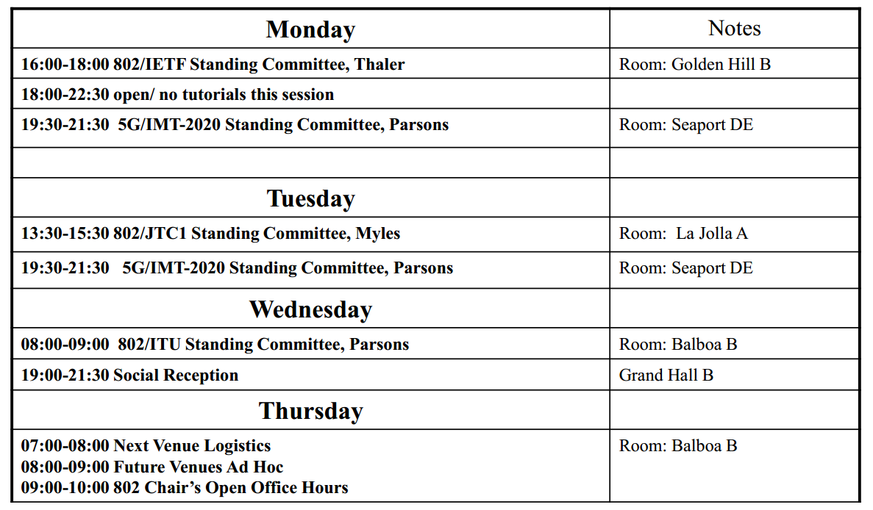
M2.5 – other announcements cross 802 meetings

Slide 7
M3.1 802.11 Working Group Session Documents
WG Session Reports
WG Agenda | https://mentor.ieee.org/802.11/dcn/11-16-0769
Opening report | https://mentor.ieee.org/802.11/dcn/11-16-0771
Snapshots | https://mentor.ieee.org/802.11/dcn/11-16-0786
1st vice chair | https://mentor.ieee.org/802.11/dcn/11-16-0804
2nd vice chair | https://mentor.ieee.org/802.11/dcn/11-16-0787
Treasurer | https://mentor.ieee.org/802.11/dcn/11-16-0805
Supplementary Material | https://mentor.ieee.org/802.11/dcn/11-16-0771
Motions | https://mentor.ieee.org/802.11/dcn/11-16-0788
Closing report | https://mentor.ieee.org/802.11/dcn/11-16-0789
Current Session Minutes | https://mentor.ieee.org/802.11/dcn/11-16-
Previous Session Minutes | https://mentor.ieee.org/802.11/dcn/11-16-0524-01

Slide 8
M3.2 Joint meetings and Reciprocal Credit
Internal Joint Meetings
  Thu am1: TGak, ARC, 802.1Qbz
Reciprocal credit is provided to 802.11 voters for attendance at: 802.18, 802.19, 802.24, 802.1
  Reciprocal credit for 802.1 is for 801.1Qbz, 802.1CF, 802E, 802c

Slide 9
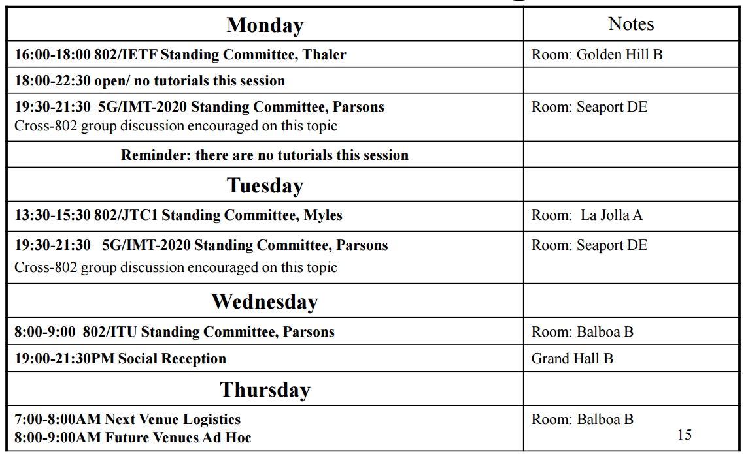
M3.2 Cross 802 Groups meetings
Source: https://mentor.ieee.org/802-ec/dcn/16/ec-16-0102-01-00EC-july-2016-802-chair-opening-slide-deck.pdf

Slide 10
M3.10 802 EC and IEEE-SA Standards Board decisions
Study Groups:
  The EC agreed (by email ballot) to the formation of the “Low Power Wakeup Radio” study group.
    I have appointed Minyoung Park (Intel Corporation) to be its chair, subject to confirmation during this session.
PARS
  None
Approval of draft standards
  None

Slide 11
M4.1.1 Type of Groups
Type of Group | Description
WG | Working Group
SC | Standing Committee
TG | Task Group
SG | Study Group
TIG | Topic Interest Group

Slide 12
M4.1.1 Groups
Type | Group | Description
WG | WG11 | The IEEE 802.11 Working Group
SC | ARC | Architecture
SC | PAR | PAR review
SC | REG | Regulatory
SC | WNG | Wireless Next Generation
802 SC | JTC1 | ISO/IEC JTC1/SC6
TG | MC | Revision mc (REVmc)
TG | AH | Operation in 900 MHz bands (S1G)
TG | AI | Fast Initial Link Setup (FILS)
TG | AJ | China Milli-Meter Wave (CMMW)
TG | AQ | Pre-association Discovery (PAD)
TG | AK | General Link (GLK)
TG | AX | High Efficiency Wireless LAN (HEW)
TG | AY | Next Generation 60 GHz (NG60)
TG | AZ | Next Generation Positioning (NGP)
SG | WUR | Wake-up Radio

Slide 13
M4.1.2 PAR Expiration/Renewal Schedule
Project | PAR Expiration Date
AH | 31-DEC-2016
AI | 31-DEC-2016
MC | 31-DEC-2016
AJ | 31-DEC-2016
AK | 31-DEC-2016
AQ | 31-DEC-2016
AX | 31-DEC-2018
AY | 31-DEC-2019
AZ | 31-DEC-2019
Sept 22nd NesCom Submission date 5th August.
December 6th NesCom: Submission date 17th October
http://www.ieee802.org/11/PARs/index.html

Slide 14
M4.1.3 802.11 WG Appointed positions
WG Secretary – Stephen McCann
Treasurer – Jon Rosdahl
ANA Authority – Robert Stacey
WG Technical Editors – Robert Stacey, Peter Ecclesine

Slide 15
M4.1.3 Officers
Cat | Group | Chair | Vice Chair | Technical Editor | Secretary
WG |  | Adrian STEPHENS | Jon ROSDAHL Dorothy STANLEY | Robert STACEY Peter ECCLESINE | Stephen MCCANN
SC | ARC | Mark HAMILTON | Joseph LEVY |  | Joseph LEVY
SC | REG | Richard KENNEDY
SC | PAR | Jon ROSDAHL | Michael MONTEMURRO
SC | WNG | Jim LANSFORD | Lei WANG
TG | MC | Dorothy STANLEY | Mark HAMILTON Jon ROSDAHL | Adrian STEPHENS, Sub-editors Emily QI and Edward AU | Jon ROSDAHL
TG | AH | Yongho SEOK | Alfred ASTERJADHI Zander LEI | Yongho SEOK Alfred ASTERJADHI | Zander LEI
TG | AI | Hiroshi MANO | Marc EMMELMANN | Lee ARMSTRONG Ping FANG | Hitoshi MORIOKA
TG | AJ | Jiamin CHEN | Haiming WANG | Jiamin CHEN Shiwen HE (subeditor) | Open
TG | AK | Donald EASTLAKE | Mark HAMILTON | Donald EASTLAKE Norm FINN | Open
TG | AQ | Stephen MCCANN | Yunsong YANG | Lee ARMSTRONG | Open
TG | AX | Osama ABOUL-MAGD | Simone MERLIN Ron PORAT | Robert STACEY | Yasuhiko INOUE
TG | AY | Edward AU | SangHyun CHANG | Carlos CORDEIRO | Jeorge HURTARTE
TG | AZ | Jonathan SEGEV | Carlos ALDANA | CC WANG | Open
SG | WUR | Minyoung PARK (Pending confirmation)
Changed since last session

Slide 16
IEEE 802.11 Revisions
802.11
-2003
802.11
-2007
802.11
-2012
802.11
-2016 (TBC)
MAC
11k
RRM
11s
Mesh
11aa
Video Transport
11e
QoS
IEEE
Std
802.11
-1997
11h
DFS & TPC
11u
WIEN
11v
Network
Management
11ae
QoS Mgt Frames
11d
Intl roaming
11i
Security
11z
TDLS
11w
Management
Frame
Security
11f
Inter AP
11r
Fast Roam
11n
High
Throughput
(>100 Mbps)
11af
TV Whitespace
11a
54 Mbps
5GHz
11j
JP bands
11ac -VHT
>1 Gbps @ 5GHz
11b
11 Mbps
2.4GHz
11g
54 Mbps
2.4GHz
11p
WAVE
11y
Contention
Based
Protocol
11ad - VHT
>1 Gbps @ 60GHz
MAC
&
PHY
Notes:
doc.: IEEE 802.11-11/0483r0
May 2011
Bruce Kraemer (Marvell)
Page 16

Slide 17
IEEE 802.11 Standards Pipeline
MAC
802.11
-2016
802.11
-2012
802.11aq
PAD
802.11aa
Video Transport
802.11ak
GLK
802.11ae
QoS Mgt Frames
802.11ai
FILS
WUR SG
Wake-up
Radio
802.11az
NGP
WNG
802.11ax
HEW
802.11ah
< 1Ghz
802.11af
TVWS
802.11ac
VHT 5GHz
802.11ay
NG60
802.11ad
VHT 60 GHz
802.11aj
CMMW
MAC & PHY
Discussion Topics
TIG/Study
groups
TG without
Approved draft
WG
Letter Ballot
Sponsor
Ballot
Published
Amendment
Published
Standard
17
Notes:
doc.: IEEE 802.11-11/0483r0
May 2011
Bruce Kraemer (Marvell)
Page 17

Slide 18
M4.1.5 Summary of ballots and comment collections
Type | Label | Group | Opened (mm-dd) | Dur (d) | # Comments | Pool | Approve | Disapprove + invalid | Abstain | Return % | Approve % | Result
LB | 220 | TGaj | 06-15 | 15 | 38 | 377 | 218 | 28+5 | 53 | 79 | 89 | P
LB | 221 | TGaq | 07-04 | 15 | 65 | 357 | 218 | 16 | 46 | 78 | 93 | P
SB | 2nd R | REVmc | 06-07 | 23 | 334 | 219 | 169 | 12 | 10 | 87 | 93 | P
SB | 2nd R | TGai | 06-28 | 15 | 6 | 160 | 117 | 9 | 5 | 82 | 93 | P

Slide 19
M4.1.6 Current Membership Status
Status | Number
Aspirant | 126
Potential Voter | 56
Voter | 372
Ex Officio Voter | 11
Definitions:
  Aspirant: a member who has attended 1 qualifying meeting
  Potential Voter: a member who has attended 2 qualifying meetings and will become a voter at the start of the next plenary they attend
  Ex Officio Voter: a voter who has voting rights by virtue of their membership of the 802 EC and has requested to be recorded as an ex officio voter in 802.11
Data as of 2016-03-08

Slide 20
M4.1.6 Recent voting member history

Slide 21
M5.1 - Allegation of dominance in TGax and TGai
See: 11-16/784r0 – TGax, 11-16/799r0 - TGai
The WG chair has consulted with the WG officers, the IEEE 802 executive committee (EC) and IEEE-SASB legal.
A generic process has been identified, which will be tailored to the needs of the individual allegations.

Slide 22
Dominance - responsibilities
The WG chair is given the responsibility for determining dominance: “Determine if the Working Group is dominated by an organization and, if so, treat that organizations’ vote as one (with the approval of the Sponsor)” (802 WG P&P under “Chair’s Responsibilities”).
The Sponsor has responsibilities too: “Monitor standards developing committees for signs of dominance by any single interest category, individual, or organization. If dominance is suspected, the Sponsor shall promptly notify the IEEESA Standards Board and shall immediately address the concern with the standards developing committee leadership.” (IEEE SASB OM).

Slide 23
Dominance – 2
The IEEE SASB bylaws define dominance: (my emphasis)
“Dominance is normally defined as the exercise of authority, leadership, or influence by reason of superior leverage, strength, or representation to the exclusion of fair and equitable consideration of other viewpoints.
Dominance can also be defined as the exercise of authority, leadership, or influence by reason of sufficient leverage, strength, or representation to hinder the progress of the standards development activity. Such dominance is contrary to open and fair participation by all interested parties and is unacceptable.”

Slide 24
Dominance – generic process
WG Chair obtains documentation of a specific complaint
WG Chair communicates complaint to WG members
WG Chair notifies EC of complaint
WG Chair determines who is going to handle the process – investigating officer (IO)
  Must be unconflicted
IO Solicits neutral volunteer to observe and advise on procedure
  Typically should be an EC member or IEEE-SA staff member
  Person should be familiar with IEEE-SA P&P
IO Collects data, considering some or all of
  Inspect previous minutes and recorded votes
  Interview selected participants
  Use recorded votes by instruction in the TG – but TG chair can exercise discretion
IO writes report of findings
IO communicates findings to WG chair in a public submission
WG Chair reports out to WG, TG at an 802.11 plenary meeting
WG Chair’s responsibilities include reporting findings to EC, make a recommendation to the EC on how to proceed, request instructions from EC

Slide 25
Dominance – specific process for TGai
James Gilb has agreed to be the EC member supporting this investigation
A number of individuals will be contacted during this session and asked to attend in person a short interview during this session.
It is hoped that a report containing findings and conclusion will be made to the September 2016 session, and will be communicated to the 802 EC.
In the case of a finding of dominance, a recommendation will be made to the EC, and instructions from the EC requested

Slide 26
Status of Investigation for 11-16-784 (11ax)
WG chair posted 11-16-784 and notified EC
WG chair: Assign Dorothy Stanley as Investigative Officer
For the 11ax dominance investigation, the additional folks that will be assisting me are:
  Roger Marks – Procedure advisor
  Mike Montemurro – Interview and data collection assistant
  IEEE legal, IEEE staff, as required
Current status: data collection
  Schedule goal: complete data collection by September 2016 session and report/recommendation by November 2016 session
Recall 2008 dominance investigations,
  see http://grouper.ieee.org/groups/802/secmail/pdf7HnhutvAB2.pdf

Slide 27
background data

Slide 28
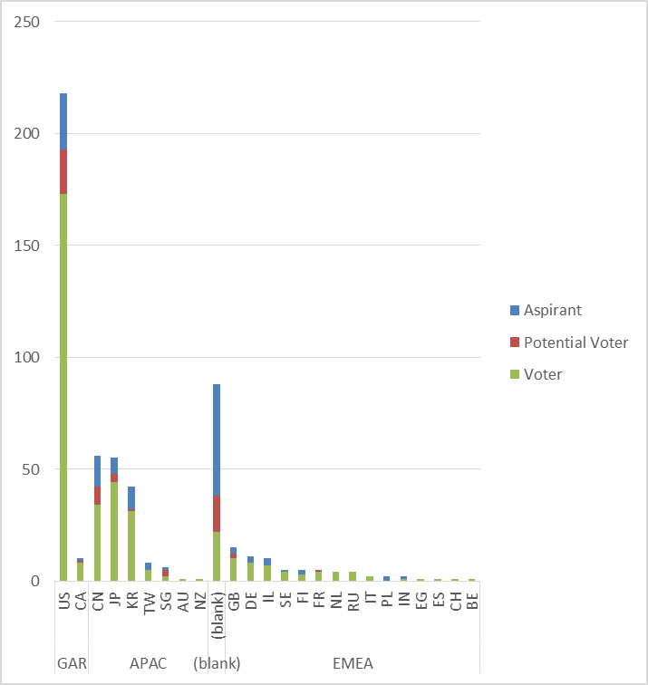
Membership by Country and Region

Slide 29
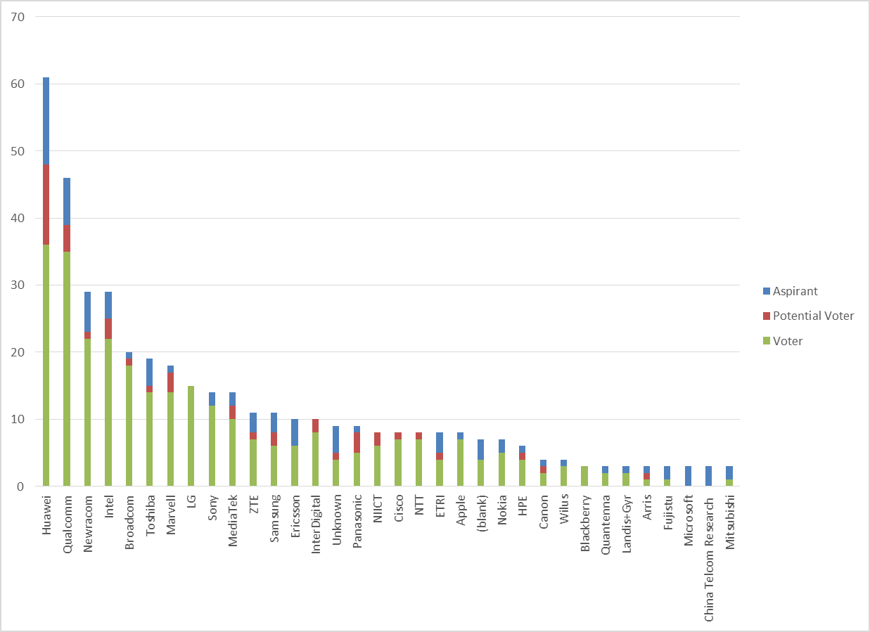
Members by Affiliation

Slide 30
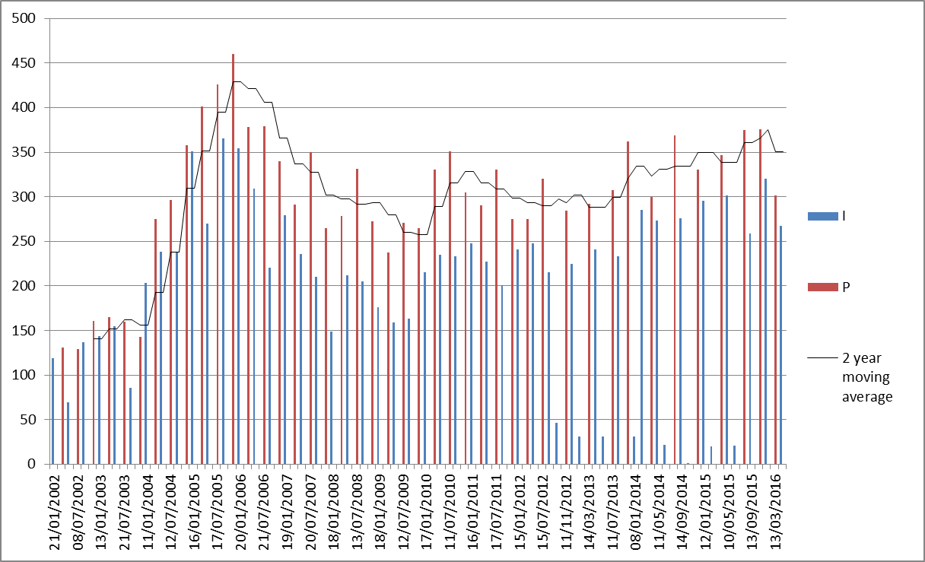
Meeting Attendance – Historic Data

Slide 31
Membership – Historic Data

