Slide 1
Stacked Architecture Discussion
Date: 2016-05-17
Authors:

Slide 2
Abstract
This presentation walks through some discussion on why, and how, we use a “stacked” architecture model in 802.11.
THIS VERSION IS A WORK IN PROGRESS, NOT COMPLETE

Slide 3
Start with a simple problem, and view: two peer entities are communicating …
Entity of type X
Protocol
Entity of type X
Peer entities communicate by exchanging protocol. Logically, this happens directly between them …

Slide 4
Why are these entities communicating?
Upper
(Layer)
Entity
Upper
(Layer)
Entity
Service
Service
Entity of type X
Protocol
Entity of type X
The model is that (other than the Application Layer), the layers do this, for the purpose of providing a Service to the layer above.

Slide 5
But, of course, they don’t really communicate directly (other than the PHY)
Service
Service
Entity of type X
(Logical) Protocol Flow
Entity of type X
Service
Service
Actual Protocol Flow
The model is that (other than the Physical Layer), the layers communicate by using services of the layer below.

Slide 6
OK, this works well for Layers. What about within a layer?

Slide 7
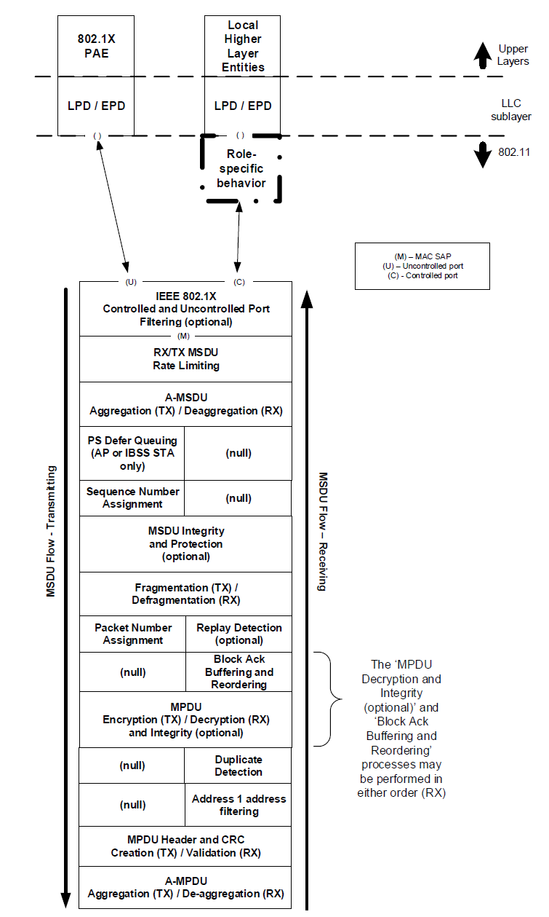
It seems to work for our “stack”, at least for “end nodes”

Slide 8
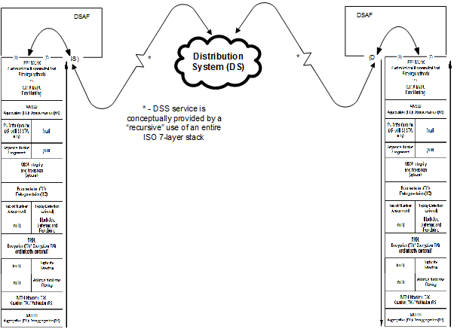
But, intermediate nodes are less intuitive

Slide 9
Or, a more complete, but less detailed view:
Upper
Upper
Upper
MAC
MAC
AP
AP
MAC
MAC
Distribution System (DS)
MAC
PHY
PHY
PHY
PHY
PHY
Non-AP STAs
AP STA 1
unspecified
AP STA 2
Non-AP STAs

Slide 10
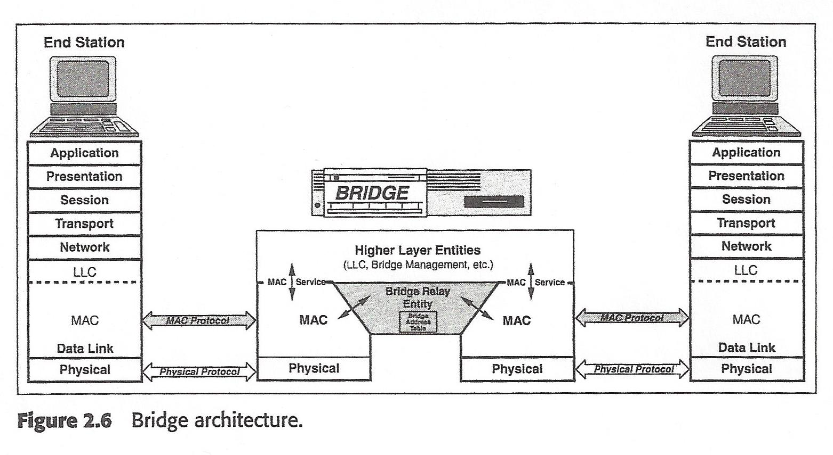
Then, there’s the Baggy Pants View
(Note the diagonal interfaces)

Slide 11
And, an alternative view, being suggested
MAC
MAC
MAC
MAC
DSCF
Distribution System (DS)
DSCF
MAC
PHY
PHY
PHY
PHY
PHY
unspecified
This builds on an idea that Services could be shown horizontally.

