Slide 1
Antenna Polarization and Beamforming for 11ay
Date: 2016-05-16
Authors:

Slide 2
Introduction
Multiple antenna polarizations is an attractive way for small devices with limited space to realize diversity and MIMO
Due to propagation characteristics of mmWave, antenna polarization can affect the performance significantly
if polarization is misaligned, it affecting end-to-end performance significantly (i.e., signal drops due to polarization misalignment, cross-polarization interference rises)
Antenna polarization can support MIMO spatial multiplexing.
11ay should adopt more powerful and efficient method to deal with the effects of polarization for ensuring reliable performance
Potential simplification in BF training for antenna polarization by exploiting the high correlation between the ray-tracing path of the multiple polarizations

Slide 3
Basic Types of Antenna Polarization
Types of antenna polarization
Linear polarization
Circular polarization
Mixed polarization
There are three possible orthogonal polarizations (e.g, x, y, z directions)
In general, the polarization direction is described by unit vector or euler angle (α, β, γ) relative to a coordinate system
Depending on antenna axial ratio, orientation, and propagation, the cross-polarization alignment loss (provided in backup charts) can be significant.

Slide 4
Polarization Implementations
Two types of polarization implementation
Separate antennas for different polarizations (e.g., one antenna vertical, one antenna horizontal)
Same antenna with multiple polarizations (e.g., one physical antenna with multiple polarization ports)
In general, the former type can be treated as separate antennas
The latter type can also be used to synthesize different antenna polarization:
Polarization rotation (i.e. to change angle of inclination for TX/RX polarization alignment)
Linear to circular polarization conversion or vice versa
Inclined Linear (θ₁= θ₂ G₁/G₂) or Circular (θ₁=θ₂ +/-90 deg, G₁=G₂)
G₁
θ₁
⁺
G₂
θ₂

Slide 5
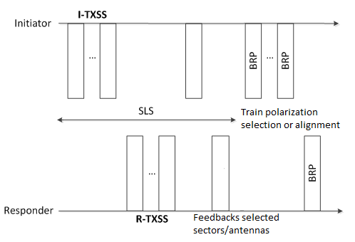
Example Antenna Polarization BF Training
As a first step, antenna type and capability needs to be known to both sides.
TX polarization BF training can be simplified by
Step 0: Indicate antenna polarization type/capability during initial Capability Exchange
Step 1: complete SLS with one of the polarization or with synthesized polarization
Step 2: Feedback some selected some sectors/antennas & request specific polarization training on selected sectors/antennas
Step 3: Additional training frame/fields for the Polarization training on the selected antenna sectors/antennas
Step 4: feedback the final selection of sector/antenna/polarization

Slide 6
Example of Polarization BF Training
Step 1 transmitter uses synthesized circular polarization to train a linear polarization receiver
Note circular polarization allows a linear polarized receiver to receive (3dB loss) without antenna alignment
Step 3 transmitter trains its linear polarization inclination
Align linear polarization to enhance SNR
TX
Step 1
Step 3
RX

Slide 7
Polarization Type/Capability
Antenna polarization capability information to be considered
Basic polarization types
linear,
circular,
mixed
Polarization switch
Polarization MIMO
Synthesizable polarization
linear (adjustable inclination)
circular (RH, LH)
mixed polarization (RH, LH, adjustable inclination & eccentricity))

Slide 8
Conclusions
11ay should enable more powerful and efficient method to deal with antenna polarization for enhanced performance
Propose, as a first step, to explicitly exchange information about antenna polarization types/capability
Allowing both sides to know the polarization type/capability
Enabling further development of more efficient or powerful BF Training protocol for antenna polarizations

Slide 9
Straw Poll 1
Move to include the antenna polarization capability information in the 11ay capability exchange. (Capability information is TBD)
Yes
No
Abstain

Slide 10
Backup Charts

Slide 11
Polarization Misalignment
The received power is affected by the misalignment in TX and RX antenna polarization, if only single polarization is used in TX and/or RX.
Received power loss due to misalignment of the two linear polarizations:
Received power loss due to misalignment one linear polarization and one circular polarization
Note that SIMO or MIMO RX with dual polarization will not have misalignment loss.

Slide 12
Polarization Misalignment
Received power loss due to misalignment of the two circular polarizations:
Received power loss due to misalignment of the two elliptical polarizations:

