Slide 1
Generic Control Frame for 802.11ay
Date: 2016-05-17
Authors:

Slide 2
Abstract
We propose a control frame for 11ay that supports different functionalities including SU/MU MIMO, channel aggregation and OFDMA.

Slide 3
Introduction
The 11ay specification will support
  SU-MIMO
  Downlink MU-MIMO
  Channel bonding of at least two 2.16 GHz
  Contiguous and non-contiguous channel aggregation of at least two 2.16 GHz channels
Current SFD defines enablers to support above functionalities
  Control Trailer on RTS/CTS [1]
  A frame for channel bonding [2]
  MIMO Set-up frame [3]
This contribution proposes a general purpose MAC control frame that
  Simplifies protocol flow with the ability to set-up the MIMO, Multi-user and Channel Bonding features
  Enables channel “protection” for these features (different from RTS/CTS)

Slide 4
Proposal
A MAC control frame that provides room for parameter configuration of 11ay functionalities such as MIMO, Channel Bonding and MU features
  Frame Control – indicates a 11ay control frame
  Duration – is for users not addressed in the packet to set a NAV
  RA field – identifies recipient STA
  TA field – identifies STA transmitting the frame.
  Purpose – can indicate
    MIMO set-up
    MU-MIMO set-up and addressing
    Non-contiguous channel bonding set-up
    OFDMA at channel level set up
    Channel bonding negotiation
    Others
  STA Info fields can change based on the purpose indicated in the format
Combine ~5 different frame types into one frame format with flexible multi-user addressing capability

Slide 5
Benefits of a generic control frame
Simple and flexible
  Allows transmission in legacy DMG Control PHY format – so legacy devices can set their NAV
  In case there are no legacy devices, allows use of 11ay PHY format
Flexible Addressing Capability
  Can address single and/or multiple STAs
  Can flexibly indicate multiple streams (in case of MIMO) and/or multiple channels (OFDMA)
  Several example protocol flows are presented in the Appendix
Future-proof
  Reserve frame control types to accommodate future amendments to the NG60 specifications

Slide 6
Protocol Flow Example
1. MIMO – SU/MU set-up
EDMG control frame can be used to set-up MIMO transmissions
  For both MU and SU MIMO transmissions, the receiver STAs can set up their receive beamforming vectors to receive the frame.

Slide 7
Protocol Flow Example
2. Channel Bonding and Aggregation
Channel Bonding and Aggregation over contiguous and non-contiguous channels
  To single and multiple users.

Slide 8
Beam Tracking and Refinement
Allows updated TRN-T/R that is addressed only to 11ay STAs to be transmitted as attachment to a legacy 11ad PPDU
Transmission in a 11ay PPDU format allows updated TRN-T/R for beam refinement and tracking of a 11ay STA

Slide 9
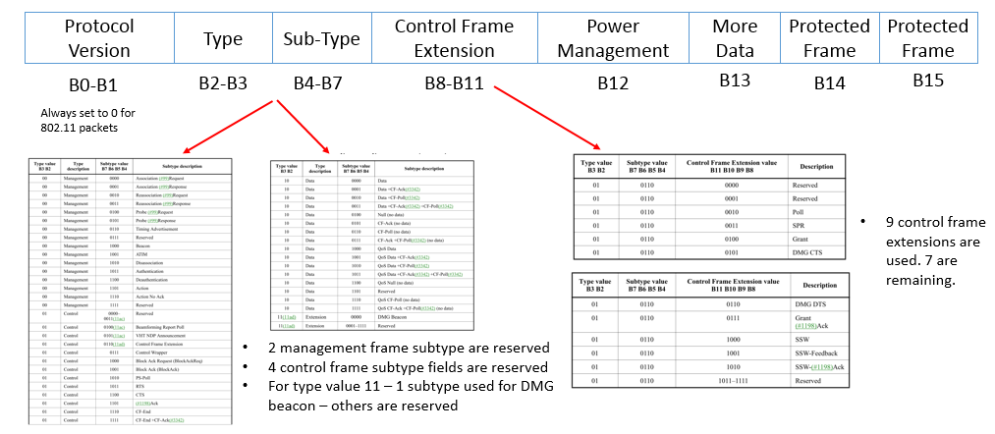
Control Frame Extension
Defining a control frame for each purpose we outlined earlier – would require use of a new frame type/sub-type/ control frame extension
  Use of new type/sub-type should be avoided since DMG allows control frame extensions
There are 7 control frame extensions available
  We propose to use of one reserved value of the control frame extension for the Generic EDMG Control Frame

Slide 10
Summary
New control frame for EDMG users to enable feature set of 11ay is proposed
  MIMO
  Multi-user: Downlink MU-MIMO and OFDMA
  Channel bonding/aggregation of two or more 2.16 GHz channels
The MAC control frame is flexible
  This EDMG Control frame– allows transmissions in DMG PHY format so that legacy users can set their NAVs
    11ax used a similar reasoning to decide on a MAC trigger frame.
Propose use of control frame extension for 11ad – to signal the generic EDMG control frame
  Useful for 11ad and amendments – so can be localized to control frame extension instead of using type/sub-type.

Slide 11
References
https://mentor.ieee.org/802.11/dcn/16/11-16-0105-00-00ay-control-trailer-in-control-mode-ppdus.pptx
https://mentor.ieee.org/802.11/dcn/16/11-16-0078-00-00ay-su-mimo-and-mu-mimo-link-access.pptx
https://mentor.ieee.org/802.11/dcn/15/11-15-1358-03-00ay-specification-framework-for-tgay.doc

Slide 12
Straw poll
Do you agree to add to the SFD:
  11ay shall define a generic MAC control frame for various purposes including but not limited to SU/MU MIMO Set-up, Channel Aggregation and OFDMA.
    The generic MAC control frame will be signaled by the control frame extension

