Slide 1
Length 1344 LDPC codes for 11ay
Date: 2016-05-17
Authors:

Slide 2
Abstract
We propose a Length-1344 LDPC block based on 11ad codes for use in 11ay
  About 1 dB of coding gain compared to length-672 code set in 11ad.

Slide 3
Introduction
Channel bonding and MIMO are core features of 11ay specification.
  To realize the 20Gbps+ throughput goal specified in the PAR
In this presentation, we propose enhancements to the 11ad channel coding scheme that can provide “significant” PER performance improvement when large packets are to be transmitted
We propose the use of a longer length LDPC code for 11ay
  11ad had defined 672 length LDPC codes. We investigate a LDPC code design that is twice that length – i.e., length 1344 LDPC code.
    ~1dB gain over 11ad LDPC codes

Slide 4
Length 1344 LDPC codes
We propose new longer block LDPC block based on 11ad codes
  Two-step lifting matrices with in-place property.
    11ad codes are in-place.
    Designed in-place 2nd lifting ➔ The larger codes are also in-place.
Architecture advantages for the two-step lifting design.
  Allow re-use of the 11ad decoding machine wrapped with MUX and Memory.
  Facilitate scalable architectures (easy to support 2x, 3x, …)
  Provide better granularity ➔ higher efficiency.

Slide 5
Proposed rate-13/16
-1 | 29
29 | -1
4 | -1
-1 | 4
1 | 0 | 1 | 1 | 1 | 1 | 0 | 0 | 1 | 1 | 0 | 1 | 1 | 0 | -1 | -1
0 | 0 | 0 | 0 | 0 | 1 | 0 | 0 | 0 | 0 | 0 | 1 | 1 | 1 | 0 | -1
1 | 0 | 1 | 1 | 0 | 1 | 0 | 1 | 0 | 0 | 1 | 0 | 1 | 0 | 0 | 0
2nd lifting
The lifting matrix above are applied on this 11ad base matrix.
29 | 30 | 0 | 8 | 33 | 22 | 17 | 4 | 27 | 28 | 20 | 27 | 24 | 23 | -1 | -1
37 | 31 | 18 | 23 | 11 | 21 | 6 | 20 | 32 | 9 | 12 | 29 | 10 | 0 | 13 | -1
25 | 22 | 4 | 34 | 31 | 3 | 14 | 15 | 4 | 2 | 14 | 18 | 13 | 13 | 22 | 24
11ad code
length-1344 code
The lifting factor, Z, is 42 in both length-672 (11ad) and length-1344 proposed codes.
Both codes share the same set of shifters.
  Simplify designing shared decoder for 11ad + length-1344 codes (See, Appendix II)
Note: If the 2nd lifting is all ‘0’s (or, all ‘1’s), then the length-1344 codes is an interleaving of two length-672 codes (No coding gain). It is the optimized mix of ‘0’s and ‘1’s in the 2nd lifting that gives the coding gain. Also, it is clear that a decoding machine with programmable 2nd lifting allow decoding one length-1344 or two length-672 codes.

Slide 6
Proposed rate-3/4 code
N=1344
Z_{p} = 2
0 | 0 | 1 | 1 | 1 | 0 | 0 | 1 | 0 | 0 | 1 | 1 | 0 | -1 | -1 | -1
1 | 0 | 1 | 1 | 1 | 1 | 0 | 0 | 1 | 1 | 0 | 1 | 1 | 0 | -1 | -1
0 | 0 | 0 | 0 | 0 | 1 | 0 | 0 | 0 | 0 | 0 | 1 | -1 | 1 | 0 | -1
1 | 0 | 1 | 1 | 0 | 1 | 0 | 1 | 0 | -1 | 1 | 0 | 1 | 0 | 0 | 0
The lifting matrix above are applied on this 11ad base matrix.
35 | 19 | 41 | 22 | 40 | 41 | 39 | 6 | 28 | 18 | 17 | 3 | 28 | -1 | -1 | -1
29 | 30 | 0 | 8 | 33 | 22 | 17 | 4 | 27 | 28 | 20 | 27 | 24 | 23 | -1 | -1
37 | 31 | 18 | 23 | 11 | 21 | 6 | 20 | 32 | 9 | 12 | 29 | -1 | 0 | 13 | -1
25 | 22 | 4 | 34 | 31 | 3 | 14 | 15 | 4 | -1 | 14 | 18 | 13 | 13 | 22 | 24

Slide 7
Proposed rate-5/8 code
N=1344
Z_{p} = 2
0 | 0 | 1 | 1 | 0 | 0 | 1 | 1 | -1 | 1 | 0 | -1 | -1 | -1 | -1 | -1
0 | 1 | -1 | 1 | -1 | 1 | 0 | 0 | 1 | 1 | 0 | 0 | -1 | -1 | -1 | -1
0 | -1 | 1 | -1 | 1 | -1 | 0 | -1 | 0 | -1 | -1 | 1 | 0 | -1 | -1 | -1
1 | -1 | 1 | -1 | -1 | 1 | -1 | 0 | -1 | 1 | -1 | 1 | 1 | 0 | -1 | -1
-1 | 0 | -1 | 0 | -1 | 1 | -1 | 0 | -1 | 0 | 0 | -1 | -1 | 1 | 0 | -1
-1 | 0 | -1 | 1 | 0 | -1 | 0 | -1 | 0 | -1 | -1 | -1 | -1 | -1 | 0 | 0
The lifting matrix above are applied on this 11ad base matrix.
20 | 36 | 34 | 31 | 20 | 7 | 41 | 34 | -1 | 10 | 41 | -1 | -1 | -1 | -1 | -1
30 | 27 | -1 | 18 | -1 | 12 | 20 | 14 | 2 | 25 | 15 | 6 | -1 | -1 | -1 | -1
35 | -1 | 41 | -1 | 40 | -1 | 39 | -1 | 28 | -1 | -1 | 3 | 28 | -1 | -1 | -1
29 | -1 | 0 | -1 | -1 | 22 | -1 | 4 | -1 | 28 | -1 | 27 | 24 | 23 | -1 | -1
-1 | 31 | -1 | 23 | -1 | 21 | -1 | 20 | -1 | 9 | 12 | -1 | -1 | 0 | 13 | -1
-1 | 22 | -1 | 34 | 31 | -1 | 14 | -1 | 4 | -1 | -1 | -1 | -1 | -1 | 22 | 24

Slide 8
Proposed rate-1/2 code
N=1344
Z_{p} = 2
0 | -1 | 1 | -1 | 0 | -1 | 1 | -1 | 0 | -1 | -1 | -1 | -1 | -1 | -1 | -1
0 | -1 | 0 | -1 | 1 | -1 | -1 | 1 | 0 | 0 | -1 | -1 | -1 | -1 | -1 | -1
-1 | 0 | -1 | 1 | -1 | 0 | -1 | 1 | -1 | 1 | 0 | -1 | -1 | -1 | -1 | -1
-1 | 1 | -1 | 1 | -1 | 1 | 0 | -1 | -1 | -1 | 0 | 0 | -1 | -1 | -1 | -1
0 | -1 | 1 | -1 | 1 | -1 | 0 | -1 | 0 | -1 | -1 | 1 | 0 | -1 | -1 | -1
1 | -1 | 1 | -1 | -1 | 1 | -1 | 0 | -1 | 1 | -1 | 1 | -1 | 0 | -1 | -1
-1 | 0 | -1 | 0 | -1 | 1 | -1 | 0 | -1 | -1 | 0 | -1 | -1 | 1 | 0 | -1
-1 | 0 | -1 | 1 | 0 | -1 | 0 | -1 | 0 | -1 | -1 | -1 | 1 | -1 | 0 | 0
The lifting matrix above are applied on this 11ad base matrix.
40 | -1 | 38 | -1 | 13 | -1 | 5 | -1 | 18 | -1 | -1 | -1 | -1 | -1 | -1 | -1
34 | -1 | 35 | -1 | 27 | -1 | -1 | 30 | 2 | 1 | -1 | -1 | -1 | -1 | -1 | -1
-1 | 36 | -1 | 31 | -1 | 7 | -1 | 34 | -1 | 10 | 41 | -1 | -1 | -1 | -1 | -1
-1 | 27 | -1 | 18 | -1 | 12 | 20 | -1 | -1 | -1 | 15 | 6 | -1 | -1 | -1 | -1
35 | -1 | 41 | -1 | 40 | -1 | 39 | -1 | 28 | -1 | -1 | 3 | 28 | -1 | -1 | -1
29 | -1 | 0 | -1 | -1 | 22 | -1 | 4 | -1 | 28 | -1 | 27 | -1 | 23 | -1 | -1
-1 | 31 | -1 | 23 | -1 | 21 | -1 | 20 | -1 | -1 | 12 | -1 | -1 | 0 | 13 | -1
-1 | 22 | -1 | 34 | 31 | -1 | 14 | -1 | 4 | -1 | -1 | -1 | 13 | -1 | 22 | 24

Slide 9
Proposed rate-7/8 code
Rate-7/8 length-1248 is derived by puncturing the first 96 parity bits of the rate-13/16 length-1344 code.
  As is currently done in 11ad (adopted recently in Revmc)

Slide 10
1344 lifting matrices are in-place
In-place property lower the decoding complexity for fully-parallel (flooding) architectures.
  Both 11ad codes and the proposed 2nd lifting are in-place ➔ 1344 codes are in-place.
0 | -1 | 1 | -1 | 0 | -1 | 1 | -1 | 0 | -1 | -1 | -1 | -1 | -1 | -1 | -1
0 | -1 | 0 | -1 | 1 | -1 | -1 | 1 | 0 | 0 | -1 | -1 | -1 | -1 | -1 | -1
-1 | 0 | -1 | 1 | -1 | 0 | -1 | 1 | -1 | 1 | 0 | -1 | -1 | -1 | -1 | -1
-1 | 1 | -1 | 1 | -1 | 1 | 0 | -1 | -1 | -1 | 0 | 0 | -1 | -1 | -1 | -1
0 | -1 | 1 | -1 | 1 | -1 | 0 | -1 | 0 | -1 | -1 | 1 | 0 | -1 | -1 | -1
1 | -1 | 1 | -1 | -1 | 1 | -1 | 0 | -1 | 1 | -1 | 1 | -1 | 0 | -1 | -1
-1 | 0 | -1 | 0 | -1 | 1 | -1 | 0 | -1 | -1 | 0 | -1 | -1 | 1 | 0 | -1
-1 | 0 | -1 | 1 | 0 | -1 | 0 | -1 | 0 | -1 | -1 | -1 | 1 | -1 | 0 | 0
Rate
1/2
0 | 0 | 1 | 1 | 0 | 0 | 1 | 1 | -1 | 1 | 0 | -1 | -1 | -1 | -1 | -1
0 | 1 | -1 | 1 | -1 | 1 | 0 | 0 | 1 | 1 | 0 | 0 | -1 | -1 | -1 | -1
0 | -1 | 1 | -1 | 1 | -1 | 0 | -1 | 0 | -1 | -1 | 1 | 0 | -1 | -1 | -1
1 | -1 | 1 | -1 | -1 | 1 | -1 | 0 | -1 | 1 | -1 | 1 | 1 | 0 | -1 | -1
-1 | 0 | -1 | 0 | -1 | 1 | -1 | 0 | -1 | 0 | 0 | -1 | -1 | 1 | 0 | -1
-1 | 0 | -1 | 1 | 0 | -1 | 0 | -1 | 0 | -1 | -1 | -1 | -1 | -1 | 0 | 0
Rate
5/8
Rate
3/4
0 | 0 | 1 | 1 | 1 | 0 | 0 | 1 | 0 | 0 | 1 | 1 | 0 | -1 | -1 | -1
1 | 0 | 1 | 1 | 1 | 1 | 0 | 0 | 1 | 1 | 0 | 1 | 1 | 0 | -1 | -1
0 | 0 | 0 | 0 | 0 | 1 | 0 | 0 | 0 | 0 | 0 | 1 | -1 | 1 | 0 | -1
1 | 0 | 1 | 1 | 0 | 1 | 0 | 1 | 0 | -1 | 1 | 0 | 1 | 0 | 0 | 0
Rate 13/16
1 | 0 | 1 | 1 | 1 | 1 | 0 | 0 | 1 | 1 | 0 | 1 | 1 | 0 | -1 | -1
0 | 0 | 0 | 0 | 0 | 1 | 0 | 0 | 0 | 0 | 0 | 1 | 1 | 1 | 0 | -1
1 | 0 | 1 | 1 | 0 | 1 | 0 | 1 | 0 | 0 | 1 | 0 | 1 | 0 | 0 | 0
Non ‘-1’ values in the same column and in rows of the same color are identical.

Slide 11
Simulation setup
Simulation environment:
  Packet length 4096 Bytes.
  OFDM tone mappings for QPSK, 16-QAM, and 64-QAM are shown in Appendix I.
  Conference Room model used in 11ad [2].
    Fs = 5.28 GHz
    Directional Tx – Directional Rx
    NLOS
  No HW impairments.
  Ideal channel estimation.
  MMSE equalization.
[2] 2015-TECH-Samsung-0002-00-Channel Coding Framework for 802.11ay - Channel Bonding and MIMO in OFDM PHY

Slide 12
In-place two-step lifting performance: QPSK
Coding gains @ 1% PER :
0.75, 0.65, 0.7 dB

Slide 13
In-place two-step lifting performance: QPSK
~ 0.8 dB gain

Slide 14
In-place two-step lifting performance: 16-QAM
Coding gains @ 1% PER :
1.0, 1.6, 1.0, 0.7, 1.0 dB
Note: Rate-7/8 is created by puncturing the rate-13/16 code

Slide 15
In-place two-step lifting performance: 16-QAM
~ 0.8 dB gain

Slide 16
In-place two-step lifting performance: 64-QAM
Coding gains @ 1% PER:
1.4, 1.15, 0.5, 1.0 dB

Slide 17
In-place two-step lifting performance: 64-QAM
~ 0.8 dB gain

Slide 18
Theoretical improvement of the proposed L1344 over the L672 in 11ad
Proposed L1344 Two-step code set has larger minimum distances than the L672 (11ad) codes.
The minimum cycle-size of any code in both sets is 6.
  Two-step lifting codes have significantly lower number of 6-cycles than that in the L672 (11ad) codes.
minimum distance
Rate | L1344 | L672 (11ad)
1/2 | 19 | 17
5/8 | 13 | 12
3/4 | 12 | 9
13/16 | 8 | 6
Number of 6-cycles
Rate | L1344 | L672 (11ad)
1/2 | 84 | 504
5/8 | 168 | 714
3/4 | 5796 | 7476
13/16 | 1680 | 2646

Slide 19
Summary
Two step lifting matrix construction for new longer block length LDPC codes with 11ad codes “in-place”
  Compared to 11ad, longer codes have ~ 1 dB gain and another ~1dB can be extracted from interleaving
Two step lifting has better minimum-distance and small-cycle properties than extended lifting.
Architecture advantages for the two-step lifting design.
  Allow re-use of the 11ad decoding machine wrapped with MUX and Memory.
  Facilitate scalable architectures (easy to support 2x, 3x, …)
  Provide better granularity ➔ higher efficiency.

Slide 20
Straw Poll
Do you agree to use the code matrices listed in slides 5-8 for length 1344 LDPC code in IEEE 802.11ay?
27Y/0N/8A

Slide 21
References
[11ad] IEEE 802.11ad-2012 standard.
[2] 11-09-0334-08-00ad-channel-models-for-60-ghz-wlan-systems.

Slide 22
Appendix I

Slide 23
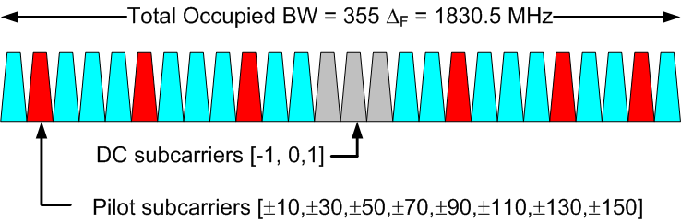
OFDM parameters for 2x channel bonding
(only for simulation purpose)
Parameter | Notation | Value (11ad) | Value (2x)
FFT Size | N_{FFT} | 512 | 1024
Number of data subcarriers | N_{SD} | 336 | 672
Number of pilot subcarriers | N_{SP} | 16 | 32
OFDM sampling frequency | F_{s} | 2640 MHz | 5280 MHz
Subcarrier frequency spacing | Δ_{F} | 5.16 MHz | 5.16 MHz
Guard Interval/Cyclic Prefix | T_{GI} | 128/F_{s}= ~48ns | 256/F_{s}= ~48ns
Ref [11ad]
-386
-209
-32
32
209
386

Slide 24
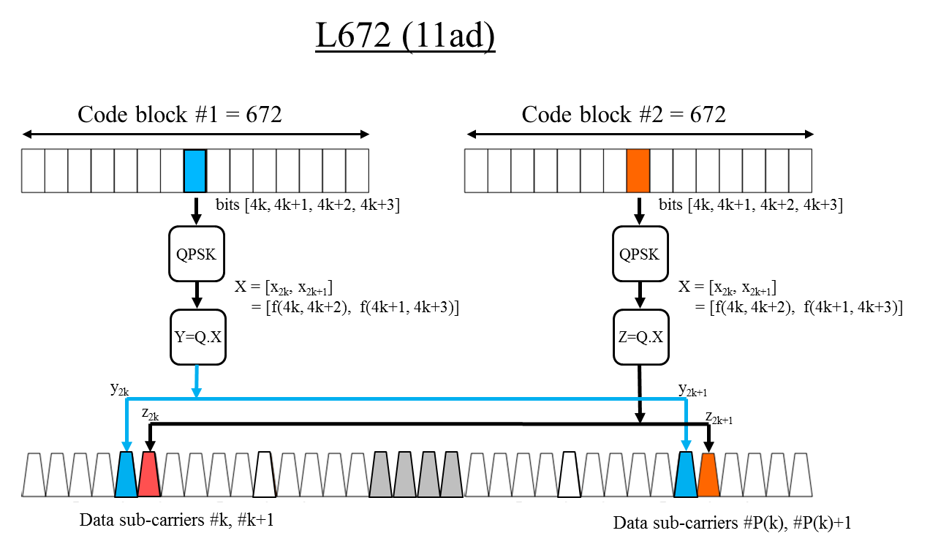
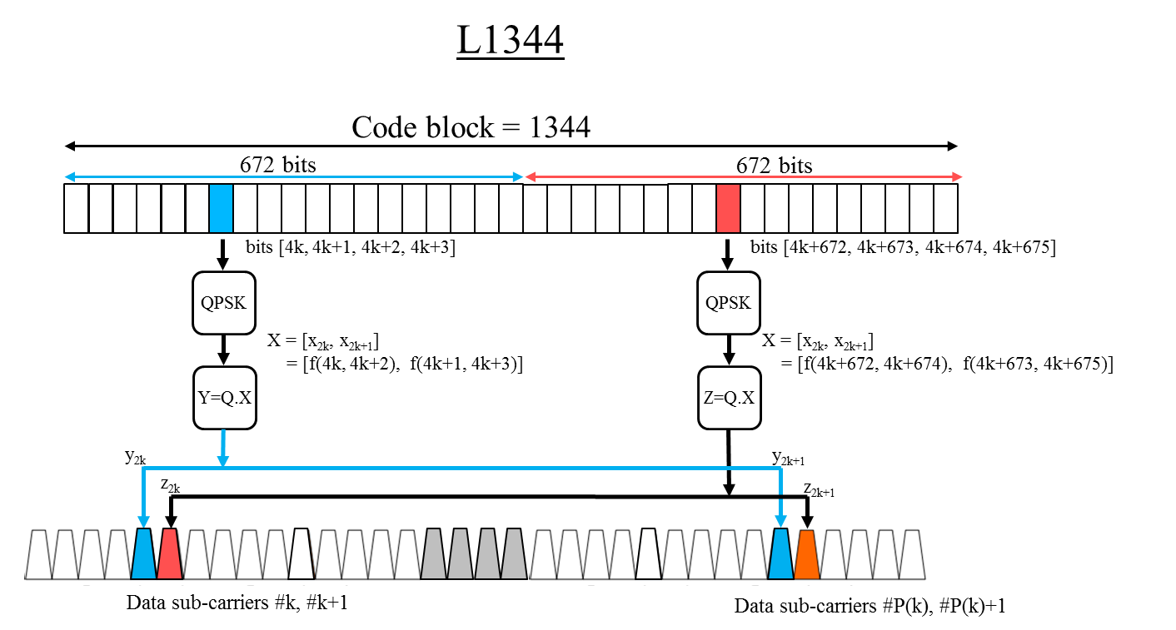
Simulation setup
OFDM Tone Mapping: QPSK

Slide 25
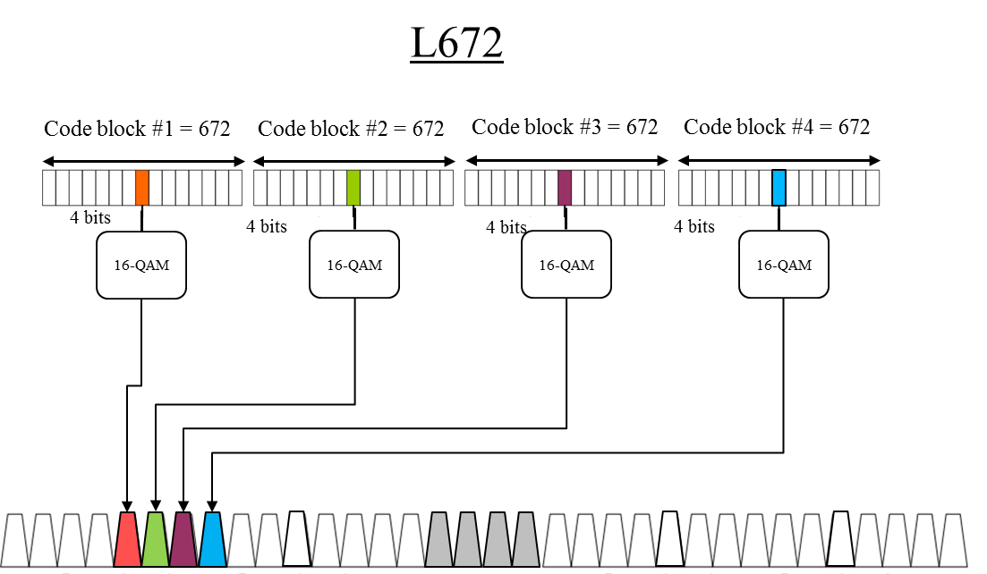
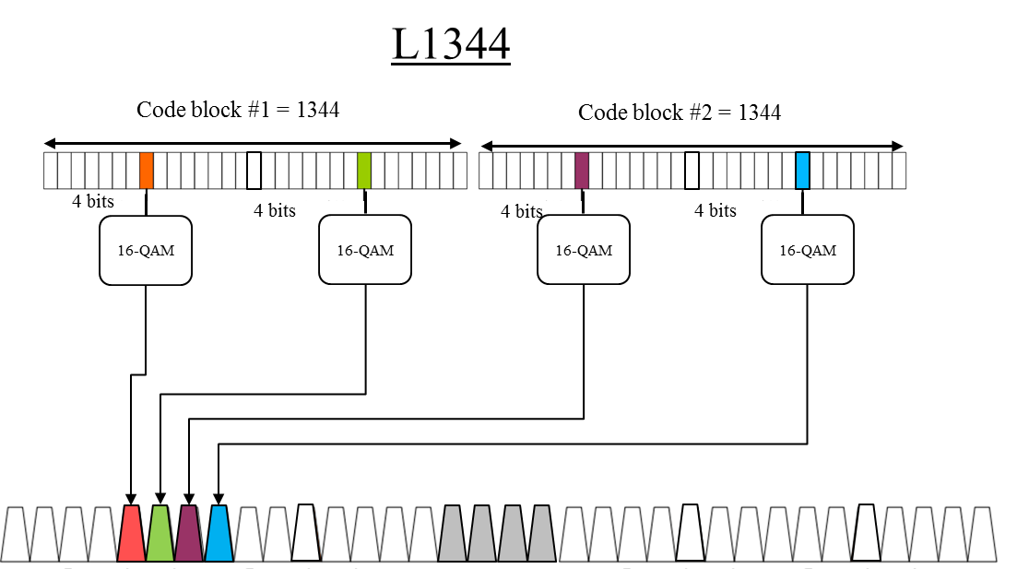
Simulation setup
OFDM Tone Mapping: 16-QAM

Slide 26
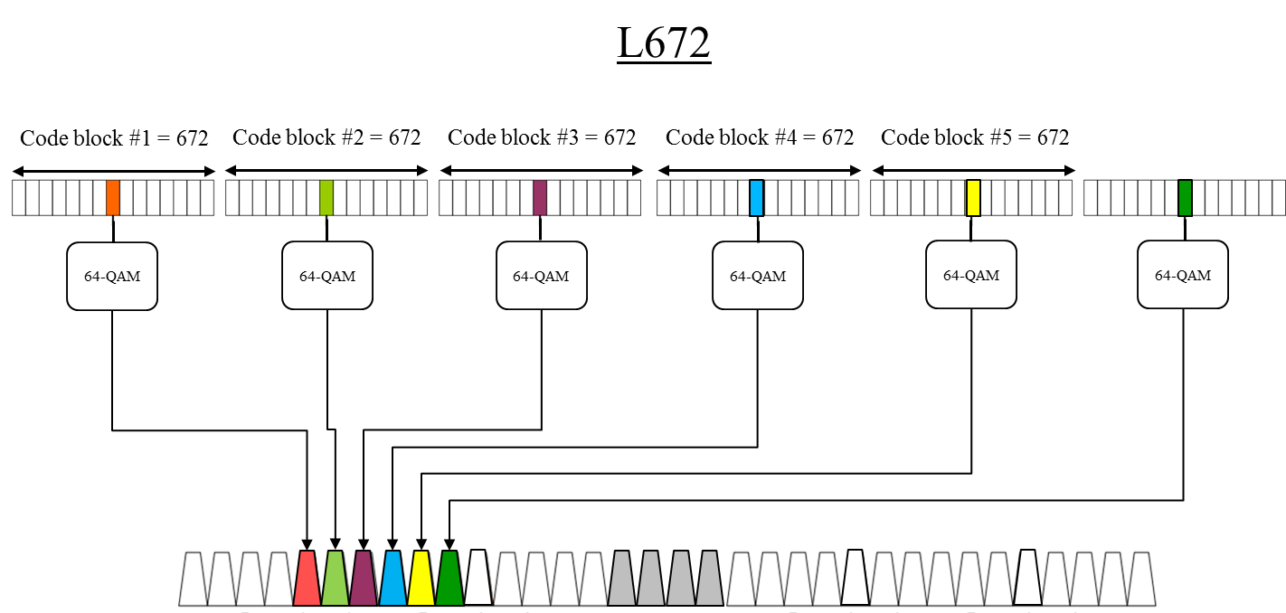
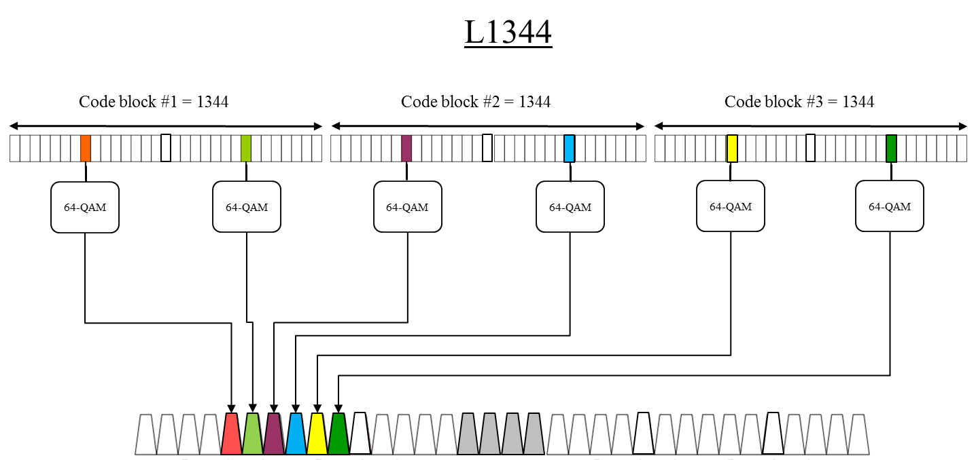
Simulation setup
OFDM Tone Mapping: 64-QAM

Slide 27
Appendix II

Slide 28
Layered Decoder: Architectures (1x Throughput*)
Re-use of the 11ad decoding machine wrapped with MUX and Memory
Only 4% increase in area due to the extra MUXs (excluding the memory)
11ad LDPC decoder
11ad + 2-step 1344 shared LDPC decoder
11ad machine
11ad machine
Check Node 41 (degree 16)
Check Node 41 (degree 16)
Check Node 0 (degree 16)
Check Node 0 (degree 16)
42 Shifter
… 16x …
42 Shifter
42 Shifter
… 16x …
42 Shifter
Gamma
Proc.
… 16x …
Gamma
Proc.
Gamma
Proc.
… 16x …
Gamma
Proc.
MUX
MUX
LLR
Mem.
… 16x …
LLR
Mem.
… 16x …
42 values
42 values
LLR
Mem.
LLR
Mem.
LLR
Mem.
LLR
Mem.
* 1x throughput relative to 11ad machine assuming same number of iterations.
42 values
42 values
42 values
42 values

Slide 29
Layer Decoder: Architectures (2x Throughput*)
11ad + 2-step 1344 shared LDPC decoder
11ad machine
Check Node 41 (degree 16)
Scalable Architecture in throughput increase, which reuse the 11ad machine
11ad machine
Check Node 0 (degree 16)
Check Node 41 (degree 16)
Check Node 0 (degree 16)
42 Shifter
… 16x …
42 Shifter
42 Shifter
… 16x …
42 Shifter
Gamma
Proc.
… 16x …
Gamma
Proc.
Gamma
Proc.
… 16x …
Gamma
Proc.
MUX
MUX
… 16x …
LLR
Mem.
LLR
Mem.
LLR
Mem.
LLR
Mem.
* 2x throughput relative to 11ad machine assuming same number of iterations.
42 values
42 values
42 values
42 values

Slide 30
Appendix III

Slide 31
Theoretical comparison: Proposed L1344, 11ad codes with Z=84 (instead of Z =42), and L672 in 11ad
minimum distance
Rate | L1344 | 11ad w/ Z =84 | L672 (11ad)
1/2 | 19 | 18 | 17
5/8 | 13 | 13 | 12
3/4 | 12 | 9 | 9
13/16 | 8 | 6 | 6
Number of 6-cycles
Rate | L1344 | 11ad w/ Z =84 | L672 (11ad)
1/2 | 84 | 420 | 504
5/8 | 168 | 756 | 714
3/4 | 5796 | 9492 | 7476
13/16 | 1680 | 3948 | 2646
Proposed L1344 Two-step code set has larger minimum distances than the 11ad w/ Z-84 codes.
The minimum cycle-size of any code in both sets is 6.
  Proposed two-step lifting codes have significantly lower number of 6-cycles than that in the 11ad w/ Z-84 codes.

Slide 32
Performance comparison: Proposed L1344 vs 11ad codes with Z=84 (instead of Z =42)
Proposed codes provides about [0.1, 0.2, 0.2, 0.6] dB gain over AWGN channel, and up to 0.9 dB gain over Conference Room channel.

