Slide 1
EIFS excess problem of Acknowledgement for UL MU procedure
Date: 2016-05-16
Authors:

Slide 2
Introduction
In the SFD and the spec draft, Block Acknowledgement procedures for UL MU are agreed:
  In the SFD: The addressed recipient that receives the trigger information, within a DL MU PPDU returns an immediate Ack/BlockAck response, either individually or as part of an A-MPDU after the PPDU carrying the frame, according to the trigger information carried in the same DL MU PPDU
  In the proposed draft: When receiving multiple frames from more than one STA that are part of an UL MU transmission (Clause 9.42.2) and that require an immediate acknowledgement, an AP may send multiple BlockAck frames (or ACK frames) in an OFDMA HE MU PPDU or a Multi-STA BlockAck (M-BA) frame.
However, in most cases, acknowledgement for UL MU cannot be transmitted within EIFS duration for MCS0
In this presentation, acknowledgement transmission time is discussed

Slide 3
Problem: BA length exceeds EIFS
For MCS0, BA transmission time exceeds EIFS duration and in some cases, is much longer than EIFS duration
Hidden STAs may send Data frames after EIFS duration, which makes collision

Slide 4
Recap: Block Ack procedure
For 20MHz bandwidth, following Block Ack methods can be used:
  BlockAck for each user using HE format
  M-BA using non-HT format
For 40MHz or wider bandwidth, non-HT format should be in duplicate format of 20MHz band. Therefore, following Block Ack methods can be used:
  Non-HT duplicate M-BA using non-HT format
  M-BA for all STAs using HE format for each 20MHz: because some STAs may not able to decode in other channels which they are not assigned

Slide 5
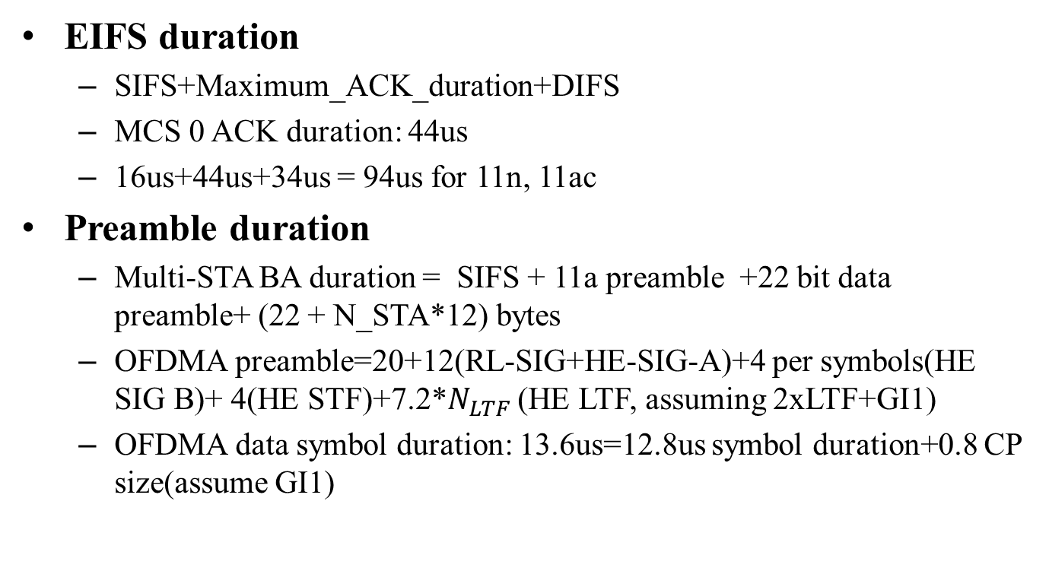
Calculation of EIFS and preamble duration
EIFS duration
  SIFS+Maximum_ACK_duration+DIFS
  MCS 0 ACK duration: 44us
  16us+44us+34us = 94us for 11n, 11ac
Preamble duration
  Multi-STA BA duration = SIFS + 11a preamble +22 bit data preamble+ (22 + N_STA*12) bytes
  OFDMA preamble=20+12(RL-SIG+HE-SIG-A)+4 per symbols(HE SIG B)+ 4(HE STF)+7.2*$N_{LTF}$ (HE LTF, assuming 2xLTF+GI1)
  OFDMA data symbol duration: 13.6us=12.8us symbol duration+0.8 CP size(assume GI1)

Slide 6
Block Ack procedure time for each blockack method
Each block acknowledgement frame in 20MHz channel
  BA duration exceeds EIFS even for single user with no BA bitmap, because of long preamble in HE format
  Therefore, the BA duration for less than 242 RU also exceeds EIFS duration
min RU size | # of STA | Bits per symbol | BA bit | SERVICE+tail bit | SIGB duration | HE-LTF | Other preamble | SIFS | maximum BA time
26 | 9 | 12 | 256 | 22 | 40 | 7.2 | 36 | 16 | 453
52 | 4 | 24 | 256 | 22 | 20 | 7.2 | 36 | 16 | 256
 | 1 | 24 | 256 | 22 | 0 | 7.2 | 36 | 16 | 236
106 | 2 | 51 | 256 | 22 | 12 | 7.2 | 36 | 16 | 166
 | 1 | 51 | 256 | 22 | 0 | 7.2 | 36 | 16 | 154
242 | 1 | 117 | 256 | 22 | 0 | 7.2 | 36 | 16 | 100

Slide 7
Block Ack procedure time for each blockack method
Multi-STA BA for all users in 20MHz band, using non-HT format
  For more than 1 BlockAck bitmaps, the BA procedure time exceeds EIFS duration
  For 1 BlockAck bitmap, the BA procedure time exceeds EIFS duration for not less than 4 STAs in 20MHz
  For 9 STAs in 20MHz, , the BA procedure time exceeds EIFS duration even though all of A-MPDUs received correctly
# of STA | # of BA bitmap | 11a preamble | ack bit | SERVICE+tail bit | Bit per symbol (non-HT) | T_transba | SIFS | total time
1 | 1 | 20 | 272 | 22 | 24 | 72 | 16 | 88
2 | 2 | 20 | 368 | 22 | 24 | 88 | 16 | 104
3 | 3 | 20 | 464 | 22 | 24 | 104 | 16 | 120
9 | 9 | 20 | 1040 | 22 | 24 | 200 | 16 | 216
4 | 1 | 20 | 320 | 22 | 24 | 80 | 16 | 96
9 | 0 | 20 | 320 | 22 | 24 | 80 | 16 | 96

Slide 8
Block Ack procedure time for each blockack method in more than 20MHz
Using non-HT duplicate M-BA,
  Block Ack duration exceeds EIFS duration for more than 1 BlockAck bitmaps
  It exceeds EIFS duration for more than 3 STAs for 1 Block Ack bitmap
  The maximum BA duration is about 1ms in case of maximum number of bitmaps in 160MHz bandwidth, which is more than 10 times of EIFS duration
# of STA in all bandwidth | # of BA Bitmaps | 11a preamble(us) | ack bit | SERVICE+tail bit | bits per symbol (non-HT) | T_transba (us) | SIFS | total time (us)
1 | 1 | 20 | 272 | 22 | 24 | 72 | 16 | 88
2 | 2 | 20 | 368 | 22 | 24 | 88 | 16 | 104
3 | 3 | 20 | 464 | 22 | 24 | 104 | 16 | 120
… | … | … | … | … | … | … | … | …
72 | 72 | 20 | 7088 | 22 | 24 | 1208 | 16 | 1224
4 | 1 | 20 | 320 | 22 | 24 | 80 | 16 | 96

Slide 9
Block Ack procedure time for each blockack method in more than 20MHz
  Grouping of STAs in M-BA:
  This procedure can be operated by 20MHz units, because 20MHz unit is same as preamble unit
  For this procedure, the number of SIG-B users may be 1 for each 20MHz M-BA, because there is no resource allocation or user info is needed in SIGB
  For this procedure, the M-BA duration is almost same as the duration of M-BA in 20MHz with HE format, except the duration of SIG-B field

Slide 10
Block Ack procedure time for each blockack method in more than 20MHz
Therefore, for the grouping STAs in M-BA for each 20MHz,
Which exceeds EIFS duration even though all of A-MPDUs received correctly, but the duration is much shorter than non-HT duplicated M-BA for large number of bitmaps
band | # of STAs in 20MHz | # of Bitmaps | bits per symbol | ack bit | SERVICE+Tail bit | SIGB field | HE-LTF | Other preamble | SIFS | Max BA time
40 | 2 | 0 | 117 | 208 | 22 | 8 | 7.2 | 36 | 16 | 108
 | 9 | 9 | 117 | 1040 | 22 | 8 | 7.2 | 36 | 16 | 203
80 | 2 | 0 | 117 | 208 | 22 | 12 | 7.2 | 36 | 16 | 112
 | 9 | 9 | 117 | 1040 | 22 | 12 | 7.2 | 36 | 16 | 207
160 | 2 | 0 | 117 | 208 | 22 | 20 | 7.2 | 36 | 16 | 120
 | 9 | 9 | 117 | 1040 | 22 | 20 | 7.2 | 36 | 16 | 215

Slide 11
Rules to prevent collision by long BA duration
As shown in previous slides, for MCS0, the most cases of BA transmission for UL MU PPDU exceed EIFS duration, which might cause collision from hidden STAs, which is a severe problem
In order to alleviate the EIFS excess problem, 802.11ax should provide mechanisms for ACK protection from hidden nodes.
There could be 3 possible mechanisms to solve the EIFS excess problem.
  Option 1: Use RTS/CTS procedure in mandatory to protect the UL MU OFDMA.
  Option 2: Use further optimization of Ack procedure
  Option 3: RTS/CTS procedure to protect the Ack transmission

Slide 12
Option 1: Use RTS/CTS procedure in mandatory
For every data UL MU transmission, use (MU)RTS and CTS procedure to protect the data transmission from hidden node

Slide 13
Option 2: Use further optimization
Use further optimization to shorten the duration of BA procedure
  For example, in case of A-MPDUs from all AIDs are received successfully, use a specific group AID to indicate the all frames from all triggered STAs are successfully received
  Or, in case of all frames from all TIDs in an AID are received successfully, use a specific TID to indicate that

Slide 14
Option 3: Using RTS/CTS procedure after data transmission
After receiving the UL MU PPDUs, if AP acknowledges that the duration of acknowledgement exceeds the EIFS, AP may transmit (MU)RTS frame to protect the BA transmission from hidden nodes

Slide 15
Conclusion
The MU acknowledgement for the UL MU transmission exceed the EIFS duration in MCS0 for most cases, including some cases that Ack Type field of all STAs is Ack, which does not contain BlockAck bitmap
The long duration for Ack can cause collision with hidden STAs, which results in retransmission of entire A-MPDU(s) in some STAs that degrades performance
Therefore, additional optimization methods or rules are needed for UL MU transmission in case the acknowledgement cannot be processed in EIFS duration

Slide 16
Straw Poll 1
Do you agree to add to the TG Specification Frame work document?
  Spec shall include mechanisms to avoid the EIFS excess during the Acknowledgement for UL MU PPDU(s)
    Y
    N
    A

