Slide 1
Multi-Channel Spatial Sharing for 11ay
Date: 2016-05-17
Authors:
Name | Company | Address | Phone | Email
Kyungtae Jo | LG Electronics |  |  | kyungtae.jo@lge.com
SungJin Park |  |  |  | allean.park@lge.com
HanGyu Cho |  |  |  | hg.cho@lge.com
JinMin Kim |  |  |  | jinmin1230.kim@lge.com
Saehee Bang |  |  |  | saehee.bang@lge.com
Sang G. Kim |  |  |  | sanggook.kim@lge.com

Slide 2
Introduction
Motion related to multi-channel SPSH was passed in IEEE meeting, March. :
“11ay shall provide means to extend the IEEE 802.11ad spatial sharing mechanism to be supported in multi-channel.”
This contribution intends to investigate how spatial sharing protocol in single channel for 11ad is modified to extend to the spatial reuse for multi-channel.

Slide 3
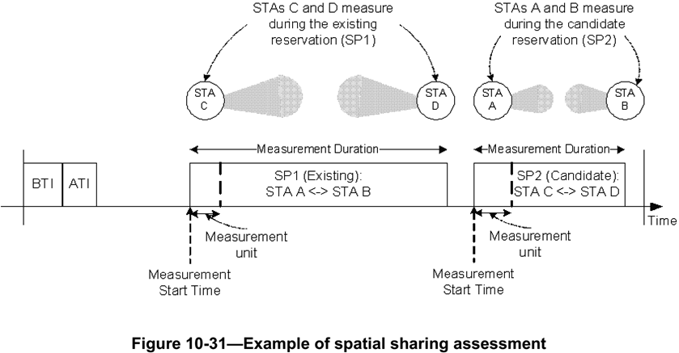
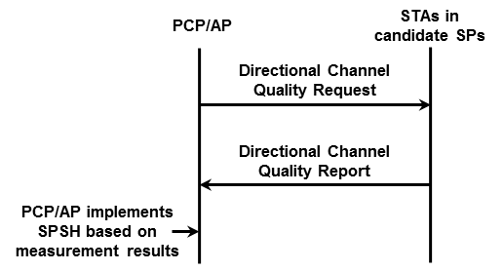
Recap : 11ad SPSH
Spatial sharing mechanisms allow SPs belonging to different STAs in the same spatial vicinity to be scheduled concurrently over the same channel.
The PCP/AP should request STAs to perform and report spectrum and radio resource measurements to assess the possibility to perform spatial sharing.

Slide 4
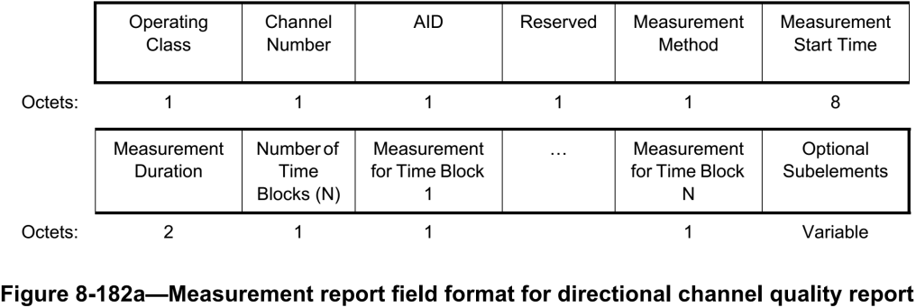
Recap : 11ad SPSH (cont.)
Directional Channel Quality Request/Report
Operating Class and Channel Number fields together specify the channel frequency and spacing for which the measurement request applies.
AID field indicates the Target STA.
Measurement Method field : If this field is set to 0, it indicates ANIPI. If this field is set to 1, it indicates RSNI.
Measurement for Time Block fields are set to the ANIPI value measured during each measurement unit, which is the ratio of Measurement Duration to Number of Time Blocks.

Slide 5
Proposal for 11ay SPSH
For multi-channel SPSH, channel measurements for the channels should be achieved.
We suggest how to modify the Directional Channel Quality Request/Report frames for multi-channel SPSH.

Slide 6
Proposal : Modified Directional Channel Quality Request

Slide 7
Proposal: Modified Directional Channel Quality Report

Slide 8
Summary
We suggest that “Enhanced Directional Channel Quality Request/Report frame” are modified by using the reserved bits of existing “Directional Channel Quality Request/Report frame” of 11ad in order to keep backward compatibility with legacy.

Slide 9
References
11-16-0387-02-00ay-Multi-Channel Spatial Sharing

Slide 10
Straw poll/motion #1
Do you agree to add the following text into SFD?
“11ay shall modify Directional Channel Quality Request/Report frames to request/report for measurements on multiple channels”
Y/N/A

Slide 11
Straw poll/motion #2
Do you agree to add the following text into SFD?
“11ay shall enable Directional Channel Quality Request/Report frames to provide the measurements averaged over multiple Channels”
Y/N/A

