Slide 1
Multi-Channel Spatial Sharing for 11ay
Date: 2016-05-17
Authors:
Name | Company | Address | Phone | Email
Kyungtae Jo | LG Electronics |  |  | kyungtae.jo@lge.com
SungJin Park |  |  |  | allean.park@lge.com
HanGyu Cho |  |  |  | hg.cho@lge.com
JinMin Kim |  |  |  | jinmin1230.kim@lge.com
Saehee Bang |  |  |  | saehee.bang@lge.com
Sang G. Kim |  |  |  | sanggook.kim@lge.com

Slide 2
Introduction
Motion related to multi-beamforming was passed in IEEE meeting, March. :
  “11ay shall provide means to extend the IEEE 802.11ad spatial sharing mechanism to be supported in multi-channel.”
This contribution intends to investigate how spatial sharing protocol in single channel for 11ad is modified to extend to the spatial reuse for multi-channel.

Slide 3
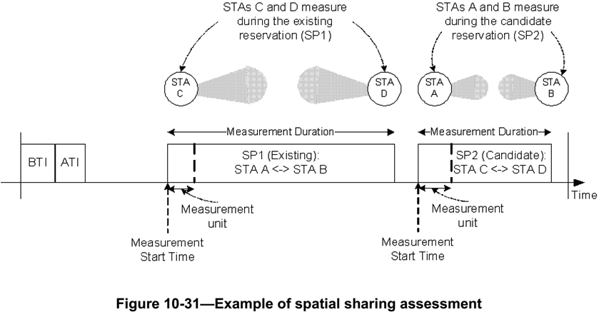
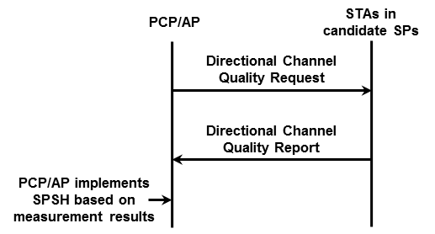
Recap : 11ad SPSH
Spatial sharing mechanisms allow SPs belonging to different STAs in the same spatial vicinity to be scheduled concurrently over the same channel.
The PCP/AP should request STAs to perform and report spectrum and radio resource measurements to assess the possibility to perform spatial sharing.

Slide 4
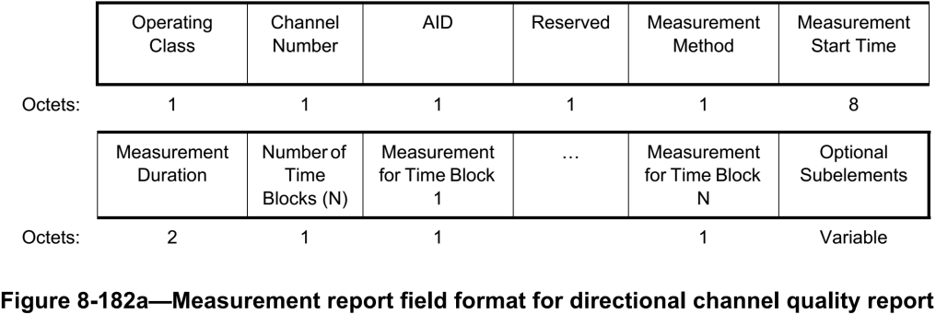
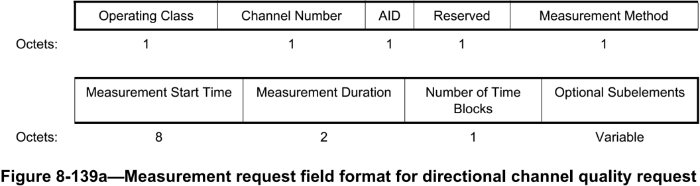
Recap : 11ad SPSH (cont.)
Directional Channel Quality Request/Report
  Operating Class and Channel Number fields together specify the channel frequency and spacing for which the measurement request applies.
  AID field indicates the Target STA.
  Measurement Method field : If this field is set to 0, it indicates ANIPI. If this field is set to 1, it indicates RSNI.
  Measurement for Time Block fields are set to the ANIPI value measured during each measurement unit, which is the ratio of Measurement Duration to Number of Time Blocks.

Slide 5
Proposal for 11ay SPSH
For multi-channel SPSH, channel measurements for the channels should be achieved.
We suggest how to modify the Directional Channel Quality Request/Report frames for multi-channel SPSH.

Slide 6
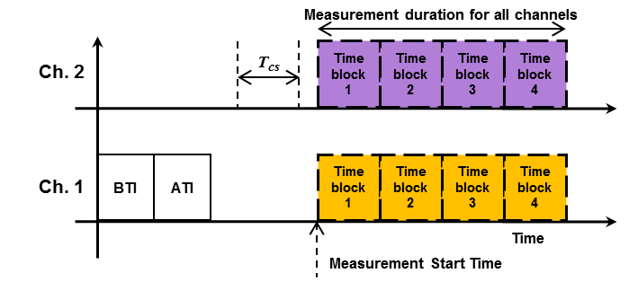
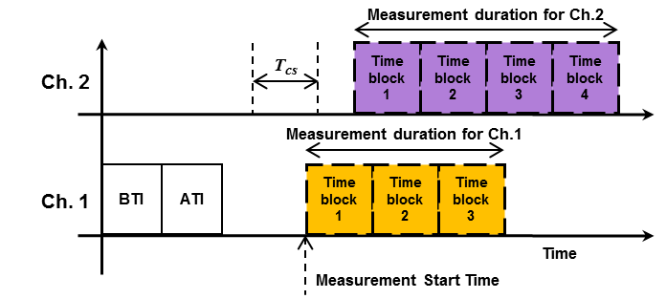
Proposal for Multi-channel SPSH
There are 2 options how to indicate measurement information for multi-channel SPSH in the modified Directional Channel Quality Request/Report frames.
Consistent measurement mode for multi-channel
  Same measurement information over multiple channels, e.g., Number of Time Blocks, Measurement Duration, Measurement Method and Measurement Report Method for measurement
  Same Measurement Start Time over multiple channels
Flexible measurement mode for multi-channel
  Different measurement information for each channel
  It can achieve the dynamic SPSH measurement.
* T_{cs} may be needed for RF bandwidth set to the assigned channels

Slide 7
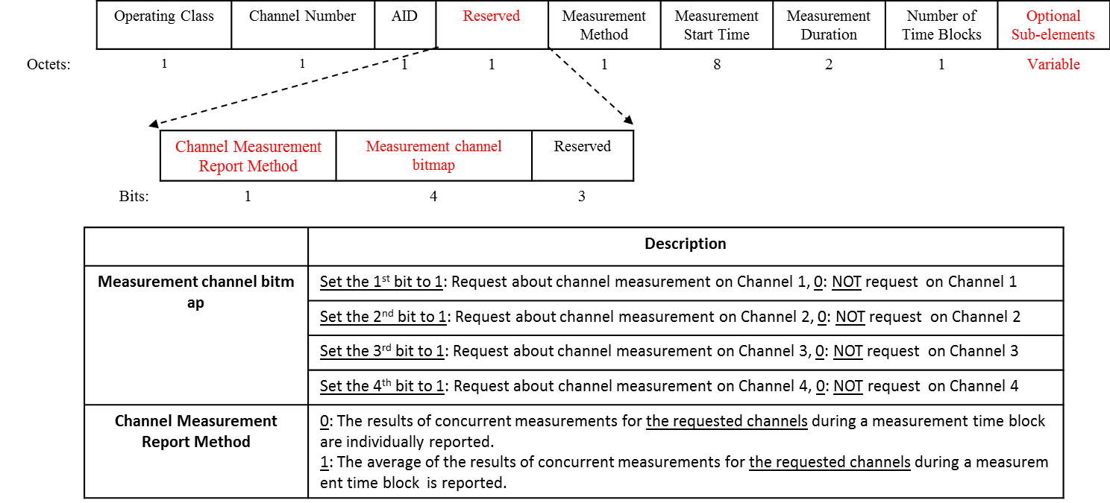
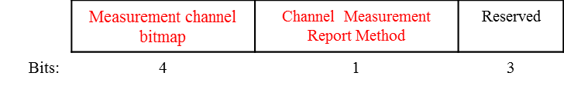
Proposal : Modified Directional Channel Quality Request

Slide 8
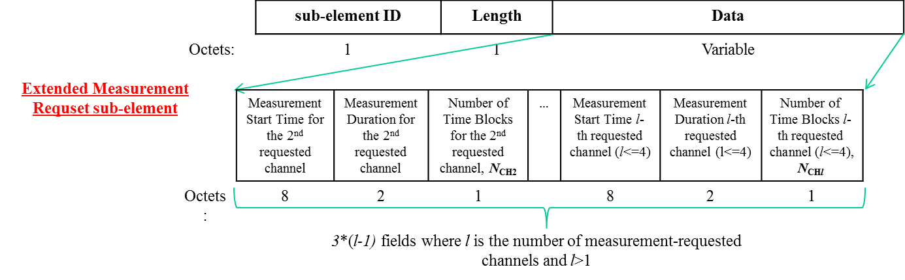
Extended sub-element on Proposed Request Frame
Measurement information for flexible measurement is transmitted by Modified Directional Channel Quality Request
  Measurement information about the first-requested channel is carried in the Measurement for Time Blocks fields.
  Optional Sub-elements are consisted of measurement information about requested channel except for first-requested channel in channel bitmap.

Slide 9
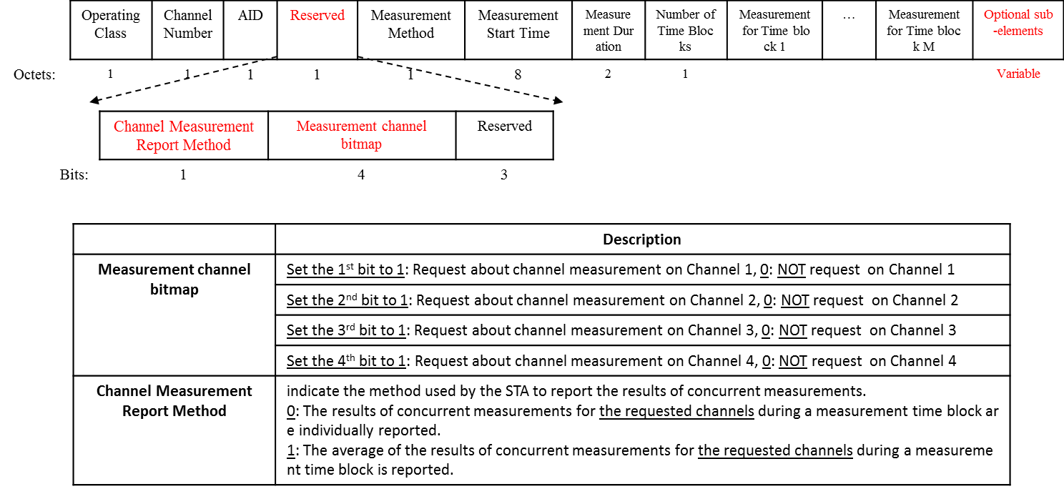
Proposal: Modified Directional Channel Quality Report

Slide 10
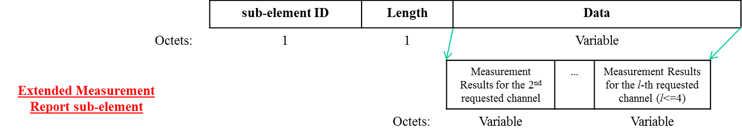
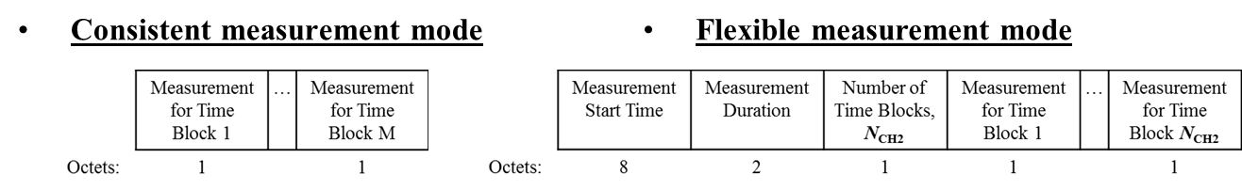
Extended sub-element on Proposed Report Frame
Measurement results for flexible measurement are reported by Modified Directional Channel Quality Report
  Measurement result about the first-requested channel is carried in the Measurement for Time Blocks fields.
  Optional Sub-elements are consisted of measurement results about requested channel except for first-requested channel in channel bitmap.

Slide 11
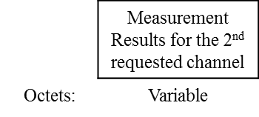

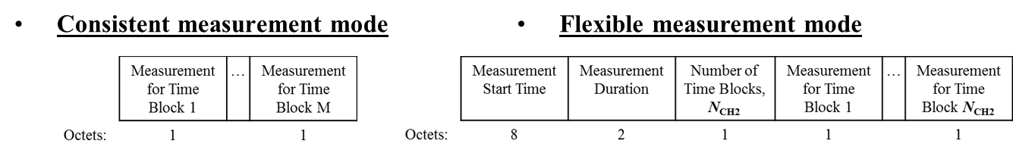
Extended sub-element on Proposed Report Frame (cont.)
Case 1. Channel Measurement Report Method = 0
  Measurement results over the 1-st requested channel are carried in the Measurement for Time Blocks fields.
  Remaining measurement results are carried in an Extended Measurement Report sub-element
  E.g. Channel bitmap = 1100 (bonded channel)

Slide 12
Extended sub-element on Proposed Report Frame (cont.)
Case 2. Channel Measurement Report Method = 1
  Average of measurement results over all requested channels are carried in the Measurement for Time Blocks fields.
  E.g. Channel bitmap = 1100 (bonded channel)
  ⇒ Average values of measurement results with respect to channel carried in the Measurement for Time Blocks fields. (We don’t need the “Optional sub-elements”)

Slide 13
Summary
We suggest that “Enhanced Directional Channel Quality Request/Report frame” are modified by using the reserved bits of existing “Directional Channel Quality Request/Report frame” of 11ad in order to keep backward compatibility with legacy.

Slide 14
References
11-16-0387-02-00ay-Multi-Channel Spatial Sharing

Slide 15
Straw poll/motion #1
Do you agree to add the following text into SFD?
  “11ay shall modify Directional Channel Quality Request/Report frames to request/report for measurements on multiple channels”
  Y/N/A

Slide 16
Straw poll/motion #2
Do you agree to add the following text into SFD?
  “11ay shall enable Directional Channel Quality Request/Report frames to provide the measurements averaged over multiple Channels”
  Y/N/A

