Slide 1
Some Notes on Interference Alignment for Downlink Multi-User MIMO
Date: 2016-05-15
Authors:

Slide 2
Abstract
We show that standard DL MU-MIMO precoding for BPSK is severely suboptimal
We propose an improved way of precoding and decoding BPSK symbols
Similar ideas are applied to complex-valued alphabets
Simulation results show the improvements

Slide 3
Introduction
DL MU-MIMO introduced in IEEE 802.11ac
Up to 8 Tx antennas at AP
Linear precoding in DL improves performance
Zero Forcing (ZF) and Regularized Inverse (RI) popular choices
Straightforward with full spatial multiplexing and complex-valued alphabets
If one of these conditions do not hold, is it still trivial?

Slide 4
Example
AP with 4 Tx antennas
4 STAs with one antenna each
Channel $H=[h_{1}^{T}; h_{2}^{T}; h_{3}^{T}; h_{4}^{T}]$
AP transmits one BPSK symbol to each STA
$$y=HFb+n$$
Precoder $F$ , vector of BPSK streams $b={\left[b_{1} b_{2} b_{3} b_{4}\right]}^{T}$
Standard ZF: $F=H^{+}$ (pseudo-inverse) [1]
$y=b+n$
Each STA receives BPSK without interference

Slide 5
Example (cont.)
Standard ZF results in beams that are orthogonal to both I and Q parts of undesired users
Since the constellation is one dimensional, orthogonality towards the other dimension not necessary [2]
Beams that are orthogonal to only one dimension have one extra degree of freedom / STA → interference from others placed on the other dimension
Let AP choose signaling dimension for each STA (in such a way so that the resulting linear precoder has minimal power).

Slide 6
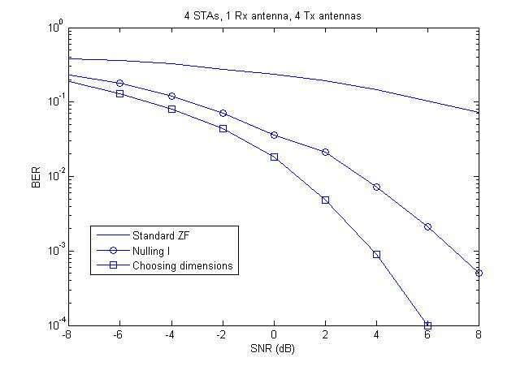
Example (cont.)
AP constructs a ZF precoder that only nulls out one dimension / STA
Also works for RI precoder

Slide 7
Implementation
A possible implementation of the proposed method
The AP collects all received channels (or some factorization of them) and extends them to the real-valued domain
It chooses I or Q as the channel to a STA in such a way that the resulting ZF or RI has minimal energy
The STA processes the signal in the I-Q (real-valued) domain; standard MU-MIMO IC receiver [1] no longer optimal!

Slide 8
Complex-valued alphabets
Example considered BPSK (in general, one-dimensional constellation)
How about complex-valued (QPSK, 16-QAM,…)?
The single antenna now receives two independent dimensions → no possibility to choose anymore

Slide 9
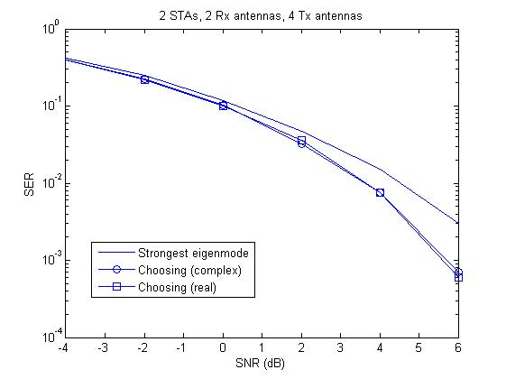
Complex-valued alphabets (general)
Already well-known that, in case of fewer streams than Rx antennas at each STA, AP can place interference on the other (complex) subspaces
Possibility to choose gives gain
Strongest eigenmodes not always optimal!
How about having additional choice of placing it on I or Q parts in the different subspaces?
Simulations show that there is no gain compared to the complex-valued representation

Slide 10
Summary
In case of BPSK, AP has freedom to place interference on I or Q part → more degrees of freedom
STA must process in the I-Q domain→ Standard MU-MIMO IC receiver suboptimal
Large gains compared to standard ZF
For complex-valued alphabets, no need to place interference on I or Q separately
However, choosing subspaces gives gain!

Slide 11
Straw poll
Do you support that 802.11ax implements a selection mechanism in conjunction with improved receiver capabilities for BPSK?
Yes
No
Abstain
Do you support that 802.11ax implements a selection mechanism for reduced rank transmission with complex-valued symbols?
Yes
No
Abstain

Slide 12
References
[1] Robert Stacey and Eldad Perahia, “Next Generation Wireless LANs”, 2nd edition
[2] Rodrigo de Miguel, Ralf R. Müller, “Real vs. Complex BPSK Precoding for MIMO Broadcast Channels”

