Slide 1
Adaptive Random Access UL OFDMA
Date: 2016-05-16
Authors:

Slide 2
Summary
Detailed parameters and procedure for random access UL OFDMA are still TBD in the SFD and draft 0.1
In this contribution, we present analysis and simulation results of random access UL OFDMA and make recommendations on how to obtain maximum efficiency at all times.

Slide 3
Preliminary
The current random access UL OFDMA has very similar structure with DCF MAC. Many rules that apply to DCF MAC also apply to random access UL OFDMA.
1. STAs increase OCW from an OCWmin value everytime collision occurs
a. OCWmax parameter is a must.
b. Exponential increase is easy, effective and well understood.
2. AP adaptively adjusts OCWmin and OCWmax to fine tune the MAC performance.

Slide 4
Simulation Scenario
TF-R Start Time 2
TF-R Start Time 1
Service Period
Service Period
Beacon
TF-R
TF-R
TF-R
TF
TF-R
TF-R
TF-R
TF-R
TF-R
TF-R Start Time 1
TF-R Start Time 2
AP
(no random access)
(random access)
Cascaded Trigger Frames

Slide 5
Simulation Parameters
Assumptions
Exponential Back off
Service Period Length = 30ms (1 per beacon)
Beacon Interval=100ms
Full Buffer Traffic
Random access parameters
  Number of STAs (N_STA)= [1:32]
  Number of RUs/TF-R (N_RU)= [4, 8]
  OCWmin = [1, 2, 4, 8, 16, 32]
  OCWmax = [32]

Slide 6
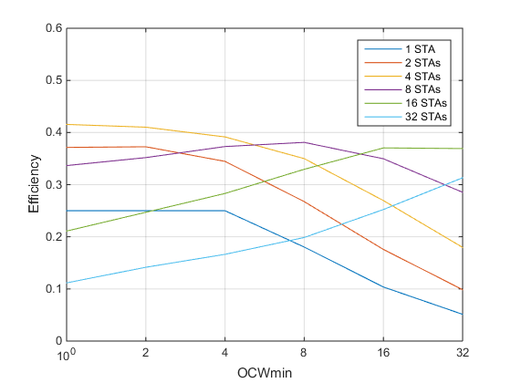
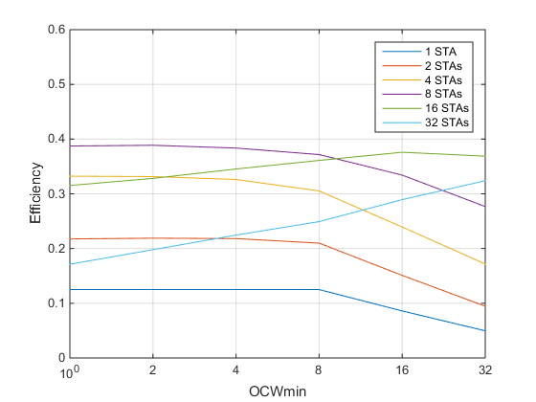
Simulation Results
N_RU=4
N_RU=8

Slide 7
Observations
Higher number of STAs need higher OCWmin and vice versa.
Efficiency is low when N_RU is lower than the N_STA.
There exist an optimal OCWmin depending on the number of STAs.
How to optimize OCWmin?

Slide 8
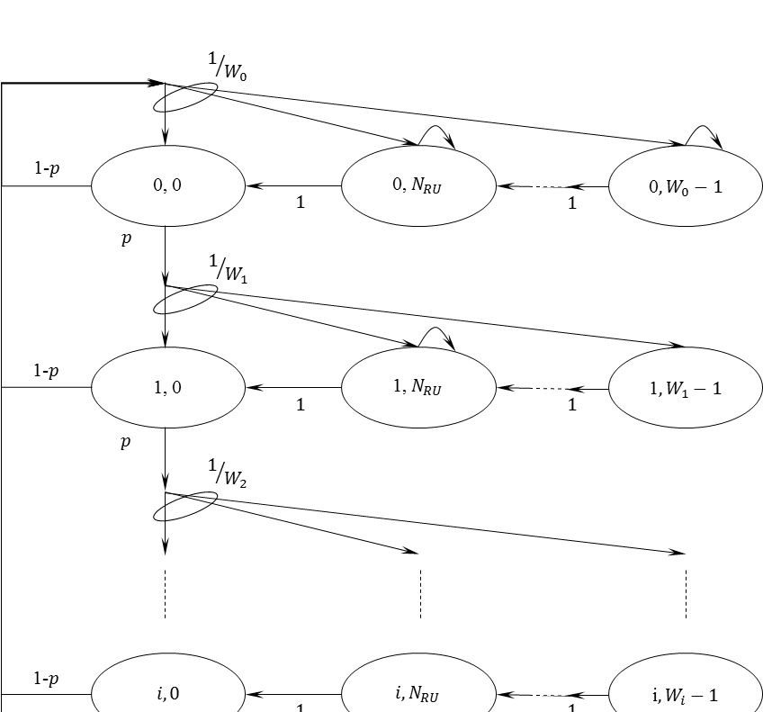

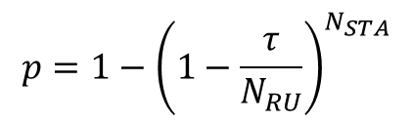
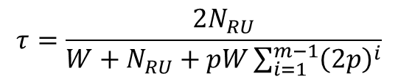
Adaptive Control of OCWmin
Similar to DCF MAC, random access OFDMA can be analyzed using Markov chain modeling.
With exponential back-off , analytical expressions for efficiency are as follows
$$E=\frac{τN_{STA}}{N_{RU}}{\left(1−\frac{τ}{N_{RU}}\right)}^{N_{STA}−1}$$
$$τ=\frac{2N_{RU}}{W+N_{RU}+pW\sum_{i=1}^{m−1}{{\left(2p\right)}^{i}}}$$
$$p=1−{\left(1−\frac{τ}{N_{RU}}\right)}^{N_{STA}}$$

Slide 9

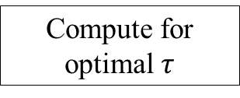
Adaptive Control of OCWmin and N_RU
Beacon
Trigger Frame
N_STA
N_RU
Compute for optimal $τ$
N_STA>N_RU
yes
$$τ_{opt}$$
no
Compute for optimal OCWmin
N_RU=N_STA
Broadcast OCWmin
Trigger Frame

Slide 10
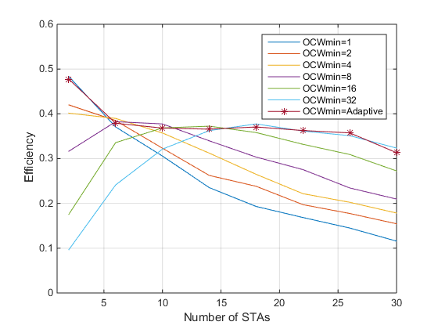
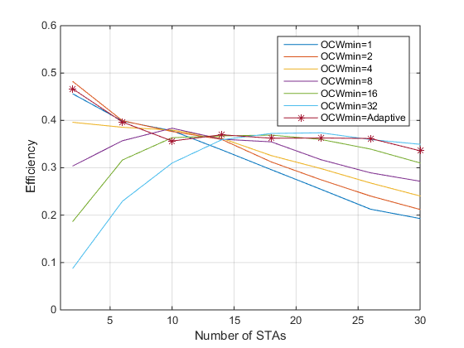
Adaptive Control of OCWmin
N_RU=4
N_RU=8

Slide 11
Conditions for Maintaining Optimal Performance
N_STA accurate estimation
N_RU must be less than or equal than N_STA
Adaptive Control of OCWmin based on N_STA
  we propose OCWmin report through beacon information element
Others:
Exponential back off
OCWmax effect is more subtle but need to be set for consistency.

Slide 12
Conclusion
We presented conditions that could enable optimal efficiency at all times.

