Slide 1
On Modulation of MCS0 DCM and DCM Capability
Date: 2016-05-12
Authors:
Name | Affiliation | Address | Phone | Email
Jianhan Liu | Mediatek | 2860 Junction Ave, San Jose, CA 95134, USA | +1-408-526-1899 | jianhan.Liu@mediatek.com
Thomas Pare |  |  |  | thomas.pare@mediatek.com
ChaoChun Wang |  |  |  | chaochun.wang@mediatek.com
James Wang |  |  |  | james.wang@mediatek.com
Tianyu Wu |  |  |  | tianyu.wu@mediatek.com
Russell Huang |  |  |  | russell.huang@mediatek.com
James Yee |  | No. 1 Dusing 1st Road, Hsinchu, Taiwan | +886-3-567-0766 | james.yee@mediatek.com
Frank Hsu |  |  |  | frank.hsu@mediatek.com

Slide 2
Authors (continued)
Name | Affiliation | Address | Phone | Email
David X. Yang | Huawei | F1-17, Huawei Base, Bantian, Shenzhen |  | david.yangxun@huawei.com
Jiayin Zhang |  | 5B-N8, No.2222 Xinjinqiao Road, Pudong, Shanghai | +86-18601656691 | zhangjiayin@huawei.com
Jun Luo |  | 5B-N8, No.2222 Xinjinqiao Road, Pudong, Shanghai |  | jun.l@huawei.com
Yi Luo |  | F1-17, Huawei Base, Bantian, Shenzhen | +86-18665891036 | Roy.luoyi@huawei.com
Yingpei Lin |  | 5B-N8, No.2222 Xinjinqiao Road, Pudong, Shanghai |  | linyingpei@huawei.com
Jiyong Pang |  | 5B-N8, No.2222 Xinjinqiao Road, Pudong, Shanghai |  | pangjiyong@huawei.com
Zhigang Rong |  | 10180 Telesis Court, Suite 365, San Diego, CA 92121 NA |  | zhigang.rong@huawei.com
Jian Yu |  | F1-17, Huawei Base, Bantian, Shenzhen |  | ross.yujian@huawei.com
Ming Gan |  | F1-17, Huawei Base, Bantian, Shenzhen |  | ming.gan@huawei.com
Yuchen Guo |  | F1-17, Huawei Base, Bantian, Shenzhen |  | guoyuchen@huawei.com
Yunsong Yang |  | 10180 Telesis Court, Suite 365, San Diego, CA 92121 NA |  | yangyunsong@huawei.com
Junghoon Suh |  | 303 Terry Fox, Suite 400 Kanata, Ottawa, Canada |  | Junghoon.Suh@huawei.com
Peter Loc |  |  |  | peterloc@iwirelesstech.com
Edward Au |  | 303 Terry Fox, Suite 400 Kanata, Ottawa, Canada |  | edward.ks.au@huawei.com
Teyan Chen |  | F1-17, Huawei Base, Bantian, Shenzhen |  | chenteyan@huawei.com
Yunbo Li |  | F1-17, Huawei Base, Bantian, Shenzhen |  | liyunbo@huawei.com

Slide 3
Authors (continued)
Name | Affiliation | Address | Phone | Email
Alice Chen | Qualcomm | 5775 Morehouse Dr. San Diego, CA, USA |  | alicel@qti.qualcomm.com
Albert Van Zelst |  | Straatweg 66-S Breukelen, 3621 BR Netherlands |  | allert@qti.qualcomm.com
Alfred Asterjadhi |  | 5775 Morehouse Dr. San Diego, CA, USA |  | aasterja@qti.qualcomm.com
Bin Tian |  | 5775 Morehouse Dr. San Diego, CA, USA |  | btian@qti.qualcomm.com
Carlos Aldana |  | 1700 Technology Drive San Jose, CA 95110, USA |  | caldana@qca.qualcomm.com
George Cherian |  | 5775 Morehouse Dr. San Diego, CA, USA |  | gcherian@qti.qualcomm.com
Gwendolyn Barriac |  | 5775 Morehouse Dr. San Diego, CA, USA |  | gbarriac@qti.qualcomm.com
Hemanth Sampath |  | 5775 Morehouse Dr. San Diego, CA, USA |  | hsampath@qti.qualcomm.com
Lin Yang |  | 5775 Morehouse Dr. San Diego, CA, USA |  | linyang@qti.qualcomm.com
Lochan Verma |  | 5775 Morehouse Dr. San Diego, CA USA |  | lverma@qti.qualcomm.com
Menzo Wentink |  | Straatweg 66-S Breukelen, 3621 BR Netherlands |  | mwentink@qti.qualcomm.com
Naveen Kakani |  | 2100 Lakeside Boulevard Suite 475, Richardson TX 75082, USA |  | nkakani@qti.qualcomm.com
Raja Banerjea |  | 1060 Rincon Circle San Jose CA 95131, USA |  | rajab@qit.qualcomm.com
Richard Van Nee |  | Straatweg 66-S Breukelen, 3621 BR Netherlands |  | rvannee@qti.qualcomm.com

Slide 4
Authors (continued)
Name | Affiliation | Address | Phone | Email
Rolf De Vegt | Qualcomm | 1700 Technology Drive San Jose, CA 95110, USA |  | rolfv@qca.qualcomm.com
Sameer Vermani |  | 5775 Morehouse Dr. San Diego, CA, USA |  | svverman@qti.qualcomm.com
Simone Merlin |  | 5775 Morehouse Dr. San Diego, CA, USA |  | smerlin@qti.qualcomm.com
Tevfik Yucek |  | 1700 Technology Drive San Jose, CA 95110, USA |  | tyucek@qca.qualcomm.com
VK Jones |  | 1700 Technology Drive San Jose, CA 95110, USA |  | vkjones@qca.qualcomm.com
Youhan Kim |  | 1700 Technology Drive San Jose, CA 95110, USA |  | youhank@qca.qualcomm.com
Joonsuk Kim | Apple |  |  | joonsuk@apple.com
Aon Mujtaba |  |  |  | mujtaba@apple.com
Guoqing Li |  |  |  | guoqing_li@apple.com
Eric Wong |  |  |  | ericwong@apple.com
Chris Hartman |  |  |  | chartman@apple.com
Jarkko Kneckt |  |  |  | jkneckt@apple.com

Slide 5
Authors (continued)
Robert Stacey | Intel | 2111 NE 25th Ave, Hillsboro OR 97124, USA | +1-503-724-893 | robert.stacey@intel.com
Shahrnaz Azizi |  |  |  | shahrnaz.azizi@intel.com
Po-Kai Huang |  |  |  | po-kai.huang@intel.com
Qinghua Li |  |  |  | quinghua.li@intel.com
Xiaogang Chen |  |  |  | xiaogang.c.chen@intel.com
Chitto Ghosh |  |  |  | chittabrata.ghosh@intel.com
Laurent Cariou |  |  |  | laurent.cariou@intel.com
Yaron Alpert |  |  |  | yaron.alpert@intel.com
Assaf Gurevitz |  |  |  | assaf.gurevitz@intel.com
Ilan Sutskover |  |  |  | ilan.sutskover@intel.com
Ron Porat | Broadcom |  |  | rporat@broadcom.com
Sriram Venkateswaran
Matthew Fischer |  |  |  | mfischer@broadcom.com
Zhou Lan
Leo Montreuil
Andrew Blanksby
Vinko Erceg
Thomas Derham
Mingyue Ji

Slide 6
Authors (continued):
Name | Affiliation | Address | Phone | Email
Hongyuan Zhang | Marvell | 5488 Marvell Lane, Santa Clara, CA, 95054 | 408-222-2500 | hongyuan@marvell.com
Lei Wang |  |  |  | Leileiw@marvell.com
Liwen Chu |  |  |  | liwenchu@marvell.com
Jinjing Jiang |  |  |  | jinjing@marvell.com
Yan Zhang |  |  |  | yzhang@marvell.com
Rui Cao |  |  |  | ruicao@marvell.com
Sudhir Srinivasa |  |  |  | sudhirs@marvell.com
Bo Yu |  |  |  | boyu@marvell.com
Saga Tamhane |  |  |  | sagar@marvell.com
Mao Yu |  |  |  | my@marvel..com
Xiayu Zheng |  |  |  | xzheng@marvell.com
Christian Berger |  |  |  | crberger@marvell.com
Niranjan Grandhe |  |  |  | ngrandhe@marvell.com
Hui-Ling Lou |  |  |  | hlou@marvell.com

Slide 7
Authors (continued)
Name | Affiliation | Address | Phone | Email
Hyeyoung Choi | LG Electronics | 19, Yangjae-daero 11gil, Seocho-gu, Seoul 137-130, Korea |  | hy0117.choi@lge.com
Kiseon Ryu |  |  |  | kiseon.ryu@lge.com
Jinyoung Chun |  |  |  | jiny.chun@lge.com
Jinsoo Choi |  |  |  | js.choi@lge.com
Jeongki Kim |  |  |  | jeongki.kim@lge.com
Giwon Park |  |  |  | giwon.park@lge.com
Dongguk Lim |  |  |  | dongguk.lim@lge.com
Suhwook Kim |  |  |  | suhwook.kim@lge.com
Eunsung Park |  |  |  | esung.park@lge.com
HanGyu Cho |  |  |  | hg.cho@lge.com
Bo Sun | ZTE | #9 Wuxingduan, Xifeng Rd., Xi'an, China |  | sun.bo1@zte.com.cn
Kaiying Lv |  |  |  | lv.kaiying@zte.com.cn
Yonggang Fang |  |  |  | yfang@ztetx.com
Ke Yao |  |  |  | yao.ke5@zte.com.cn
Weimin Xing |  |  |  | xing.weimin@zte.com.cn
Brian Hart | Cisco Systems | 170 W Tasman Dr, San Jose, CA 95134 |  | brianh@cisco.com
Pooya Monajemi |  |  |  | pmonajem@cisco.com

Slide 8
Authors (continued)
Name | Affiliation | Address | Phone | Email
Fei Tong | Samsung | Innovation Park, Cambridge CB4 0DS (U.K.) | +44 1223 434633 | f.tong@samsung.com
Hyunjeong Kang |  | Maetan 3-dong; Yongtong-Gu Suwon; South Korea | +82-31-279-9028 | hyunjeong.kang@samsung.com
Kaushik Josiam |  | 1301, E. Lookout Dr, Richardson TX 75070 | (972) 761 7437 | k.josiam@samsung.com
Mark Rison |  | Innovation Park, Cambridge CB4 0DS (U.K.) | +44 1223 434600 | m.rison@samsung.com
Rakesh Taori |  | 1301, E. Lookout Dr, Richardson TX 75070 | (972) 761 7470 | rakesh.taori@samsung.com
Sanghyun Chang |  | Maetan 3-dong; Yongtong-Gu Suwon; South Korea | +82-10-8864-1751 | s29.chang@samsung.com
Yasushi Takatori | NTT | 1-1 Hikari-no-oka, Yokosuka, Kanagawa 239-0847 Japan | +81 46 859 3135 | takatori.yasushi@lab.ntt.co.jp
Yasuhiko Inoue |  |  | +81 46 859 5097 | inoue.yasuhiko@lab.ntt.co.jp
Shoko Shinohara |  |  | +81 46 859 5107 | Shinohara.shoko@lab.ntt.co.jp
Yusuke Asai |  |  | +81 46 859 3494 | asai.yusuke@lab.ntt.co.jp
Koichi Ishihara |  |  | +81 46 859 4233 | ishihara.koichi@lab.ntt.co.jp
Junichi Iwatani |  |  | +81 46 859 4222 | Iwatani.junichi@lab.ntt.co.jp
Akira Yamada | NTT DOCOMO | 3-6, Hikarinooka, Yokosuka-shi, Kanagawa, 239-8536, Japan | +81 46 840 3759 | yamadaakira@nttdocomo.com

Slide 9
Authors (continued)
Authors (continued)
Name | Affiliation | Address | Phone | Email
Masahito Mori | Sony Corp. |  |  | Masahito.Mori@jp.sony.com
Yusuke Tanaka |  |  |  | YusukeC.Tanaka@jp.sony.com
Yuichi Morioka |  |  |  | Yuichi.Morioka@jp.sony.com
Kazuyuki Sakoda |  |  |  | Kazuyuki.Sakoda@am.sony.com
William Carney |  |  |  | William.Carney@am.sony.com
Sigurd Schelstraete | Quantenna |  |  | Sigurd@quantenna.com
Huizhao Wang |  |  |  | hwang@quantenna.com
Minho Cheong | Newracom | 9008 Research Dr. Irvine, CA 92618 |  | minho.cheong@newracom.com
Reza Hedayat |  |  |  | reza.hedayat@newracom.com
Young Hoon Kwon |  |  |  | younghoon.kwon@newracom.com
Yongho Seok |  |  |  | yongho.seok@newracom.com
Daewon Lee |  |  |  | daewon.lee@newracom.com
Yujin Noh |  |  |  | yujin.noh@newracom.com

Slide 10
Authors (continued)

Slide 11
Introduction
Fill the TBD modulation for MCS0 DCM in spec draft
Modulation for DCM with MCS0
We propose a low PAPR modulation for DCM with MCS0
Define the capability field for DCM
DCM is an optional feature, to enable flexible implementation of DCM, we will define the DCM capability field for 11ax.

Slide 12
MCS0 DCM modulation scheme
and are modulated symbol for data subcarrier k and k+N_{SD} for DCM. are both BPSK modulated.
To reduce the PAPR of MCS0 DCM modulation, we propose the following modulation scheme
Interleaved/coded bits
DCM
IFFT
BPSK Mapping #1
BPSK Mapping #2
Sub-carrier k
Sub-carrier k+N_{SD}

Slide 13
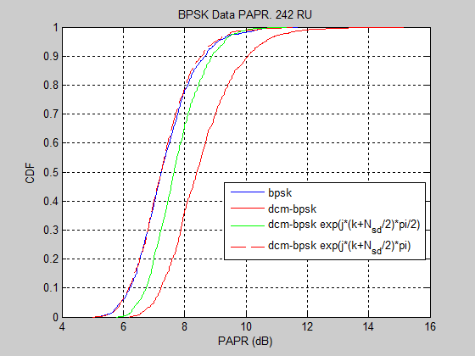
Results for PAPR
We can see that the proposed MCS0 DCM modulation scheme reaches the similar PAPR as BSPK modulation.
Other MCS0 DCM modulation schemes have larger PAPR.

Slide 14
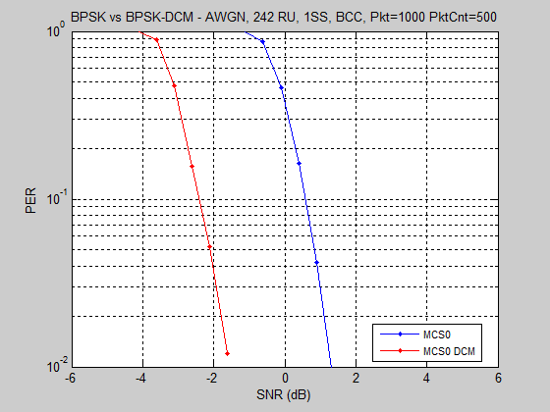
Performance of Proposed DCM MCS0 Scheme in AWGN Channel

Slide 15
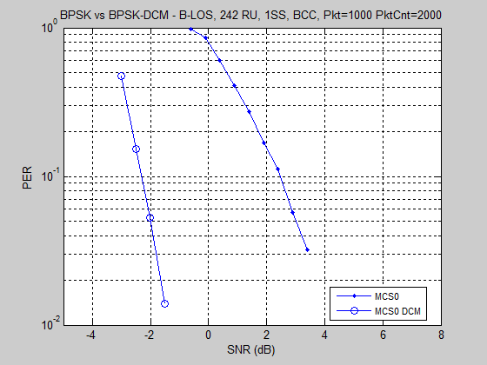
Performance of Proposed BPSK DCM Scheme in B-NLOS Channel

Slide 16
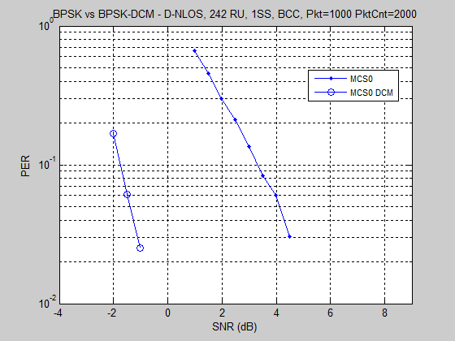
Performance of Proposed BPSK DCM Scheme in D-NLOS Channel

Slide 17
Capability field for DCM
DCM is mostly used for robustness in frequency selective fading channel and when there is narrow band interference. So to reduce implementation complexity, we propose to limit the DCM usage as follows
DCM is only applied to MCS0, MCS1, MCS3 and MCS4.
DCM is only applied to 1 and 2 spatial streams.
DCM is only applied to HE SU PPDU, HE extend range SU PPDU, and SU RUs in HE MU PPDU.
DCM is not applied to MU-MIMO.
DCM is not applied to STBC.
We propose to define the following capability field for DCM
Max constellation supported: 2 bits.
00: does not support DCM; 01: BPSK; 10: QPSK; 11: 16QAM
Max number of streams supported: 1 bit.
0: 1stream; 1: 2 streams

Slide 18
Conclusion
MCS0 DCM modulation scheme is proposed.
Simple +1/-1 masking achieves low PAPR
DCM capability field is defined.

Slide 19
Straw Poll #1
Do you agree to add the 11ax SFD the following MCS0 DCM constellation mapping for data subcarriers k and k+N_{SD}
is BPSK modulated
Note: N_{SD} is defined for DCM which is half of .
_{Y/N/Abs}

Slide 20
Straw Poll #2
Do you agree to add the following usage of DCM to 11ax SFD?
DCM is only applied to MCS0, MCS1, MCS3 and MCS4.
DCM is only applied to 1 and 2 spatial streams.
DCM is only applied to HE SU PPDU, HE extend range SU PPDU, and SU RUs in HE MU PPDU.
DCM is not applied to MU-MIMO. The DCM field in the HE-SIGB per user for MU-MIMO is changed to a reserved field.
DCM is not applied to STBC.
_{Y/N/Abs}

Slide 21
Straw Poll #3
Do you agree to add the following capability field of DCM to 11ax SFD?
Max constellation supported: 2 bits.
00: does not support DCM; 01: BPSK; 10: QPSK; 11: 16QAM
Max number of streams supported: 1 bit.
0: 1stream; 1: 2 streams
_{Y/N/Abs}

