Slide 1
HE Beamforming Feedback
Date: 2016-05-16
Authors:
Name | Affiliation | Address | Phone | Email
Liwen Chu | Marvell | 5488 Marvell Lane, Santa Clara, CA, 95054 | 408-222-2500 | liwenchu@marvell.com
Lei Wang |  |  |  | Leileiw@marvell.com
Hongyuan Zhang |  |  |  | hongyuan@marvell.com
Jinjing Jiang |  |  |  | jinjing@marvell.com
Yan Zhang |  |  |  | yzhang@marvell.com
Rui Cao |  |  |  | ruicao@marvell.com
Sudhir Srinivasa |  |  |  | sudhirs@marvell.com
Bo Yu |  |  |  | boyu@marvell.com
Saga Tamhane |  |  |  | sagar@marvell.com
Mao Yu |  |  |  | my@marvel..com
Xiayu Zheng |  |  |  | xzheng@marvell.com
Christian Berger |  |  |  | crberger@marvell.com
Niranjan Grandhe |  |  |  | ngrandhe@marvell.com
Hui-Ling Lou |  |  |  | hlou@marvell.com

Slide 2
Authors (continued)
Name | Affiliation | Address | Phone | Email
Ron Porat | Broadcom |  |  | rporat@broadcom.com
Matthew Fischer |  |  |  | mfischer@broadcom.com
Sriram Venkateswaran
Zhou Lan
Leo Montreuil
Andrew Blanksby
Vinko Erceg
Robert Stacey | Intel | 2111 NE 25th Ave, Hillsboro OR 97124, USA | +1-503-724-893 | robert.stacey@intel.com
Eldad Perahia |  |  |  | eldad.perahia@intel.com
Shahrnaz Azizi |  |  |  | shahrnaz.azizi@intel.com
Po-Kai Huang |  |  |  | po-kai.huang@intel.com
Qinghua Li |  |  |  | quinghua.li@intel.com
Xiaogang Chen |  |  |  | xiaogang.c.chen@intel.com
Chitto Ghosh |  |  |  | chittabrata.ghosh@intel.com
Rongzhen Yang |  |  |  | rongzhen.yang@intel.com
Laurent cariou |  |  |  | laurent.cariou@intel.com

Slide 3
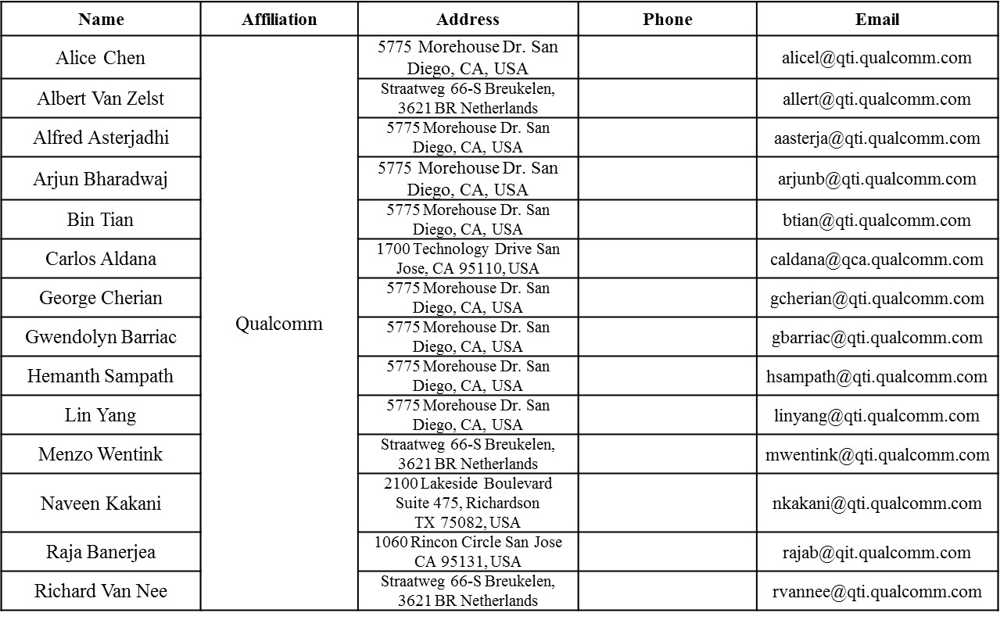
Authors (continued)

Slide 4
Authors (continued)
Name | Affiliation | Address | Phone | Email
James Yee | Mediatek | No. 1 Dusing 1st Road, Hsinchu, Taiwan | +886-3-567-0766 | james.yee@mediatek.com
Alan Jauh |  |  |  | alan.jauh@mediatek.com
Frank Hsu |  |  |  | frank.hsu@mediatek.com
Thomas Pare | Mediatek USA | 2860 Junction Ave, San Jose, CA 95134, USA | +1-408-526-1899 | thomas.pare@mediatek.com
ChaoChun Wang |  |  |  | chaochun.wang@mediatek.com
James Wang |  |  |  | james.wang@mediatek.com
Jianhan Liu |  |  |  | Jianhan.Liu@mediatek.com
Tianyu Wu |  |  |  | tianyu.wu@mediatek.com
Russell Huang |  |  |  | russell.huang@mediatek.com
Brian Hart | Cisco Systems | 170 W Tasman Dr, San Jose, CA 95134 |  | brianh@cisco.com
Pooya Monajemi |  |  |  | pmonajem@cisco.com
Joonsuk Kim | Apple |  |  | joonsuk@apple.com
Aon Mujtaba |  |  |  | mujtaba@apple.com
Guoqing Li |  |  |  | guoqing_li@apple.com
Eric Wong |  |  |  | ericwong@apple.com
Chris Hartman |  |  |  | chartman@apple.com

Slide 5
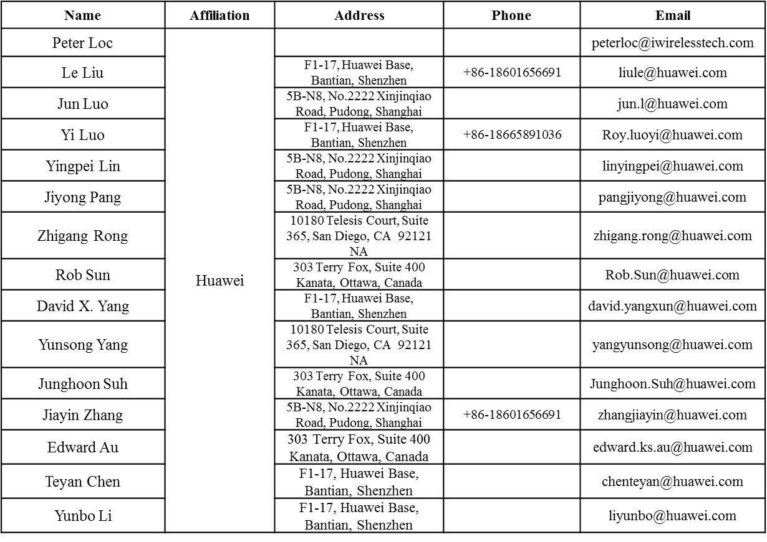
Authors (continued)

Slide 6
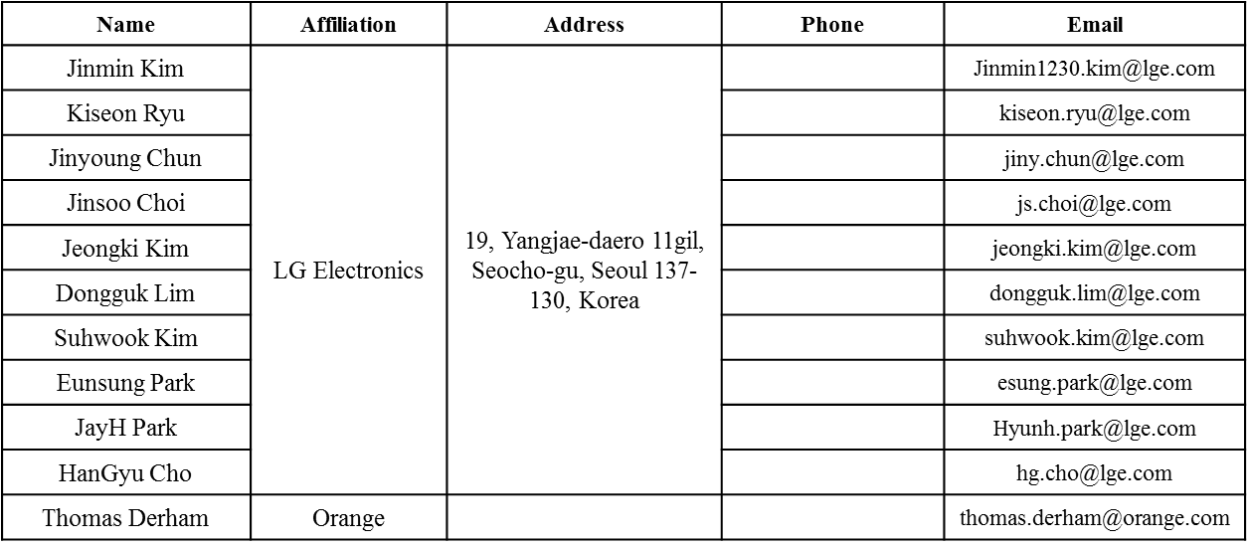
Authors (continued)
Bo SunBo Sun | ZTE | #9 Wuxing duan, Xifeng Rd, Xi’an, China |  | SubSub.bo1@zte.com.cn
Kaiying Lv |  |  |  | lv.kaiying@zte.com.cn
Yonggang Fang |  |  |  | yfang@ztetx.com
Ke Yao |  |  |  | Yao.ke5@zte.com.cn
Weimin Xing |  |  |  | Xing.weimin@zte.com.cn

Slide 7
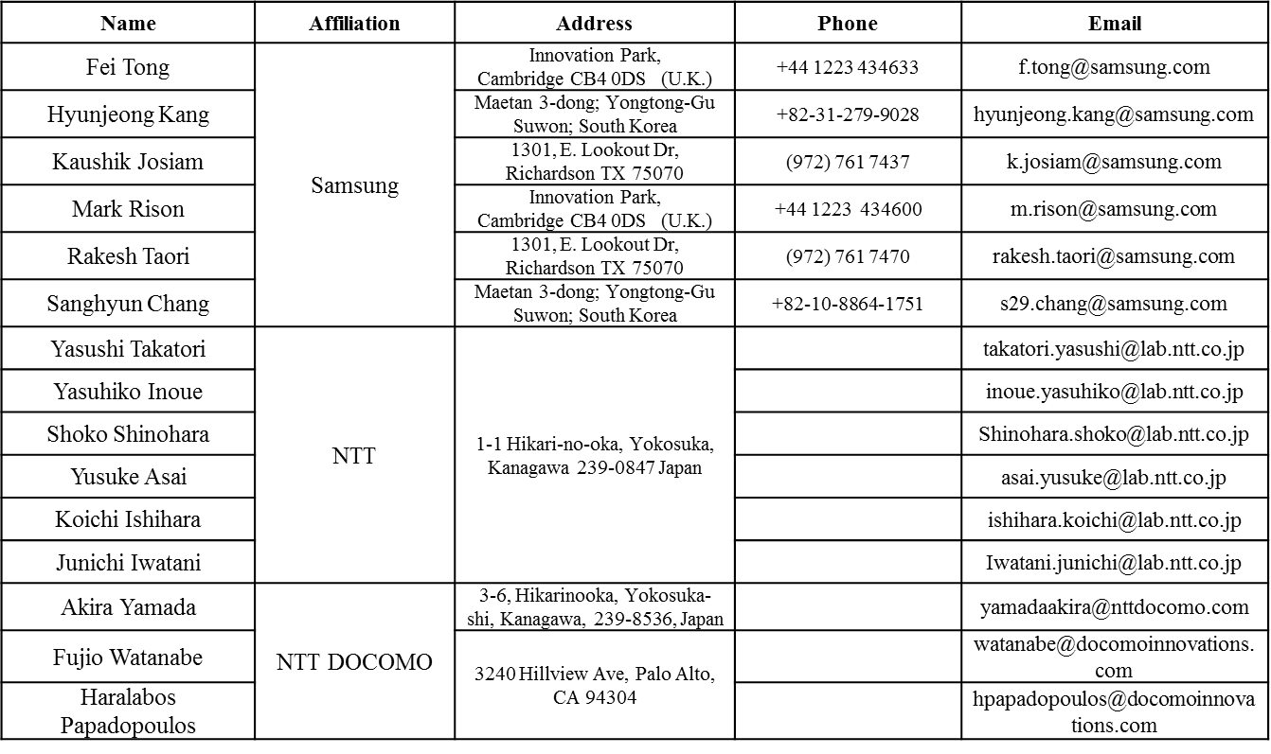
Authors (continued)

Slide 8
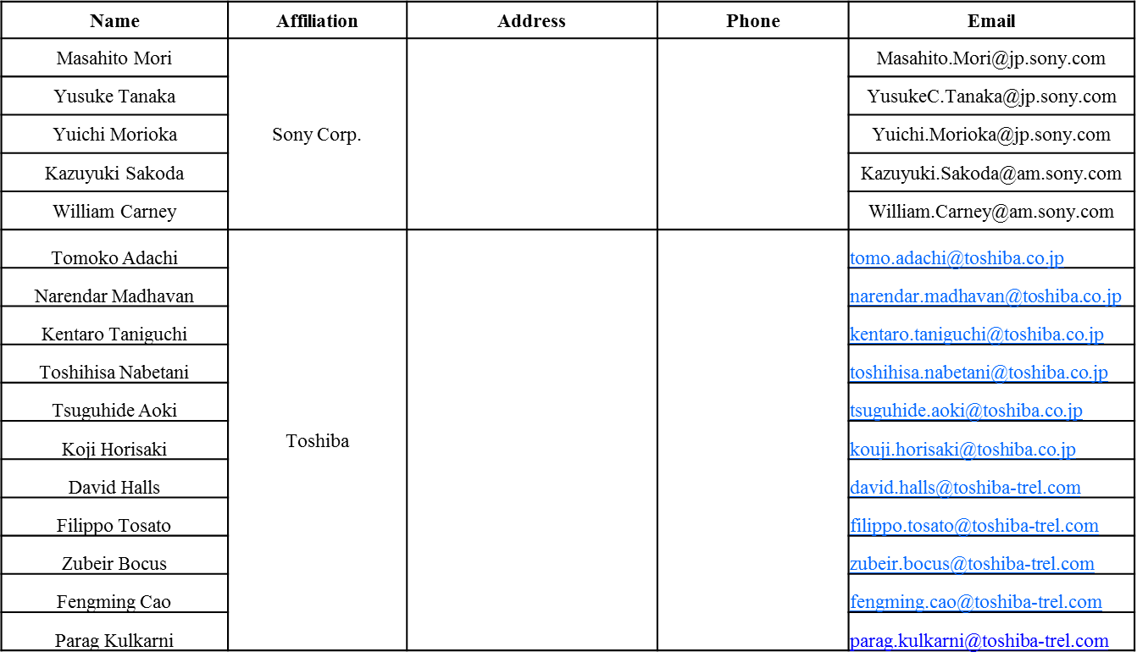
Authors (continued)

Slide 9
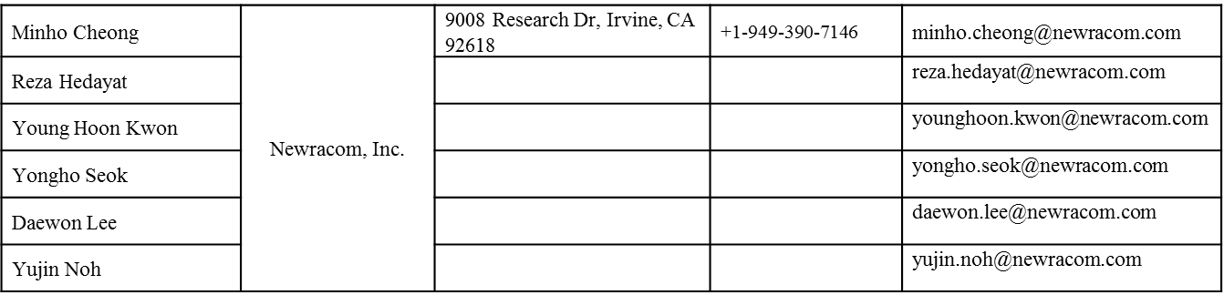
Authors (continued)

Slide 10
Recap of Beamforming Feedback
In 11ac, a VHT beamformee may not be able to transmit the beamforming feedback in one frame because of the maximal MPDU length restriction of the VHT beamformer.
  The STA only needs to do fragmentation in this case.
In 11ax, UL MU (UL OFDMA, UL MU MIMO) can be used for BF feedback transmission.
VHT NDPA
BF Feedback MPDU
BFee has the flexibility to select the PPDU length, MCS.
NDP
SIFS
SIFS
VHT NDPA
BFee has the flexibility to select the PPDU length, MCS.
NDP
BF Feedback A-MPDU
SIFS
SIFS
BF Feedback fragment 1
…...
BF Feedback fragment n
DL
DL
DL
UL OFDMA
DL
UL OFDMA
HE NDPA
BF Feedback
BF Feedback
Trigger
BF Feedback
Trigger
BF Feedback
HE NDPA
NDP
BF Feedback
BF Feedback
Trigger
BF Feedback
Trigger
BF Feedback
SIFS
IFS
SIFS

Slide 11
HE BF FB Fragmentation Discussion
There are two options about BF feedback consideration:
  Option 1: The HE beamformer shall have the supported MPDU size large enough to avoid fragmentation except when 11,454 is reached.
  Option 2: the HE beamformer may have supported maximal MPDU size without considering the maximal beamforming(BF) feedback(FB) size.
We prefer Option 1. However, the fragmentation is still not avoidable for some HE devices, e.g. red items in the following table:
  The maximal MPDU length of 11ax spec is same as 11ac spec, e.g. 11,454 since 11,454 is restricted by 4-byte FCS capacity.
  The BF FB may be longer than 11,454.
SM Size | # of Angles | Codebook Size | # of SNRs | 80 NG =4 | 160NG =4
4x3 | 12 | 10 | 3 | 1873.5 | 3711
4x4 | 12 | 10 | 4 | 1874.5 | 3712
6x4 | 28 | 10 | 4 | 4319.5 | 8607
8x3 | 36 | 10 | 3 | 5543.5 | 11056
8x4 | 44 | 10 | 4 | 6769.5 | 13507
8X6 | 54 | 10 | 6 | 8302.75 | 16571.5
SM Size | # of Angles | Codebook Size | # of SNRs | 80 NG =4 | 160NG =4
4x3 | 12 | 6 | 3 | 1138.5 | 2241
4x4 | 12 | 6 | 4 | 1139.5 | 2242
6x4 | 28 | 6 | 4 | 2609.5 | 5182
8x3 | 36 | 10 | 3 | 3338.5 | 6646
8x4 | 44 | 6 | 4 | 4074.5 | 8117
8X6 | 54 | 6 | 6 | 4995.25 | 9956.5
SU Codebook (6, 4)
SU Codebook (4, 2)
SM Size | # of Angles | Codebook Size | # of SNRs | 80 NG =4 | 160NG =4
4x3 | 12 | 16 | 3 | 3157 | 6278.5
4x4 | 12 | 16 | 4 | 3220 | 6402
6x3 | 24 | 16 | 3 | 6097 | 12158.5
6x4 | 28 | 16 | 4 | 7140 | 14242
8x2 | 26 | 16 | 2 | 6524 | 13015
8x3 | 36 | 16 | 3 | 9037 | 18038.5
SM Size | # of Angles | Codebook Size | # of SNRs | 80 NG =4 | 160NG =4
4x3 | 12 | 12 | 3 | 2422 | 4808.5
4x4 | 12 | 12 | 4 | 2485 | 4932
6x4 | 28 | 12 | 4 | 5425 | 10812
8X4 | 44 | 12 | 4 | 8365 | 16692
MU Codebook (7, 5)
MU Codebook (9, 7)

Slide 12



Trigger for Beamforming Report Poll
As in 11ac, a HE STA may not be able to transmit the beamforming feedback in one frame because of the maximal MPDU length restriction of 11454 bytes. The STA needs to do fragmentation in this case
  11ac’s fragmentation procedure for beamforming feedback can be used here.
Trigger for HE Beamforming Report Poll is the extension basic trigger frame.
  Trigger Type is Beamforming Report Poll.
When the Trigger Type is Beamforming Report Poll, Per User Info field includes 8-bit Feedback Segment Retransmission Bitmap subfield.
RA
Common Info
Per User Info 1
………..
Per User Info n
DL
DL
DL
UL OFDMA
DL
UL OFDMA
HE NDPA
BF Feedback
BF Feedback
Trigger
BF Feedback
Trigger
BF Feedback
HE NDPA
NDP
BF Feedback
BF Feedback
Trigger
BF Feedback
Trigger
BF Feedback
SIFS
IFS
SIFS
Liwen Chu, Marvell, et. al.

Slide 13
Straw Poll 1
Do you support to add the following text in 11ax SFD:
  The HE beamformer shall have the supported MPDU size large enough to avoid fragmentation except when 11,454 is reached?

Slide 14
Straw Poll 2
Do you support to add the following text in 11ax SFD:
  The BRP variant of the Trigger frame includes 8-bit Feedback Segment Retransmission Bitmap in Per STA Info?

