Slide 1
MU Minimum MPDU Start Spacing
Date: 2016-05-16
Authors:
Name | Affiliation | Address | Phone | Email
Liwen Chu | Marvell | 5488 Marvell Lane, Santa Clara, CA, 95054 | 408-222-2500 | liwenchu@marvell.com
Lei Wang |  |  |  | Leileiw@marvell.com
Hongyuan Zhang |  |  |  | hongyuan@marvell.com
Jinjing Jiang |  |  |  | jinjing@marvell.com
Yan Zhang |  |  |  | yzhang@marvell.com
Rui Cao |  |  |  | ruicao@marvell.com
Sudhir Srinivasa |  |  |  | sudhirs@marvell.com
Bo Yu |  |  |  | boyu@marvell.com
Saga Tamhane |  |  |  | sagar@marvell.com
Mao Yu |  |  |  | my@marvel..com
Xiayu Zheng |  |  |  | xzheng@marvell.com
Christian Berger |  |  |  | crberger@marvell.com
Niranjan Grandhe |  |  |  | ngrandhe@marvell.com
Hui-Ling Lou |  |  |  | hlou@marvell.com

Slide 2
Authors (continued)
Name | Affiliation | Address | Phone | Email
Ron Porat | Broadcom |  |  | rporat@broadcom.com
Matthew Fischer |  |  |  | mfischer@broadcom.com
Sriram Venkateswaran
Zhou Lan
Leo Montreuil
Andrew Blanksby
Vinko Erceg
Robert Stacey | Intel | 2111 NE 25th Ave, Hillsboro OR 97124, USA | +1-503-724-893 | robert.stacey@intel.com
Eldad Perahia |  |  |  | eldad.perahia@intel.com
Shahrnaz Azizi |  |  |  | shahrnaz.azizi@intel.com
Po-Kai Huang |  |  |  | po-kai.huang@intel.com
Qinghua Li |  |  |  | quinghua.li@intel.com
Xiaogang Chen |  |  |  | xiaogang.c.chen@intel.com
Chitto Ghosh |  |  |  | chittabrata.ghosh@intel.com
Rongzhen Yang |  |  |  | rongzhen.yang@intel.com
Laurent cariou |  |  |  | laurent.cariou@intel.com

Slide 3
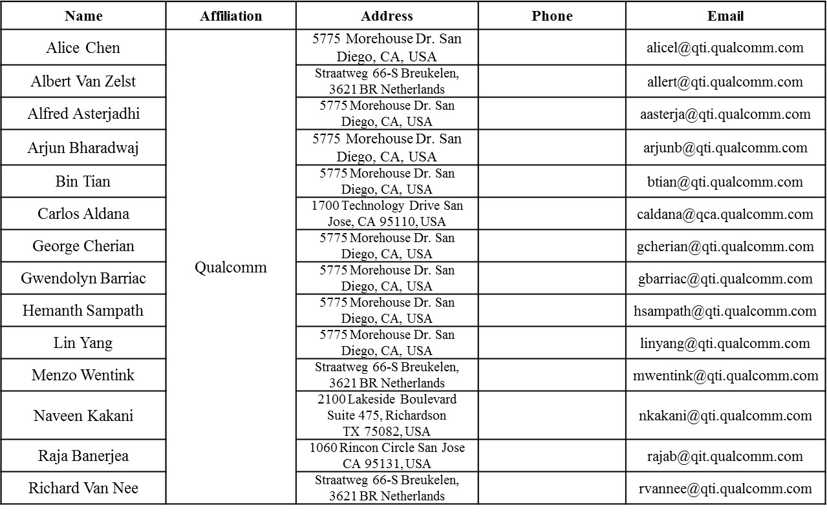
Authors (continued)

Slide 4
Authors (continued)
Name | Affiliation | Address | Phone | Email
James Yee | Mediatek | No. 1 Dusing 1st Road, Hsinchu, Taiwan | +886-3-567-0766 | james.yee@mediatek.com
Alan Jauh |  |  |  | alan.jauh@mediatek.com
Frank Hsu |  |  |  | frank.hsu@mediatek.com
Thomas Pare | Mediatek USA | 2860 Junction Ave, San Jose, CA 95134, USA | +1-408-526-1899 | thomas.pare@mediatek.com
ChaoChun Wang |  |  |  | chaochun.wang@mediatek.com
James Wang |  |  |  | james.wang@mediatek.com
Jianhan Liu |  |  |  | Jianhan.Liu@mediatek.com
Tianyu Wu |  |  |  | tianyu.wu@mediatek.com
Russell Huang |  |  |  | russell.huang@mediatek.com
Brian Hart | Cisco Systems | 170 W Tasman Dr, San Jose, CA 95134 |  | brianh@cisco.com
Pooya Monajemi |  |  |  | pmonajem@cisco.com
Joonsuk Kim | Apple |  |  | joonsuk@apple.com
Aon Mujtaba |  |  |  | mujtaba@apple.com
Guoqing Li |  |  |  | guoqing_li@apple.com
Eric Wong |  |  |  | ericwong@apple.com
Chris Hartman |  |  |  | chartman@apple.com

Slide 5
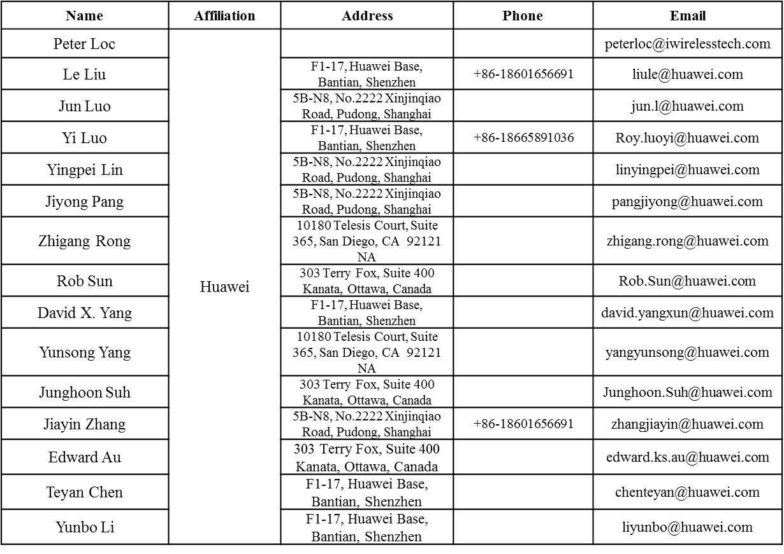
Authors (continued)

Slide 6
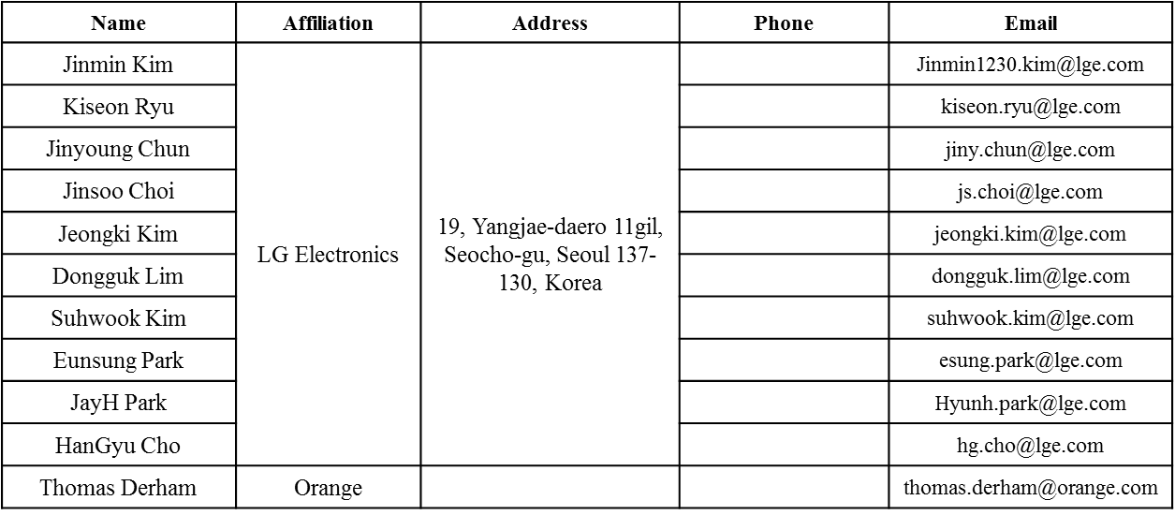
Authors (continued)
Bo SunBo Sun | ZTE | #9 Wuxing duan, Xifeng Rd, Xi’an, China |  | SubSub.bo1@zte.com.cn
Kaiying Lv |  |  |  | lv.kaiying@zte.com.cn
Yonggang Fang |  |  |  | yfang@ztetx.com
Ke Yao |  |  |  | Yao.ke5@zte.com.cn
Weimin Xing |  |  |  | Xing.weimin@zte.com.cn

Slide 7
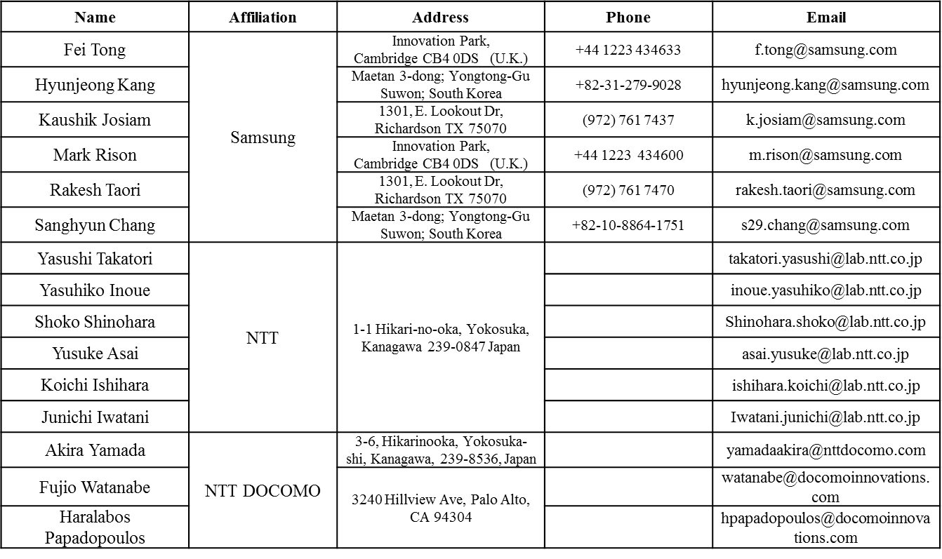
Authors (continued)

Slide 8
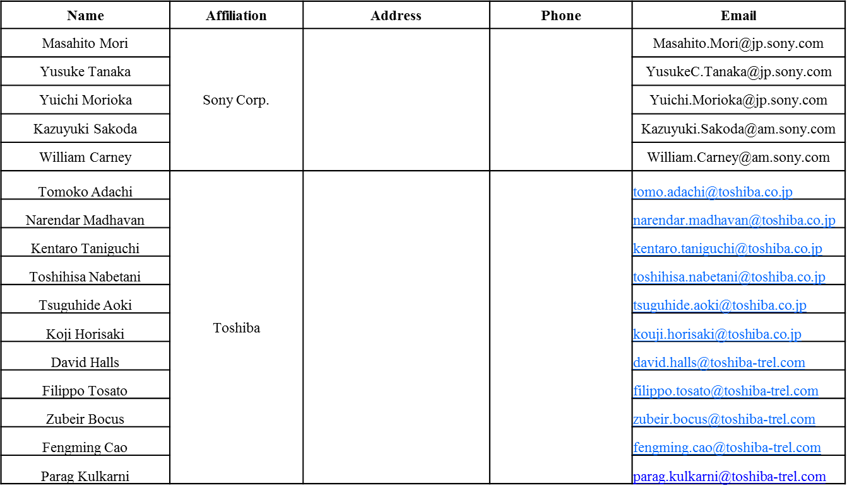
Authors (continued)

Slide 9
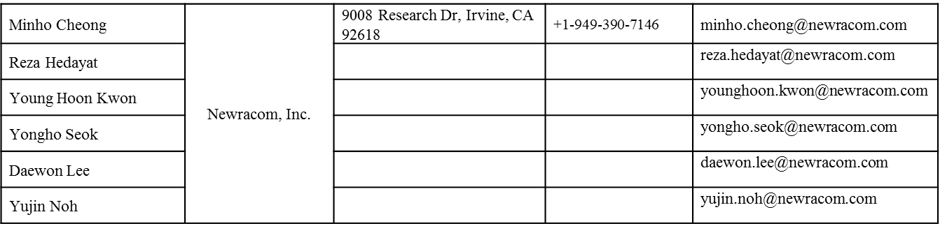
Authors (continued)

Slide 10
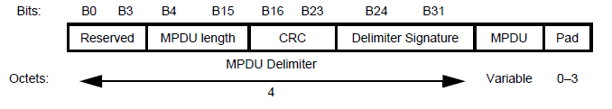
Recap of Minimum MPDU Start Spacing
  Minimum MPDU Start Spacing defines the minimum time between the start of adjacent MPDUs (MPDU density) within an AMPDU that the STA can receive, measured at the PHY-SAP.
    This restriction is because of the processing capacity of the receiver, not because of the channel/Nss/MCS capacity.
    If necessary, in order to satisfy this requirement, a STA shall add padding between MPDUs in an A-MPDU.
Minimum MPDU Start Spacing = 2us
MPDU Delimiter
MPDU
MPDU Delimiter
MPDU Delimiter
MPDU
MPDU Delimiter
MPDU
Liwen Chu, Marvell, et. al.

Slide 11
Recap of MU Transmission
DL MU transmission will not increase the MPDU density of A-MPDU in A-MPDU receiver.
UL MU transmission may increase the MPDU density of A-MPDUs that the AP can’t process, e.g.
  AP supports 2us Minimum MPDU Start Spacing but with MU transmission, the accumulated minimum MPDU spacing is 1us (2 STAs have 2us minimum MPDU Start spacing @ 160MHz, 4SS, MCS8 and AP schedule 8x8 UL MU MIMO for 2 STAs with each STA’s transmission @ 160MHz, 4SS, MCS8).
DL OFDMA
UL OFDMA
A-MPDU
BA
A-MPDU
BA
Each STA receives/decodes one A-MPDU.
A-MPDU
BA
A-MPDU
BA
>2 MPDUs need to processed within 2us.
UL OFDMA
DL OFDMA
Minimum MPDU Start Spacing = 2us
Trigger
A-MPDU1
BA
A-MPDU1
MPDU Delimiter
MPDU
MPDU Delimiter
MPDU Delimiter
MPDU
A-MPDU2
BA
Minimum MPDU Start Spacing = 2us
AP receives/decodes all A-MPDUs from multiple STAs.
Trigger
A-MPDU3
BA
A-MPDU2
MPDU Delimiter
MPDU
MPDU Delimiter
MPDU Delimiter
MPDU
A-MPDU4
BA
Liwen Chu, Marvell, et. al.

Slide 12
Discussion: MU MPDU Spacing Factor
Per the discussion, an AP should define MU minimum MPDU start spacing for UL MU transmission in addition to Minimum MPDU Start Spacing and UL SU transmission.
MU minimum MPDU start spacing shouldn’t be put in HE Capabilities element.
  Different UL MU transmissions have different number of users that are solicited by the Trigger frames.
  Different UL MU transmissions have different bandwidth.
  Different MU transmission methods are used in different UL transmission, e.g. ML MU MIMO, UL OFDMA.
  It is better to put MU minimum MPDU start spacing in Trigger frame.
In a UL MU transmission, RUs for different STAs may have different bandwidth etc.
  Different users should have different MU minimum MPDU start spacing.
  It is better to put MU minimum MPDU start spacing in Per User Info field.
MU Minimum MPDU Start Spacing is only useful for UL A-MPDU with data frames. So MU Minimum MPDU Start Spacing should only be in basic variant of trigger frame.
Liwen Chu, Marvell, et. al.

Slide 13

Proposal: MU MPDU Spacing Factor
A two-bit MPDU MU Spacing Factor is added to the end of Per User Info field in the basic variant of trigger frame.
  A STA uses Minimum MPDU Start Spacing(in AP’s HT Capabilities element) * (MPDU MU Spacing Factor +1) as the MU minimum MPDU start space in UL MU transmission.
Broadcast Trigger with MU MPDU Spacing Factor
MPDU MU Spacing Factor
12
Unicast Trigger with MU MPDU Spacing Factor
FCS
4
Liwen Chu, Marvell, et. al.

Slide 14
Straw Poll
  Do you support to add the following text to 11ax SFD?
    Trigger frame includes a two-bits MPDU MU Spacing Factor subfield in type dependent subfield of the per-User Info field in the basic variant of trigger frame?
Liwen Chu, Marvell, et. al.

