Slide 1
SS Allocation in Trigger Frame
Date: 2016-05-16
Authors:
Name | Affiliation | Address | Phone | Email
Liwen Chu | Marvell | 5488 Marvell Lane, Santa Clara, CA, 95054 | 408-222-2500 | liwenchu@marvell.com
Lei Wang |  |  |  | Leileiw@marvell.com
Hongyuan Zhang |  |  |  | hongyuan@marvell.com
Jinjing Jiang |  |  |  | jinjing@marvell.com
Yan Zhang |  |  |  | yzhang@marvell.com
Rui Cao |  |  |  | ruicao@marvell.com
Sudhir Srinivasa |  |  |  | sudhirs@marvell.com
Bo Yu |  |  |  | boyu@marvell.com
Saga Tamhane |  |  |  | sagar@marvell.com
Mao Yu |  |  |  | my@marvel..com
Xiayu Zheng |  |  |  | xzheng@marvell.com
Christian Berger |  |  |  | crberger@marvell.com
Niranjan Grandhe |  |  |  | ngrandhe@marvell.com
Hui-Ling Lou |  |  |  | hlou@marvell.com

Slide 2
Authors (continued)
Name | Affiliation | Address | Phone | Email
Ron Porat | Broadcom |  |  | rporat@broadcom.com
Matthew Fischer |  |  |  | mfischer@broadcom.com
Sriram Venkateswaran
Zhou Lan
Leo Montreuil
Andrew Blanksby
Vinko Erceg
Robert Stacey | Intel | 2111 NE 25th Ave, Hillsboro OR 97124, USA | +1-503-724-893 | robert.stacey@intel.com
Eldad Perahia |  |  |  | eldad.perahia@intel.com
Shahrnaz Azizi |  |  |  | shahrnaz.azizi@intel.com
Po-Kai Huang |  |  |  | po-kai.huang@intel.com
Qinghua Li |  |  |  | quinghua.li@intel.com
Xiaogang Chen |  |  |  | xiaogang.c.chen@intel.com
Chitto Ghosh |  |  |  | chittabrata.ghosh@intel.com
Rongzhen Yang |  |  |  | rongzhen.yang@intel.com
Laurent cariou |  |  |  | laurent.cariou@intel.com

Slide 3
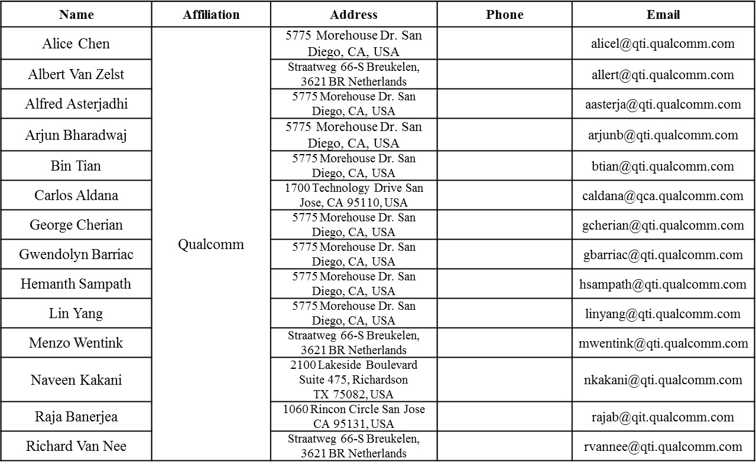
Authors (continued)

Slide 4
Authors (continued)
Name | Affiliation | Address | Phone | Email
James Yee | Mediatek | No. 1 Dusing 1st Road, Hsinchu, Taiwan | +886-3-567-0766 | james.yee@mediatek.com
Alan Jauh |  |  |  | alan.jauh@mediatek.com
Frank Hsu |  |  |  | frank.hsu@mediatek.com
Thomas Pare | Mediatek USA | 2860 Junction Ave, San Jose, CA 95134, USA | +1-408-526-1899 | thomas.pare@mediatek.com
ChaoChun Wang |  |  |  | chaochun.wang@mediatek.com
James Wang |  |  |  | james.wang@mediatek.com
Jianhan Liu |  |  |  | Jianhan.Liu@mediatek.com
Tianyu Wu |  |  |  | tianyu.wu@mediatek.com
Russell Huang |  |  |  | russell.huang@mediatek.com
Brian Hart | Cisco Systems | 170 W Tasman Dr, San Jose, CA 95134 |  | brianh@cisco.com
Pooya Monajemi |  |  |  | pmonajem@cisco.com
Joonsuk Kim | Apple |  |  | joonsuk@apple.com
Aon Mujtaba |  |  |  | mujtaba@apple.com
Guoqing Li |  |  |  | guoqing_li@apple.com
Eric Wong |  |  |  | ericwong@apple.com
Chris Hartman |  |  |  | chartman@apple.com

Slide 5
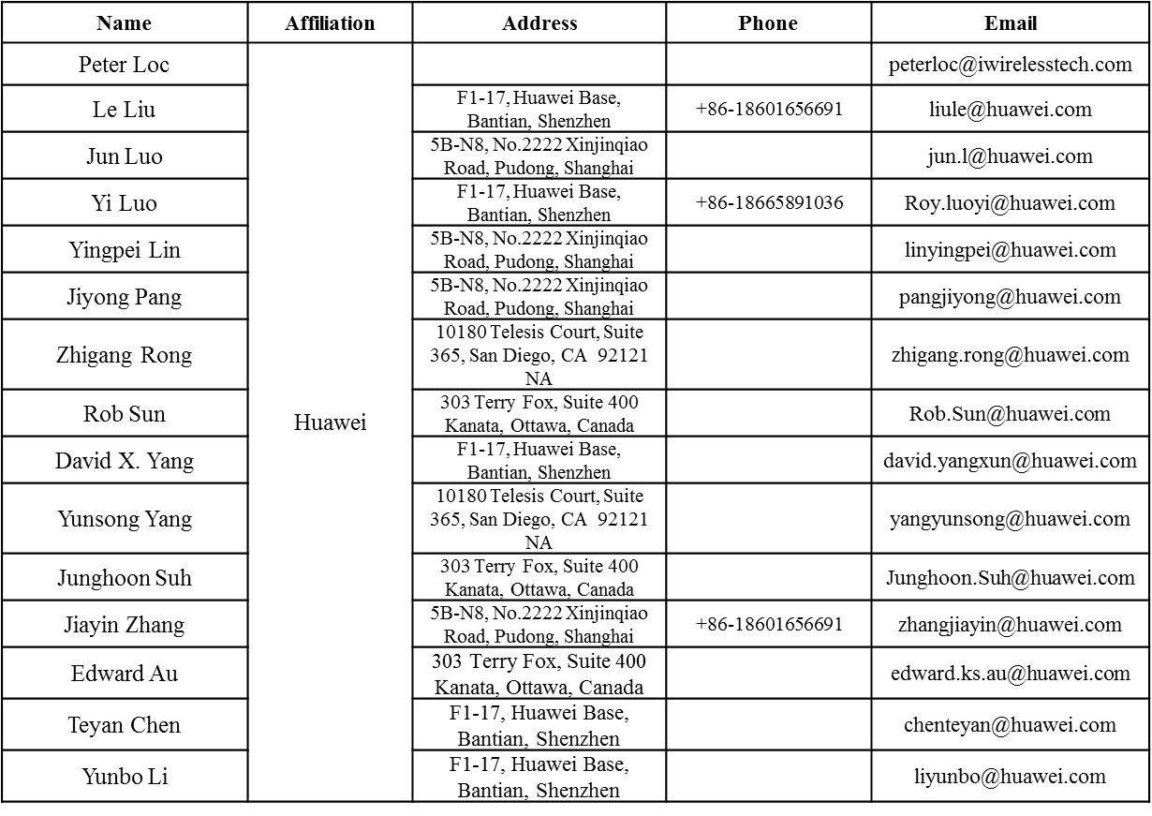
Authors (continued)

Slide 6
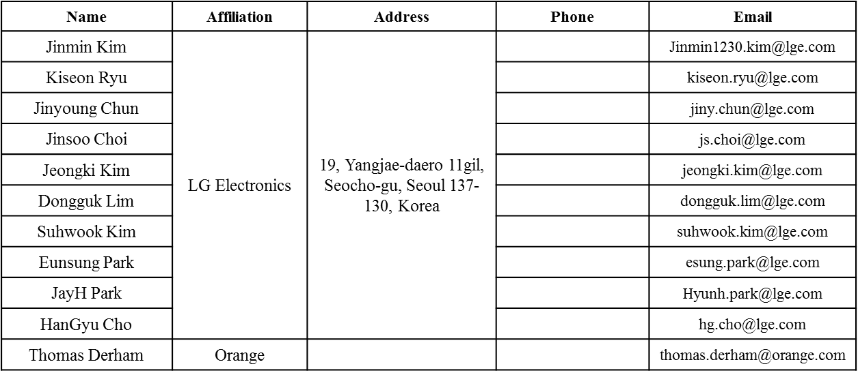
Authors (continued)
Bo SunBo Sun | ZTE | #9 Wuxing duan, Xifeng Rd, Xi’an, China |  | SubSub.bo1@zte.com.cn
Kaiying Lv |  |  |  | lv.kaiying@zte.com.cn
Yonggang Fang |  |  |  | yfang@ztetx.com
Ke Yao |  |  |  | Yao.ke5@zte.com.cn
Weimin Xing |  |  |  | Xing.weimin@zte.com.cn

Slide 7
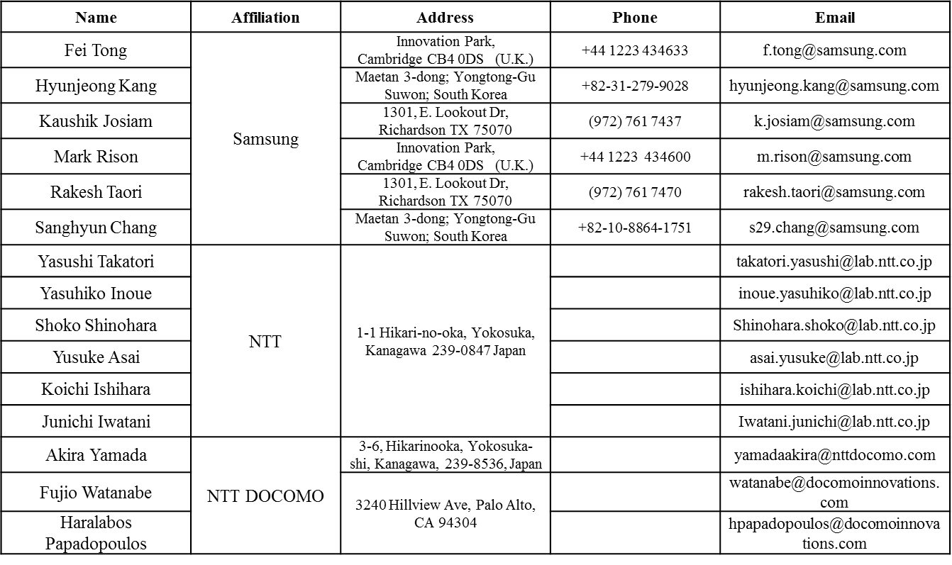
Authors (continued)

Slide 8
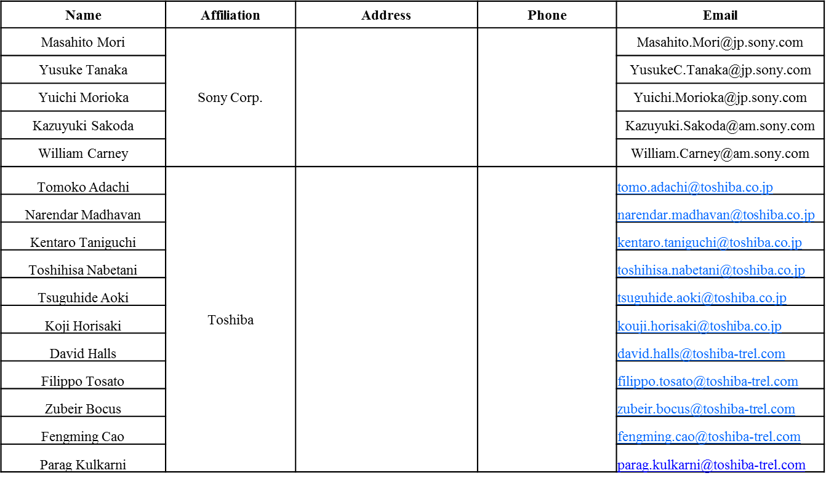
Authors (continued)

Slide 9
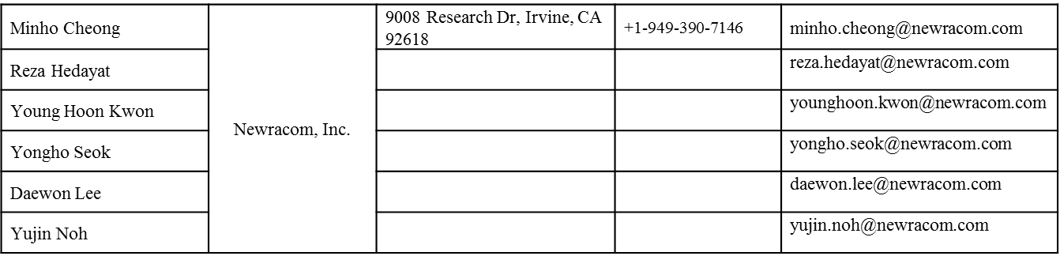
Authors (continued)

Slide 10

Recap of Trigger Frame
  Unicast and broadcast Trigger can trigger UL MU transmission.
Broadcast Trigger
FCS
Unicast Trigger
4

Slide 11
SS Allocation in HE SIG-B
  SS allocation in SIG-B is not suitable for Trigger frame since one STA may only can decode the trigger information for itself.
Nuser | B0…B3 | Nsts[1] | Nsts[2] | Nsts[3] | Nsts[4] | Nsts[5] | Nsts[6] | Nsts[7] | Nsts[8] | Number of Entries
2 | 0000~0011 | 1~4 | 1 |  |  |  |  |  |  | 10
 | 0100~0110 | 2~4 | 2
 | 0111~1000 | 3~4 | 3
 | 1001 | 4 | 4
3 | 0000~0011 | 1~4 | 1 | 1 |  |  |  |  |  | 13
 | 0100~0110 | 2~4 | 2 | 1
 | 0111~1000 | 3~4 | 3 | 1
 | 1001~1011 | 2~4 | 2 | 2
 | 1100 | 3 | 3 | 2
4 | 0000~0011 | 1~4 | 1 | 1 | 1 |  |  |  |  | 11
 | 0100~0110 | 2~4 | 2 | 1 | 1
 | 0111 | 3 | 3 | 1 | 1
 | 1000~1001 | 2~3 | 2 | 2 | 1
 | 1010 | 2 | 2 | 2 | 2
5 | 0000~0011 | 1~4 | 1 | 1 | 1 | 1 |  |  |  | 6
 | 0100~0101 | 2~3 | 2 | 1 | 1 | 1
6 | 0000~0010 | 1~3 | 1 | 1 | 1 | 1 | 1 |  |  | 4
 | 0011 | 2 | 2 | 1 | 1 | 1 | 1
7 | 0000~0001 | 1~2 | 1 | 1 | 1 | 1 | 1 | 1 |  | 2
8 | 0000 | 1 | 1 | 1 | 1 | 1 | 1 | 1 | 1 | 1

Slide 12
SS Allocation Discussion
  Since each STA can only decode its own SS information, SS Allocation in Per User Info field is defined by Starting Spatial Stream (3 bits) and Spatial Stream Number (3 bits) .
  In broadcast Trigger frame, two options exist for SS allocation:
    Option 1: SS allocation in Per User Info of broadcast Trigger is same as SS allocation in Per User Info of unicast Trigger.
    Option 2: SS allocation indicate the spatial stream number (3 bits).
    We prefer option 1.

Slide 13
Straw Poll 1
  Do you support to add the following text in 11ax SFD?
    SS Allocation in Per User Info field is defined by Starting Spatial Stream (3 bits) and Spatial Stream Number (3 bits)

