Slide 1
UL MU Response Scheduling
Date: 2016-05-16
Authors:
Name | Affiliation | Address | Phone | Email
Liwen Chu | Marvell | 5488 Marvell Lane, Santa Clara, CA, 95054 | 408-222-2500 | liwenchu@marvell.com
Lei Wang |  |  |  | Leileiw@marvell.com
Hongyuan Zhang |  |  |  | hongyuan@marvell.com
Jinjing Jiang |  |  |  | jinjing@marvell.com
Yan Zhang |  |  |  | yzhang@marvell.com
Rui Cao |  |  |  | ruicao@marvell.com
Sudhir Srinivasa |  |  |  | sudhirs@marvell.com
Bo Yu |  |  |  | boyu@marvell.com
Saga Tamhane |  |  |  | sagar@marvell.com
Mao Yu |  |  |  | my@marvel..com
Xiayu Zheng |  |  |  | xzheng@marvell.com
Christian Berger |  |  |  | crberger@marvell.com
Niranjan Grandhe |  |  |  | ngrandhe@marvell.com
Hui-Ling Lou |  |  |  | hlou@marvell.com

Slide 2
Authors (continued)
Name | Affiliation | Address | Phone | Email
Ron Porat | Broadcom |  |  | rporat@broadcom.com
Matthew Fischer |  |  |  | mfischer@broadcom.com
Sriram Venkateswaran
Zhou Lan
Leo Montreuil
Andrew Blanksby
Vinko Erceg
Robert Stacey | Intel | 2111 NE 25th Ave, Hillsboro OR 97124, USA | +1-503-724-893 | robert.stacey@intel.com
Eldad Perahia |  |  |  | eldad.perahia@intel.com
Shahrnaz Azizi |  |  |  | shahrnaz.azizi@intel.com
Po-Kai Huang |  |  |  | po-kai.huang@intel.com
Qinghua Li |  |  |  | quinghua.li@intel.com
Xiaogang Chen |  |  |  | xiaogang.c.chen@intel.com
Chitto Ghosh |  |  |  | chittabrata.ghosh@intel.com
Rongzhen Yang |  |  |  | rongzhen.yang@intel.com
Laurent cariou |  |  |  | laurent.cariou@intel.com

Slide 3
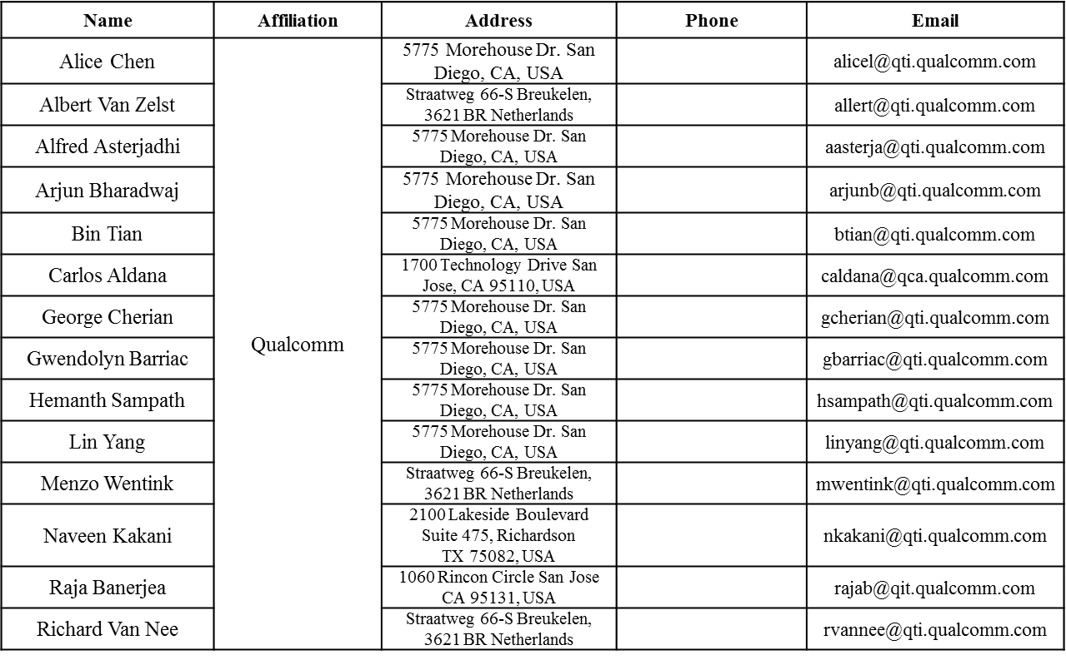
Authors (continued)

Slide 4
Authors (continued)
Name | Affiliation | Address | Phone | Email
James Yee | Mediatek | No. 1 Dusing 1st Road, Hsinchu, Taiwan | +886-3-567-0766 | james.yee@mediatek.com
Alan Jauh |  |  |  | alan.jauh@mediatek.com
Frank Hsu |  |  |  | frank.hsu@mediatek.com
Thomas Pare | Mediatek USA | 2860 Junction Ave, San Jose, CA 95134, USA | +1-408-526-1899 | thomas.pare@mediatek.com
ChaoChun Wang |  |  |  | chaochun.wang@mediatek.com
James Wang |  |  |  | james.wang@mediatek.com
Jianhan Liu |  |  |  | Jianhan.Liu@mediatek.com
Tianyu Wu |  |  |  | tianyu.wu@mediatek.com
Russell Huang |  |  |  | russell.huang@mediatek.com
Brian Hart | Cisco Systems | 170 W Tasman Dr, San Jose, CA 95134 |  | brianh@cisco.com
Pooya Monajemi |  |  |  | pmonajem@cisco.com
Joonsuk Kim | Apple |  |  | joonsuk@apple.com
Aon Mujtaba |  |  |  | mujtaba@apple.com
Guoqing Li |  |  |  | guoqing_li@apple.com
Eric Wong |  |  |  | ericwong@apple.com
Chris Hartman |  |  |  | chartman@apple.com

Slide 5
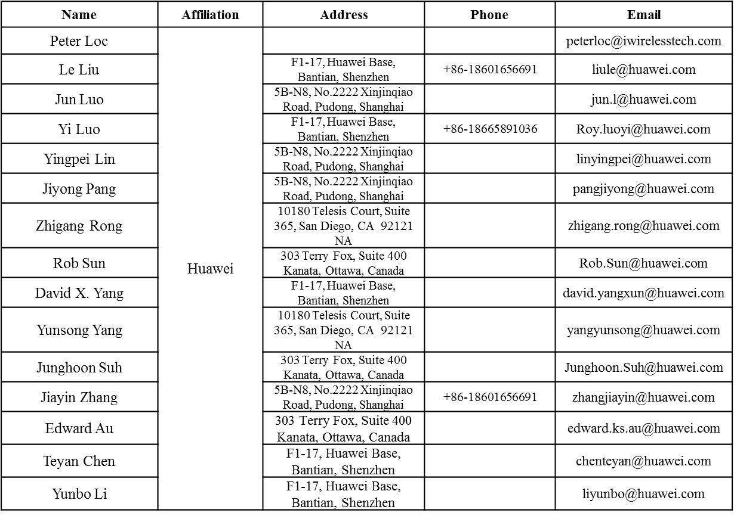
Authors (continued)

Slide 6
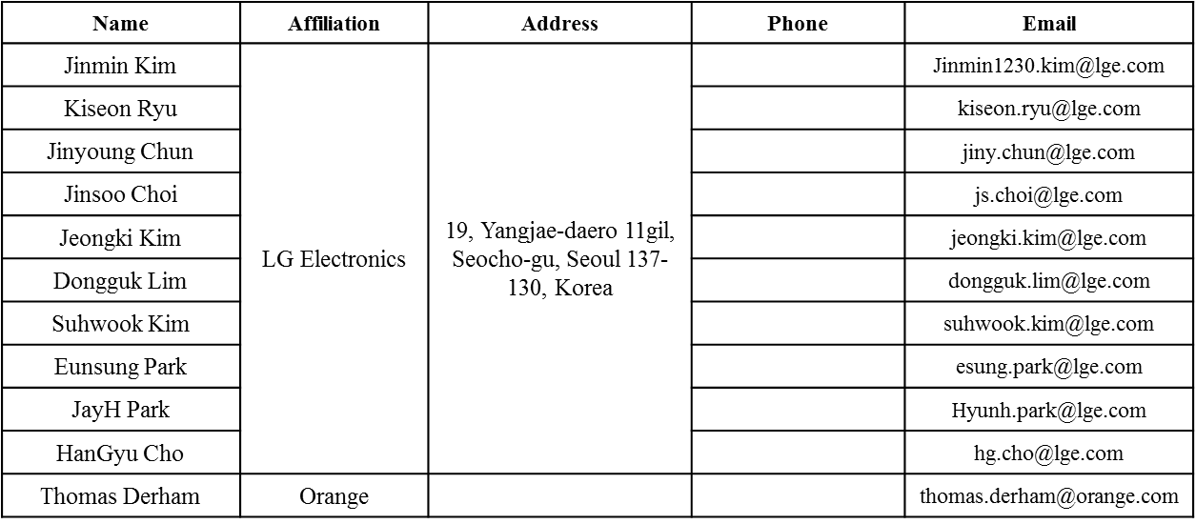
Authors (continued)
Bo SunBo Sun | ZTE | #9 Wuxing duan, Xifeng Rd, Xi’an, China |  | SubSub.bo1@zte.com.cn
Kaiying Lv |  |  |  | lv.kaiying@zte.com.cn
Yonggang Fang |  |  |  | yfang@ztetx.com
Ke Yao |  |  |  | Yao.ke5@zte.com.cn
Weimin Xing |  |  |  | Xing.weimin@zte.com.cn

Slide 7
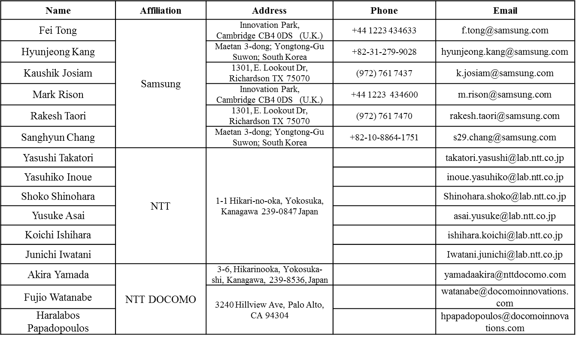
Authors (continued)

Slide 8
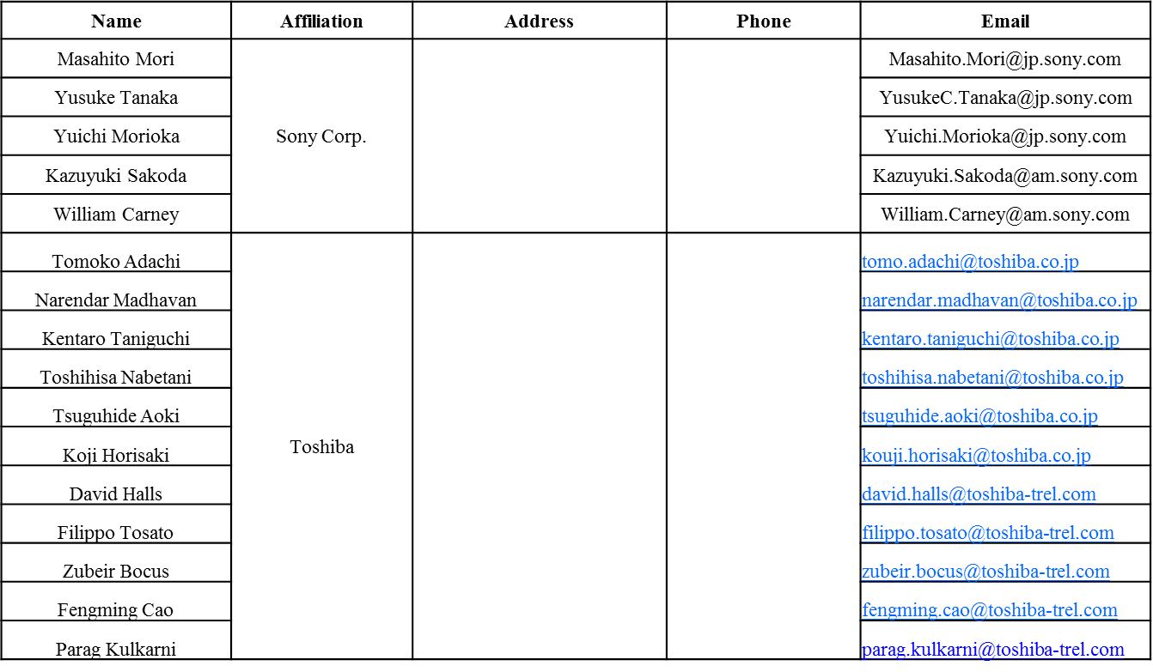
Authors (continued)

Slide 9
Authors (continued)

Slide 10
Recap of UL MU Response Scheduling
He Control field is variant of HT Control field.
Currently UL MU response scheduling is carried in HE variant HT Control field.
2-bit HE variant HT Control indication, 4-bit Control ID field, 9-bit UL PPDU Length field, RU Allocation TBD, TBD other field.
HE
Control
B0
B1
B2
……
B31
Control 1
Control N
Padding
HE Control Indication
Control ID
Control Information
4 bits
variable
Control ID
Control Information
4 bits
UL PPDU Length
RU Allocation
TBD
9 bits
TBD

Slide 11
Analysis of UL PPDU Length
9-bit UL PPDU length can indicate as long as 512us with 1us granularity, 1024us with 2us granularity.
With indicating OFDMA symbols of the Data field, 6-bit UL PPDU length can indicates as long as 64*(12.8us+0.8us) + legacy PHY header length + length of HE SIG-A + HE LTF length > 870us, and 5-bit UL PPDU Length can indicates as long as 32*(12.8us+0.8us) + legacy PHY header length + length of HE SIG-A + HE LTF length>435.2us.
So 5-bit/6-bit UL PPDU field is enough.
Control ID
Control Information
4 bits
UL PPDU Length
RU Allocation
TBD
9 bits
TBD

Slide 12
Analysis of UL MU Acknowledgement Response
RU Allocation:
Option 1: Being same as RU Allocation in Trigger frame, e.g. 8-bit RU field,
Option 2: 7-bit RU where the DL MU transmission in one 80MHz channel will not be acknowledged by Ack/BA/M-BA in another 80MHz channel.
When the number of the users in one 80MHz are much larger than the number of the users in another 80MHz, e.g. 1 user vs 8 users, option 2 is not good. However Trigger frame can be used in this case.
Other optimization is not preferable.
20MHz
26
7 bits indices | Message | Number of entries
0000000 ~ 0100100 | Possible 26 RU cases in 80MHz | 37*
0100101 ~ 0110100 | Possible 52 RU cases in 80MHz | 16
0110101 ~ 0111100 | Possible 106 RU cases in 80MHz | 8
0111101 ~ 1000000 | Possible 242 RU cases in 80MHz | 4
1000001 ~ 1000010 | Possible 484 RU cases in 80MHz | 2
1000011 | Possible 996 RU cases in 80MHz | 1
52
106
242
484
996

Slide 13
Analysis of UL MU Acknowledgement Response
The UL MU response can be in UL OFDMA or MU MIMO:
Option 1: Spatial stream information should be defined for MU MIMO.
If one SS is only allowed in MU MIMO, start spatial stream (3 bits) is the only field.
Option 2: HE Control field doesn’t support UL MU MIMO acknowledgement response.
Option 3: HE Control field supports separate format of UL MU MIMO acknowledgement and UL OFDMA acknowledgement.
We prefer option 2 or 3.
TX power:
Recap: Trigger frame carries TX power of the trigger frame and target RX power of UL transmission from each STA.
each STA uses Trigger frame’s TX power to get path loss, and uses the path loss and target RX power to calculate the TX power.
The target RX power of the STA will be carried in HE A-Control field.
Path Loss
Option 1: The newest path loss from the AP calculated through received Trigger or Beacon will be used by the STA to calculate STA’s TX power.
Option 2: TX power of DL transmission is carried in HE A-Control field.
We prefer option 2.
In unit 2db, 5-bit TX Power filed and Target RX Power can describe 64db difference respectively.

Slide 14
Analysis of UL MU Acknowledgement Response (Cont’d)
MCS:
Option 1: each STA figures out the MCS of its UL MU transmission per DL MU MCS based on MCS selection rules, e.g. the maximal mandatory MCS which is less than the DL MU MCS.
Option 2: The most robust MCS that can fit in UL RU width, PPDU length.
This option may not work since AP may not be able to figure out the length of the responding acknowledgement frame when some MPDUs in the A-MPDU get lost: AP think M-BA includes 2-TID’s block ack and STA think one TID BA, AP thinks BA bitmap of a TID is 256 and STA thinks the bitmap of the TID is 64 etc.
Option 3: HE Control field indicates the MCS of UL acknowledgement.
We prefer option 3.
One SS is used for UL acknowledgement.
One HE LTF is used for UL MU acknowledgement.
The CP+LTF Type is TBD.
Fixed value or using one reserved bit to indicate two value
The other parameters for UL acknowledgement are same as DL MU transmission that solicits the UL acknowledgement or have some default value.
If those parameters of UL acknowledgement are different from the DL soliciting MU PPDU or default value, Trigger frame is used.

Slide 15
Proposal for UL MU response scheduling
Based on the analysis, HE A-Control field for UL acknowledgement through OFDMA (acknowledgement through MU MIMO and MUMIMO in OFDMA are not supported) is defined as following:
5-bit UL PPDU Length indicates OFDMA symbols of the Data field.
5-bit DL TX Power indicates the transmission power of the Trigger frame in unit of 2db.
5-bit Target UL RX Power indicates the target RX power in unit of 2db.
8-bit RU Allocation is same as Trigger frame.
2-bit MCS indicates the MCS of the UL acknowledgement, MCS 0 to 3.
One SS is used for UL acknowledgement
The STAs that are the receivers of HE A-Control don’t do CCA sensing before sending UL MU acknowledgement.
One HE LTF is used for UL acknowledgement
Spatial reuse is disallowed.
The CP+LTF Type is TBD.
The other missed parameters are same or derived from related parameters in DL MU transmission or some default value.
Control ID
Control Information
4 bits
UL PPDU Length
RU Allocation
DL TX Power
Target UL RX Power
MCS
Reserved
5 bits
8 bits
2 bits
1 bits
10 bits

Slide 16
Straw Poll 1
Do you support to add the following text to 11ax SFD:
The HE A-Control field for UL acknowledgement through OFDMA (acknowledgement through MU MIMO and MUMIMO in OFDMA are not supported) is defined as following:
5-bit UL PPDU Length indicates OFDMA symbols of the Data field.
5-bit DL TX Power indicates the transmission power of the Trigger frame in unit of 2db.
5-bit Target UL RX Power indicates the target RX power in unit of 2db.
8-bit RU Allocation which is same as Trigger frame.
2-bit MCS indicates the MCS of the UL acknowledgement, MCS 0 to 3.
One SS is used for UL acknowledgement
The STAs that are the receivers of HE A-Control don’t do CCA sensing before sending UL MU acknowledgement.
One HE LTF is used for UL acknowledgement
Spatial reuse is disallowed.
The CP+LTF Type is TBD.
The other missed parameters are same or derived from related parameters in DL MU transmission or some default value
Control ID
Control Information
4 bits
UL PPDU Length
RU Allocation
DL TX Power
Target UL RX Power
MCS
Reserved
5 bits
8 bits
2 bits
1bits
10 bits

Slide 17
Straw Poll 2
Do you support to add the following text to 11ax SFD?
HE A-Control field for UL acknowledgement is optional in RX

