Slide 1
Open Loop vs Closed Loop SU-MIMO for 11ay
Date: 2016-05-16
Authors:

Slide 2
Abstract
In this contribution we demonstrate potential benefit from using closed loop (or channel-dependent precoding) SU-MIMO via system level simulations with different antenna configurations and deployment scenarios.

Slide 3
Background
Open loop (OL) SU-MIMO is a viable MIMO scheme for communication in mmW if the analog beam width is very narrow and LoS link is available
The performance of open loop SU-MIMO may be degrade by strong inter-stream interference. This may be caused by mutual coupling between the antennas, near field interference, antenna distances, and channel conditions [2].
Questions for a given antenna configuration
  In which scenario will the inter-stream interference be strong?
  If closed-loop (CL) SU-MIMO is used, e.g. channel-dependent precoding, can SU-MIMO improve the performance in the presence of strong inter-stream interference?

Slide 4


Analysis based on Idealized Channel
LoS channel model [2]
  $φ_{ij}$ are random variables, uniformly distributed between 0 and $2π$
Receiver: LMMSE
CL SU-MIMO is achieved by precoding the Tx signal with the “V” matrix generated from SVD of the channel matrix ($H=UΣV^{H})$
Performance metric
  Achievable sum rate of two streams based on per stream SINR at the output of the LMMSE
    $\sum_{i=1}^{2}{E[log_{2}\left(1+γ_{i}\right)]}$, where $γ_{i}$ is the per-stream SINR at the MMSE output) [5]
Observation
  CL SU-MIMO outperforms OL SU-MIMO when the inter-stream interference is strong.

Slide 5
Analysis based on 11ad Channel Models
Consider antenna configuration #3 [3]
  Each PAA has 4x4 antenna elements
  Include Right (R) and Left (L) hand circular polarization cases.
  Assume the distance (d) between two antennas is 5cm
Back lobes are assumed blocked
Polarization cases
  Linear Polarization
  Tx(V, V) – Rx(V, V)
  Tx(V, H) – Rx(V, H)
  Circular Polarization
  Tx(L, L) – Rx(L, L)
  Tx(L, L) – Rx (R, R)
The relative orientation of the Tx and Rx is included when generating the channel matrices [4].
R
or
L
R
or
L

Slide 6
Simulation Setup
Consider five different models described in [1]
  Case 1: Cubicle Laptop Far (NLoS only)
  Case 2: Cubicle Laptop Near (LoS + NLoS)
  Case 3: Conference Room STA-STA (LoS + NLoS)
  Case 4: Conference Room STA-AP (LoS + NLoS)
  Case 5: Living Room (LoS + NLoS)
Stations are randomly placed with one degree freedom in orientation
Analog Tx and Rx beams are assumed perfectly aligned in cases with LoS
AP
.
.
Top view of case 3 and 5
Top view of case 1,2 and 4

Slide 7
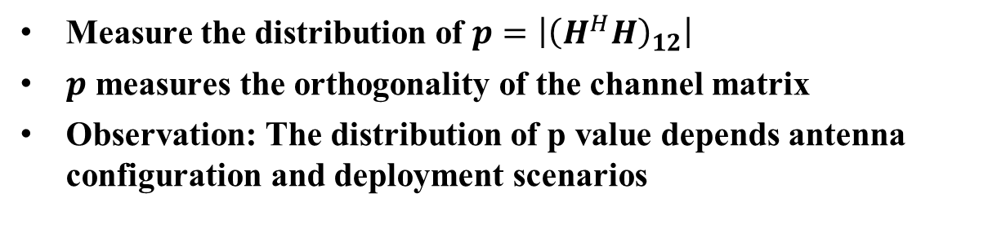
Distribution of Inter-stream Interference Power
Measure the distribution of $p=\left|{\left(H^{H}H\right)}_{12}\right|$
$p$ measures the orthogonality of the channel matrix
Observation: The distribution of p value depends antenna configuration and deployment scenarios
(Results with circular polarized antennas are available in Appendix)

Slide 8
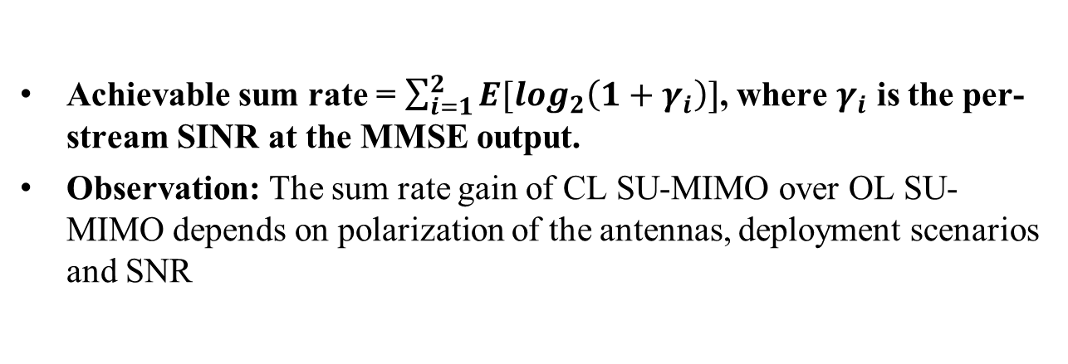
Achievable Sum Rate of LMMSE
Achievable sum rate = $\sum_{i=1}^{2}{E[log_{2}\left(1+γ_{i}\right)]}$, where $γ_{i}$ is the per-stream SINR at the MMSE output.
Observation: The sum rate gain of CL SU-MIMO over OL SU-MIMO depends on polarization of the antennas, deployment scenarios and SNR
(Results with circular polarized antennas are available in Appendix)

Slide 9
Conclusion
Although the OL SU-MIMO is an important MIMO mode for 11ay due to its simplicity, its performance may suffer from strong inter-stream interference which depends on many different factors, such as antenna configuration, polarization, environment, accuracy of analog beamforming, etc..
The 11ay system throughput may benefit from CL SU-MIMO, especially when the inter-stream interference is strong.
The cost-benefit of using CL SU-MIMO may need to be studied further with consideration of more antenna configurations and usage cases generated in TGay.

Slide 10
References
Alexander Maltsev, et. al., ”Channel Models for 60 GHz WLAN Systems”, 11-09-0334-08-11ad
Artyom Lomayev, et. al., “Performance Analysis of Open Loop SU-MIMO Receivers for IEEE 802.11ay”, IEEE 802.11-16/0388r0
Alexander Maltsev, et. al. “Channel models for ieee 802 11ay”, IEEE 802.11-15/1150r3
Rui Yang, et. al. “Channel Modeling with PAA Orientations”, IEEE 802.11-16/0339r1
Matthew R. McKay, et. al., “Achievable Sum Rate of MIMO MMSE Receivers: A General Analytic Framework”, IEEE Transaction on information theory, Vol. 56, No. 1, Jan 2010

Slide 11
Appendix
Inter-stream interference power distribution and CL gain over OL SU-MIMO for Configuration #3 with polarized antennas

Slide 12
SP (for survey)
Do you agree that closed-loop SU-MIMO based on channel-dependent precoding should be considered for 802.11ay?
Y:
N:
A:

