Slide 1
Feedback Element Compression for 802.11ax
Date: 2016-05-11
Authors:

Slide 2
Outline
Introduction
Current Agreements
Further Compression Schemes
Conclusion

Slide 3
Introduction
  In this contribution, we discuss methods to further reduce the overhead of explicit MIMO compressed beamforming feedback in 802.11ax.
  802.11ac supports explicit MIMO compressed beamforming feedback with
    (4,2) or (6,4) bits to quantize angle (ϕ, ψ) for single user, and
    (7,5) or (9,7) bits to quantize angle (ϕ, ψ) for multi-user.
In [7], we discussed possible methods to reduce explicit MIMO compressed beamforming feedback overhead in 802.11ax.
Current agreements have adopted the following [7][8]:
  Large Ng: Increase the tone grouping size {Ng} during feedback [3][4]
  Multi-resolution/Multi-stage feedback: Identify frequency band(s)/Resource Units (RU(s)) based on scalar feedback (e.g. SNR/CQI) and feed back full CSI for desired frequency band /RU(s).
In this contribution, we highlight methods that may result in additional feedback savings.

Slide 4
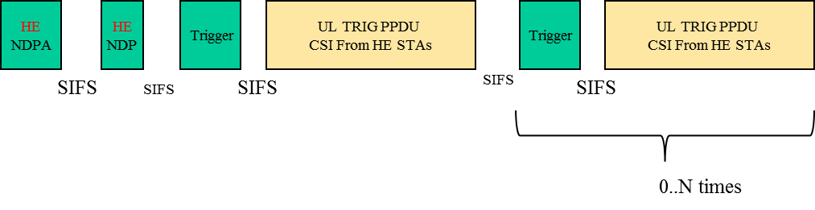
Current Agreements
The specification framework [1] has the following agreements:
  The amendment shall define a channel sounding sequence (Figure 22) initiated by an HE AP that includes a Trigger frame that is sent SIFS after the NDP frame in order to solicit UL MU mode of Compressed Beamforming Action frame from multiple HE STAs [MU Motion 18, September 17, 2015, see [9], modified with MU Motion 37, November 2015, see [9]]
  The amendment shall define a mechanism to reduce the MIMO compressed beamforming feedback overhead [MU Motion 25, September 17, 2015, see [10]]
  That mechanism shall use the compressed beamforming feedback as defined in section 8.4.1.48 in 802.11ac as a baseline [PHY Motion 100, November 2015]

Slide 5
Current Agreements
Agreements (ctd)
  A channel quality indicator only (CQI-only) feedback (exact metric TBD) will be supported by the sounding protocol in 11ax. The request for CQI-only feedback goes in NDPA [PHY Motion 152, March 2016, see [8]]
  AP can request beamforming feedback over partial BW which is less than the NDP BW. The indication of the feedback BW goes in NDPA [PHY Motion 148, March 2016, see [8]]
  The granularity of channel feedback requested by the AP is a 26 tone RU. The AP signals start and end 26 tone RUs requested for feedback [PHY Motion 149, March 2016, see [8]]

Slide 6
Further Compression Schemes
The current agreements reduce the feedback overhead by structural changes to the feedback mechanism but do not address savings that may be gained by changing the feedback elements themselves.
Examples of this include:
  ϕ Only Feedback: Feed back ϕ only in N x 1 transmission and assume a fixed ψ [5]
  Variable Angle Quantization : Use different quantization levels for different Given’s rotation angles (ϕ_{i}, ψ_{i}).
  Differential Given’s Rotation : Feed back time or frequency difference in Given’s Rotation angles [6]

Slide 7
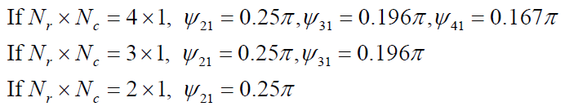
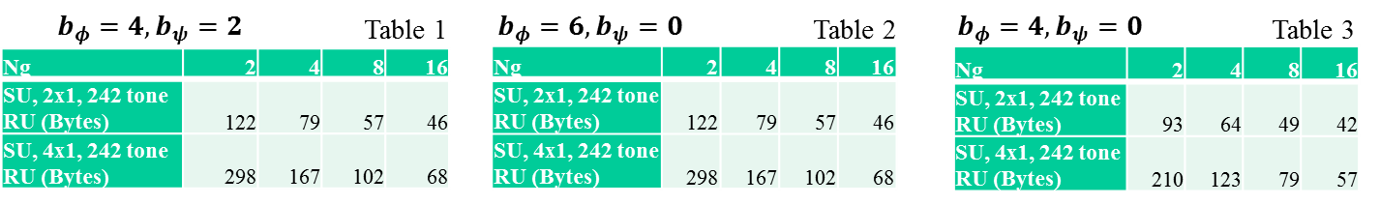
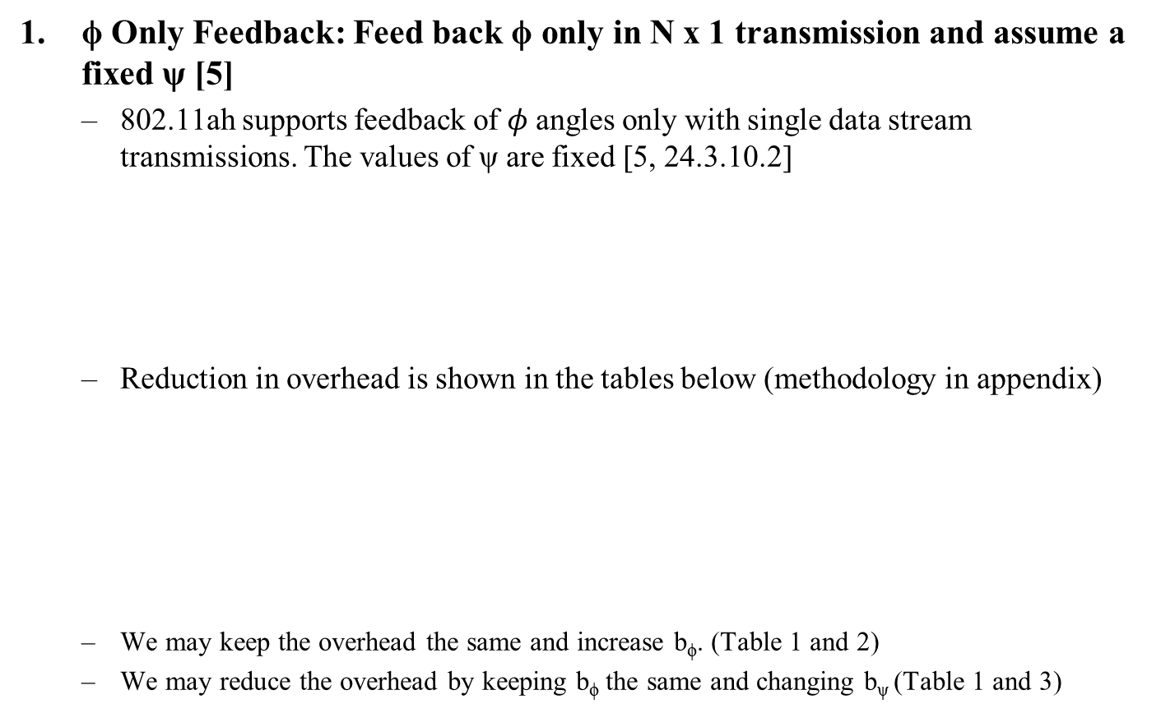
Extension Scheme (1)
ϕ Only Feedback: Feed back ϕ only in N x 1 transmission and assume a fixed ψ [5]
  802.11ah supports feedback of $φ$ angles only with single data stream transmissions. The values of ψ are fixed [5, 24.3.10.2]
  Reduction in overhead is shown in the tables below (methodology in appendix)
  We may keep the overhead the same and increase b_{ϕ}. (Table 1 and 2)
  We may reduce the overhead by keeping b_{ϕ} the same and changing b_{ψ} (Table 1 and 3)

Slide 8
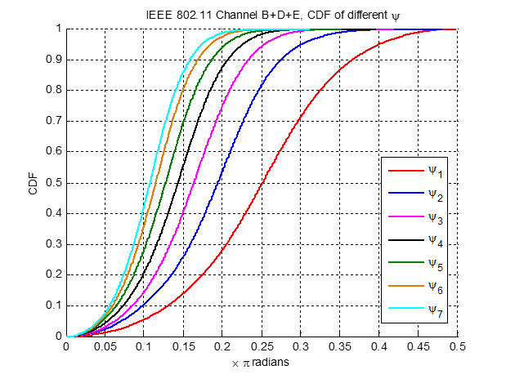
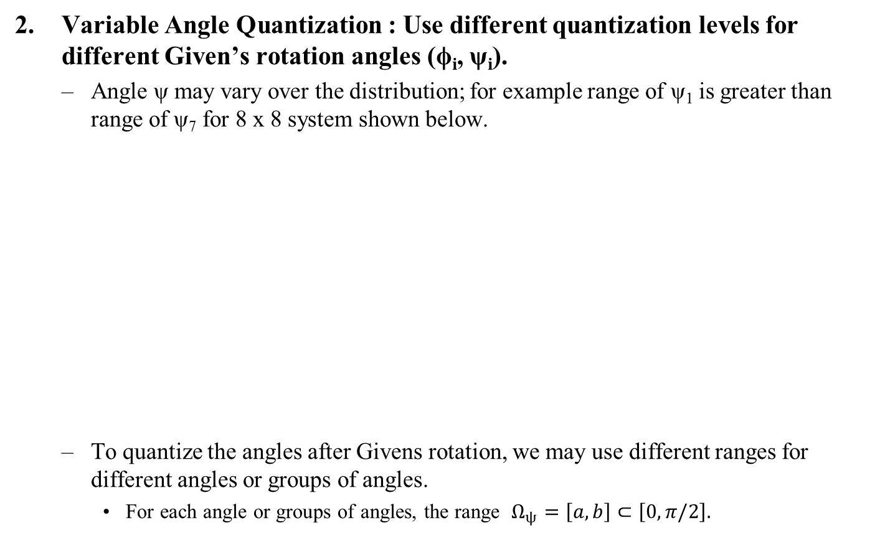
Extension Schemes (2)
Variable Angle Quantization : Use different quantization levels for different Given’s rotation angles (ϕ_{i}, ψ_{i}).
  Angle ψ may vary over the distribution; for example range of ψ₁ is greater than range of ψ₇ for 8 x 8 system shown below.
  To quantize the angles after Givens rotation, we may use different ranges for different angles or groups of angles.
    For each angle or groups of angles, the range $Ω_{ψ}=\left[a,b\right]⊂\left[0, π/2\right].$
Notes:
Focus on psi
Look at 8x8 channel with channel B, D and E
Assume uniform antenna spacing with 0.5 antenna spacing, generate 100 MHz channel and select 20 Mhz channel
Given’s rotation nullifies later entries in te same column, the angle range drops

Slide 9


Extension Schemes (3)
Differential Given’s Rotation : Feed back time or frequency difference in Given’s Rotation angles
  Send differential information between Given’s rotation angles of ‘baseline’ channel and next channel in time [6] or frequency
  May use scalar difference (subtraction) or vector difference (range/null space overlap).
$δφ$ is approximately distributed within
the range of $\left[−π/2, π/2\right] vs \left[0, 2π\right]$
$δψ$ is approximately distributed
within the range of $\left[−π/8, π/8\right] vs\left[0, π/2\right]$
Notes:
4 Tx, 4 Rx, B, D and E
D phi and d psi are reduced: assume frequency difference in this example

Slide 10
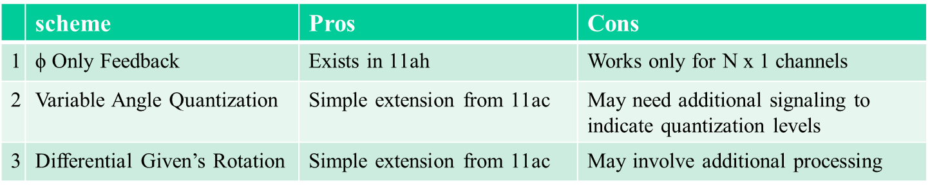
Summary (Pros and Cons)

Slide 11
Conclusions
Current agreements in 802.11ax have reduced the feedback overhead compared with 802.11ac
Further feedback overhead reduction may be achieved by modifying the explicit feedback elements themselves using 802.11ac feedback as a baseline.
The performance of these methods should be studied and a combination of them adopted in 802.11ax

Slide 12
References
11-15-0132-09-00ax-spec-framework
11-15-1129-01-00ax-feedback-overhead-in-dl-mu-mimo
11-15-1071-02-00ax-tone-grouping-factors-and-ndp-format-for-802-11ax
11-15-1320-00-00ax-Maximum-tone-grouping-for-802_11ax-feedback
IEEE P802.11ah™/D2.0 Amendment 6: Sub 1 GHz License Exempt Operation
Porat, R.; Ojard, E.; Jindal, N.; Fischer, M.; Erceg, V., "Improved MU-MIMO performance for future 802.11 systems using differential feedback," in Information Theory and Applications Workshop (ITA), 2013 , vol., no., pp.1-5, 10-15 Feb. 2013
11-15-1321-02-00ax-Reducing Explicit MIMO Compressed Beamforming Feedback Overhead for 802.11ax, Kome Oteri (InterDigital)
11-16-0389-01-00ax-sounding-design, Sriram Venkateswaran (Broadcom)
11-15-109-01-00ax Reducing Channel Sounding Protocol Overhead for 11ax, Narendar Madhavan (Toshiba),
11-15-1129-01-00ax Feedback overhead in DL-MU-MIMO”, Filippo Tosato (Toshiba),

Slide 13
Straw Poll #1
Do you agree to add the following to section 4.6 of the SFD ?
  Methods that further compress the feedback elements of compressed beamforming feedback as defined in section 8.4.1.48 in 802.11ac shall be considered.
  Y/ N/ A

Slide 14
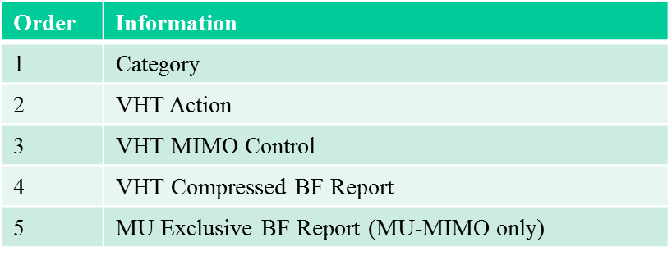
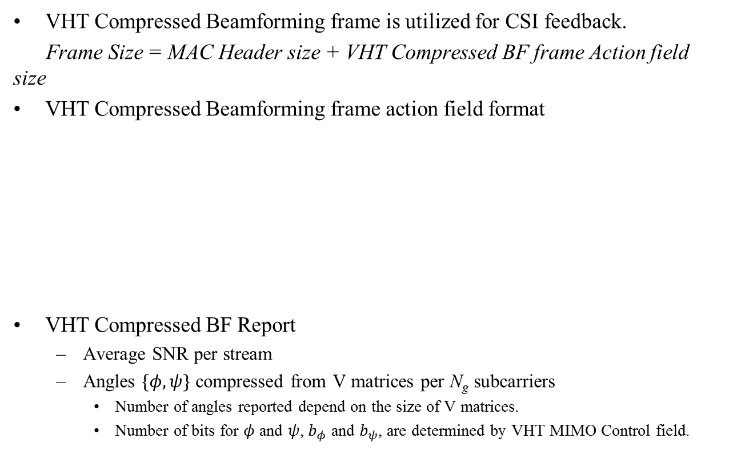
Overhead Calculation Details
VHT Compressed Beamforming frame is utilized for CSI feedback.
Frame Size = MAC Header size + VHT Compressed BF frame Action field size
VHT Compressed Beamforming frame action field format
VHT Compressed BF Report
  Average SNR per stream
  Angles $\{φ,ψ\}$ compressed from V matrices per N_{g} subcarriers
    Number of angles reported depend on the size of V matrices.
    Number of bits for $φ$ and $ψ$, $b_{φ}$ and $b_{ψ}$, are determined by VHT MIMO Control field.

