Slide 1
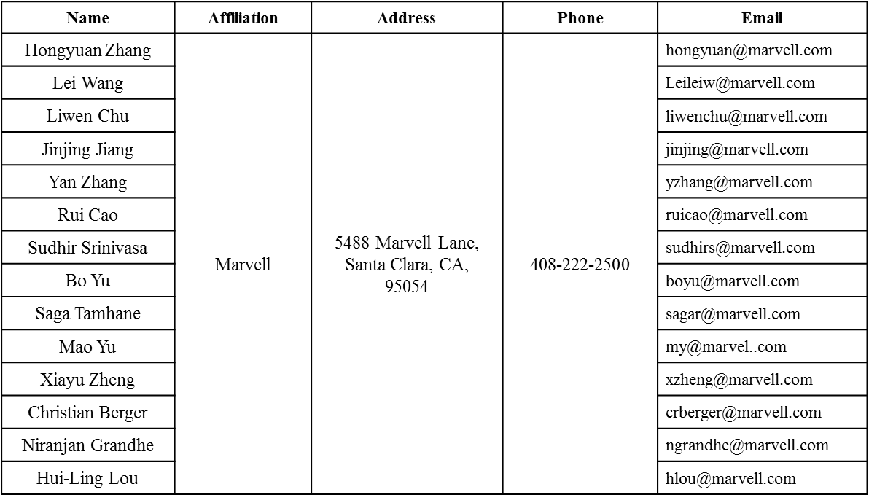
DCM PHY Parameters
Date: 2016-05-16
Authors:

Slide 2
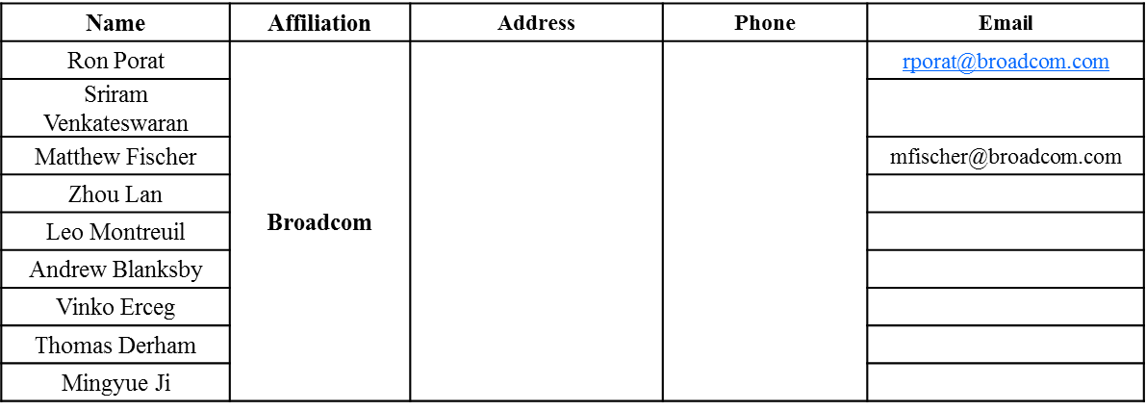
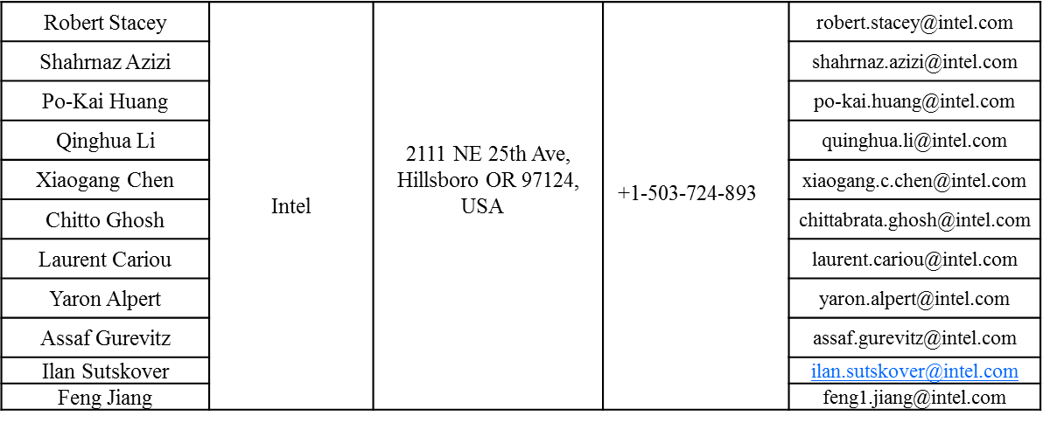
Authors (continued)

Slide 3
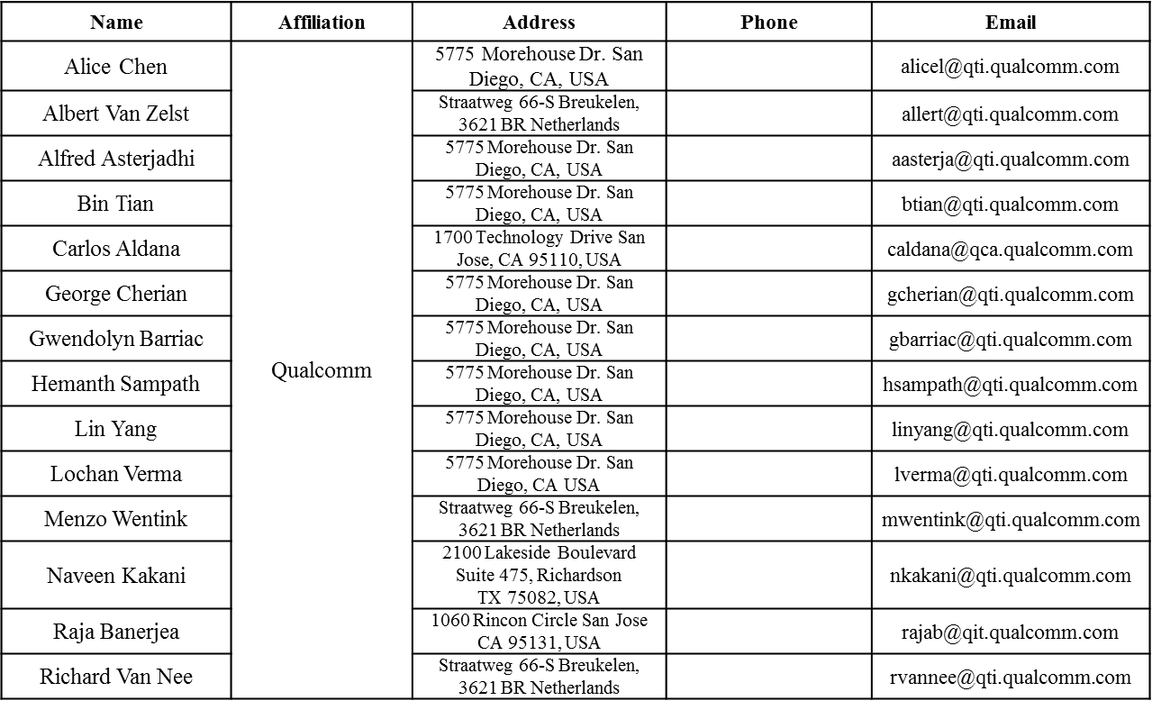
Authors (continued)

Slide 4
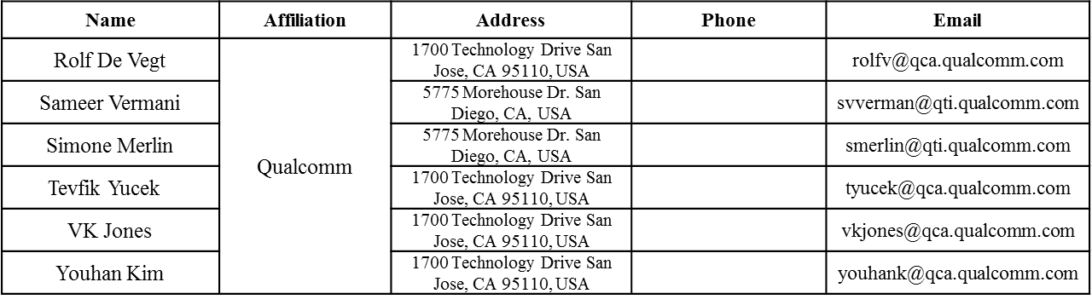
Authors (continued)

Slide 5
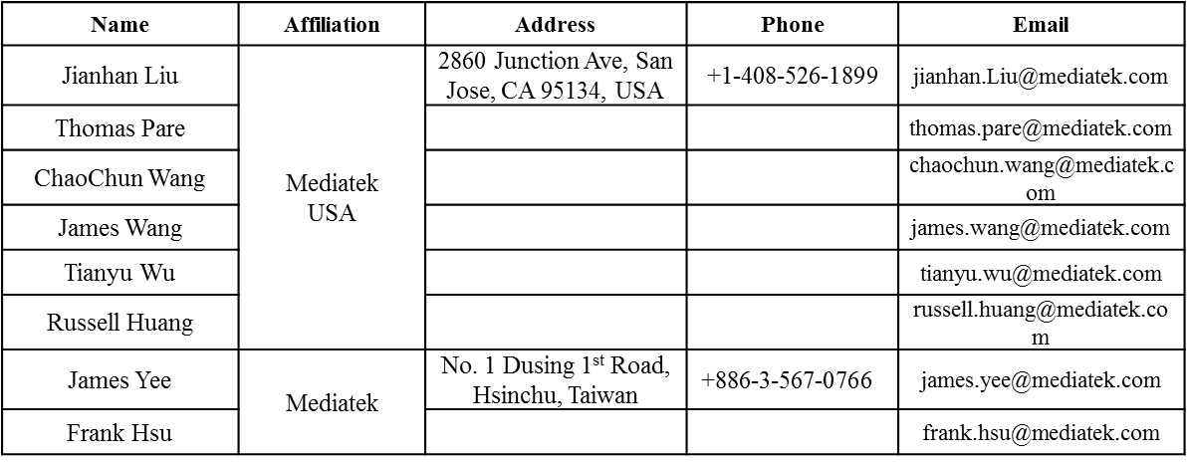

Authors (continued)
Authors (continued)

Slide 6
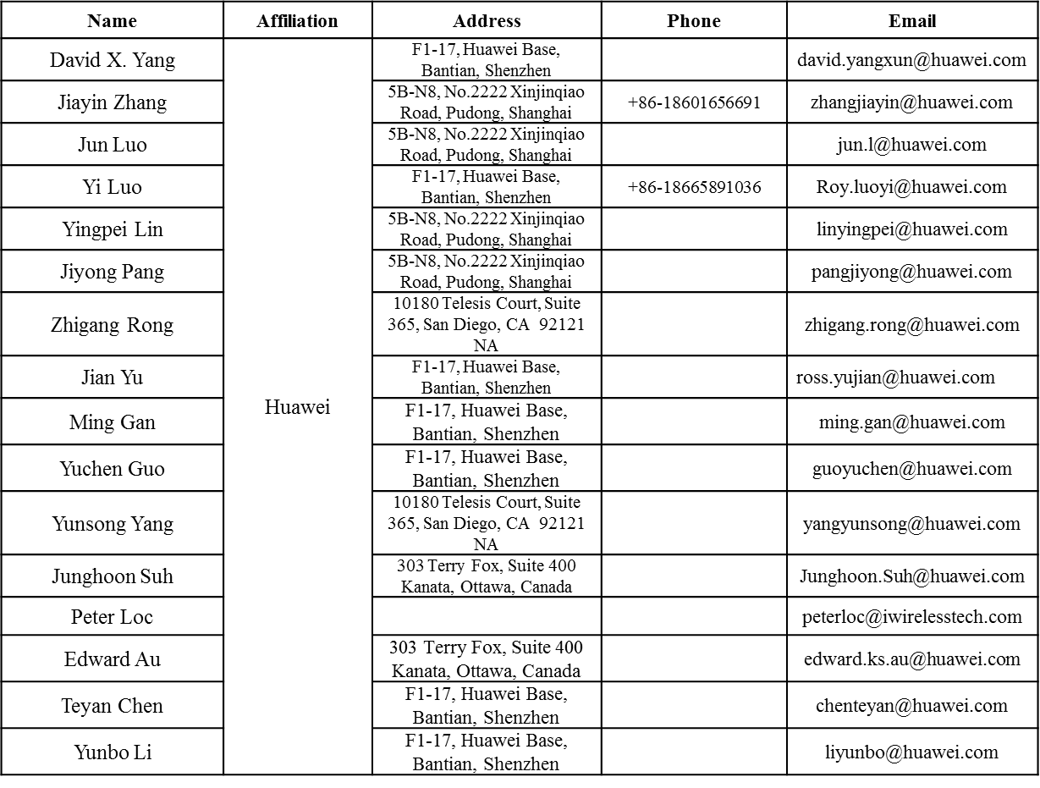
Authors (continued)

Slide 7
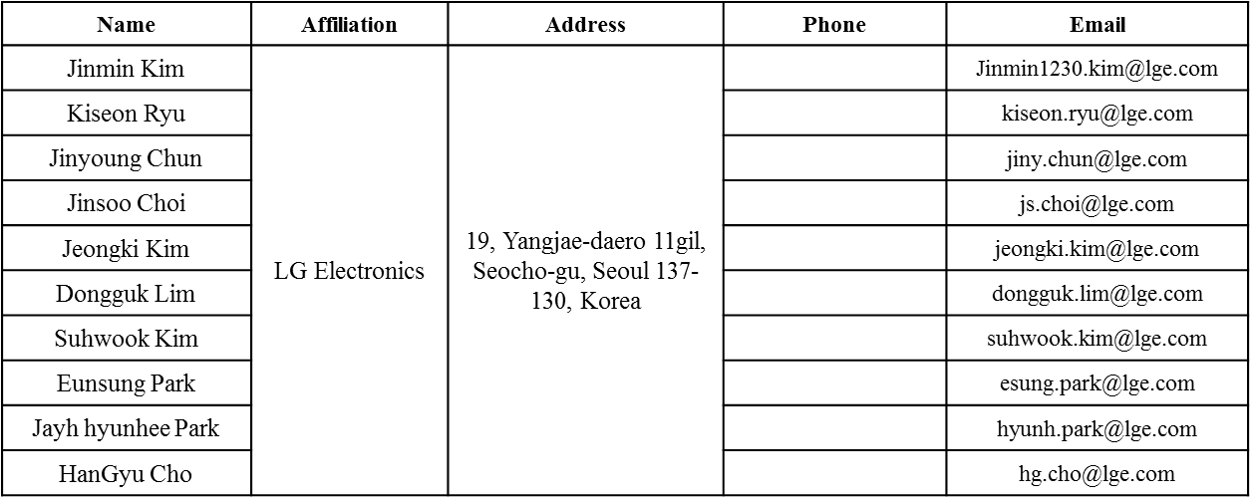
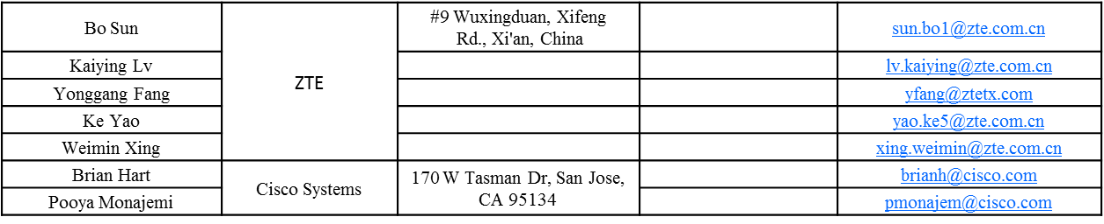
Authors (continued)

Slide 8
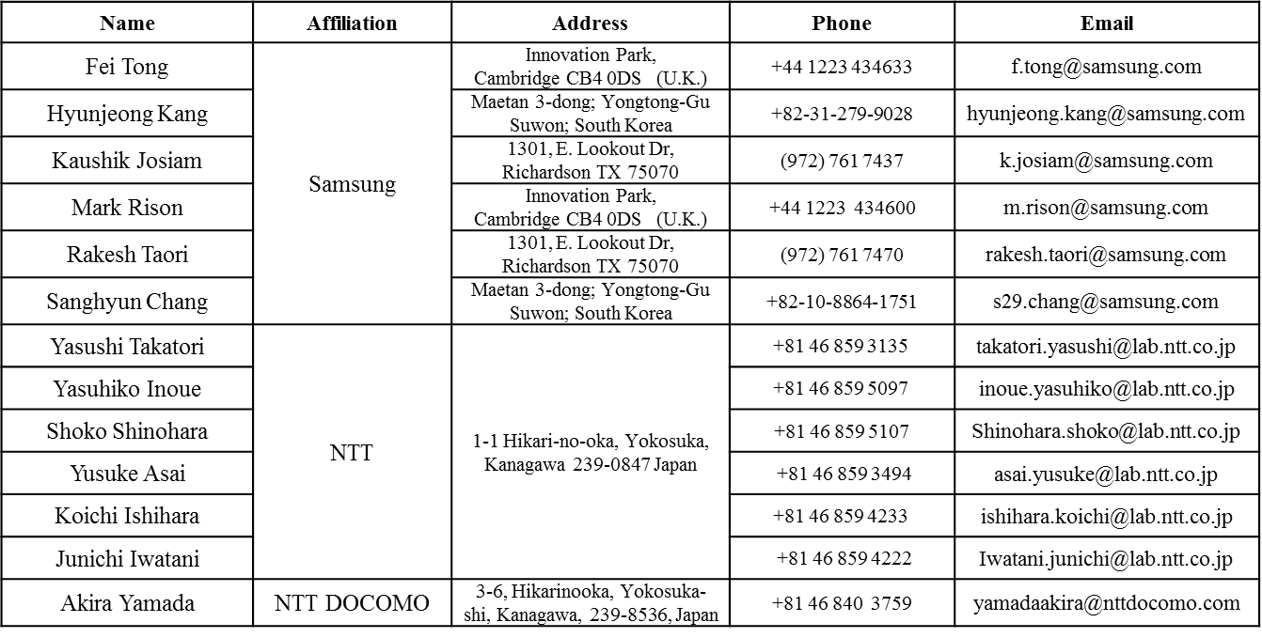
Authors (continued)

Slide 9
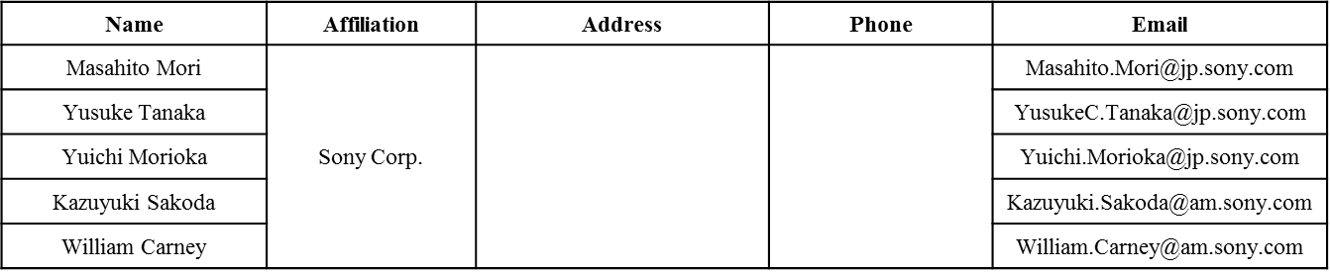
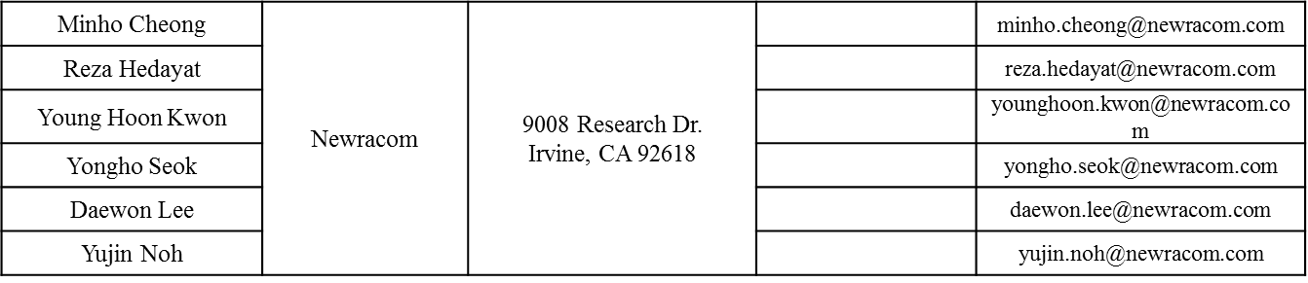
Authors (continued)

Slide 10
Authors (continued)

Slide 11
Overviews
DCM has been introduced to 11ax as an optional mode.
Some PHY parameter exceptions for MCS0-DCM need to be addressed when DCM is used.
There are also some related issues in current D0.1 on the MCS tables.

Slide 12
MCS0-DCM Non-Integer NDBPS Issue
For some RU sizes, with MCS0-DCM, NDBPS is non-zero.
  106-RU, MCS0-DCM, 1SS: NSD.DCM =102/2=51, NCBPS=51, NDBPS = 51/2.
  242-RU, MCS0-DCM, 1SS: NSD.DCM=234/2=117, NCBPS=117, NDBPS=117/2
Proposed parameters for these cases.

Slide 13
1. BCC Case: Post-FEC padding for MCS0-DCM
Conduct post-FEC padding of 1 bit per-symbol after BCC encoder to make up NCBPS coded bits, before interleaving.
Constellation Mapper for 1st half band
BCC
Padding 1 bit
(for MCS0-DCM, 1SS, 106-RU or 242-RU)
BCC Interleaver
IDFT
Consellation Mapper
DCM Modulation Mapper
Constellation Mapper for 2nd half band

Slide 14
2. LDPC Case
Solution: no post-FEC padding required, directly conduct LDPC encoding process as in 11ac assuming the NCBPS, NDBPS, parameters – just like any other non-integer NDBPS cases for LDPC.

Slide 15
Notes on the MCS Table in D0.1
In Current MCS table of D0.1 we saw the following issues:
  In DCM=1 case, NSD and NCBPS are identical to DCM=0, with a coding rate 1/4. There is no such a coding scheme especially for LDPC, in which we reuse 11ac encoding procedure and this NCBPS value leads to a different LDPC code!
  DCM=1 is applied to all MCS tables, we need to mark DCM=1 only in the MCS tables that allows DCM.
Proposed Changes:
  Change the NSD, NCBPS and NDBPS parameters as proposed.
  Change the coding rate R to be identical to DCM=0.
  Limit DCM=1 only to the allowed Nss cases.

Slide 16
SP1
Do you agree to add the following text to the SFD:
  When DCM = 1, the NSD, NCBPS, and NDBPS are set by the following expressions:
  In the case of MCS0, DCM=1, Nss=1, 106-RU or 242-RU, if the coding is BCC, then for each OFDM symbol 1 bit is padded after the NDBPS*2 BCC encoded bit before going into the BCC interleaver; if the coding is LDPC, LDPC encoding flow should be based on NDBPS and NCBPS as defined in the above equations

Slide 17
SP2
Do you agree to make the following changes to D0.1 MCS Tables:
  When DCM=1, change the NSD parameter to be ½ of DCM=0 cases for the same RU size.
  When DCM=1, change the NCBPS parameter to be ½ of DCM=0 case.
  When DCM=1, change the NDBPS parameter to be ½ of DCM=0 case, or take the floor for the two cases: 106-RU, MCS0, DCM=1, Nss=1, and 242-RU, MCS0, DCM=1, Nss=1.
  When DCM=1, change the coding rate R parameter to be identical to the DCM=0 case.
  Limit DCM=1 only to the allowed Nss.

