Slide 1
Proposal for LP-WUR (Low-Power Wake-Up Receiver) Study Group
Date: 2016-05-17
Authors:

Slide 2
Authors (continued):

Slide 3
Background
November 2015
LP-WUR (low-power wake-up receiver) [1] was introduced to WNG and received strong support for standardization in the 802.11 WG
Result of the following straw poll in [1]:
“Do you support the basic concept of the LP-WUR technique in this presentation for standardization in the 802.11WG? Y: 65, N: 1, A: 51”
January 2016
The basic concept of LP-WUR was introduced in LRLP TIG [2]
March 2016
More companies (Intel, MediaTek, and Ericsson) presented technical contributions on LP-WUR in LRLP TIG [3,4,5] (50% of technical contributions)
After 6 months of discussion, LRLP TIG did not reach consensus to create a SG during the March meeting
The combined target of long-range and low-power prevented narrowing the focus of TIG, which resulted in considering many different use cases and requirements [6]

Slide 4
Development Times of Previous Amendments
It takes a long time to develop an amendment in 802.11WG
There are exceptions such as 802.11z and 802.11ae that had a limited and well-defined scope of work
Amendments | PAR approved (t1) | Draft 2.0 (t2) | Duration (t2-t1)
802.11ah | 2010-10-04 | 2014-07-05 | 3 years, 9 months
802.11af | 2009-12-09 | 2012-08-19 | 2 years, 8 months
802.11ac | 2008-09-26 | 2012-02-18 | 3 years, 5 months
802.11ad | 2008-12-10 | 2011-04-05 | 2 years, 3 months
802.11aa | 2008-03-27 | 2010-12-08 | 2 years, 8 months
802.11ae | 2009-12-09 | 2011-02-18 | 1 year, 2 months
802.11s | 2004-05-13 | 2008-05-03 | 4 years
802.11v | 2004-12-08 | 2008-03-15 | 3 years, 3 months
802.11z | 2007-08-22 | 2008-08-20 | 1 year
802.11n | 2003-09-11 | 2007-03-09 | 3 years, 6 months
Reference: http://www.ieee802.org/11/Reports/802.11_Timelines.htm

Slide 5
Proposal to Create a LP-WUR SG
Why LP-WUR SG?
New capability for 802.11
LP-WUR enables energy efficient data reception mode without increase of latency
Independent of 802.11 PHY
LP-WUR can be used for any existing and future 802.11 PHY amendments (i.e. 802.11 a/b/g/n/ac/ad/ax/…)
Feasibility
LP-WUR is well-defined technology with many proof points of feasibility [1]
Limited and well-defined scope of work
We propose to create a SG for LP-WUR [1]
Define a PAR that limits the scope of the work to LP-WUR
Target a quick implementation of an amendment for LP-WUR

Slide 6
Proposed Timeline
2016
July: create a LP-WUR SG
Define a PAR limited to LP-WUR
November: create a LP-WUR TG
2017
May: complete LP-WUR D0.1
November: complete LP-WUR D1.0
2018
May: complete LP-WUR D2.0
Today
2016
2017
2018
May
4 mo.
6 mo.
6 mo.
6 mo.
July ’16 Create a LP-WUR SG
Nov. ‘16
- Create a LP-WUR TG
May ‘17
- LP-WUR D0.1
Nov. ‘17
- LP-WUR D1.0
May. ‘18
- LP-WUR D2.0

Slide 7
Straw Poll
Do you support the formation of a new 802.11 Study Group to develop PAR&CSD for the LP-WUR technique described in [1]?
Y: 79
N: 3
A: 35

Slide 8
References
[1] IEEE 802.11-15/1307r1, “Low-power wake-up receiver for 802.11”
[2] IEEE 802.11-16/0027r0, “LP-WUR (Low-Power Wake-Up Receiver): Enabling Low-Power and Low-Latency Capability for 802.11”
[3] IEEE 802.11-16/0341r0, “Low-power wake-up receiver follow-up”
[4] IEEE 802.11-16/0402r0, “LP WUR Wake-up Packet Identity Considerations”
[5] IEEE 802.11-16/0381r0, “Discussion of Wake-up Receivers for LRLP”
[6] IEEE 802.11-16/1446r12, “LRLP Output Report Draft”

Slide 9
Backup

Slide 10
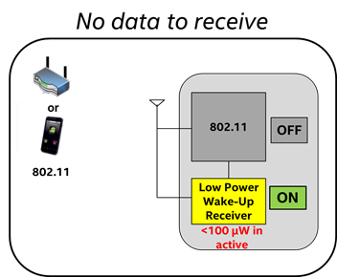
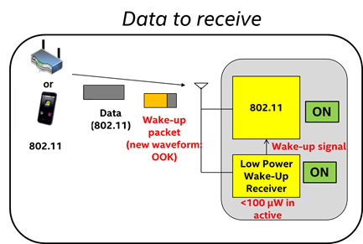
Recap: Low-Power Wake-Up Receiver (LP-WUR) as Companion Radio for 802.11
Comm. Subsystem = Main radio (802.11) + LP-WUR
Main radio (802.11): for user data transmission and reception
Main radio is off unless there is something to transmit
LP-WUR wakes up the main radio when there is a packet to receive
User data is transmitted and received by the main radio
LP-WUR: not for user data; serves as a simple “wake-up” receiver for the main radio
LP-WUR is a simple receiver (doesn’t have a transmitter)
Active while the main radio is off
Target power consumption < 100 µW in the active state
Simple modulation scheme such as On-Off-Keying (OOK)
Narrow bandwidth (e.g. < 5 MHz)
Target transmission range: LP-WUR = Today’s 802.11

Slide 11
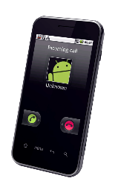
Recap: Design and Operation of LP-WUR
Transmission range
or
Data
Packet
802.11 = LP-WUR
Transmitter
Receiver
802.11
802.11
802.11
802.11
ON
OFF
OFF
+
ON
802.11
Wake-up Packet
Wake-up signal
LP-WUR
ON
Wake-up Packet
Extremely low power receiver design (< 100 uW)
- Small and simple OOK demodulator
802.11 preamble for coexistence
Use L-SIG to protect the packet
This is for 3rd party legacy stations
This is not decoded by LP-WUR
(L-SIG: legacy SIGNAL field)
Payload of wakeup packet modulated with On-Off Keying (OOK)
Payload = [Wakeup preamble | MAC header (Receiver address) | Frame body | FCS]
OOK modulation can be done using OFDM transmitter with modification (OFDM: orthogonal frequency division multiplexing; FCS: frame check sequence)

Slide 12
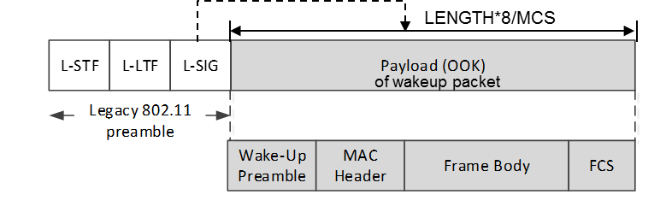
802.11 Compatible Wakeup Packet Design
Wakeup packet = Legacy 802.11 preamble (OFDM) + new LP-WUR signal waveform (OOK)
Legacy 802.11 preamble provides coexistence with legacy STAs
802.11 stations can detect beginning of this packet
802.11 stations know end of this packet
CRC
Wakeup packet may carry other information
Receiver address
Wakeup preamble (e.g. PN sequence)
Example signal waveform
1bit /1 OFDM symbol period (= 4usec) = 250kbps
Legacy 802.11
preamble
Wake-up
preamble
MAC Header + Frame Body + FCS

Slide 13
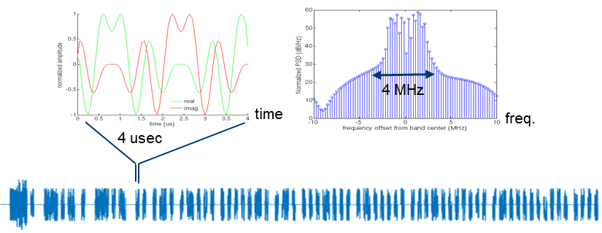
Wakeup Packet Generation Using OFDM Transmitter
OOK pulse design:
Reuse 802.11 OFDM transmitter for OOK pulse generation
Example:
Subcarrier width = 312.5 kHz, OOK pulse BW = 13 subcarriers (4.06 MHz)
s= {13 subcarrier tone sequence}
X_{t} = IFFT(s), followed by 0.8 µsec cyclic prefix extension → 4us symbol period

Slide 14
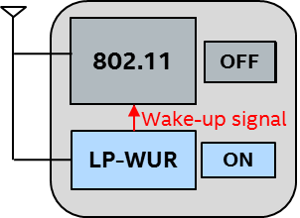
LP-WUR Function
LP-WUR receives and decodes a wakeup packet without any help from the 802.11 radio
LP-WUR
RF/Analog Front-end
Digital Baseband
Simple Packet Parser

