Slide 1
FST Enhancement
Date: 2016-05-13
Authors:

Slide 2
Background
Propagation fluctuation will be severe and drastic in public space and/or outdoor environment due to blocking or multipath by pedestrians, reflections, or sometimes cars in 11ay use scenario.
2.4/5GHz band could compensate some part of degradation in 60GHz performance.

Slide 3




Use Scenario
Video/Mass-data distribution/VOD
It supposes severe/drastic propagation fluctuation due to frequent blocking at public and/or outdoor environment.
Internet
mmW
user
Dining-Hall
Exhibition
contents
server
pedestrians
5GHz
Outdoor deployment
Throughput
Backhaul @60GHz
mmW
only
mmW
11ay AP
11ay AP
Base BW by 5GHz
N-LOS Access
LOS Access
Time
Time
BUS STOP
Traffic split by multi-link with 2.4/5GHz may moderate this issue.
It could maintain part of traffic.
Wireless backhauling with single hop

Slide 4
10.32 Multi-band operation
(Std. 802.11ad-2012)
In 2nd paragraph on page 395:
The FST session transition is managed by FST session setup protocol. ~(omitted)~ Depending on the STA’s behavior during the FST session setup, the FST session can be operational in one band, or may be transferred to another band, or channel in the same band, or can be operational in multiple bands and/or channels simultaneously ~(omitted)~.
If a multi-band capable device is operational in more than one band/channel simultaneously, the STA may use the FST session setup protocol to change the operation to a single channel.
Simultaneous communication in multiple bands/channels is already addressed in the existing standard.

Slide 5
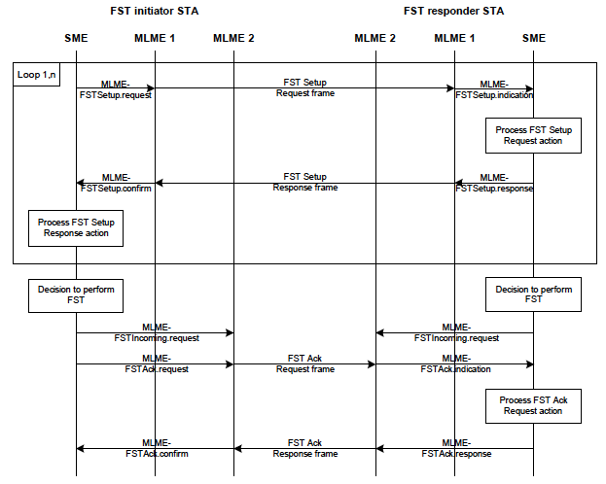
Fig. 10-33 Procedure of the FST setup protocol
Old band
(e.g. 60GHz)
New band
(e.g. 5GHz)
New band
(e.g. 5GHz)
Old band
(e.g. 60GHz)
The new band will be set up after this protocol completion.
FST Setup Request frame
FST Setup Response frame
The old band could be used along with the new band at the same time.
However, it’s not clarified how that multi-link can be enabled by this protocol.
FST Ack Request frame
FST TS switching (10.32.2.3,11ad std.) is defined for indicating which streams are to be transferred to the other band. It depends on AC of EDCA.
FST Ack Response frame

Slide 6

Typical traffic in TGay use scenario
Movie file
FTP could be one of typical traffic in 11ay use scenario.
AC is Best Effort? or Video? It’s just either one, anyway. How to categorize each application traffic to AC is another issue.
The current FST cannot split traffic streams just into multiple bands. When 60GHz will be blocked, all streams will be interrupted in 60GHz and transferred to 5GHz.
Multi-link operation with 2.4/5GHz may moderate that stream interruption. It could have base bandwidth.
There might be issues on upper layer flow control in multi-link connection. However, setup for multi-link on lower layer should be addressed more clearly for an option in the Std.
Contents
server
60GHz
+ 5GHz
FTP?

Slide 7
Summary
Severe/drastic propagation fluctuation may be compensated by always-simultaneous multi-band operation. It could be an option of FST.

Slide 8
Straw Poll / Motion
Do you support to add the following text into the 11ay SFD?
11ay amendment addresses FST enhancement to enable multi-link operation to split and transfer traffic stream into multiple bands/channels simultaneously.
Result: Y/N/A=

Slide 9
References
doc. IEEE802.11-15/625r3, “IEEE802.11 TGay Use Cases”
IEEE Std. 802.11ad-2012
IEEE Std. 802.11-2012

Slide 10
Appendix

Slide 11


10.32.2.3 FST TS switching
(TS stands for Traffic Stream)
If a STA transmitting an FST Setup Request or an FST Setup Response does not intend to switch all its streams, then the STA shall include the Switching Stream element in the transmitted frame to indicate which streams are requested to be transferred to the other band/channel.
Switching Stream element
The TID subfield specifies the stream in the corresponding band.
It identifies TC (Traffic Category) or TS (Traffic Stream) to which the corresponding or AMSDU in the Frame Body field belongs. .
This FST TS switching is depending on TID (AC in EDCA).

