Slide 1
TG ax
Indoor Enterprise Scenarios,
Color, DSC and TPC
Date: 2016-05
Authors:

Slide 2
Background
DSC, Color and TPC have all been proposed for spatial reuse.
The OBSS situation is fully examined based upon the two indoor enterprise scenarios
The Indoor Enterprise scenario is examined for two rooms with the 4CH case and the 9 channel case
The Indoor cell enterprise scenario is examined for two cells with the 3CH and 7 channel cases.
Legacy, Legacy/TPC, Color, Color/TPC, DSC, DSC/TPC and DSC/ “TPC one” are all examined.
Results show blocking and sharing and a ‘figure of merit’ is used for comparison

Slide 3
Topography of Indoor Enterprise
We examine just this case

Slide 4
4 Channel re-use

Slide 6
9 CH Scenario

Slide 7
Indoor Cell enterprise scenario
24 STAs per cell

Slide 9
Methodology
UL case example
  For each STA, the wanted UL RSSI at the AP is calculated,
  “Pr wanted”
  The RSSIs at the AP from all the other STAs and the AP in the other network are calculated, “Pr unwanted”
  The RSSIs at the transmitting STA, from all the other STAs and the AP in the other network are calculated, “Pr interference”
  If “Pr interference” < CCA Threshold, the STA will transmit
    If “Pr wanted – Pr unwanted” > 20dB, SUCCESS
    If “Pr wanted – Pr unwanted” < 20dB, BLOCKED
  If “Pr interference” > CCA Threshold, the STA will not transmit
  SHARE
“Blocked” and “Share” terminology
“Blocked” – Transmission allowed when SNIR < 20dB, then both signals fail.
“Share” – Transmission prevented when SNIR < 20dB, standard contention.

Slide 10
Methodology
DL case example
  For each STA, the wanted DL RSSI from the AP is calculated,
  “Pr wanted”
  The RSSIs at the STA from all the other STAs and the AP in the other network are calculated, “Pr unwanted”
  The RSSIs at the transmitting AP, from all the other STAs and the AP in the other network are calculated, “Pr interference”
  If “Pr interference” < CCA Threshold, the STA will transmit
    If “Pr wanted – Pr unwanted” > 20dB, SUCCESS
    If “Pr wanted – Pr unwanted” < 20dB, BLOCKED
  If “Pr interference” > CCA Threshold, the STA will not transmit
  SHARE
“Blocked” and “Share” terminology
“Blocked” – Transmission allowed when SNIR < 20dB, then both signals fail.
“Share” – Transmission prevented when SNIR < 20dB, standard contention.

Slide 11
DSC and Color
DSC (as per this analysis)
  STA measures the Beacon signal (wanted DL signal) and sets effective CCA Threshold 20dB lower. (DSC Margin = 20dB)
  AP sets its effective CCA level at 10dB below the lowest received wanted signal.
  DSC AP can prohibit DSC usage in its network.
Color
  STA/AP looks at color bits in preamble to determine if signal is from same or inter BSS.
  If not same BSS, ignore signal.
  (A variation is to only reject if the inter BSS signal is lower than a set threshold)

Slide 12
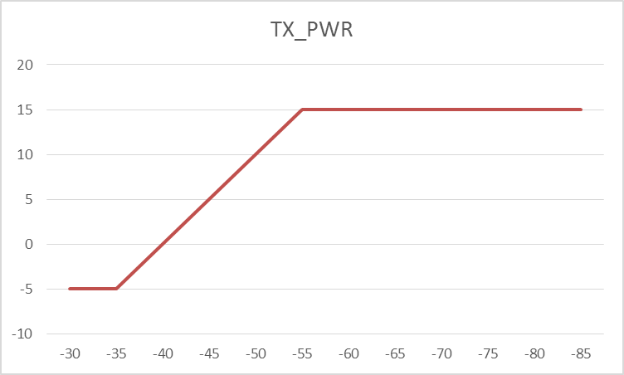
TPC from 15/1609
Adjusted TX_PWR = 15 – RSSI + A -5<TX_PWR<15 dBm
Assume the STA is close to the AP then RSSImax = -35dBm and TX_PWR = -5dBm
TX_PWR = 15 – (-35) + A = -5
Hence, A = -55dB
For RSSI = -55dBm, TX_PWR = 15dBm

Slide 13
Display of results – Shared and Blocked
The number of Shared and Blocked links is calculated and the results tabulated.
  “DL STAs”, out of all the combinations (4096 for Indoor enterprise and 576 for cell enterprise)
  Due to interference from the STAs in other network
    # links Shared,
    # links blocked
  “DL” APs, out of all the combinations (64 for Indoor enterprise and 24 for cell enterprise)
  Due to interference from the AP in other network
    # links Shared,
    # links blocked
  “UL STAs”, out of all the combinations (4096 for Indoor enterprise and 576 for cell enterprise)
  Due to interference from the STAs in the other network
    # links Shared,
    # links blocked
  “DL APs”, out of all the combinations (64 for Indoor enterprise and 24 for cell enterprise)
  Due to interference from the AP in other network
    # links Shared,
    # links blocked

Slide 14
Display of results – Figure of Merit
In order to produce a nice “easy to compare” illustration, a ‘Figure of Merit’ is used.
  Success = 1, Shared = 0.5, Blocked = 0
  Merit = (# links – (# shared + # blocked) + # shared x 0.5)/(# links)
Examples:
  Total # links = 4096, Shared = 4096, Blocked = 0
  Merit = (4096 – 4096 + (4096 x 0.5))/4096 = 0.5 (i.e. all shared)
  Total # links = 4096, Shared = 0, Blocked = 0
  Merit = (4096 – 0 + (0 x 0.5))/4096 = 1 (perfect, no OBSS)
  Total # links = 4096, Shared = 0, Blocked = 4096
  Merit = (4096 – 4096 + (0 x 0.5))/4096 = 0 (totally blocked)
  Total # links = 4096, Shared = 768, Blocked = 698
  Merit = (4096 – 1466 + (768 x 0.5))/4096 = .0.736

Slide 15
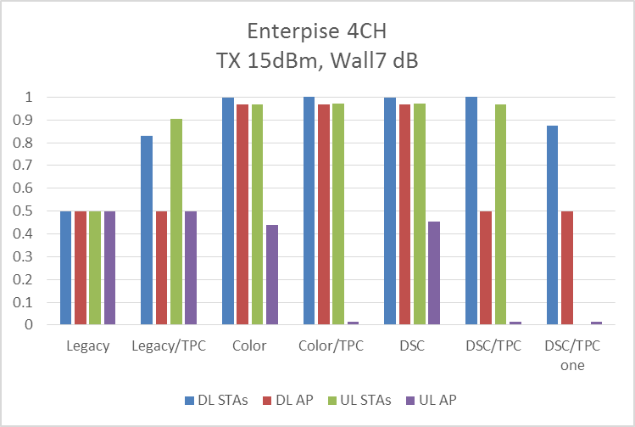
Results Indoor Enterprise 4CH, 15dBm, 7dB
4CH | TX 15dBm, 7dB wall
 | DL |  |  |  |  |  | UL
 | STAs |  |  | AP |  |  | STAs |  |  | AP
 | Merit | Share | Block | Merit | Share | Block | Merit | Share | Block | Merit | Share | Block
Legacy | 0.5 | 4096 | 0 | 0.5 | 64 | 0 | 0.5 | 4096 | 0 | 0.5 | 64 | 0
Legacy/TPC | 0.828125 | 1408 | 0 | 0.5 | 64 | 0 | 0.904297 | 768 | 8 | 0.5 | 64 | 0
Color | 0.998535 | 0 | 6 | 0.96875 | 0 | 2 | 0.96875 | 0 | 128 | 0.4375 | 0 | 36
Color/TPC | 1 | 0 | 0 | 0.96875 | 0 | 2 | 0.969482 | 6 | 122 | 0.015625 | 2 | 62
DSC | 0.998535 | 0 | 6 | 0.96875 | 0 | 2 | 0.969482 | 6 | 122 | 0.453125 | 2 | 34
DSC/TPC | 1 | 0 | 0 | 0.5 | 64 | 0 | 0.96875 | 0 | 128 | 0.015625 | 2 | 62
DSC/TPC one | 0.875 | 1024 | 0 | 0.5 | 64 | 0 | 0.000732 | 6 | 4090 | 0.015625 | 2 | 62
DSC and Color are best
TPC on STAs causes UL AP interference to block due to AP not TPC

Slide 16
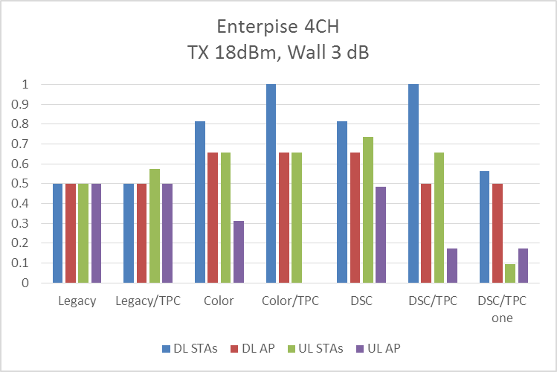
Results Indoor Enterprise 4CH, 18dBm, 3dB
4CH | TX 18dBm, 3dB wall
 | DL |  |  |  |  |  | UL
 | STAs |  |  | AP |  |  | STAs |  |  | AP
 | Merit | Share | Block | Merit | Share | Block | Merit | Share | Block | Merit | Share | Block
Legacy | 0.5 | 4096 | 0 | 0.5 | 64 | 0 | 0.5 | 4096 | 0 | 0.5 | 64 | 0
Legacy/TPC | 0.5 | 4096 | 0 | 0.5 | 64 | 0 | 0.574707 | 3484 | 0 | 0.5 | 64 | 0
Color | 0.8125 | 0 | 768 | 0.65625 | 0 | 22 | 0.65625 | 0 | 1408 | 0.3125 | 0 | 44
Color/TPC | 1 | 0 | 0 | 0.65625 | 0 | 22 | 0.65625 | 0 | 1408 | 0 | 0 | 64
DSC | 0.8125 | 0 | 768 | 0.65625 | 0 | 22 | 0.73584 | 768 | 698 | 0.484375 | 22 | 22
DSC/TPC | 1 | 0 | 0 | 0.5 | 64 | 0 | 0.65625 | 0 | 1408 | 0.171875 | 22 | 42
DSC/TPC one | 0.561035 | 3584 | 6 | 0.5 | 64 | 0 | 0.09375 | 768 | 3328 | 0.171875 | 22 | 42
DSC is best all round
TPC improves DL STAs
TPC on STAs causes UL AP interference to block due to AP not TPC

Slide 17
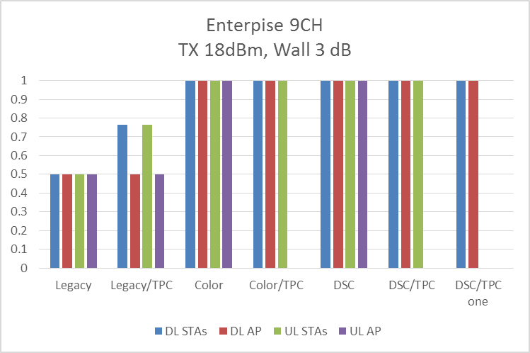
Results Indoor Enterprise 9CH, 18dBm, 3dB
9CH | TX 18dBm, 3dB wall
 | DL |  |  |  |  |  | UL
 | STAs |  |  | AP |  |  | STAs |  |  | AP
 | Merit | Share | Block | Merit | Share | Block | Merit | Share | Block | Merit | Share | Block
Legacy | 0.5 | 4096 | 0 | 0.5 | 64 | 0 | 0.5 | 4096 | 0 | 0.5 | 64 | 0
Legacy/TPC | 0.765625 | 1920 | 0 | 0.5 | 64 | 0 | 0.765625 | 1920 | 0 | 0.5 | 64 | 0
Color | 1 | 0 | 0 | 1 | 0 | 0 | 1 | 0 | 0 | 1 | 0 | 0
Color/TPC | 1 | 0 | 0 | 1 | 0 | 0 | 1 | 0 | 0 | 0 | 0 | 64
DSC | 1 | 0 | 0 | 1 | 0 | 0 | 1 | 0 | 0 | 1 | 0 | 0
DSC/TPC | 1 | 0 | 0 | 1 | 0 | 0 | 1 | 0 | 0 | 0 | 0 | 64
DSC/TPC one | 1 | 0 | 0 | 1 | 0 | 0 | 0 | 0 | 4096 | 0 | 0 | 64
DSC and Color are best
Spatial Re-use!!!!
TPC on STAs causes UL AP interference to block due to AP not TPC

Slide 18
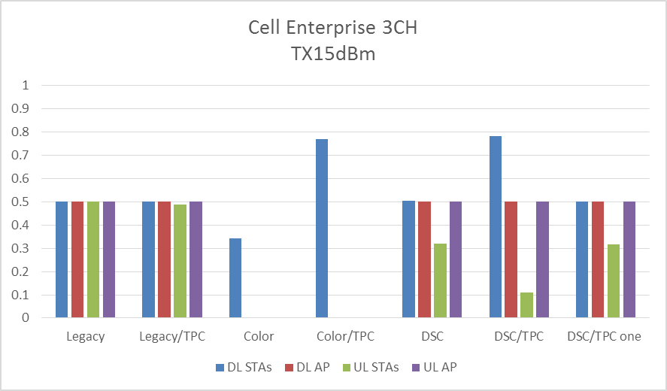
Results Indoor Cell Enterprise 3CH, 15dBm, 0dB
3CH | TX 15dBm, 0dB wall
 | DL |  |  |  |  |  | UL
 | STAs |  |  | AP |  |  | STAs |  |  | AP
 | Merit | Share | Block | Merit | Share | Block | Merit | Share | Block | Merit | Share | Block
Legacy | 0.5 | 576 | 0 | 0.5 | 24 | 0 | 0.5 | 576 | 0 | 0.5 | 24 | 0
Legacy/TPC | 0.5 | 576 | 0 | 0.5 | 24 | 0 | 0.489583 | 564 | 12 | 0.5 | 24 | 0
Color | 0.34375 | 0 | 378 | 0 | 0 | 24 | 0 | 0 | 576 | 0 | 0 | 24
Color/TPC | 0.770833 | 0 | 132 | 0 | 0 | 24 | 0 | 0 | 576 | 0 | 0 | 24
DSC | 0.505208 | 288 | 141 | 0.5 | 24 | 0 | 0.319444 | 368 | 208 | 0.5 | 24 | 0
DSC/TPC | 0.78125 | 192 | 30 | 0.5 | 24 | 0 | 0.110243 | 127 | 449 | 0.5 | 24 | 0
DSC/TPC one | 0.5 | 576 | 0 | 0.5 | 24 | 0 | 0.317708 | 366 | 210 | 0.5 | 24 | 0
Legacy is best
DSC is close second
(Note: DSC can be disabled by AP if it recognizes such a situation)
Particularly strong OBSS as cells adjacent to each other.

Slide 19
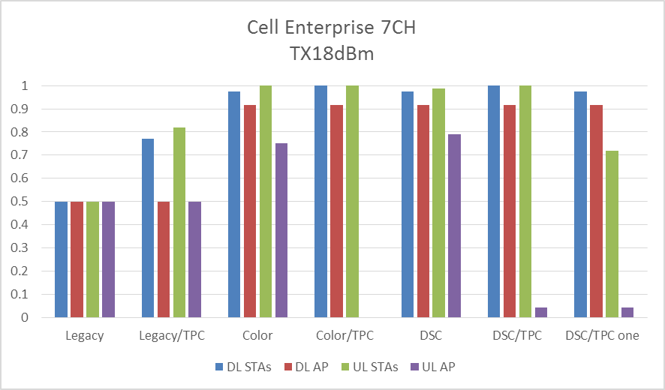
Results Indoor Cell Enterprise 7CH, 18dBm, 0dB
7CH | TX 18dBm, 0dB wall
 | DL |  |  |  |  |  | UL
 | STAs |  |  | AP |  |  | STAs |  |  | AP
 | Merit | Share | Block | Merit | Share | Block | Merit | Share | Block | Merit | Share | Block
Legacy | 0.5 | 576 | 0 | 0.5 | 24 | 0 | 0.5 | 576 | 0 | 0.5 | 24 | 0
Legacy/TPC | 0.770833 | 264 | 0 | 0.5 | 24 | 0 | 0.817708 | 210 | 0 | 0.5 | 24 | 0
Color | 0.975694 | 0 | 14 | 0.916667 | 0 | 2 | 1 | 0 | 0 | 0.75 | 0 | 6
Color/TPC | 1 | 0 | 0 | 0.916667 | 0 | 2 | 1 | 0 | 0 | 0 | 0 | 24
DSC | 0.975694 | 0 | 14 | 0.916667 | 0 | 2 | 0.987847 | 14 | 0 | 0.791667 | 2 | 4
DSC/TPC | 1 | 0 | 0 | 0.916667 | 0 | 2 | 1 | 0 | 0 | 0.041667 | 2 | 22
DSC/TPC one | 0.975694 | 0 | 14 | 0.916667 | 0 | 2 | 0.720486 | 14 | 154 | 0.041667 | 2 | 22
DSC is best.
Spatial Reuse.
TPC improves DL and UL STAs
But blocks UL AP

Slide 20
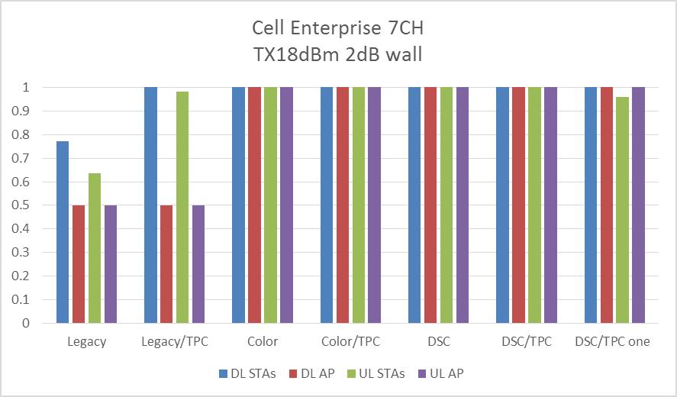
Results Indoor Cell Enterprise 7CH, 18dBm, 2dB
7CH | TX 18dBm, 2dB wall
 | DL |  |  |  |  |  | UL
 | STAs |  |  | AP |  |  | STAs |  |  | AP
 | Merit | Share | Block | Merit | Share | Block | Merit | Share | Block | Merit | Share | Block
Legacy | 0.770833 | 264 | 0 | 0.5 | 24 | 0 | 0.635417 | 420 | 0 | 0.5 | 24 | 0
Legacy/TPC | 1 | 0 | 0 | 0.5 | 24 | 0 | 0.980903 | 22 | 0 | 0.5 | 24 | 0
Color | 1 | 0 | 0 | 1 | 0 | 0 | 1 | 0 | 0 | 1 | 0 | 0
Color/TPC | 1 | 0 | 0 | 1 | 0 | 0 | 1 | 0 | 0 | 1 | 0 | 0
DSC | 1 | 0 | 0 | 1 | 0 | 0 | 1 | 0 | 0 | 1 | 0 | 0
DSC/TPC | 1 | 0 | 0 | 1 | 0 | 0 | 1 | 0 | 0 | 1 | 0 | 0
DSC/TPC one | 1 | 0 | 0 | 1 | 0 | 0 | 0.958333 | 0 | 24 | 1 | 0 | 0
Assume a little obstruction loss and perfect Spatial Reuse with Color and DSC

Slide 21
Discussion of results – Enterprise
DSC performs the best overall
Color performs close to DSC
TPC improves DL and UL STAs interference
TPC blocks UL AP interference (AP not TPC)
  Device a TPC method for the AP?

Slide 22
Discussion of results – Cell Enterprise
DSC performs well in 3CH, but legacy is better
Color performs bad in 3CH case
TPC improves DL STAs interference
DSC and color provide great spatial reuse for 7CH case

Slide 23
DSC or Color?
Color
  Provides improved OBSS performance UL and DL
  Will block UL and DL ‘overlapping’ packets rather than share.
  Only works if ALL STAs and APs in OBSSs have the feature
    Relies on the OTHER DEVICES having the feature as well
    Will NOT work with legacy OBSS STAs and/or AP.
    Note: Color was originally proposed for a particular PHY, so met the above requirements
DSC
  Provides improved OBSS performance UL and DL
  Tends to share ‘overlapping’ packets UL, blocks DL
  Works with OBSS legacy STAs and/or legacy AP
    Results presented are for the ‘wanted’ BSS, other BSS can be legacy.
  DSC is implemented by the STA, can be independent
  There is an incentive for a STA to use DSC.

Slide 24
TPC?
TPC can improve STAs interference but unless APs also use TPC it results in blocking of the AP interference
If overlapping network is not using TPC, then do not use TPC in the wanted network.
  All STAs and APs must use TPC for it to be effective
No real incentive for a STA to use TPC as it as it makes the STA vulnerable.
NOTE: A TPC scheme for APs may be possible, but still problem with legacy.

Slide 25
Discussion and Conclusion
Both Color and DSC provide improvements in Spatial Re-Use
Color will not work until ALL STA/APs have the feature (designed for an independent PHY)
  Color is in the 11ax SFD
TPC only works if ALL STA AND APs use the feature. If just STAs use TPC then results are worse.
  DSC with TPC is in the 11ax SFD
DSC works, is completely defined, easy to implement and has more analysis than any other Spatial Reuse scheme. DSC presents a good incentive for a vendor to adopt. Does not rely on other STAs having it.
  Text for DSC has been proposed 16/0310r1.
This presentation shows that overall DSC performs better than Color or DSC/TPC in the evaluated scenarios.

Slide 26
Straw Poll
DSC should be incorporated into the Draft 11ax Amendment
Note: 16/0310 may be used as a basis.
Y
N
A

