Slide 1
Follow up on Issue related to unused UL OFDMA RUs
Date: 2016-05-16
Authors:
Name | Affiliation | Address | Email
Stéphane BARON | Canon | Cesson-Sevigné, France | stephane.baron@crf.canon.fr
Patrice NEZOU |  |  | patrice.nezou@crf.canon.fr
Romain GUIGNARD |  |  | romain.guignard@crf.canon.fr
Pascal VIGER |  |  | pascal.viger@crf.canon.fr

Slide 2
Introduction
In March 2016, we raised the issue of the consequences of having unused Rus in a UL MU OFDMA transmission [2].
The TGax SFD [1] includes specifications for the random access Trigger Frame (TF-R)
A STA randomly selects any one of the assigned RUs for random access and transmits its UL PPDU in the selected RU
Through simulation, ratio of unused RUs can be high (slide 3)
This presentation proposes a solution to limit the impact of the unused random RUs.

Slide 3
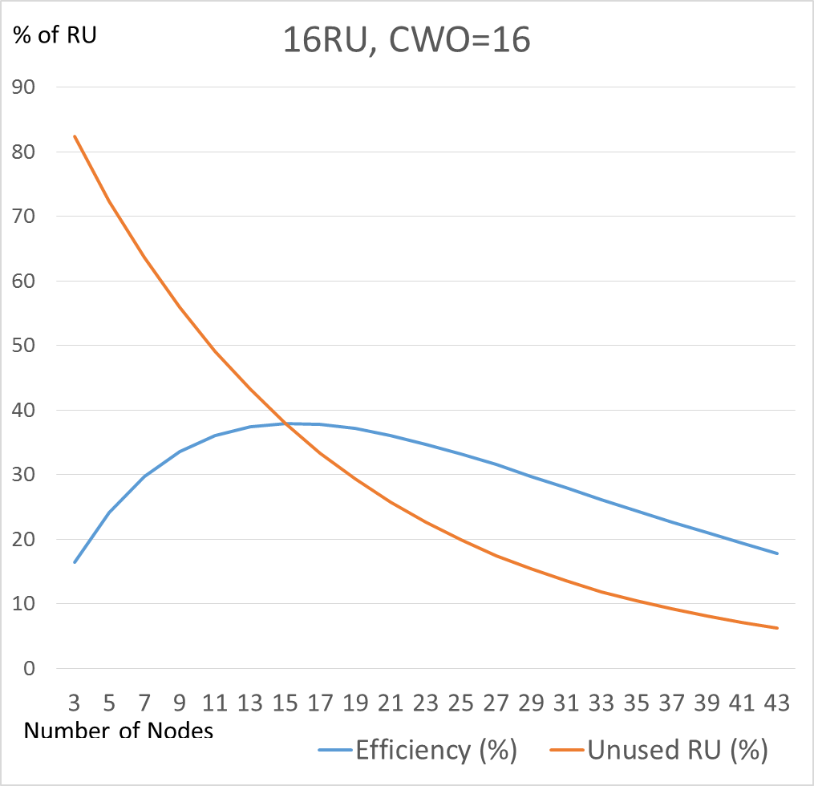
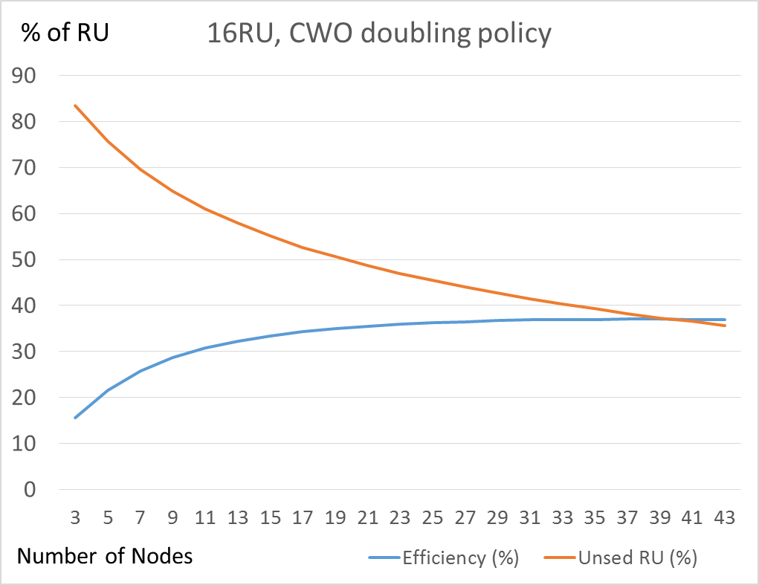
Number of unused RUs in MU_UL OFDMA is also significant… (especially in random access)
Example of simulation results for random RU allocation (TF-R):
Note: some scheduled RUs may also be empty (because scheduled station still in doze state, or no data ready for tx)
Efficiency > 33%
20% < Unused RU < 57%
Efficiency > 33%
35%<Unused RU<57%

Slide 4
Issue : unused RUs modify busy detection ?
Non-ht duplicate
OFDMA UL (random allocation)
Used RU
Primary
channel
TF-R
ACK
Unused RU
Secondary
channel
TF-R
ACK
Collided RU
Tertiary
channel
TF-R
ACK
Quaternary
channel
TF-R
ACK
SIFS
SIFS
A STA performs the energy-detect (ED) per single 20 MHz channel.
Unused RUs can mislead (legacy or foreign OBSS) STAs, so they start transmitting.
STA thinks the 20MHz sub-channel is free (false ED)

Slide 5
Proposed solution : random RUs interleaving.
Non-ht duplicate
OFDMA UL (random RUs allocation)
Scheduled RUs
Primary
channel
TF-R
ACK
ACK
Used Random RUs
Secondary
channel
TF-R
Tertiary
channel
TF-R
ACK
Collided Random RUs
Quaternary
channel
TF-R
ACK
Unused Random RUs
SIFS
SIFS
The AP uniformly distributes the random RUs among the 20Mhz channel, to reduce the impact of having several unused RUs per 20Hz channel.
The AP can group scheduled RUs but should avoid grouping random RUs in a single 20MHz channel.

Slide 6
Conclusion
We note that the MU uplink transmission may lead to have unused RUs, and thus low-energy on corresponding 20MHz channel.
We suppose that this could impact the tentatively reserved MU TXOP, by letting other (legacy/OBSS) transmission occur (same issue as the case of early termination of RU).
As the efficiency of OFDMA random access is already low (<37%), it shall not be more damaged due to amount of unused RUs.
We propose a solution to reduce the risk of collision by legacy devices due to the unused RUs by interleaving (uniformly distributing) the Random and Scheduled RUs in a Trigger Frame.

Slide 7
Straw Poll 1
Do You agree to add to the 802.11 draft specification the following text :
25.5.1.1 : When an AP allocates random RUs in a trigger frame, the AP should interleave random RUs with scheduled RUs over the overall reserved channel, to avoid having only Random RUs in a 20MHz channel.
Y/N/A

Slide 8
References
[1] 11-15/0132r15 “Tgax Specification Framework”,
[2] 11-16/0333r0 “Issue related to unused UL OFDMA RUs”

