Slide 1
Issues related to OCW management
Date: 2016-05-16
Authors:
Name | Affiliation | Address | Email
Patrice NEZOU | Canon | Cesson-Sevigné, France | patrice.nezou@crf.canon.fr
Stéphane BARON |  |  | stephane.baron@crf.canon.fr
Romain GUIGNARD |  |  | romain.guignard@crf.canon.fr
Pascal VIGER |  |  | pascal.viger@crf.canon.fr

Slide 2
Introduction
The TGax SFD [1] includes specifications for the random access Trigger Frame (TF-R) allocating a set of random resource units (RUs) for UL MU OFDMA:
The RU allocation procedure is not clearly described.
The settings and management of parameters associated (OCW, OCW_{min}, OBO …) to the RU allocation procedure are not specified.
This contribution aims to provide clarification and clear mechanisms to optimize the efficiency of the UL MU OFDMA transmission using random trigger frames.
This contribution addresses the following 14 CIDs: 49, 179, 442, 600, 773, 1084, 1085, 1199, 1201, 2177, 2178, 2291, 2384, 2385.

Slide 3
Random RU allocation procedure [1,2]
When a STA has a frame to send, it initializes an OBO counter (OFDMA backoff) to a random value in a range [0,OCW] (OCW: OFDMA Contention Window)
OCW is in a range [OCW_{min}, OCW_{max}] where OCW_{min} is provided by the AP
Upon the reception of a random trigger frame (TF-R), each STA decrements its OBO by the number of RUs specified in the TF-R.
When OBO reaches 0, the STA randomly selects any one of the RUs assigned in the TF-R and initiates a transmission (UL MU OFDMA transmission)

Slide 4
STA side: Effect of OCW « Doubling » policy
As commonly known for the EDCA protocol, a good solution is to double OCW upon each collision detection and to set OCW to OCW_{min} upon the successful transmission.
Results:
OCW Doubling policy guarantees an efficiency greater than 35% for a high number of STAs.
Remaining Issues:
When the number of STAs is low, the efficiency hardly decreases.

Slide 5
AP side: OCW_{min} Determination
AP is the best place to compute OCWmin.
OCW_{min} should take into account:
the number of STA waiting an UL MU OFDMA transmission.
The number of available RUs inside each random trigger frame
But it is impossible to determine OCW_{min} precisely (mainly due to evaluation of number of STAs).
Multiple algorithms could be applied to compute OCWmin by the AP. But simulation results show that a simple OCW_{min} value could be the mean number of available RUs.

Slide 6
AP side: OCW_{min} and TBD parameter Transmission
OCW_{min} is transmitted in the beacon frame.
It can be decoded by all STAs.
Dedicated field is already available.
A rough value is enough to define a global behavior of the network (Nbr of STAs willing to participate to MU UL OFDMA transmission and nbr of available random RUs for trigger frames)
TBD parameter (clause 25.5.2.6) transmitted in the trigger frame = Contention Policy (CP) parameter
Define a bit in the trigger frame named “Contention policy” (CP) parameter and indicating an information about the collision rate
(For instance: set to 1 if the collision rate is greater than 20%)
This CP parameter is inserted in “Trigger-dependent Common Info” field of the trigger frame
Thanks to the CP parameter , each STA can drive its OCW to reach the best efficiency.
The default value of the CP parameter is 1.

Slide 7
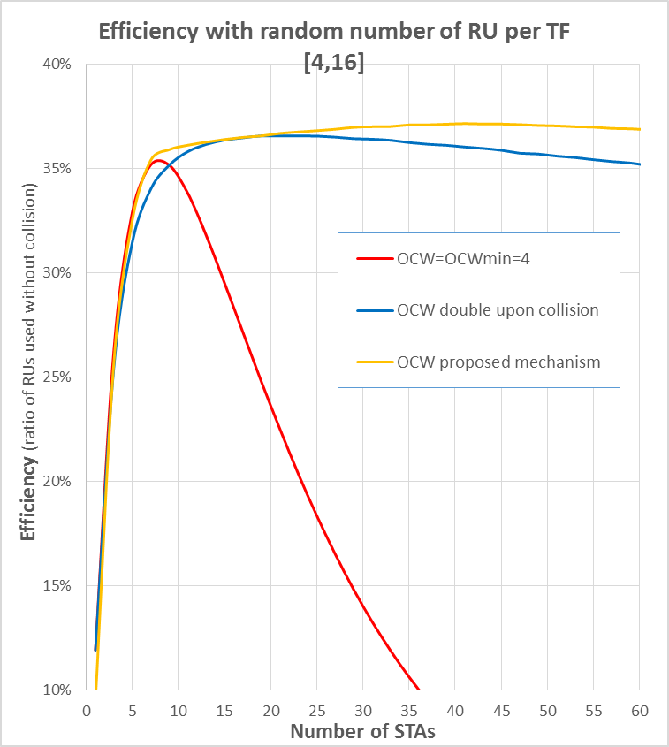
STA side: OCW update proposed mechanism
Upon Beacon frame reception:
Update OCW_{min} with beacon frame information
Upon Trigger Frame reception:
If Contention Policy (CP) parameter = 0,
OCW_{min} = Nbr RUs of the current trigger frame
OCW = OCW_{min} (no doubling upon transmission failure)
If Contention Policy (CP) parameter = 1,
OCW_{min} unchanged
If previous MU UL transmission failed,
OCW= OCW x 2
If previous MU UL transmission succeeded,
OCW = OCWmin

Slide 8
Conclusion
We propose a OCW mechanism allowing to obtain the best efficiency for the MU UL OFDMA transmission.
AP is the best candidate to define a rough value of OCW_{min} transmitted in the beacon frame.
STA must refine the OCW/OCW_{min} values to react as soon as possible to the channel conditions:
Double the OCW upon collision detection
Adapt the OCW_{min} value according to the number of available RUs and to the collision rate
The Contention Policy (CP) parameter is a key parameter to get the best efficiency.

Slide 9
References
[1] 11-15/0132r15 “Tgax Specification Framework”
[2] 11-16/0024r1 “Proposed TGax draft specification”
[3] 11-15/1105r0 “UL OFDMA-based Random Access Procedure”

Slide 10
Straw Poll 1 (AP)
Do you agree to add the following text in the .11ax draft :
25.5.2.6.1 An AP indicates the value of OCW_{min} used by all STAs for the random RU allocation process for the next UL MU OFDMA transmission. The value of OCW_{min} is transmitted through a dedicated field in the beacon frame.
Y/N/A

Slide 11
Straw Poll 2 (AP)
Do you agree to amend the clause 25.5.2.6 in the .11ax draft as follow:
The HE AP indicates an Contention Policy parameter in the Trigger frame for HE STAs to initiate random access following the Trigger frame transmission.
(replaced text in clause 25.5.2.6 : “The HE AP indicates a TBD parameter in the Trigger frame for HE STAs to initiate random access following the Trigger frame transmission.”)
Y/N/A

Slide 12
Straw Poll 3 (STA)
Do you agree to the following text in the .11ax draft :
25.5.2.6 An HE STA that uses the random access procedure maintains an internal counter termed as OBO counter. The OFDMA contention window (OCW) management is based on the following:
Upon Beacon frame reception:
Update OCW_{min} with beacon frame information
Upon Trigger Frame reception:
If Contention Policy parameter = 0,
OCW_{min} = Nbr RUs of the current trigger frame
OCW = OCW_{min} (no doubling upon transmission failure)
If Contention Policy parameter = 1,
OCW_{min} unchanged
If previous MU UL transmission failed,
OCW= OCW x 2
If previous MU UL transmission succeeded,
OCW = OCWmin
Y/N/A

