Slide 1
Dwell Time In Probe Request Presentation
Date: 2016-05-16
Authors:

Slide 2
Abstract
Communication of client channel dwell time (aka MaxChannelTime) in Probe Requests during active channel scanning will decrease the amount of airtime consumed by management frames in a congested environment.
Notes:
Addresses CID just. In text proposal ref other CID.

Slide 3
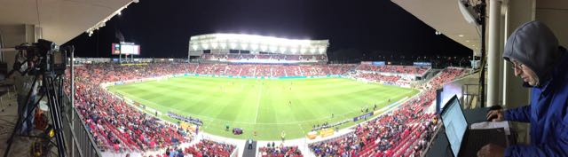
Characterization of Rio Tinto Stadium Environment
Salt Lake City Soccer Stadium
  ~80APs in bowl
  ~105APs total (for concessions and infrastructure)
  ~20k seat capacity
  ½ Full during testing -> ~10k clients
We analyze WiFi data sniffed in this environment and take it to be representative of a High Density WiFi installation.

Slide 4
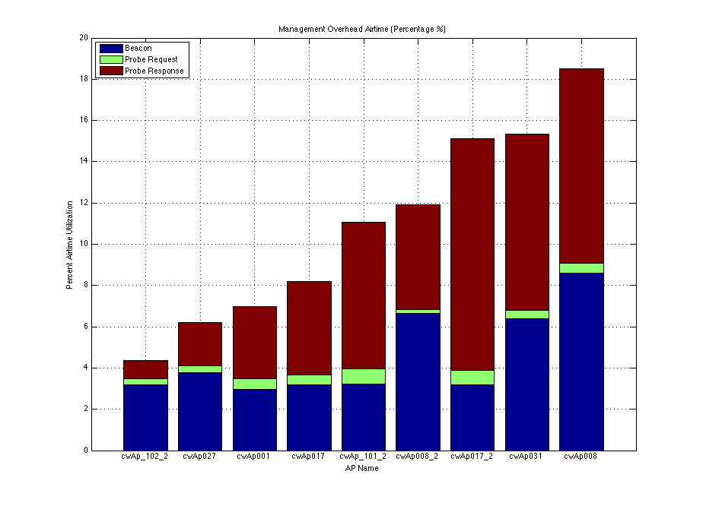
Airtime Utilization in High Density Environment
Management Traffic can consume substantial amounts of airtime.
  Beacons up to 8-9%
  Probe Responses up to 9-10%
  Probe Requests ¼ - ¾%
Utilization depends on AP placement
  APs placed in the center of the stadium hear more clients and other APs.
Notes:
Expand Labels

Slide 5
Probe Response Problem in Congested Network
If an AP cannot successfully transmit a Probe Response in the client Off Channel Scan dwell time, a significant amount of airtime may be consumed for Probe Response management traffic by APs transmitting to a client that has changed channels.

Slide 6
Probe Request Solution to Problem
Problem is solved by the transmission of dwell time, MaxChannelTime, in the broadcast Probe Request. AP2 will not send Probe Responses unnecessarily. Exists in 802.11ai standard but is optional.

Slide 7
Overhead Load vs Benefit
Worst case adding entire FILS Request element is 5 octets additional overhead 2% per Probe Request. Really adding only 1 octet of additional overhead for station already sending FILS Element. This is increase of ½% overhead.
When the Probe Request overhead increases by ½ - 2% to break even on overall management overhead we only need to prevent the transmission of 1 to 4 Probe Responses out of 200.
From the airtime utilization analysis in slide 4 the ratio of Probe Response to Probe Request airtime is 13 – 14. This high ratio gives us an excellent opportunity for a sizable reduction in management traffic.

Slide 8
Client Variation in Active Scan Implementation Provides Opportunity for Benefit
The needed elimination of 1 – 4 Probe Responses in 200 sets a very low bar for overall gain.
Client implementation of active off channel scanning is not standardized and therefore varies from implementation to implementation. MaxChannelTime is not fixed or even known by AP vendors.
AP wants to ensure reception of its Probe Response so that client will stop scanning. But transmitting for the longest MaxChannelTime that accommodates one client may waste transmissions for a client that has a shorter MaxChannelTime.

Slide 9
Client Variation in Active Scan Implementation Provides Opportunity for Benefit
In a congested network, Probe Responses have been observed to consume 9-10% of the total air time.
Within a congested network, Probe Responses’ egress are likely to be delayed and an active scanning client will probably no longer on channel.
Typical networks have multiple BSSIDs, so this repeats for multiple Probe Responses per (broadcast) Probe Request.
Multiplied again, by the number of retries the AP will use for each failed attempt, likely means more than 10 wasted transmissions for a single event.
If we can save 1 Probe Response per 200, the additional overhead of MaxChannelTime transmission is worth it.

Slide 10
Summary
The mandatory inclusion of this simple field with very little overhead and little implementation complexity will provide a substantial reduction in management overhead in a high density environment.

