Slide 1
Multiple BSSID Support
Date: 2016-05-16
Authors:

Slide 2
Abstract
Support of Multiple BSSID information element will contribute substantially to reducing management overhead. Because this feature can be used in Probe Responses, these savings accrue even when only some of the network clients support this feature. This gives an opportunity for introduction of a feature that is universally beneficial.

Slide 3
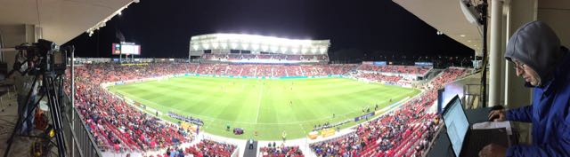
Characterization of Rio Tinto Stadium Environment
Salt Lake City Soccer Stadium
  ~80APs in bowl
  ~105APs total (for concessions and infrastructure)
  ~20k seat capacity
  ½ Full during testing -> ~10k clients
We analyze WiFi data sniffed in this environment and take it to be representative of a High Density WiFi installation.

Slide 4
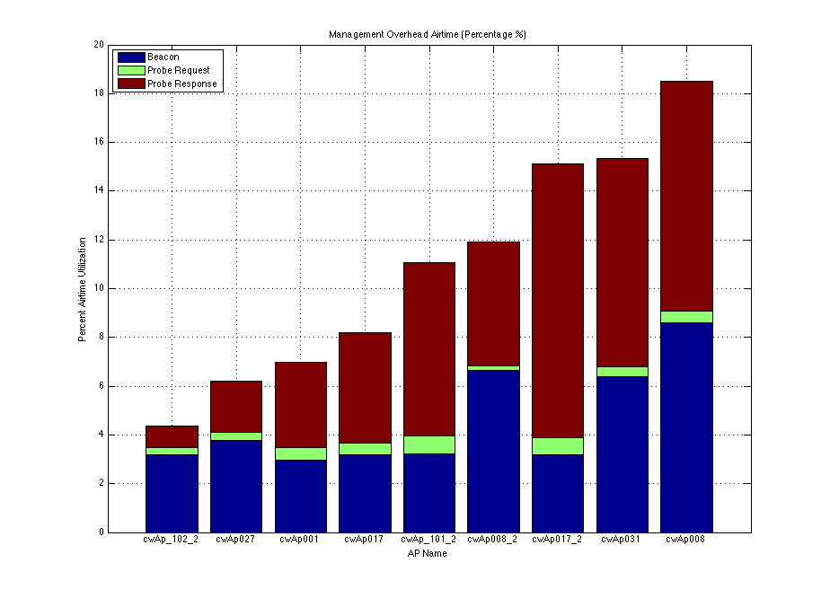
Airtime Utilization in High Density Environment
Management Traffic can consume substantial amounts of airtime.
  Beacons up to 8-9%
  Probe Responses up to 9-10%
  Probe Requests ¼ - ¾%
Utilization depends on AP placement
  APs placed in the center of the stadium hear more clients and other APs.
Notes:
Expand Labels

Slide 5
Multiple SSIDs on every AP
Many deployed networks have Multiple SSIDs broadcast by every physical AP.
This stadium had five SSIDs.
Must compromise convenience of multiple SSIDs for performance.
  During every HD installation Ruckus engineers must advocate and explain the necessity of limiting the number of SSIDs. Ideally only one SSID would be used which oftentimes is not ideal for network management.
Neutral host APs will require more SSIDs which exacerbates this problem.
  One SSID will be needed per provider.

Slide 6
Multiple SSIDs on every AP
With multiple SSIDs multiple Beacons and Probe Responses must be transmitted which wastes access time and airtime.
Illustration of waste and potential savings for Probe Responses.

Slide 7
Multiple BSSID Airtime Savings
The diagrams below show standard broadcast probe request response behavior above the proposed broadcast probe request behavior.
All of the time indicated in light gray is saved when the network can make use of the multiple BSSID feature.
The savings can be broken into two components.
Access Time
Transmission Time

Slide 8
AccessTime Benefits
For management frames CWmin might be set to 2 or 3 which corresponds to 4 to 8 slots. In this case 36us to 72us are consumed per medium access.
A network having 5 SSIDs in which a broadcast probe request is heard by 5 APs will need to access the airtime 25 times. With implementation of the multiple BSSID feature only 5 accesses would be necessary providing a savings of 720us to 1.4ms.
The above calculations are conservative assuming no other devices contending for the network and no chance of collision.

Slide 9
AccessTime Benefits Cont.
In a congested network these numbers can become much worse.
  CWmin should increase in a congested network
  Collisions require rebroadcast of packets
Management packets contending for airtime preempt desirable useful data packets. Implementation of the Multiple BSSID feature can dramatically reduce the number of management packets contending for the medium. This allows for greater transmission of useful data with less latency.

Slide 10
Time Savings for Probe Response in a Network with 5 SSIDs
 | Without Multiple BSSIDs |  |  |  | With Multiple BSSIDs
Field | Octets in Field | Repetitions | Total Octets |  | Octets in Field | Repetitions | Total Octets
3 Address Header w/o BSSID | 18 | 5 | 90 |  | 18 | 1 | 18
BSSID | 6 | 5 | 30 |  | 8 | 5 | 40
Fixed Params (time & interval) | 10 | 5 | 50 |  | 10 | 1 | 12
Fixed params (capabilities) | 2 | 5 | 10 |  | 4 | 5 | 20
SSID | 9 | 5 | 45 |  | 9 | 5 | 45
Supported Rates | 6 | 5 | 30 |  | 6 | 1 | 6
DS Param Set | 3 | 5 | 15 |  | 3 | 1 | 3
Country Info | 18 | 5 | 90 |  | 18 | 1 | 18
ERP Info | 3 | 5 | 15 |  | 3 | 1 | 3
Extended Supported Rates | 10 | 5 | 50 |  | 10 | 1 | 10
WMM/WME | 26 | 5 | 130 |  | 26 | 5 | 130
HT Capabilities | 28 | 5 | 140 |  | 28 | 1 | 28
HT Information | 24 | 5 | 120 |  | 24 | 1 | 24
Total | 163 |  | 815 |  |  |  | 357

Slide 11
Multiple BSSID Packet Time Savings
5 SSID’s in Stadium Environment
Current Probe Response Transmission
  163 octet payload at 12Mbs takes 132us
  Repeated 5 times takes 660us
Proposed Probe Response Transmission
  327 octet payload at 12Mbs takes 240us
  Only transmitted once
Savings of 420ms or 64% savings
Effect in Rio Tinto
  Currently 9% of Network Airtime Consumed by Probe Responses
  Becomes only 3% of Network Airtime

Slide 12
Multiple BSSID Total Savings
Probe Response Access Time drops from
900us to 180us saving 720us
Probe Response Transmission Time drops from
660us to 240us saving 240us
Total savings
1560us to 420us saving 1140us
73% improvement from the current 9-10% airtime consumed

Slide 13
Summary
The implementation of the straight-forward Multiple BSSID mechanism can produce real immediate savings in existing high density networks.
Additionally mandating this feature now will start the process of getting it implemented in clients allowing future networks to achieve additional savings by allowing Beacons make use of the feature.

