Slide 1
Need of SDU Fragmentation to Reduce Padding Ratio in UL-OFDMA Transmission
Date: 2016-05-11
Authors:

Slide 2
Abstract
The submission analysis padding ratio of UL –OFDMA transmissions without SDU fragmentation based on simulation results
Typical padding ratio is between 0 and 15%

Slide 3
Background and Problem Description
In 802.11ax UL-OFDMA transmission, transmission duration, RU allocation and MCS are specified in a Trigger Frame (TF) sent from an AP to STAs
After receiving a TF, an AMPDU is generated in a STA for transmission. When adding an additional SDU exceeds the specified transmission duration, either the SDU should be fragmented or padding needs to be applied.
Scheduled duration
PDU(n)
PDU(n+1)
Padding duration
Notes:
Specify the scope and target more clear

Slide 4
Scope of the Study
Padding due to insufficient data in STA buffer comparing to the scheduled radio resources is not in the scope of this study
The simulation in this study was designed to exclude the padding due to insufficient data by using full buffer traffic

Slide 5
Target of Study
Identify typical padding ratio for UL OFDMA transmissions based on simulation results
Given the identified padding ratio, identify the necessity of SDU fragmentation
SDU fragmentation brings additional overhead and complexity

Slide 6
Simulation Setup
System configuration:
802.11ax frame configuration, 80 MHz BW
Equal RU allocation among scheduled STAs
MCS is selected based on the actual SINR before transmission
Duration for scheduled UL OFDMA transmission: 1 ms to 5 ms
Scenario:
1 AP: cell radius between 50 m and 250 m
2 or 10 STAs randomly located within the AP coverage area
Full buffer UDP uplink traffic
Typical IPv4 packet size: 500 B, 1500 B
Notes:
Elaborate the full buffer choice

Slide 7
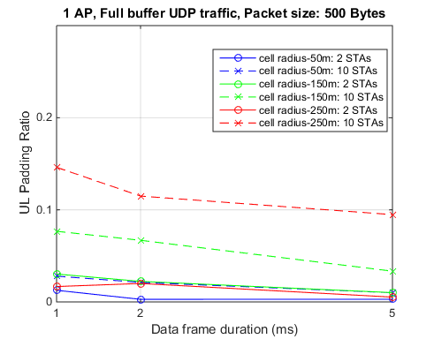
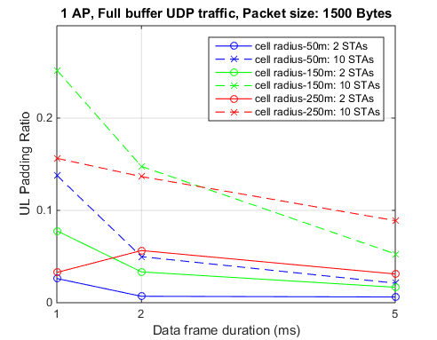
Simulation Results
In general higher padding ratio was observed with larger cell radius (lower MCS), shorter transmission duration and larger packet size
500 B: 0 – 10% (Max: 15%)
1500 B: 0 – 15% (Max: 25%)
Notes:
With fragmentation: assume 0% padding

Slide 8
Conclusion
By avoid scheduling relatively short (< 1 ms) UL OFDMA transmissions for low MCS transmission, the padding ratio is most time less than 10%
Given the overhead and implementation issues of SDU fragmentation, we suggest SDU fragmentation should not be mandatory for the purpose of padding reduction

Slide 9
Straw Poll
Do you believe the option of fragmentation should be removed from the ax specification?
Yes 6
No 21
Abstain 12

