Slide 1
1st Vice Chair Report –
May 2016 - Waikoloa
Date: 2016-05-18
Authors:

Slide 2
Abstract
Agenda Items for 1st Vice Chair -
M3.3 II Other WG meeting plans
M3.4 II Meeting room locations
M3.5 II Next meeting reminder
M3.6 II Meeting registration
M3.7 II Recording attendance
M3.8 II File server
M3.9 II Breakfast, breaks, Social logistics
Friday:
  F3.1.1 II Straw Poll of membership regarding this meeting location
  F3.1.2 DT Future venues status and discussion

Slide 3
Monday–
802.11 Opening Plenary
802.11 First Vice Chair Report

Slide 4
M3.3 Other WG meeting plans
802.11 802.15 802.16 802.18 802.19 802.21 802.24
Treasurer Report:
Patent policy (in IEEE-SA bylaws), patent policy (slide set), and antitrust guidelines

Slide 5
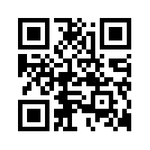
M3.4 Meeting room locations
MOBILE DEVICE SCHEDULE
http://802world.org/attendee

Slide 6
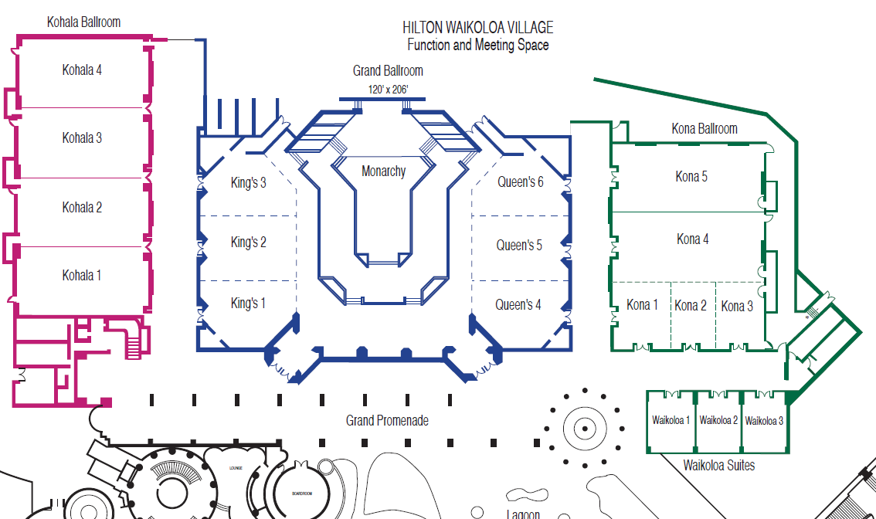
M3.4 Meeting Room Locations

Slide 7
Online Calendar
This session’s meetings are also shown on the 802.11 calendar on the 802.11 home page (http://www.ieee802.org/11).
This is a Google calendar “802_11_calendar@ieee.org”
There are multiple ways of accessing this information, for example from a cell-phone, or as a remote calendar.
Note: the schedule on this calendar will be updated as will IMAT.

Slide 8
M3.5 Next meeting reminder
802 Plenary: 24-29 July 2016
Manchester Grand Hyatt, San Diego, CA, USA
Meeting Registration
Hotel Reservations
Social Ticket Purchase
Make Hotel Reservations NOW!
Early-Bird Meeting Registration Deadline: 27 May 2016
Remember to purchase Networking Social Ticket

Slide 9
July 2016 Networking Social
Registered attendees and their guests are invited to attend a casual reception with comedic entertainment by acclaimed tech industry entertainer Don McMillian.
Date: Wednesday July 27, 2016
Time: 6:30 PM – 8:30 PM
Place: Grand Hyatt Manchester (Room TBC)
SOCIAL TICKET PRICE: $US 24.99 each
  Tickets are non refundable, but are transferable.
SOCIAL TICKET PURCHASE WEBSITE
  Tickets may be purchased online at: http://802world.org/plenary/social/
SOCIAL TICKET PICK UP
  Tickets may be picked up at the IEEE 802 Plenary Registration Desk
  Ticket Receipt and Photo ID Required.

Slide 10
M3.5 Next Meeting Reminder (Cont)
2016 Sept 11-16 802 Wireless Interim:
Marriott Warsaw, Warsaw, Poland
Registration opens in about 10 days….

Slide 11
M3.6 Meeting registration
IEEE 802W Interim Session – May 15-20, 2016 Registration Report by Working Group
Working Group | Number
802.11 | 242
802.15 | 57
802.xx | 11
802.21 | 10
802.19 | 8
none | 7
802.18 | 5
802.24 | 2
802.16 | 1
Updated 2016-05-15

Slide 12
M3.7 Recording attendance
It is a requirement that attendees record their participation at an 802.11 session and declare their affiliation. This record is usually made using the IMAT attendance system.
  If you wish to participate without recording attendance, send an email per session to the WG 2nd vice chair declaring your participation and affiliation. You cannot gain or maintain 802.11 voting membership using this method.
You must record 75% attendance of required 802.11 slots in a session for that session to count towards gaining or maintaining 802.11 voting membership
  You need a single IEEE-SA web account
    The IEEE SA web account requires a working email address
    do not remove your email address from the account
  Use the email address associated with that web account when registering attendance
    If you change email addresses, update the web account, don’t create a new web account, or your membership status may not be calculated properly
  Record attendance using this URL: IMAT.IEEE.ORG/

Slide 13
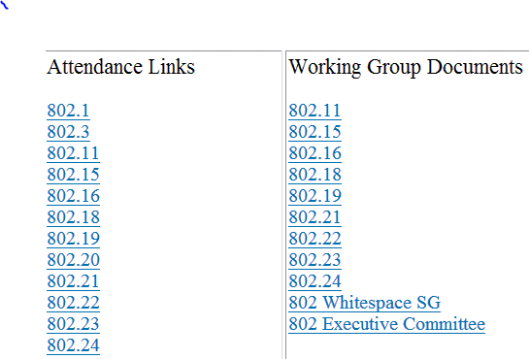
M3.8 Local File Document Server information
Local FTP server: ftp://griffin.events.ieee.org (anonymous)
External Document Server https://mentor.ieee.org/802.11/documents

Slide 14
M3.09 FOOD & BEVERAGE
Breakfast: 07:15 to 08:30
Morning Coffee/Tea 10:00 to 11:00
Lunch Service 12:00 to 13:30
Afternoon Coffee/Tea/Snacks 15:00 to 16:00
Served at Lagoon Lanai
For Registered Attendees Only

Slide 15
M3.9 Social Event
Registered attendees and their guests are invited to attend a casual networking reception at the Lagoon Lanai.
Wednesday 18 May 2016
6:30 pm - 8:30 pm
Tickets are not required.
Please wear your name badge
Pick-up Guest badges at Registration Desk.
Drink Ticket included with name badge

Slide 16
802.11 Mid-Week Plenary
Agenda Items:
2.5 – Announcements
5.1 – Room Change Reports

Slide 17
2.5 II Announcements
Reminder about Social Tonight
Wednesday 18 May 2016
6:30 pm - 8:30 pm
Tickets are not required.
Please wear your name badge
Pick-up Guest badges at Registration Desk.
Drink Ticket included with name badge

Slide 18
W5.1 Room Change Requests
Delete:
LRLP adjourned (WED AM1 and Thurs PM1)
TGay (Thurs AM1)

Slide 19
802.11 WG Closing Plenary
Agenda Items:
3.1.1 – Straw Poll
3.1.2 -- Future venues status and discussion

Slide 20
F3.1.1 -Straw Poll of membership regarding this meeting location
Straw Poll:
How many people would like to come back to this venue?
Yes -
No –

Slide 21
F3.1.2: Future Venue Insight
Future 802 Wireless Interims:
Sept 2016 Warsaw Marriott, Poland
Jan 2017 Hyatt Regency Atlanta
May 2017 Daejeon Convention Center, Korea
Sept 2017 Hilton Waikoloa
Jan 2018 Hotel Irvine
May 2018 TBD
Sept 2018 Hilton Waikoloa

Slide 22
F3.1.2: Future Venue Insight
Future 802 Plenary Sessions:
  July 2016 Manchester Grand Hyatt – San Diego
  Nov 2016 Grand Hyatt San Antonio
  March 2017 Hyatt Regency/Fairmont – Vancouver
  July 2017 Estrel Hotel – Berlin
  Nov 2017 Caribe Hotel and Convention Center – Orlando
  March 2018 Hyatt Regency O’Hare – Rosemont, IL
  July 2018 Manchester Grand Hyatt – San Diego
  Nov 2018 Suzhou, China - TBC
    (New facility, pricing model being negotiated, Sponsor capability investigation)

Slide 23
References
https://mentor.ieee.org/802-ec/dcn/12/ec-12-0040-11-00EC-802-plenary-future-venue-contract-status.xlsx

