Slide 1
TGax May 2016 Meeting Agenda
Date: 2016-04-05
Authors:

Slide 2
IEEE 802.11 TGax:
High Efficiency WLAN
Task Group
Big Island, Hawaii, USA
May 15-20, 2016
Chair: Osama Aboul-Magd (Huawei Technologies)
Vice Chair: Simone Merlin (Qualcomm)
Vice Chair: Ron Porat (Broadcom)
Secretary: Yasuhiko Inoue (NTT)
Technical Editor: Robert Stacey (Intel)

Slide 3
Meeting Protocol
Please announce your affiliation when you first address the group during a meeting slot
Slide 3

Slide 4
Attendance
http://newton.meeting.verilan.com
Register
Indicate attendance
Slide 4

Slide 5
Attendance, Voting & Document Status
Make sure your badges are correct
If you plan to make a submission be sure it does not contain company logos or advertising
Questions on Voting status, Ballot pool, Access to Reflector, Documentation, member’s area
  see Jon Rosdahl – jrosdahl@ieee.org
Cell Phones Silent or Off
Slide 5

Slide 6
Patent Policy
Following 5 slides

Slide 7
Instructions for the WG Chair
The IEEE-SA strongly recommends that at each WG meeting the chair or a designee:
  Show slides #1 through #4 of this presentation
  Advise the WG attendees that:
    The IEEE’s patent policy is described in Clause 6 of the IEEE-SA Standards Board Bylaws;
    Early identification of patent claims which may be essential for the use of standards under development is strongly encouraged;
    There may be Essential Patent Claims of which the IEEE is not aware. Additionally, neither the IEEE, the WG, nor the WG chair can ensure the accuracy or completeness of any assurance or whether any such assurance is, in fact, of a Patent Claim that is essential for the use of the standard under development.
  Instruct the WG Secretary to record in the minutes of the relevant WG meeting:
    That the foregoing information was provided and that slides 1 through 4 (and this slide 0, if applicable) were shown;
    That the chair or designee provided an opportunity for participants to identify patent claim(s)/patent application claim(s) and/or the holder of patent claim(s)/patent application claim(s) of which the participant is personally aware and that may be essential for the use of that standard
    Any responses that were given, specifically the patent claim(s)/patent application claim(s) and/or the holder of the patent claim(s)/patent application claim(s) that were identified (if any) and by whom.
  The WG Chair shall ensure that a request is made to any identified holders of potential essential patent claim(s) to complete and submit a Letter of Assurance.
  It is recommended that the WG chair review the guidance in IEEE-SA Standards Board Operations Manual 6.3.5 and in FAQs 14 and 15 on inclusion of potential Essential Patent Claims by incorporation or by reference.
  Note: WG includes Working Groups, Task Groups, and other standards-developing committees with a PAR approved by the IEEE-SA Standards Board.
(Optional to be shown)

Slide 8
Participants, Patents, and Duty to Inform
All participants in this meeting have certain obligations under the IEEE-SA Patent Policy.
  Participants [Note: Quoted text excerpted from IEEE-SA Standards Board Bylaws subclause 6.2]:
    “Shall inform the IEEE (or cause the IEEE to be informed)” of the identity of each “holder of any potential Essential Patent Claims of which they are personally aware” if the claims are owned or controlled by the participant or the entity the participant is from, employed by, or otherwise represents
    “Should inform the IEEE (or cause the IEEE to be informed)” of the identity of “any other holders of potential Essential Patent Claims” (that is, third parties that are not affiliated with the participant, with the participant’s employer, or with anyone else that the participant is from or otherwise represents)
  The above does not apply if the patent claim is already the subject of an Accepted Letter of Assurance that applies to the proposed standard(s) under consideration by this group
  Early identification of holders of potential Essential Patent Claims is strongly encouraged
  No duty to perform a patent search
Slide #1

Slide 9
Patent Related Links
  All participants should be familiar with their obligations under the IEEE-SA Policies & Procedures for standards development.
  Patent Policy is stated in these sources:
  IEEE-SA Standards Boards Bylaws
  http://standards.ieee.org/develop/policies/bylaws/sect6-7.html#6
  IEEE-SA Standards Board Operations Manual
  http://standards.ieee.org/develop/policies/opman/sect6.html#6.3
  Material about the patent policy is available at
  http://standards.ieee.org/about/sasb/patcom/materials.html
If you have questions, contact the IEEE-SA Standards Board Patent Committee Administrator at patcom@ieee.org or visit http://standards.ieee.org/about/sasb/patcom/index.html
This slide set is available at https://development.standards.ieee.org/myproject/Public/mytools/mob/slideset.ppt
Slide #2

Slide 10
Call for Potentially Essential Patents
If anyone in this meeting is personally aware of the holder of any patent claims that are potentially essential to implementation of the proposed standard(s) under consideration by this group and that are not already the subject of an Accepted Letter of Assurance:
  Either speak up now or
  Provide the chair of this group with the identity of the holder(s) of any and all such claims as soon as possible or
  Cause an LOA to be submitted
Slide #3

Slide 11
Other Guidelines for IEEE WG Meetings
All IEEE-SA standards meetings shall be conducted in compliance with all applicable laws, including antitrust and competition laws.
  Don’t discuss the interpretation, validity, or essentiality of patents/patent claims.
  Don’t discuss specific license rates, terms, or conditions.
    Relative costs, including licensing costs of essential patent claims, of different technical approaches may be discussed in standards development meetings.
      Technical considerations remain primary focus
  Don’t discuss or engage in the fixing of product prices, allocation of customers, or division of sales markets.
  Don’t discuss the status or substance of ongoing or threatened litigation.
  Don’t be silent if inappropriate topics are discussed … do formally object.
---------------------------------------------------------------
See IEEE-SA Standards Board Operations Manual, clause 5.3.10 and “Promoting Competition and Innovation: What You Need to Know about the IEEE Standards Association's Antitrust and Competition Policy” for more details.
Slide #4

Slide 12
Agenda Items for the Week
Approve TG and Telecons minutes since March meeting.
Confirmation of the TG leadership
Resolution of comments received on draft D0.1
Ad Hoc group meetings
Technical Presentations and related straw polls and/or motions
Schedule Telecon times.

Slide 13
General Flow of the Meeting
Monday May16, 10:30 – 12:30
  Call Meeting to order
  IEEE 802 and 802.11 IPR Policy and procedure.
  Review from March 2016 meeting
  Call for submissions
  Agenda setting and approval
  TG Motions
  Presentations
  Recess
Monday May 16, 16:00 – 18:00
  Ad Hoc Group Meetings
Tuesday May 17, 10:30 – 12:30
  Ad Hoc Group Meetings
Tuesday May 17, 14:00 – 16:00
  Ad Hoc Group Meetings
Tuesday May 17, 19:30 – 21:30
  Call Meeting to order
  IEEE 802 and 802.11 IPR Policy and procedure.
  Presentations
  Recess
Wednesday May 18, 13:30 – 15:30
  Ad Hoc Group Meetings
Wednesday May 18, 16:00 – 18:00
  Ad Hoc Group Meetings
Thursday May 19, 10:30 – 12:30
  Call Meeting to order
  IEEE 802 and 802.11 IPR Policy and procedure.
  Presentations
  TG Motions
  Recess
Thursday May 19, 16:00 – 18:00
  Call Meeting to order
  IEEE 802 and 802.11 IPR Policy and procedure.
  Presentations
  TG Motions
  Goals for March 2016
  Telecon Schedule
  Adjourn

Slide 14
TGax Schedule in a Glance
 | Monday |  | Tuesday |  | Wednesday |  | Thursday
AM1
AM2 | TGax |  | PHY | MAC/SR |  |  | TGax
PM1 |  |  |  |  | PHY | MAC/SR
PM2 | PHY | MAC/SR | PHY | MU | PHY | MAC/SR | TGax
EVE | PHY | MU | TGax
* Ad Hoc group is tbd

Slide 15
PHY Submissions
DCN | Title | Author | Ad Hoc
11-16/0608 | Beamforming Feedback Report Structure | Sameer Vermani | PHY
11-16/0610 | CR HE-SIG-A Part I | Ross Jian Yu | PHY
11-16/0611 | Remaining Issues in Trigger Frame Design | Sameer Vermani | PHY
11-16/0613 | SIG-B Related Issues | Lochan Verma | PHY
11-16/0614 | Comment Resolution on Clause 26.1.1 Part 1 | Lochan Verma | PHY
11-16/0615 | Comment Resolution on Clause 26.3.12 Part 1 | Lochan Verma | PHY
11-16/0617 | Remaining Topics in Power Control | Bin Tian | PHY
11-16/0618 | 11ax CSD Design | Bin Tian | PHY
11-16/0619 | PAPR Reduction of HE-SIGB | Bin Tian | PHY
11-16/0620 | DCM PHY Parameters | Hongyuan Zhang | PHY
11-16/0621 | DCM Interleaver | Tianyu Wu | PHY
11-16/0622 | 16 QAM Napping for DCM | Sudhir Srinivasa | PHY
11-16/0623 | CR on Section 26.3.10.12 | Bin Tian | PHY
11-16/0625 | CR on Section 26.3.6 | Bin Tian | PHY
11-16/0626 | Feedback Element Compression for 802.11ax | Kome Oteri | PHY
11-16/0633 | Left over Issues in RU Signaling for HE-SIGB | Yan Zhang | PHY
11-16/0634 | 11ax Comment Resolutions for Clauses 26.3.2 | Yan Zhang | PHY
11-16/0635 | BW indication for Non-contiguous Channel Bonding | Yunbo Li | PHY
11-16/0636 | TXOP Duration field in HE-SIG-A | Jeongki Kim | PHY
11-16/0637 | Load balancing indication for MU-MIMO over 484-tone and larger RU in OFDMA | Ming Gan | PHY
11-16/0638 | Discussions for Non-contiguous Channel Bonding | John Son | PHY
11-16/0639 | Follow-up on HE-SIG-B user-specific field | Jinsoo Choi | PHY
11-16/0649 | Feedback Tone Map and Quantization | Sriram Venkateswaran | PHY
11-16/0652 | Power scaling of 4 extra tones | Xiaogang Chen | PHY
11-16/0653 | CR on section 26.3.3 | Xiaogang Chen | PHY
11-16/0654 | CP and LTF Options and Signaling | Ron Porat | PHY
11-16/0655 | On MCS0 DCM Modulation and DCM Capability | Jianhan Liu | PHY
11-16/0656 | 1024QAM Modulation | Jianhan Liu | PHY
11-16/0658 | CR on 26.3.7.1 | Jinsoo Choi | PHY
11-16/0659 | CR on 26.3.9.9 and 26.3.5 | Eunsung Park | PHY
11-16/0663 | CR on Secition 26.2.2 | Ke Yao | PHY
11-16/0681 | Comment Resolution CID 215 2486 | Daewon Lee | PHY
11-16/0682 | CR CID on PHY data field other | Daewon Lee | PHY
33 Submissions

Slide 16
MAC Submissions
DCN | Title | Author | Ad Hoc
11-16/0583 | Backoff Procedure Handling Upon TF Reception | Yu Wang | MAC
11-16/0584 | Need of SDU Fragmentation to Reduce Padding Ratio in UL-OFDMA Transmission | Yu Wang | MAC
11-16/0588 | Channel State Estimation based Bidirectional Initialized Random Access | Bo Li | MAC
11-16/0590 | Multi-BSS Association for Edge Users¡¯ Throughput Improvements | Mao Yang | MAC
11-16/0616 | BlockAck generation and selection rules | Alfred Asterjadhi | MAC
11-16/0627 | ROM Recovery Rules | Jayh Hyunhee Park | MAC
11-16/0628 | Buffer Status Report in HE Control field | Jayh Hyunhee Park | MAC
11-16/0640 | BSS Color Collision | Geonjung Ko | MAC
11-16/0641 | Regarding HE fragmentation | Woojin Ahn | MAC
11-16/0643 | HE Control Scheduling | Liwen Chu | MAC
11-16/0644 | SS Allocation in Trigger | Liwen Chu | MAC
11-16/0645 | MU Minimum MPDU Start Spacing | Liwen Chu | MAC
11-16/0646 | HE Beamforming Feedback | Liwen Chu | MAC
11-16/0657 | In-device Multi-radio Coexistence and UL MU operation | Robert Stacey | MAC
11-16/0673 | Multi-User EDCA | Jinsoo Ahn | MAC
11-16/0674 | EIFS excess problem of Acknowledgement for UL MU procedure | Hanseul Hon | MAC
11-16/0675 | comment resolution for CID2383 | Yonggang Fang | MAC
11-16/0684 | Channel Access Efficiency | Evgeny | MAC
18 Submissions

Slide 17
MU Submissions
DCN | Title | Author | Ad Hoc
11-16/0582 | Random Access RU Allocation in the Trigger Frame | Evgeny Khorov | MU
11-16/0591 | Issues related to OCW management | Patrice Nezou | MU
11-16/0592 | Follow up on Issue related to unused UL OFDMA Rus | Stephane Baron | MU
11-16/0648 | MU-RTS/CTS PHY Format | Po-Kai Huang | MU
11-16/0661 | Adaptive Random Access UL OFDMA | Leonardo Lanante | MU
11-16/0662 | Further consideration on channel access rule to facilitate MU transmission opportunity | Jing Ma | MU
11-16/0664 | Consideration on backoff procedure for UL MU transmission | Jing Ma | MU
11-16/0665 | Some Notes on Interference Alignment for Downlink Multi-User MIMO | Dzevdan Kapetanovic | MU
11-16/0667 | Signaling of Multi-TID Aggregation Limit | Chittabrata Ghosh | MU
9 submissions

Slide 18
SR Submissions
DCN | Title | Author | Ad Hoc
11-16/0581 | Proposed changes to SR clause | Soma Tayamon | SR
11-16/0589 | actional-Backoff Procedure and Dynamic CCA | Bo Li | SR
11-16/0647 | Consideration of Spatial Reuse for Trigger Frame | Po-Kai Huang | SR
3 submissions

Slide 19
TG submissions
DCN | Title | Author | Ad Hoc
11-16/0571 | QoS Handling of Trigger Frame | Yu Wang | TG
11-16/0597 | Indoor Enterprise Scenarios, Color, DSC and TPC | Graham Smith | TG
11-16/0604 | Simulation-based evaluation of DSC in enterprise scenario | Tanguy Ropitault | TG
11-16/0609 | HE NDPA Frame Format | Ross Jian Yu | TG
11-16/0612 | Mandatory/Optional Support Issues for 802.11ax | Sameer Vermani | TG
11-16/0629 | Box5 Calibration Results | Andrew Tsai | TG
6 submissions

Slide 20
Agenda for Monday May 16, 10:30 – 12:30
Call meeting to order
Patent policy, etc.
Call for submissions
Set Ad Hoc Groups schedule and approve agenda
Affirmation vote for the TG leadership
TG motions
  Approve TG meeting and Telecon minutes since November meeting.
Comment Resolution Status – Robert Stacey
Summary since March 2016 meeting
Timeline
The End of the SFD process
PAR Reminder
Presentations and Comment Resolution
  11-16/0571
  11-16/0597
  11-16/0604
Recess

Slide 21
Confirmation of the TG Leadership
From 802.11 Operation Manual
  https://mentor.ieee.org/802.11/dcn/14/11-14-0629-14-0000-802-11-operations-manual.docx
See next page

Slide 22
Task Group Chair
The TG Chair shall be appointed by the WG Chair and confirmed by a WG majority approval. The TG Chair is re-affirmed every 2 years: one session after the WG Chair is elected.
The TG Chair is required to confirm that the function of secretary is performed for each TG meeting. TG meetings are not allowed to function without a secretary.
Task Group Vice-Chair
TG Vice-Chair is elected by a TG majority approval and confirmed by a WG majority approval. The TG Vice-Chair is reaffirmed every 2 years; one session after the WG Chair is elected.
Task Group Secretary
The TG Secretary shall be appointed by the TG Chair and confirmed by a TG motion that is approved with a minimum 50% majority. The TG Secretary is re-affirmed every 2 years; one session after the WG Chair is elected.
The minutes of meetings taken by the TG Secretary (or designee) are to be provided to the TG Chair in time to be available to the WG Chair for publication 30- days after close of the session.
The minutes of the meeting are to include documents produced by the voting process and document list. See section 10 of this document (802.11 Guidelines for Secretaries) for details on content and form of minutes.
Task Group Technical Editor
The TG Technical Editor shall be appointed by the TG Chair and confirmed by a TG majority approval.
The TG Technical Editor is responsible for:
Organizing, maintaining the draft standards for the TG in the format used by the IEEE standards department.
Preparing technical drafts following the editor’s guidelines in section 11 of this document.
Preparing an update of the draft standard as soon after a session as possible, as directed by the TG.
Proof reading and coordinating changes of documents edited by IEEE staff.
Sending the TG Chair the following:
The Adobe Acrobat PDF file of the standard ([other3]).
A word processing document file in a format that is acceptable by the IEEE standards department.

Slide 23
Confirmation of the TG Leadership
Confirmation of the TG Chairs will be done by the WG Chair on Friday.
The TG need to confirm the Vice Chairs, Secretary, and Technical Editor

Slide 24
Confirmation of Vice Chairs, Secretary, and Technical Editor
Position | Name
1st Vice Chair | Simone Merlin
2nd Vice Chair | Ron Porat
Secretary | Yasuhiko Inoue
Technical Editor | Robert Stacey
Move to confirm Simone Merlin, Ron Porat, Yasuhiko Inoue, and Robert Stacey for the positions of 1st Vice Chair, 2nd Vice Chair, Secretary, and Technical Editor respectively.
Move: Al Petric Second: Bin Tian
Y/N/A
Approved with no objection

Slide 25
Ad Hoc Group Chairs
MAC | PHY | MU | Spatial Reuse
Eric Wong (Apple) | Bo Sun (ZTE) | Sigurd Schelstraete (QAT) | Laurent Cariou (Orange)
Reza Hedayat (NEWRACOM) | Jianhan Liu (MTK) | Kiseon Ryu (LG) | Guido Hiertz (Ericsson)
Brian Hart (Cisco) | Yakun Sun (MRVL) | Kaushik Josiam (Samsung) | Jae Seung Lee (ETRI)

Slide 26
Ad Hoc Group Chairs
MAC | PHY | MU | Spatial Reuse
Eric Wong (Apple) | Bo Sun (ZTE) | Sigurd Schelstraete (QAT) | Laurent Cariou (Orange)
Reza Hedayat (NEWRACOM) | Jianhan Liu (MTK) | Kiseon Ryu (LG) | Guido Hiertz (Ericsson)
Brian Hart (Cisco) | Hongyuan Zhang (MRVL) | Kaushik Josiam (Samsung) | Jae Seung Lee (ETRI)

Slide 27
Summary since March 2016 Meeting
Approved TG draft D0.1 and started a 21-day comment collection period.
The comment collection period closed on April 11. 2919 comments were received.
Held a three of Telecons (April 14 and April 21, May 5). All comments are assigned.

Slide 28
Approval of TG Minutes ( March 2016 Meeting and Telecon Minutes)
Approve TGax minutes of meetings and teleconferences from March 2016 interim meeting to today:
  https://mentor.ieee.org/802.11/dcn/16/11-16-0415-01-00ax-tgax-march-2016-macau-meeting-minutes.docx
  https://mentor.ieee.org/802.11/dcn/16/11-16-0536-02-00ax-tgax-teleconference-minutes-april-14th-2016.docx
  https://mentor.ieee.org/802.11/dcn/16/11-16-0568-01-00ax-tgax-teleconference-minutes-april-21st-2016.docx
  https://mentor.ieee.org/802.11/dcn/16/11-16-0575-01-00ax-tgax-teleconference-minutes-may-5th-2016.docx
  https://mentor.ieee.org/802.11/dcn/16/11-16-0537-00-00ax-spatial-reuse-ad-hoc-group-march-2016-minutes.docx
  https://mentor.ieee.org/802.11/dcn/16/11-16-0509-00-00ax-tgax-march-2016-macau-phy-ad-hoc-meeting-minutes.docx
  https://mentor.ieee.org/802.11/dcn/16/11-16-0439-01-00ax-mar-2016-macau-tgax-mac-ad-hoc-meeting-minutes.docx
  https://mentor.ieee.org/802.11/dcn/16/11-16-0466-00-00ax-tgax-mu-ad-hoc-meeting-minutes-march-2016.docx
Move: Simone Merlin Second: Al Petrick
Accepted with no objection

Slide 29
Comment Resolution Status
(Editor Report)
Robert Stacey

Slide 30
Timeline
Proposed Timeline
Current Timeline
May 2014: start of the TG
Nov. 2014: First draft of the TG SFD was approved
Jan. 2016: proposed TG draft
March 2016: Draft D0.1 was approved and CC started
September 2016: Draft 1.0 and WG letter ballot
March 2017: Draft 2.0 and recirculation
July 2017: MDR (Mandatory Document Review)
November 2017: Formation of SB pool
March 2018: Sponsor Ballot
December 2018: RevCom
May 2014: start of the TG
Nov. 2014: First draft of the TG SFD was approved
Jan. 2016: proposed TG draft
March 2016: Draft D0.1 was approved and CC started
July 2016: Draft 1.0 and WG letter ballot
March 2017: Draft 2.0 and recirculation
Jan 2018: Sponsor Ballot

Slide 31
Ad Hoc Group Rules
A straw poll needs to achieves at least 75% at the ad-hoc level to be converted to a motion at the TG level.
In the case a consensus can not be reached within an Ad Hoc group (a stalemate that prohibits further progress), the subject is moved to the Task group, if an Ad Hoc straw poll vote to move the subject to the Taskgroup achieves > 50% approval.
A straw poll affecting the Spec Framework has to start with,
  Do you agree to add to the TG Specification Frame work document?
    x.y.z. <feature description>
For further details, please see 11-15-0075r0
Minutes of the Ad Hoc group meetings will be available on mentor.

Slide 32
SFD Process
This meeting is the last meeting where we consider changes to SFD.
Going forward all submissions should target the TG draft

Slide 33
PAR Reminder
This amendment defines standardized modifications to both the IEEE 802.11 physical layers (PHY) and the IEEE 802.11 Medium Access Control layer (MAC) that enable at least one mode of operation capable of supporting at least four times improvement in the average throughput per station (measured at the MAC data service access point) in a dense deployment scenario, while maintaining or improving the power efficiency per station.
This amendment defines operations in frequency bands between 1 GHz and 6 GHz. The new amendment shall enable backward compatibility and coexistence with legacy IEEE 802.11 devices operating in the same band.

Slide 34
Agenda for Monday May 16, 16:00 – 18:00
Ad Hoc Group Meetings
  PHY → Kona 4/5
  MAC → Queens 4

Slide 35
Agenda for Monday May 16, 19:30 – 21:30
Ad Hoc Group Meetings
  PHY → Kona 4/5
  MU → Queens 4

Slide 36
Agenda for Tuesday May 17, 10:30 – 12:30
Ad Hoc Group Meetings
  Ad Hoc #1
  Ad Hoc #2

Slide 37
Agenda for Tuesday May 17, 16:00 – 18:00
Ad Hoc Group Meetings
  Ad Hoc #1
  Ad Hoc #2

Slide 38
Agenda for Tuesday May 17, 19:30 – 21:30
TG Meeting
Call Meeting to order
IEEE 802 and 802.11 IPR Policy and procedure.
Progress Review
Presentations
  11-16/0604- Simulation-based Evaluation of DSC
  SP from 11-16/0597
  11-16/0609 – NDPA frame format
  11-16/0612 – Mandatory and Optional Support for 11ax
  11-16/0629 – Box 5 calibration
  11-16/0665 – Notes on Interference Alignment
Recess

Slide 39
Agenda for Wednesday May 18, 13:30 – 15:30
Ad Hoc Group Meetings
  Ad Hoc #1
  AD Hoc #2

Slide 40
Agenda for Wednesday May 18, 16:00 – 18:00
Ad Hoc Group Meeting
  Ad Hoc #1
  Ad Hoc #2

Slide 41
Agenda for Thursday May 19, AM2 and PM2
TG Meeting
Call Meeting to order
IEEE 802 and 802.11 IPR Policy and procedure.
Presentations (if any)
TG Motions
  Timeline Motion
  PHY, MAC, MU, and SR motions
  Comment Resolution Motions
Goals for July 2016
Telecon Schedule
AoB
Adjourn

Slide 42
Timeline Motion
Move to accept the proposed timeline in slide #30 as the official TG timeline.
Move: Simone Merlin Second: Rolf de Vegt
Y/N/A
Motion accepted with no objection

Slide 43
PHY Motion #156
Move to modify the TG specification framework as in slide 44 to slide 80
Move: Ron Porat Second: Bin Tian
Y/N/A
Accepted with no objection

Slide 44
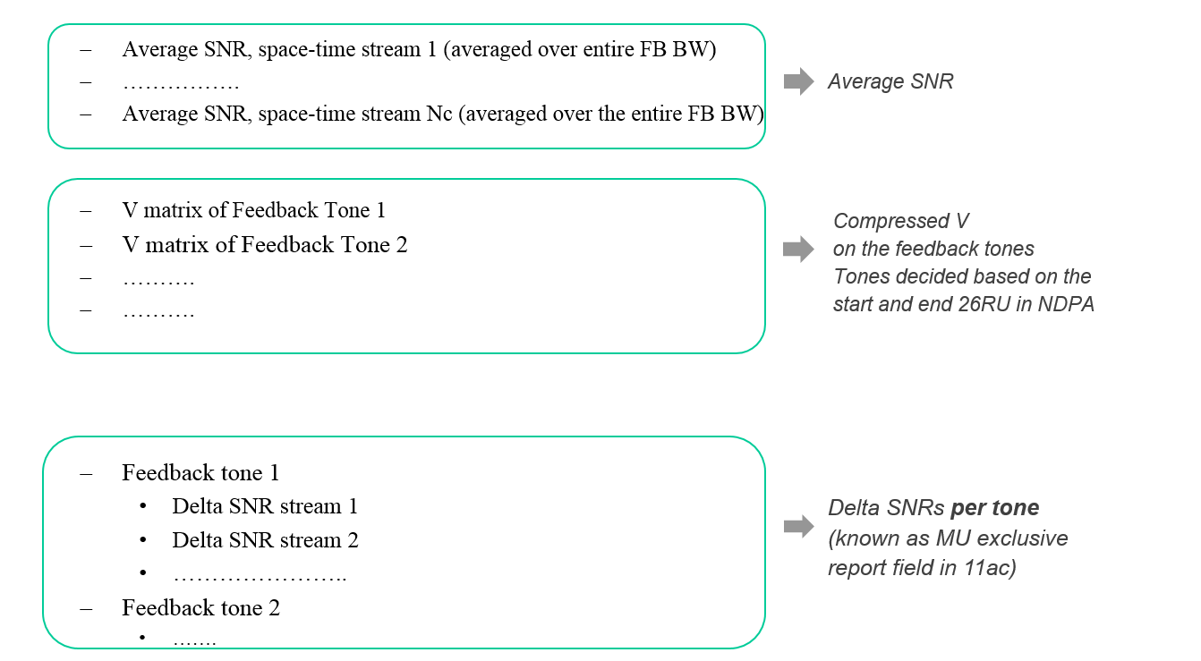
11-16/0608r0
add the following feedback structure for MU type feedback to 1

Slide 45
11-16/0608r0
Add the following feedback structure for SU type feedback to 11ax SFD
  Average SNR, space-time stream 1 (averaged over entire FB BW)
  …………….
  Average SNR, space-time stream Nc (averaged over entire FB BW)
  V matrix of Feedback Tone 1
  V matrix of Feedback Tone 2
  ……….......
Average SNR
Compressed V
on the feedback tones
Tone decided based on
start and end 26RU in NDPA

Slide 46
11-16/0608r0
add the following feedback structure for CQI feedback to 11ax SFD :
  1st RU26
    Stream 1 SNR (only one number per RU)
    Stream 2 SNR (only one number per RU)
    ….....
  2nd RU26
    …….
    …….
  ……
  Each SNR is an absolute number represented by 6 bits, with 1 dB granularity and a range of -10 dB to 53 dB
Absolute SNRs per RU26

Slide 47
11-16/0608r0
Adopt the following design for the HE-MIMO control field and add it to the 11ax SFD
  Changes from VHT are listed below
  BW (2 bits) – Same meaning as channel width field of VHT
  RU_Start_Index (7 bits) : The index of the first RU26 of the feedback being sent
  RU_End_Index (7 bits) : The index of the last RU26 of the feedback being sent
  Grouping is 1 bit
    0: Ng=4, 1: Ng=16
  Feedback type is 2 bits
    0: SU, 1: MU, 2: CQI only, 3: Reserved
  4 bits unused (reserved)

Slide 48
11-16/0611r0
Add the following to the SFD
  “BW subfield length in the Common Info Field of the Trigger frame is 2 bits”
  “PE subfield length in the Common Info Field of the Trigger frame is 3 bits”
  ‘CP and LTF Type’ subfield length in the Common Info Field of the Trigger frame is 2 bits”
  The AP specifies in the Trigger frame, the value of SR and Reserved bits which is used by the STA in HE-SIG-A of a trigger-based PPDU.
  The HE AP shall set the MU MIMO LTF Mode bit in the trigger to indicate:
    Single-stream pilots for any OFDMA transmission (including the case where MU-MIMO happens on part of the BW)
    The appropriate LTF mode (single stream pilots or masked LTFs) for full BW MU-MIMO

Slide 49
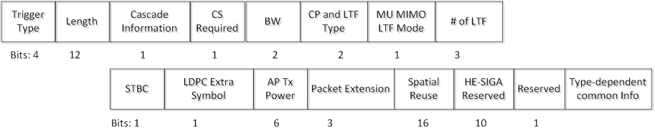
11-16/0611r2
Add the following ordering of the common info fields of the trigger frame to the SFD

Slide 50
11-16/0613r0
Add the following to the 11ax SFD ?
  AID value of 2046 is reserved to indicate unallocated RUs in the user-specific HE-SIG-B content blocks”
  For an 80 MHz and 160 MHz PPDUs, in each SIG-B content channel, the HE-SIG-B common blocks of the multiple 20MHz channels that the content channel corresponds to, are transmitted in an increasing order of the absolute frequency”
  For MU-MIMO allocations of RU sizes larger than 242 tones, user specific content blocks are ordered across the two SIG-B content channels from left to right on the 1st SIG-B content channel, followed by left to right on 2nd SIG-B content channel”
  For HE MU PPDU transmissions on the UL, the STA-ID field of the HE-SIG-B per-user field shall carry the AID of the transmitter assigned by the AP”

Slide 51
11-16/0617r0
Add the following text to 11ax SFD
  The AP Tx power is signaled in trigger frame using 6 bits.
  Value 0 to 60 maps to -20dBm to 40dBm with 1dB resolution. Value 61, 62 and 63 are reserved.
  AP Tx power is defined as the averaged power in 20MHz unit and is the combined power over all Tx antennas.

Slide 52
11-16/0617r0
Do you agree to add the following text to 11ax SFD
  The target received power (RSSI) in trigger frame is signaled using 7 bits.
  Value 0 to 90 maps to -110 to -20dBm target received signal level with 1dB resolution.
  Value 127 indicates STA to transmit at its max power allowed for the assigned MCS
  Other values are reserved.

Slide 53
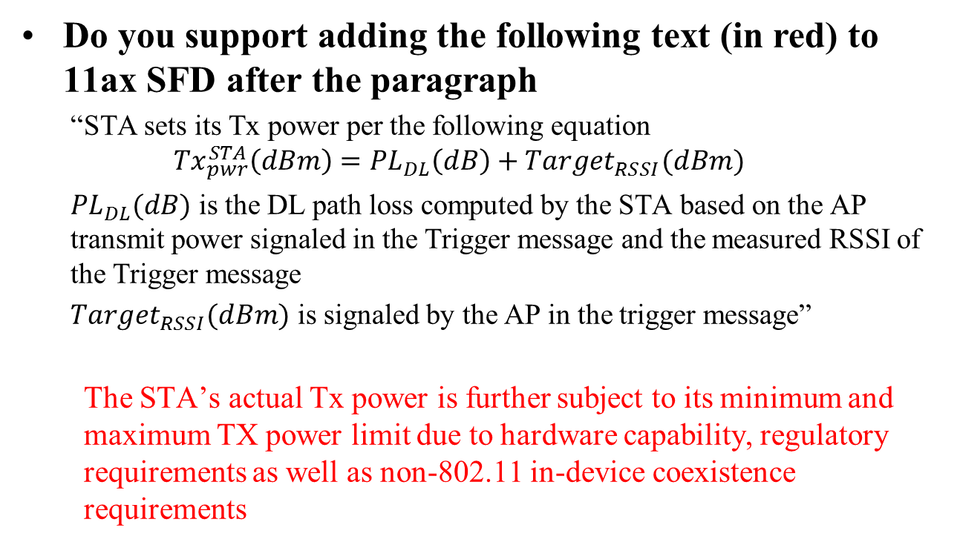
11-16/0617r0
Do you support adding the following text (in red) to 11ax SFD after the paragraph
  “STA sets its Tx power per the following equation
  $${Tx}_{pwr}^{STA}\left(dBm\right)={PL}_{DL}\left(dB\right)+Target_{RSSI}(dBm)$$
  ${PL}_{DL}(dB)$ is the DL path loss computed by the STA based on the AP transmit power signaled in the Trigger message and the measured RSSI of the Trigger message
  $Target_{RSSI}(dBm)$ is signaled by the AP in the trigger message”
  The STA’s actual Tx power is further subject to its minimum and maximum TX power limit due to hardware capability, regulatory requirements as well as non-802.11 in-device coexistence requirements

Slide 54
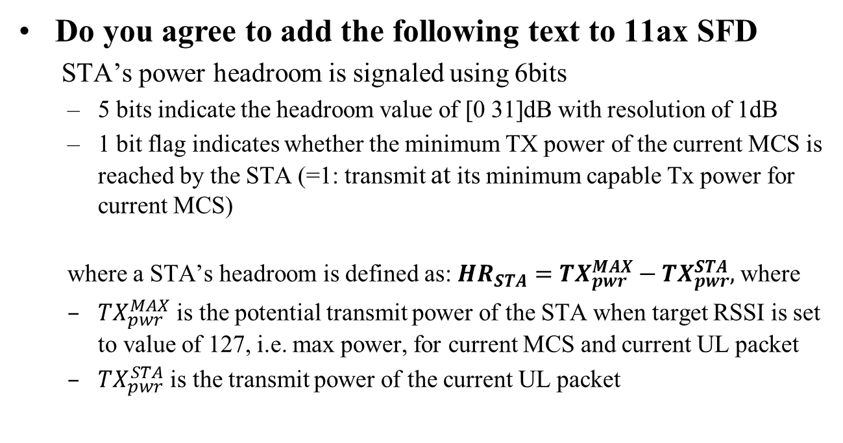
11-16/0617r0
Do you agree to add the following text to 11ax SFD
  STA’s power headroom is signaled using 6bits
  5 bits indicate the headroom value of [0 31]dB with resolution of 1dB
  1 bit flag indicates whether the minimum TX power of the current MCS is reached by the STA (=1: transmit at its minimum capable Tx power for current MCS)
  where a STA’s headroom is defined as: $HR_{STA}={TX}_{pwr}^{MAX}−{TX}_{pwr}^{STA},$ where
  ${TX}_{pwr}^{MAX}$ is the potential transmit power of the STA when target RSSI is set to value of 127, i.e. max power, for current MCS and current UL packet
  ${TX}_{pwr}^{STA}$ is the transmit power of the current UL packet

Slide 55
11-16/0617r0
Do you agree to make the following changes (highlighted in red) to 11ax SFD
  STAs that participate in HE trigger-based PPDU shall support the following absolute Tx power requirements and the RSSI measurement accuracy requirements for the two device classes:
  Class A:
    Tx power accuracy: +/-3dB
    RSSI measurement accuracy: +/-2dB +/- 3dB
  Class B:
    Tx power accuracy: +/-9dB
    RSSI accuracy: +/-5dB
  The RSSI accuracy requirements shall be applied to receive signal level range from -82dBm to -20dBm (2.4GHz) or -30dBm (5GHz). The requirement is stated for nominal (room) temperature conditions. RSSI is measured over legacy preamble

Slide 56
11-16/0618
Reuse the 11ac per stream CSD values for all HE PPDU
UL MU-MIMO transmission the per stream CSD value is based on global stream index
Per antenna CSD values for in Pre HE modulation
  Reuse the 11ac per antenna CSD values when beam change =1
  Not specified (absorbed in the Q matrix) when beam_change=0
In UL MU transmission the per antenna CSD value is based on the antenna index of each STA (i.e. local index)?

Slide 57
11-16/0619r0
The following PAPR reduction scheme for HE SIG-B
  Phase rotation is applied to the HE SIG-B data tones after constellation mapping. For the kth data tone in the HE SIG-B, the phase rotation pattern is defined as
  1 for 0=<k<26 and (-1)^{k} for 26=<k<52
  For DCM + MCS0, since the same rotation has already been applied in the DCM BPSK bit mapping, this step of phase rotation after constellation mapping shall be skipped
  Legacy gamma rotation still applies among different 20MHz channels

Slide 58
11-16/0620
Add the following text to the SFD
  When DCM = 1, the NSD, NCBPS, and NDBPS are set by the following expressions:
  In the case of MCS0, DCM=1, Nss=1, 106-RU or 242-RU, if the coding is BCC, then for each OFDM symbol 1 bit is padded after the NDBPS*2 BCC encoded bit before going into the BCC interleaver; if the coding is LDPC, LDPC encoding flow should be based on NDBPS and NCBPS as defined in the above equations

Slide 59
11-16/0620r0
Make the following changes to D0.1 MCS Tables:
  When DCM=1, change the NSD parameter to be ½ of DCM=0 cases for the same RU size.
  When DCM=1, change the NCBPS parameter to be ½ of DCM=0 case.
  When DCM=1, change the NDBPS parameter to be ½ of DCM=0 case, or take the floor for the two cases: 106-RU, MCS0, DCM=1, Nss=1, and 242-RU, MCS0, DCM=1, Nss=1.
  When DCM=1, change the coding rate R parameter to be identical to the DCM=0 case.
  Limit DCM=1 only to the allowed Nss.

Slide 60
11-16/0621r0
Add the following text to the 11ax SFD
  DCM+MCS0 has same transmission flow as other DCM MCSs.

Slide 61
11-16/0621r0
Add the following text to 11ax SFD
  The interleaver parameters for DCM are given in the following table:
Parameter for DCM | RU Size (tones)
 | 26 | 52 | 106 | 242
N_{COL} | 4 | 8 | 17 | 13
N_{ROW} | 3×N_{BPSCS} | 3×N_{BPSCS} | 3×N_{BPSCS} | 9×N_{BPSCS}
N_{ROT} | 2 | 2 | 11 | 29
  Value of N_{BPSCS} for DCM modulations equals to N_{BPSCS} of non DCM
  modulations with same constellation size.

Slide 62
11-16/0621r0
Add the following text to 11ax SFD
  The interleaver parameters for HE SIG B with DCM are given in the following table:
Parameter | HE SIG B (tones)
 | 56
N_{COL} | 13
N_{ROW} | 2×N_{BPSCS}

Slide 63
11-16/0655r0
Add the 11ax SFD the following MCS0 DCM constellation mapping for data subcarriers k and k+N_{SD}
is BPSK modulated
Note: N_{SD} is defined for DCM which is half of .
Jianhan Liu, Mediatek, et. al.

Slide 64
11-16/0655r0
Add the following usage of DCM to 11ax SFD
  DCM is only applied to MCS0, MCS1, MCS3 and MCS4.
  DCM is only applied to 1 and 2 spatial streams.
  DCM is only applied to HE SU PPDU, HE extend range SU PPDU, and SU RUs in HE MU PPDU.
  DCM is not applied to MU-MIMO. The DCM field in the HE-SIGB per user for MU-MIMO is changed to a reserved field.
  DCM is not applied to STBC.

Slide 65
11-16/0655r0
Add the following capability field of DCM to 11ax SFD
  Max constellation supported: 2 bits.
    00: does not support DCM; 01: BPSK; 10: QPSK; 11: 16QAM
  Max number of streams supported: 1 bit.
    0: 1stream; 1: 2 streams

Slide 66
11-16/0622r0
Do you support to add the following to the 11ax SFD?
  When DCM=1, 16QAM constellation mapping is done by swapping b₀ and b₁, and also b₂ and b₃ for the second half of tones, where b₀ ~ b₃ are the encoded bits that maps to one 16QAM constellation for the first half of the tones, i.e.:
where N_{SD} is defined for DCM=1, which is half of the N_{SD} value for the same RU size when DCM=0.

Slide 67
11-16/0633r3
Add the following to the current SFD:
  For full BW 80MHz, add 1 bit to indicate if center 26-tone RU is allocated in the common block fields of both SIGB content channels with same value.
  For full BW160, 80+80 MHz, add 1 bit to indicate if center 26-tone RU is allocated for one individual 80MHz in common block fields of both SIGB content channels.

Slide 68
11-16/0633r3
Use 36 “Definition TBD” entries in Table 4 in the current SFD 3.2.5 HE-SIG-B sub-clause to indicate most frequently used partial bandwidth allocations, as shown in slide 16

Slide 69
11-16/0636r2
Add the following into SFD
  In HE-SIG-A of HE (extended range) SU PPDU/HE MU PPDU/HE trigger-based PPDU, the size of TXOP Duration field is 7btis and 1 bit is reserved

Slide 70
11-16/0635r1
Add to the SFD that
  3 bits are used for the BW field in SIG-A of HE_MU PPDU

Slide 71
11-16/0637
Add the following entries in 8-bit table to the IEEE 802.11ax SFD
  two entries to indicate ‘Zero STA for 484-tone RU’ and ‘Zero STA for 996-tone RU’ respectively

Slide 72
11-16/0639r0
Add the following text to 11ax SFD
  The user-specific field for center 26-tone RU in BW>=80MHz is located at the end of the user specific fields in either SIGB content channel 1 or SIGB content channel 2 channel, if assigned?
    SIGB content channel 1 in 80MHz BW
    SIGB content channel 1 for lower 80MHz and SIGB content channel 2 for upper 80MHz in 160MHz BW

Slide 73
11-16/0649r0
Add to the 11ax SFD
For all feedback types, the AP shall use 7 bits each to signal the start and end 26 RU for partial bandwidth feedback
The index used to signal a 26 RU increases with frequency, with the minimum value of the index being 0. For NDP bandwidths of 20, 40, 80, 160 MHz, the maximum value of the index shall be 8, 17, 36 and 73 respectively.
The start and end 26 RUs in the HE MIMO Control Field shall use the same indexing as above

Slide 74
11-16/0649r0
Do you agree add to the 11ax SFD
The STA feeds back the channel on all tones from the feedback roster (Table 1, document 11-16/0649r0, on slide 13 ) between
“S” tone corresponding to start 26 RU index
and
“E” tone corresponding to end 26 RU index
where the “S” and “E” tones are defined as function of RU index in Table 2a for Ng = 4 and Table 2b for Ng = 16 (document 11-16/0649r0 on slide 13)
Note: For 160 MHz, to determine the “S” and “E” tones, RUs 37-73 occupying the higher 80 MHz use the same table as RUs 0-36 occupying the lower 80 MHz

Slide 75
11-16/0649r0
Add to the 11ax SFD
The only quantization resolutions for the Givens angles ϕ, ψ in
  MU feedback shall be (9,7) and (7,5) bits
  SU feedback shall be (6,4) and (4,2) bits
Note: MU resolution with Ng = 16 is limited to (9,7)

Slide 76
11-16/0652r2
  Add to the TG Specification Frame work document?
  For the extended range SU PPDU,
    L-LTF per-tone power is boosted by 3 dB relative to HE-SIG-A, L-STF is transmitted with the same total power as L-LTF;
    The extra four tones on the edge of L-SIG/RL-SIG in 20MHz band have the same per-tone transmission power as the per-tone transmission power of L-LTF tones, while the other populated tones in L-SIG and RL-SIG have 3dB lower per-tone transmission power than L-LTF tones.

Slide 77
11-16/0654r0
Add to the SFD
  change the bit width of the CP+LTF field in SIGA for SU and MU to 2 bits
  add 4x LTF + 3.2uS as an optional mode for the NDP frame
  define the following options to be signaled in the trigger frame for UL Trig PPDU
    2x LTF + 1.6 uS (mandatory)
    4x LTF + 3.2 uS (mandatory)
    1x LTF + 1.6 uS for full BW only. TBD whether mandatory to transmit in UL Trig PPDU

Slide 78
11-16/0656r1
Add 11ax SFD that 1024QAM uses uniform constellation with Gray mapping

Slide 79
11-16/0612r1
Add the following to the 11ax SFD:
  For an 11ax device, the support of DL and UL OFDMA (non MU-MIMO) shall be mandatory.
  For an 11ax device
    Support of Nss>1 is optional
    Support of STBC is optional.
  For an 11ax device
    Support for single spatial stream HE-MCSs 0 to 7 (transmit and receive) is mandatory in all supported channel widths and RU sizes
    Transmit and receive support for HE-MCSs 8, 9 , 10 and 11 is optional
  For an 11ax AP, support for DL MU-MIMO transmission, where MU-MIMO is being done on the entire PPDU BW, shall be mandatory if the AP supports Tx Nss>=4

Slide 80
11-16/0612r1 (cntd)
  Full BW DL MU-MIMO reception shall be mandatory at a non-AP STA. For the receiving STA, max Nss (per STA) supported for DL MU-MIMO shall be equal to the minimum of 4 and the max Nss supported for SU PPDUs. The N_{STS,total} that the STA can support in NDP sounding and in the DL MU-MIMO packet is a capability, 4 being the minimum value for both.

Slide 81
PHY Motion #157
Move to change TG draft D0.1 as in document 11-16/0736r0
Move: Bin Tian Second: Jianhan Liu
Accepted with no objection

Slide 82
MAC Motion #84
Move to modify the TG specification framework as in slide 83 to slide 99
Move: Simone Merlin Second: Reza Hedayat
Y/N/A
Accepted with no objection

Slide 83
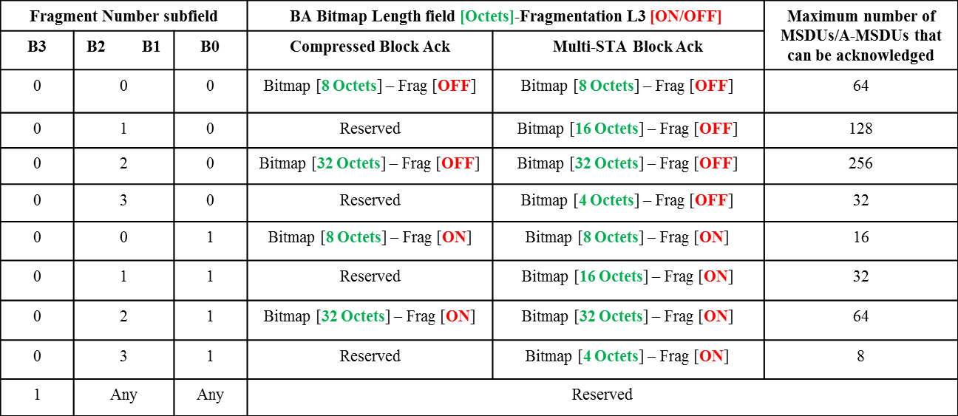
11-16/0616r1
Add to the 11ax SFD the following mapping for the FN subfield of BA frames

Slide 84
11-16/0616r1
Add to the 11ax SFD:
The BA Bitmap length of BA frames generated during a BA session is negotiated during the BA setup
  If the negotiated buffer size is within [1, X] then a BA Bitmap length of X bits will be used during the BA session for the negotiated TID
  If the negotiated buffer size is within [X+1, Y] then a BA Bitmap length of Y bits will be used during the BA session for the negotiated TID
  Note: X and Y correspond to the agreed BA Bitmap lengths of the respective BA frame (e.g., 32, 64, etc.)
  Per-PPDU BA selection rules within a BA session for the BA Bitmap length of the BA frames is TBD for <RA, TA, TID>”

Slide 85
11-16/0616r1
Add to the 11ax SFD:
The maximum number of TIDs of QoS data frames that an originator can aggregate in a multi-TID A-MPDU is indicated in the HE Capabilities element sent by the recipient
  A nonzero value also indicates that the recipient supports reception of multi-TID A-MPDUs
    Note: A multi-TID A-MPDU allows the aggregation of an Action Ack frame as well
A STA that transmits a trigger-based PPDU as an immediate response to the Basic variant Trigger frame follows the indication of max number of TIDs contained in the Trigger Dependent Per User Info field of the Trigger frame addressed to the STA (i.e., AID of the Per User Info field is that of the STA) and can transmit an A-MPDU that contains a number of aggregated TIDs in the A-MPDU that is up to that value.

Slide 86
11-16/0616r2
Add to the 11ax SFD:
  Multi STA BA frames shall be supported if either UL MU or multi-TID A-MPDU operation is supported
  Originator indicates support for reception of ALL ACK signaling (Ack Type subfield set to 0 when responding to the soliciting A-MPDU) in Multi STA Block Ack frame that is sent as a response to the A-MPDU via a capability bit”

Slide 87
11-16/0616r2
Add to the 11ax SFD:
  HE STAs follow the solicitation/response rules listed in slides 17-20, (Document 11-16-616r2)
  A STA shall not send a Multi TID BAR to a STA that has not indicated support for multi-TID A-MPDU.
    Also applicable to each BAR information carried in the MU BAR variant Trigger frame”

Slide 88
11-16/0627r0
Add the following text to the 11ax Specification Frame work document clause 6.3 Power save
For each of the ROMI parameters Rx NSS and Rx BW, the following rules are used:
  when the HE STA changes a parameter from higher to lower, it should make the change for that parameter only after receiving the ACK for the ROMI packet.
  when the HE STA changes a parameter from lower to higher, it should make the change for that parameter right after the ACK timeout or receiving the ACK for the ROMI packet.

Slide 89
11-16/0628r1
Add the following text to the 11ax Specification Frame work document:
  An HE STA may send the buffer status report (BSR) in the HE variant HT Control field for one or more queues (whether content of queue is per TID or per AC is TBD) when the AP supports its reception
    A new Control ID value of the HE variant HT Control field identifies a BSR
    One or more (number is TBD) Queue Size subfields report the queue size
    Identifier of AC/TID (and for which) is currently TBD

Slide 90
11-16/0643r0
Add the following text to 11ax SFD:
  The HE A-Control field for UL acknowledgement through OFDMA (acknowledgement through MU MIMO and MUMIMO in OFDMA are not supported) is defined as following:
    5-bit UL PPDU Length indicates OFDMA symbols of the Data field.
    5-bit DL TX Power indicates the transmission power of the Trigger frame in unit of 2db.
    5-bit Target UL RX Power indicates the target RX power in unit of 2db.
    8-bit RU Allocation which is same as Trigger frame.
    2-bit MCS indicates the MCS of the UL acknowledgement, MCS 0 to 3.
    One SS is used for UL acknowledgement
    The STAs that are the receivers of HE A-Control don’t do CCA sensing before sending UL MU acknowledgement.
    One HE LTF is used for UL acknowledgement
    Spatial reuse is disallowed.
    The CP+LTF Type is TBD.
    The other missed parameters are same or derived from related parameters in DL MU transmission or some default value
Control ID
Control Information
4 bits
UL PPDU Length
RU Allocation
DL TX Power
Target UL RX Power
MCS
Reserved
5 bits
8 bits
2 bits
1bits

Slide 91
11-16/0643r0
Add the following text to 11ax SFD
  HE A-Control field for UL acknowledgement is optional in RX

Slide 92
11-16/0644r0
Add the following text in 11ax SFD
  SS Allocation in Per User Info field is defined by Starting Spatial Stream (3 bits) and Spatial Stream Number (3 bits)

Slide 93
11-16/0645r0
Add the following text to 11ax SFD
  Trigger frame includes a two-bits MPDU MU Spacing Factor subfield in trigger dependent per-user info subfield within per-User Info field of the basic variant of trigger frame
    A STA uses Minimum MPDU Start Spacing (in AP’s HT Capabilities element) * (MPDU MU Spacing Factor +1) as the MU minimum MPDU start spacing in UL MU transmission.

Slide 94
11-16/0646r1
Add the following text in 11ax SFD
  The HE beamformer shall have the supported MPDU size large enough to avoid fragmentation except if the MPDU size 11,454 B is reached assuming that RU, MCS, and PPDU length for beamforming feedback are large enough

Slide 95
11-16/0646r1
Add the following text in 11ax SFD
  The BRP variant of the Trigger frame includes 8-bit Feedback Segment Retransmission Bitmap in Per STA Info.

Slide 96
11-16/0657r0
Add the following to the SFD:
  The Receive Operating Mode A-Control field shall include an UL MU Disable field that allows an HE STA to suspend and resume being scheduled by a Trigger frame or UL MU resource scheduling A-Control field

Slide 97
11-16/0657r0
Add the following to the SFD
  The Receive Operating Mode A-Control field shall include the following transmit operating parameters: max Tx NSS and max Tx power
    Editorial note: we may want to change the name since it would now include transmit operating parameters

Slide 98
11-16/0640r3
Add the following text into 11ax SFD:
  5.1 When a STA, that receives an HE PPDU with the same BSS Color as the BSS Color announced by its associated AP, identified from MAC header fields that the frame is an inter-BSS frame, the STA shall treat the frame as an inter-BSS frame after the FCS has been verified, unless the frame is identified as TDLS frame

Slide 99
11-16/0609r1
Add to the SFD the HE NDPA frame format as shown in slide 15 and 16 of 0609r1

Slide 100
MU Motion #56
Move to modify the TG specification framework as in slide 101 to slide 105
Move: Evgeny Second: Chitto
Y/N/A
Accepted with no objection

Slide 101
11-16/0591r0
Add the following text in the SFD:
  An AP indicates the value of OCW_{min} used by all STAs for the random RU allocation process for the next UL MU OFDMA transmissions. The value of OCW_{min} is transmitted through a dedicated field in the beacon frame.

Slide 102
11-16/0648
Add to the TG Specification Frame work document
  MU-RTS shall not be carried in an HE MU PPDU
  The CTS response to an MU-RTS shall be carried in a non-HT or a non-HT duplicate PPDU

Slide 103
11-16/0662r2
Add to the following to 11ax TG SFD:
  Allow the AP to choose any access category for contending to send the trigger frame
  The chosen AC may give to the AP higher priority in accessing the channel compared to its associated STAs

Slide 104
11-16/0667
Add to the TGax SFD:
the basic variant Trigger frame shall contain the TID Aggregation Limit subfield in the Trigger Dependent Per User Info field that indicates the limit of the number of TIDs that can be aggregated by a STA in a multi-TID A-MPDU carried in the responding Trigger-based PPDU
      The responding STA shall not aggregate QoS Data frames in the multi-TID A-MPDU with a number of TIDs that exceeds the value indicated in the TID Aggregation Limit sub-field intended to it

Slide 105
11-16/0582r3
Add the following text in SFD?
  The spec shall define that AID=0 in the User Identifier subfield of the Per User Info field in a Trigger Frame indicates the resource allocation can be used for random access by any STA.

Slide 106
SR Motion #8
Move to modify the TG specification framework as in slide 107 to slide 111
Move: James Wang Second: Yasu Inoue
Y/N/A
Motion accepted with no objection

Slide 107
11-16/0647r0
Append SR Motion 1 in TG Specification Frame work document with the following text
  If the SR field in the HE-SIG-A of the HE SU PPDU or HE extended range SU PPDU is set to a TBD value, the medium condition for the STA shall indicate BUSY for the duration of the HE SU PPDU or HE extended range SU PPDU. Note that the TBD value of the SR field in the HE-SIG-A of the HE SU PPDU or HE extended range SU PPDU can be set when trigger frame is carried in the HE SU PPDU or HE extended range SU PPDU or under other TBD conditions.

Slide 108
11-16/0647r0
Append SR Motion 1 in TG Specification Frame work document with the following text
  If the SR field in the HE-SIG-A of the HE MU PPDU is set to a TBD value, the spatial reuse transmission in the HE MU PPDU is limited to within the duration of the HE MU PPDU. Note that the TBD value of the SR field in the HE-SIG-A of the HE MU PPDU can be set when trigger frame is carried in the HE MU PPDU or under other TBD conditions.

Slide 109
11-16/0699r0
Add the following 4 bit SR field (in SIG A) for HE Trigger-Based PPDU
One TBD value for SR Disallow Flag, (under TBD restrictions)
One TBD value is reserved
Remaining 14 values for SRP
  SRP = TX PWRAP + Acceptable Receiver Interference LevelAP
  SR STA shall back-off its TX power based on
  TX PWRSR STA < SRP –RSSItrigger frame@SR STA”

Slide 110
11-16/0699r0
Propose to include in SFD:
  For HE trigger-based PPDU, in HE SIG-A, 4 SR fields are signaled:
  For 20MHz one SR field corresponding to entire 20MHz (other 3 fields indicate identical values)
  For 40MHz two SR fields for each 20MHz (other 2 fields indicate identical values)
  For 80MHz four SR fields for each 20MHz
  For 160MHz four SR fields for each 40MHz
  The exact location of each 20MHz for 80MHz BW is TBD”

Slide 111
11-16/0699r0
Add the 4 bits for SR field in SIG A of HE SU-PPDU and HE MU-PPDU, the SR field definition is TBD

Slide 112
Comment Resolution Motions

Slide 113
Comment Resolution Motion #1
Move to accept the resolution of comment CID 2383 in document 11-16/0675r1
Move: Reza Hedayat Second: Bo Sun
Y/N/A
Accepted with no objection

Slide 114
CRM #2
Move to accept resolutions of comments
  1682, 474, 1196, 1455, 2003, 844, 2122, 1197, 356, 2006, 2533, 2285, 1456, 1457, 1678, 1677, 912, 913, 1686, 1687, 1846, 2002, 843, 2121, 845, 296, 1007, 541, 2538, 2124, 524, 540, 2168, 2004
In document 11-16/0610r3
Move: Ross Jian Yu Second: Bo Sun
Y/N/A
Accepted with no objection

Slide 115
CRM #3
Move to accept resolutions to CIDs 2129, 2286, 2539, 2537, 2128, 2013, 2009, 2167, 2169, 865, 2127, 2125, 2534, 2008, 2014, 2015, 2018 in 11-16/0610r4
Move: Ross Jian Yu Second: Bo Sun
Y/N/A
Accepted wth no objection

Slide 116
CRM #4
Move to accept resolutions for the following CIDs in 11-16/0614r1:
  348, 351, 466, 467, 877, 878, 879, 1030, 1185, 1451, 1605, 1606, 1607, 1757, 1922, 2352, 2507, 2511, 2512, 2513, 2514, 2515, 2516, 2828.
Move: Lochan Verma Second: Bo Sun
Y/N/A
Accepted with no objection

Slide 117
CRM #5
Move to accept resolutions for the following CIDs in 11-16/0615r1:
  852, 853, 948, 1786, 1872, 1873, 2126.
Move: Lochan Verma Second: Bo Sun
Accepted with no objection

Slide 118
CRM #6
Move to accept the resolutions for the following CIDs in 11-16/0623r1:
  347, 531, 532, 533, 534, 535, 536, 850, 2093, 2094, 2095 .
Move: Bin Tian Second: Bo Sun
Accepted with no objection

Slide 119
CRM #7
Move to accept resolutions for the following CIDs in 11-16/0625r2:
  279, 280, 282, 283, 839, 872, 1041, 1045, 1188, 1189, 1190, 1191, 1934, 1935, 1936, 1937, 1938, 1939, 1940, 1941, 1942, 1943, 1944, 2345, 2364, 2520.
Move: Bin Tian Second: Bo Sun
Accepted with no objection

Slide 120
CRM #8
Move to accept resolutions for the following CIDs in 11-16/0634r1:
  542, 837, 881, 1186, 1032, 1612, 1613, 1614, 1615, 1844, 1929
Move: Yan Zhang Second: Bo Sun
Accepted with no objection

Slide 121
CRM #9
Move to accept resolutions for the following CIDs in 11-16/0658r2:
  353, 354, 1953, 2527, 2528, 2725, 888, 889, 890, 891, 893, 894, 895, 896, 897, 1954, 1955, 1956, 2529, 2530, 1111, 1112, 1192, 1193, 1758, 1851, 1852, 2346, 1951, 1964, 1952, 2367, 1789
Move: Kiseon Ryu Second: Bo Sun
Y/N/A
Accepted with no objection

Slide 122
CRM #10
Move to accept resolutions for the following CIDs in 11-16/0659r1:
  313, 316, 529, 848, 530, 849
  1933, 2518, 2154, 2155
Move: Kiseon Ryu Second: Bo Sun
Accepted with no objection

Slide 123
CRM #11
Move to accept resolutions for the following CIDs in 11-16/0663r4:
  1925, 835, 870, 880, 1105, 1609, 2676, 2136, 2148, 2153, 2243, 2342, 2675
Move: Ke Yao Second: Bo Sun
Y/N/A
Accepted with no objection

Slide 124
CRM #12
Move to accept resolutions for the following CIDs in 11-16/0681r3:
  215, 2486
Move: Daewon Lee Second: Bo Sun
Y/N/A
Accepted with no objection

Slide 125
CRM #13
Move to accept resolutions for the following CIDs in 11-16/0653r5:
  277,519,521,838,886,1039,1187,1931, 2360, 2361, 2362, 2134
Move: Xiaogang Chen Second: Bo Sun
Accepted with no objection

Slide 126
CRM #14
Move to accept resolutions for the following CIDs in 11-16/0682r2:
  2566, 2474, 2081, 2080, 2079, and 2078
  1866, 2087, 2086, 2089, and 2092
Motion: Daewon Lee Second: Bo sun
Accepted with no objection

Slide 127
Goals for July 2016
Continue with the comment resolutions.

Slide 128
Conference call times
June (2, 16, 30), July 14 10:00 – 12:00 ET
June 23, July 7, August 4 20:00 – 22:00 ET

