Slide 1
IETF 95-Wireless Tutorial: IEEE 802.11
Date: 2016-03-30
Authors:

Slide 2
Abstract
The document contains slides prepared for the IETF 95 Wireless Tutorial related to IEEE 802.11 status. A discussion of areas of mutual interest is included.
See the prior Wireless tutorial (2014) prepared by Donald Eastlake, http://ietf.org/edu/technical-tutorials.html#wireless
This presentation represents my views, not those of my employer, the IETF or IEEE 802 or sub-parts of those organizations

Slide 3
Topics and Agenda
Some information about the IEEE 802 standards development process
IEEE 802.11 status and projects under development
Areas of mutual interest
References, including past liaison documents
Q&A

Slide 4
IEEE-SA Individual and Corporate Standards Development
Open, consensus-based process
Open – anybody can participate (payment of meeting fees may be needed)
Individual standards development
  Each individual has one vote
Corporate standards development
  One company/one vote
Results frequently adopted by national, regional, and international standards bodies
  IEEE 802 standards are submitted to ISO/IEC JTC1 SC6
  Indicates 802.11
Dorothy Stanley, HP Enterprise

Slide 5
IEEE Standards Development: Process Flow
Decide / Choose Technology
Write / update a Draft
Ballot Draft
Idea!
Resolve Comments
Done?
Typical project lifetime: 4 years
Project Approval Process
Develop Draft Standard
(in Working Group)
Sponsor Ballot
IEEE-SA Standards Board Approval Process
Publish Standard
Revise or Withdraw Standards
Maximum of 10 years
Dorothy Stanley, HP Enterprise
Notes:
This chart illustrates the whole standards process in simplified form.
Idea: The idea for a standard is usually developed by a group of people, and the responsibility for the idea is assumed by the sponsor. The sponsor is usually a society or an existing standards committee.
Project Approval Process: This idea is then transferred onto a form called the Project Authorization Request (PAR) and submitted to the New Standards Committee (NesCom) for approval.
Develop draft standard: The draft is then developed and revised by the working group.
Ballot draft: When the draft work is finalized, the sponsor forms the balloting group and ballots the standard.
Standards Board Approval: After your ballot has achieved consensus, the draft then goes to the Review Committee (RevCom) and the Standards Board for approval. The amount of time from PAR to Board approval is 4 years (an extension can be made if absolutely necessary).
Publish Standard: The draft is then edited and formatted by an IEEE Project Editor and published.
The standard is valid for 10 years before it must be revised or withdrawn.

Slide 6
IEEE 802 Wireless

Slide 7
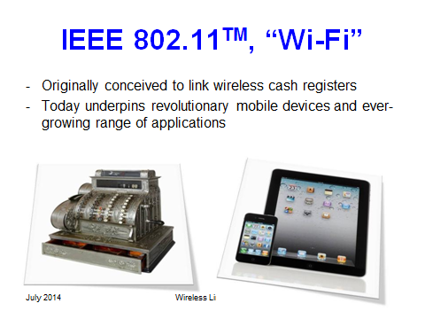
IEEE 802.11 Scope
Wireless local area networks
Typical range up to 100m, can be much
higher with directional antennas
Generally use unlicensed spectrum
  Exception for 802.11y: “lightly licensed”
  Exception for TV whitespace
Ubiquitous Deployments: Broadband network access, public venue access, sensor networks, mesh networks, automotive.
Photo credit: Slide 36 in Donald’s presentation
Dorothy Stanley, HP Enterprise
Notes:
What’s the scope of IEEE 802.11?

Slide 8
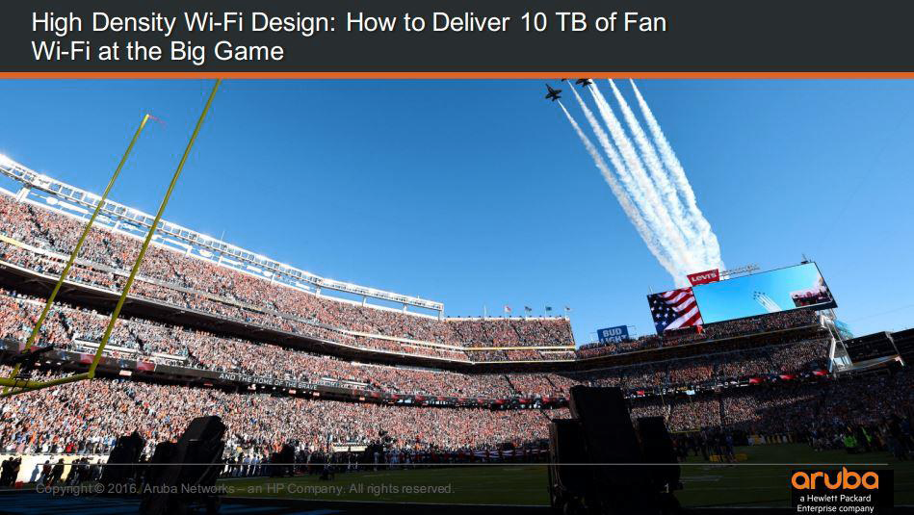
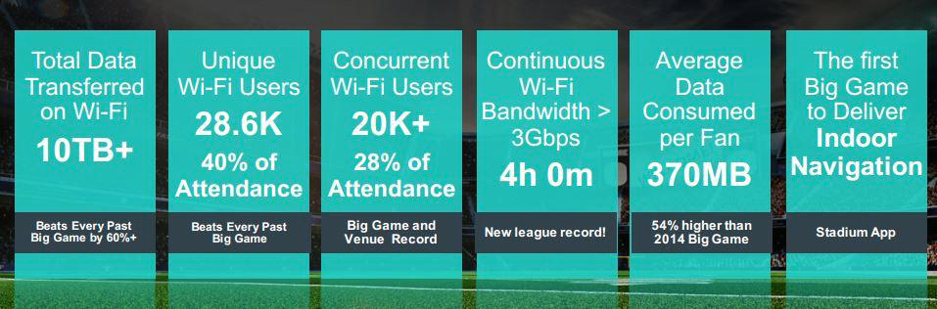
802.11 technology is serving high density applications today
Dorothy Stanley, HP Enterprise

Slide 9
In 2014 Wi-Fi traffic was 16 times cellular one
(2) Spectrum trends below 6GHz
UK Data carried in PB per month
538.5 MHz
available
538.5 MHz
available
602 MHz
available
602 MHz
available
Cisco VNI, 2014 average
Infrastructure Report, June 2014
Source: Andy Gowans (UK regulator) presentation: https://mentor.ieee.org/802.18/dcn/16/18-16-0016-01-0000-ofcom-future-spectrum-requirements.pptx
Notes:
According to Cisco VNI, 3% of all IP traffic is carried by mobile, compared to 49% over Wi-Fi and 48% wired. This is despite Wi-Fi having access to less spectrum (538.5 MHz) compared to mobile (602 MHz).
Source: Cisco VNI, Office of National Statistics, Ofcom CMR 2014 and Ofcom Infrastructure Report 2014
Notes: Infrastructure Report data is based on June 2014 only and assumes 93% use wireless routers (CMR 2014).

Slide 10


Wi-Fi Alliance
Founded in 1999
600+ member companies
The Wi-Fi Alliance provides:
  Interoperability certification programs
    Over 30,000 products certified
    Over 7 billion Wi-Fi devices deployed
  Market messaging
  Includes WiGig certified 60Ghz products (2016)
First called the “Wireless Ethernet Compatibility
Alliance”, early alliance slogan was
“The standard for Wireless Fidelity”
http://www.wi-fi.org/
Over 7,000,000 hot spots world wide

Slide 11
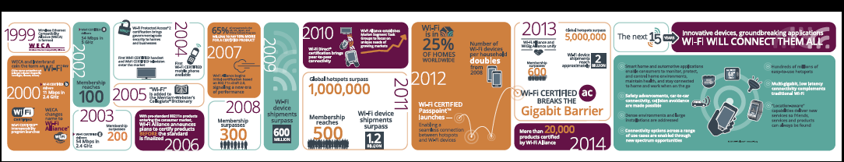
http://www.wi-fi.org/discover-wi-fi/15-years-of-wi-fi

Slide 12
Topics and Agenda
Some information about the IEEE 802 standards development process
IEEE 802.11 status and projects under development
Areas of mutual interest
References, including past liaison documents
Q&A

Slide 13
IEEE 802.11 Revisions
802.11
-2003
802.11
-2007
802.11
-2012
802.11
-2016 (TBC)
11k
RRM
11s
Mesh
11aa
Video Transport
11e
QoS
IEEE
Std
802.11
-1997
11h
DFS & TPC
11u
WIEN
11v
Network
Management
MAC
11ae
QoS Mgt Frames
11d
Intl roaming
11i
Security
11z
TDLS
11w
Management
Frame
Security
11f
Inter AP
11r
Fast Roam
11n
High
Throughput
(>100 Mbps)
11af
TV Whitespace
11a
54 Mbps
5GHz
11j
JP bands
MAC
&
PHY
11ac -VHT
>1 Gbps @ 5GHz
11b
11 Mbps
2.4GHz
11g
54 Mbps
2.4GHz
11p
WAVE
11y
Contention
Based
Protocol
11ad - VHT
>1 Gbps @ 60GHz
Project timelines and Project Authorization documents are publicly available, see http://www.ieee802.org/11/Reports/802.11_Timelines.htm
Notes:
doc.: IEEE 802.11-11/0483r0
May 2011
Bruce Kraemer (Marvell)
Page 13

Slide 14
IEEE 802.11:Types of Groups
Type of Group | Description | IETF (rough) equivalent
WG | Working Group | IETF Area
SC | Standing Committee | IETF WG
TG | Task Group | IETF WG
SG | Study Group | BOF
TIG | Topic Interest Group | BOF
See RFC 7241, “The IEEE 802/IETF Relationship”

Slide 15
802.11 Groups
Type | Group | Description
WG | WG11 | The IEEE 802.11 Working Group
SC | ARC | Architecture
SC | PAR | PAR review
SC | REG | Regulatory
SC | WNG | Wireless Next Generation
802 SC | JTC1 | ISO/IEC JTC1/SC6
TG | MC | Revision mc (REVmc)
TG | AH | Operation in 900 MHz bands (S1G)
TG | AI | Fast Initial Link Setup (FILS)
TG | AJ | China Milli-Meter Wave (CMMW)
TG | AQ | Pre-association Discovery (PAD)
TG | AK | General Link (GLK)
TG | AX | High Efficiency Wireless LAN (HEW)
TG | AY | Next Generation 60 GHz (NG60)
TG | AZ | Next Generation Positioning (NGP)
TIG | LRLP | Long Range Low Power (LRLP)

Slide 16
IEEE 802.11 subgroup status
MAC
802.11
-2016(TGmc)
802.11
-2012
802.11aq
Discovery
802.11aa
Video Transport
802.11ak
Bridging
802.11ae
QoS Mgt Frames
802.11ai
Link Setup
LRLP TIG
Long Range
Low Power
802.11az
Location
WNG
802.11ax
Efficiency
802.11ah
< 1Ghz
802.11af
TVWS
802.11ac
VHT 5GHz
802.11ay
60 GHz
802.11ad
VHT 60 GHz
802.11aj
CMMW
MAC & PHY
Discussion Topics
TIG/Study
groups
TG without
Approved draft
WG
Letter Ballot
Sponsor
Ballot
Published
Amendment
Published
Standard
16
Notes:
doc.: IEEE 802.11-11/0483r0
May 2011
Bruce Kraemer (Marvell)
Page 16

Slide 17
Market demands and new technology drive innovation (Current projects)
Demand for throughput
  Continuing exponential demand for throughput (TGax and TGay)
  ~85% of the world’s mobile data is carried on 802.11 (WiFi) devices
New usage models / features
  Dense deployments (TGax), Indoor Location (TGaz)
  Automotive (IEEE Std 802.11p), Internet of Things (TGah)
Technical capability
  MIMO (IEEE Std 802.11n, 802.11ac, TGay)
  60 GHz radios (TGay)
Changes to regulation
  3650 MHz in USA (lightly licensed) (IEEE Std 802.11y)
  TV whitespaces (IEEE Std 802.11af), Radar detection (IEEE Std 802.11h)
  Coexistence and radio performance rules (e.g., ETSI BRAN, ITU-R)
Dorothy Stanley, HP Enterprise

Slide 18
Topics and Agenda
Some information about the IEEE 802 standards development process
IEEE 802.11 status and projects under development
Areas of mutual interest
References, including past liaison documents
Q&A

Slide 19
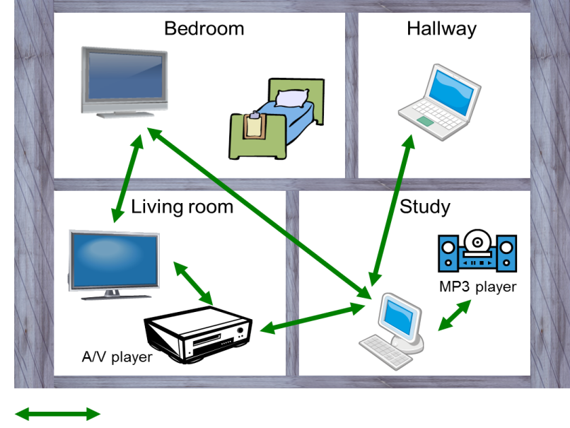
802.11ah | Sub 1 GHz |  | Status: WG Ballot complete; SB underway |  | Completion 2016
Key Project Goals
Define operation of license-exempt IEEE 802.11 wireless networks in frequency bands below 1 GHz excluding the TV White Space bands. 868-868.6 MHz (Europe), 950 MHz -958 MHz (Japan), 314-316 MHz, 430-434 MHz, 470-510 MHz, and 779-787 MHz (China), 917 - 923.5 MHz (Korea) and 902-928 MHz (USA), provides mechanisms that enable coexistence with other systems in the bands including IEEE 802.15.4 and IEEE P802.15.4g
Key Parameters
Use cases Extended range WLAN internet access, Smart home sensor networking, Outdoor access with low data rates – ranch, mountainous areas Wearable devices - health, multimedia |  | Technology OFDM PHY MAC enhancements Transmission range up to 1km data rates > 100 kbit/s maintain the IEEE 802.11 WLAN user experience for fixed, outdoor, point to multi point applications
Access to Internet, latest airlines’ announcements, and digital media such as movies and sport events
For more information: functional reqs; photo from use cases

Slide 20

802.11ai | Fast Initial Authentication |  | Status: WG Ballot complete; SB underway |  | Completion 2016
Key Project Goals
Define mechanisms that provide IEEE 802.11 networks with fast initial link set-up methods which do not degrade the security currently offered by Robust Security Network Association (RSNA) already defined in IEEE 802.11. Minimize initial link set-up time.
Key Parameters
Use cases Large number of mobile users are constantly entering and leaving the coverage area of an existing extended service set (ESS). |  | Technology EAP-RP (ERP): RFC 5296 EC(DH) authenticated by (EC)DSA MAC enhancements for probe response reduction MAC enhancements for more efficient scanning
Access to Internet, latest airlines’ announcements, and digital media such as movies and sport events
For more information: use cases, functional reqs;

Slide 21
TGai Technical Highlights
STA
11i
AP
AS
DHCP
11ai
Authentication
AP <—> AS interaction *
Association
STA
AP
AS
DHCP
EAP
(PEAP/MSCHAPv2)
Beacon/Probe Resp
Auth Req/Resp
EAPOL Key
Association & IP addr
Improved Scanning,
FILS Authentication and higher layer setup established
DHCP
*Two authentication options are defined. Public key authentication and shared key authentication using ERP. When ERP is used an optional AP <—> AS exchange is required during the FILS exchange.
Dorothy Stanley, HP Enterprise

Slide 22
802.11aj | China Milli-meter wave |  | Status: Initial WG Ballot complete |  | Completion 2017
Key Project Goals
Define defines modifications to the IEEE P802.11ad Physical (PHY) layer and the Medium Access Control (MAC) layer to enable operation in the Chinese 59-64 GHz frequency band and Chinese 45 GHz frequency band. Maintains backward compatibility with 802.11ad when it operates in the 59-64 GHz frequency band
Key Parameters
Use cases Similar to 11ad Low range, high bandwidth applications |  | Technology Narrower channels to allow for additional channels Single Carrier/OFDM MAC enhancements
Access to Internet, latest airlines’ announcements, and digital media such as movies and sport events

Slide 23
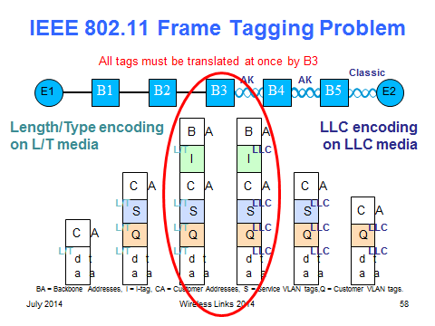
802.11ak | Enhancements For Transit Links Within Bridged Networks |  | Status: Initial WG Ballot complete |  | Completion 2017
Key Project Goals
Enables an 802.11 connection to be used as a through link in a general network, not just as a connection to an end station at the edge of a network There are a large number of new products including home entertainment systems and industrial control equipment that have both an IEEE 802.11 wireless station capability and a wired IEEE 802.3 Ethernet capability. IEEE 802.11 has media operating in the gigabit per second range and has standardized security and quality of service improvements. These developments raise a demand for bridging of IEEE 802.11 media with the same bridging services as other media: as media internal to the network as well as media offering access to the network.
Key Parameters
Use cases Fully general mixed 802.11 and wired plug and play in the home Data Center top-of-rack to top-of-rack connections for overflow traffic. Industrial control Enterprise network use |  | Technology GLK, EPD MAC enhancements
Access to Internet, latest airlines’ announcements, and digital media such as movies and sport events
For more information: see slides 49-60 in Donald’s document;

Slide 24

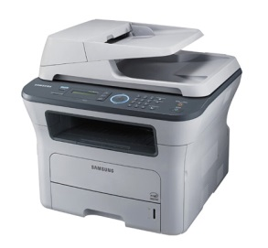


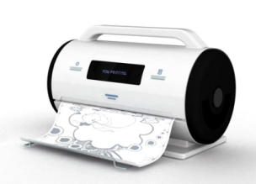
802.11aq | Pre-Association Discovery |  | Status: Initial WG Ballot complete |  | Completion 2017
Key Project Goals
Enables delivery of pre-association Service Discovery information by IEEE 802.11 stations (STAs).
Key Parameters
Use cases Printer discovery in a hotel Service discovery in a WLAN |  | Technology Container MAC protocol Service identification hash nechanism
Access to Internet, latest airlines’ announcements, and digital media such as movies and sport events
For more information: use cases, functional reqs;

Slide 25
TGaq Technical Highlights
Container MAC protocol to carry upper layer service discovery protocols (e.g. UPnP, Bonjour)
Provisioning and configuration of services in the access point
  Service Transaction Proxy is a logical element connected to the access point
Universal identification of services
  Using a hash name
  Provide service attributes (e.g. 3D printer capability or point of sale service)
Currently considering request/response or broadcast concept
Dorothy Stanley, HP Enterprise

Slide 26

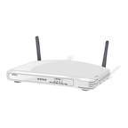
802.11ax | High Efficiency WLAN |  | Status: Pre-D1.0; D0.1 available |  | Completion 2019
Key Project Goals
Improve performance of WLAN deployments in dense scenarios Targeting at least 4x improvement in the per-STA throughput compared to 11n & 11ac. Improved efficiency through spatial reuse and enhanced power save techniques.
Key Parameters
Use cases Focus on dense deployments 2.4GHz and 5GHz (1-6GHz) Evaluation of performance includes throughput, delay, spectral efficiency, power consumption |  | Technology Significant MAC changes: Addition of scheduled OFDMA MAC inside of EDCA transmission windows PHY changes: OFDMA subdivides 20MHz channel into 9 2+MHz channels Bi-directional MU-MIMO and MU-MIMO enhancements 1024 QAM BSS Coloring spatial re-use Compatible with existing devices
Access to Internet, latest airlines’ announcements, and digital media such as movies and sport events
For more information: simulations, functional reqs, specification framework

Slide 27
BSS Coloring enables additional channel re-use
All same-channel BSS block
Same-channel BSS only block on Color Match
2
2
1
5
2
1
5
2
4
1
5
4
1
5
2
3
7
4
1
5
3
7
4
6
3
7
4
6
3
7
2
6
3
7
2
6
1
5
2
6
1
5
4
1
5
2
4
3
7
4
1
5
3
7
6
3
7
4
6
6
3
7
6
Dorothy Stanley, HP Enterprise

Slide 28
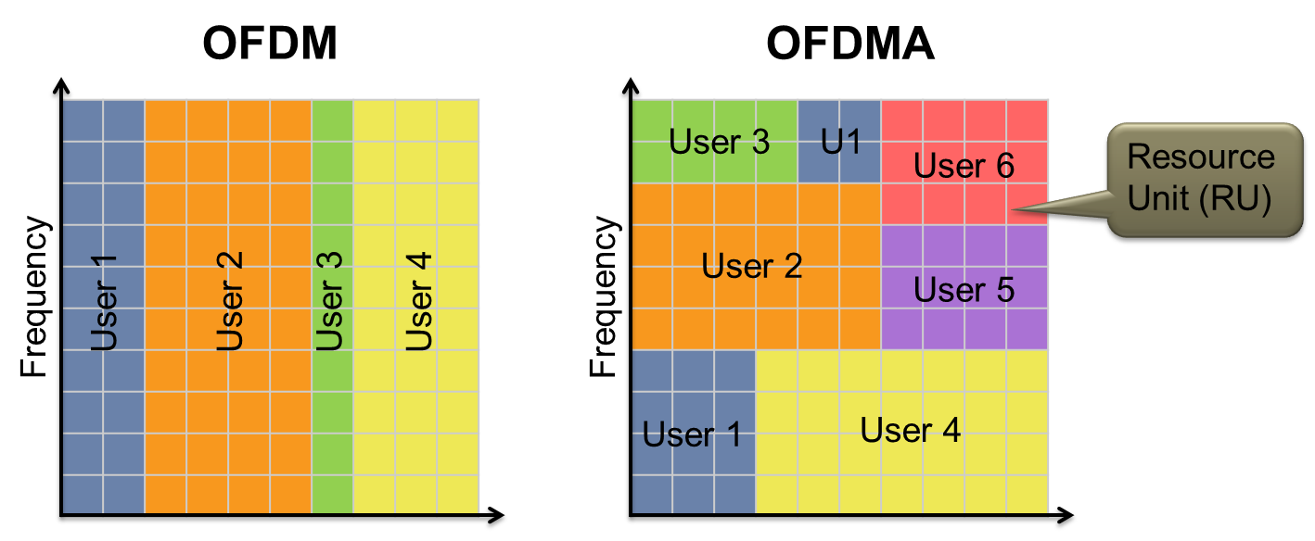
OFDMA enables further AP customization of channel use to match client and traffic demands
Increased efficiency for (high percentage of traffic) short data frames
Dorothy Stanley, HP Enterprise

Slide 29
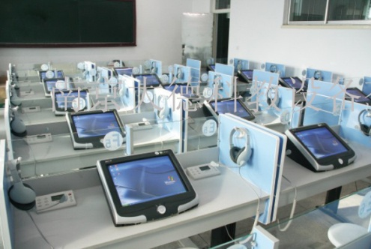
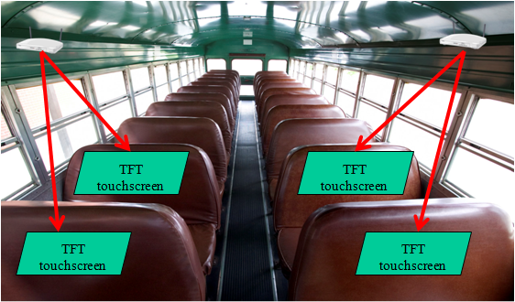
802.11ay | Next Generation 60GHz |  | Status: Pre-D1.0; Functional Reqs |  | Completion 2019
Key Project Goals
Enhanced Throughput for Operation in License-Exempt Bands Above 45 GHz: Increase aggregated throughput, range and reliability Expected to develop mode of operation capable of supporting a maximum throughput of at least 20 gigabits per second (measured at the MAC data service access point), while maintaining or improving the power efficiency per station.
Key Parameters
Use cases Wireless docking Wireless display Indoor/Outdoor backhaul Ultra short range communications 8K UHD streaming Data Center Inter-rack connectivity Video/Mass Data distribution |  | Technology Channel bonding MIMO Maintain backwards compatibility with existing deployed 60GHz devices Note: 802.11ad products coming on the market now, Wi-Fi Alliance 11ad WiGig Certified launching 2016, see link
Access to Internet, latest airlines’ announcements, and digital media such as movies and sport events
For more information: channel models, specification framework, use cases document (photos from slide 12

Slide 30
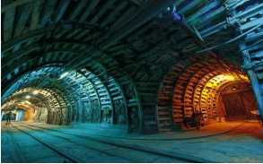
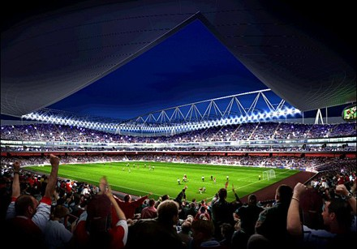
802.11az | Next Generation Positioning |  | Status: Pre-D1.0; Functional Reqs |  | Completion 2020
Key Project Goals
Improve location accuracy and scalability; consider new usages such as directionality and ranging
Key Parameters
Use cases Indoor location maps and directions Micro-location in a store Navigation in public buildings Industrial positioning: underground mining, |  | Technology additional rotational angle
Access to Internet, latest airlines’ announcements, and digital media such as movies and sport events
For more information: use cases, functional reqs, ;

Slide 31
Standing Committees
(SCs) and Topic Interest Groups (TIGs)
Dorothy Stanley, HP Enterprise

Slide 32
Architecture Standing Committee Overview
Models for STA architecture and related concepts, and overall system architecture, included in the Standard in clauses 4 and 5, generally.
Evolution of the models, either to consider amendments to the Standard, or as clarification is needed
Define how 802.11 technologies fit into 802, 802.1 use cases.
Define MIB and management conventions
Dorothy Stanley, HP Enterprise

Slide 33
802.11 Architecture Overview
Multiple Over the Air PHY options
One common MAC based on CSMA/CA
a
b
g
n
ac
ad
af
ah
ax
802.11 MAC
Dorothy Stanley, HP Enterprise

Slide 34
802.11/802.15 Regulatory SC and & 802.18 Regulatory Technical Advisory Group
Wireless standards all depend on the availability of RF spectrum for their deployment
Spectrum allocations and rules vary worldwide
The massive growth of wireless applications is forcing regulators to make changes
The Regulatory SC provides IEEE 802.11 with information about spectrum availability and changes
Where needed, the group lobbies regulators for changes to accommodate new standards
Work in transition to 802.18
Dorothy Stanley, HP Enterprise

Slide 35
802.19 Coexistence and related liaison activity
Significant work underway related to LAA coexistence
See https://mentor.ieee.org/802.19/dcn/16/19-16-0037-09-0000-laa-comments.pdf
Liaisons received related to 3GPP LWIP and LWA
See 3GPP presentation on LWA and LWIP: https://mentor.ieee.org/802.11/dcn/16/11-16-0351-01-0000-liaison-from-3gpp-on-lwa-and-lwip.pptx
And, related, BRCM presentation on LWA and LWIP: https://mentor.ieee.org/802.11/dcn/16/11-16-0437-01-0wng-discussion-on-lwa-and-lwip.pptx
And 802.11 response:802.11 liaison to 3GPP (with Adrian’s edits) re: thank you for presentation on LWA and LWIP and request for further collaboration: https://mentor.ieee.org/802.11/dcn/16/11-16-0489-02-0000-liaison-to-3gpp-on-lwa-and-lwip.docx
Dorothy Stanley, HP Enterprise

Slide 36







LRLP TIG | Long Range Low Power Topic Interest Group |  | Status: Developing use cases, requirements, technical feasibility |  | Completion July 2016
Key Project Goals
Identify use cases and requirements for long range low power applications that are not met by current 802.11 MAC/PHY capabilities and recommend a path forward.
Key Parameters
Use cases Smart grid IoT, energy management, sensors Smart home, digital health Leverage deployed WLAN internet access infrastructure |  | Technology 2.4 GHz band Asymmetrical STA and AP (enables simple client device implementation) Optimize for long range or low power Extend 11ah long range functionality to higher bands
Internet
Long-range single-hop
Access to Internet, latest airlines’ announcements, and digital media such as movies and sport events
Room1
Room2
Room3
For more information: Output report document, Figure from example use case document;

Slide 37
Topics and Agenda
Some information about the IEEE 802 standards development process
IEEE 802.11 status and projects under development
Areas of mutual interest
References, including past liaison documents
Q&A

Slide 38
IETF- IEEE 802 Liaison Activity
Joint meetings, agenda and presentations
  http://www.iab.org/activities/joint-activities/iab-ieee-coordination/
  2016-02-01 teleconference held;
  Request for tutorial on 802 wireless (.11, .15) technologies, see http://ietf.org/meeting/95/tutorials.html ; note prior presentation from Donald Eastlake: http://www.ietf.org/edu/documents/WirelessLinks2.pdf
  Next teleconference and Sept F2F meeting dates are TBD
RFC 7241, “The IEEE 802/IETF Relationship” has been published (RFC4441 update)
  https://datatracker.ietf.org/doc/rfc7241/
IEEE 802 Liaisons list is available
  http://ieee-sa.centraldesktop.com/802liaisondb/FrontPage
802 EC “IETF/IAB/IESG” 802 EC Standing Committee
  Formed March 2014, Pat Thaler as chair

Slide 39
Topic: Multicast
Multicast issues were
discussed at the IETF-IEEE 802 meeting Sept 29th 2015 and
a presentation given at the November 2015 IETF meeting, see ttps://mentor.ieee.org/802.11/dcn/15/11-15-1261-02-0arc-mulicast-performance-optimization-features-overview-for-ietf-nov-2015.ppt
Further actions: ietf mailing list has been established for ongoing discussion, will include additional 802. wireless groups, see http://www.ieee802.org/11/email/stds-802-11/msg01838.html
Internet draft describing use cases, issues, etc. under development
Insights
  Multicast used for multiple types of traffic including ARP/ND, routing protocols, video applications, and these might need to be transmitted at different MCS
  Implementations might consider APIs to allow MCS differentiation
  RFC 6775, Neighbor Discovery Optimization for IPv6 over Low-Power Wireless Personal Area Networks (6LoWPANs) defines a registration mechanism for accomplishing proxy ND
  Current Proxy ND support does not address Secure ND, see RFC 3971
Available internet drafts and related documents
  http://datatracker.ietf.org/doc/draft-mcbride-mboned-wifi-mcast-problem-statement/
  http://www.ipv6council.be/IMG/pdf/20141212-08_vyncke_-_ipv6_multicast_issues-pptx.pdf

Slide 40
Topic: Multicast - 2
PIM: http://datatracker.ietf.org/wg/pim/charter/
  The Working Group charter includes: “Optimization approaches for IGMP and MLD to adapt to link conditions in wireless and mobile networks and be more robust to packet loss.”
  And a work item (April 2016) “submit solutions for IGMP and MLD to adapt to wireless link conditions”
New internet draft: https://tools.ietf.org/id/draft-perkins-intarea-multicast-ieee802-00.txt
  “This document describes some performance issues that have been observed when multicast packet transmission is attempted over IEEE 802 wireless media. Multicast features specified for IEEE 802 wireless media related to multicast are also described, along with explanations about how these features can help ameliorate the observed performance issues. IETF protocols that are likely to be affected by the observed performance issues are identified, and workarounds are proposed in some cases. The performance of multicast over wireless media often can be quite different than the performance of unicast. This draft describes the nature of the differences and the effects on representative IETF protocols. We also describe some efforts that have been made by IEEE 802 Wireless groups to ameliorate the performance differences.”

Slide 41
Additional topics of mutual interest
Quality of Service and DSCP code mapping
  RFC 7561: Mapping PMIPv6 QoS Procedures with WLAN QoS Procedures, see http://datatracker.ietf.org/doc/rfc7561/
  https://tools.ietf.org/html/draft-szigeti-tsvwg-ieee-802-11-01.
White-Space database access
  RFC 7545: Protocol to Access White-Space (PAWS) Databases, see https://datatracker.ietf.org/doc/rfc7545/
CAPWAP protocol and extensions
RADIUS Extensions
Additional EAP methods
EAP Method Requirements
IEEE 802.11 uses IANA registry to define domain parameter sets for DH.

Slide 42
References
http://www.ieee802.org/11/
Documents: https://mentor.ieee.org/802.11/documents

Slide 43
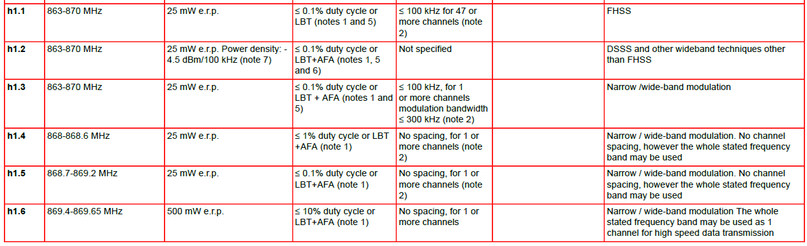
EU Spectrum for 802.11ah

Slide 44
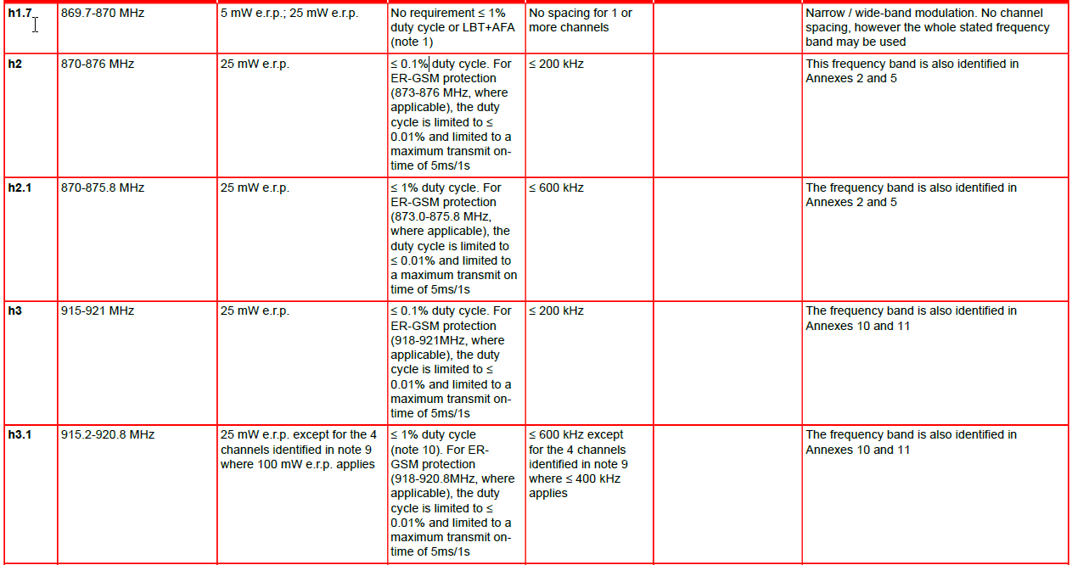
EU Spectrum for 802.11ah [2]

Slide 45
US Spectrum for IEEE 802.11ah (FCC 15.247)
Systems using digital modulation techniques may operate in the 902-928 MHz, 2400-2483.5 MHz, and 5725-5850 MHz bands. The minimum 6 dB bandwidth shall be at least 500 kHz.
The maximum peak conducted output power of the intentional radiator shall not exceed the following:
  For systems using digital modulation in the 902-928 MHz, 2400-2483.5 MHz, and 5725-5850 MHz bands: 1 Watt. As an alternative to a peak power measurement, compliance with the one Watt limit can be based on a measurement of the maximum conducted output power. Maximum Conducted Output Power is defined as the total transmit power delivered to all antennas and antenna elements averaged across all symbols in the signaling alphabet when the transmitter is operating at its maximum power control level. Power must be summed across all antennas and antenna elements. The average must not include any time intervals during which the transmitter is off or is transmitting at a reduced power level. If multiple modes of operation are possible (e.g., alternative modulation methods), the maximum conducted output power is the highest total transmit power occurring in any mode.

