Slide 1
LiFi: Concept, Use-cases and Progress
Date: 2016-03-14
Authors:

Slide 2
Abstract
The exponential demand for wireless communications, estimated at over 70% CAGR, is set to continue. The electromagnetic spectrum is becoming increasingly crowded and alternative, unlicensed mediums are being explored.
Light offers a completely unlicensed and very well understood medium for wireless communications. The use of light to provide high speed, bidirectional and networked wireless communications is named LiFi.

Slide 3
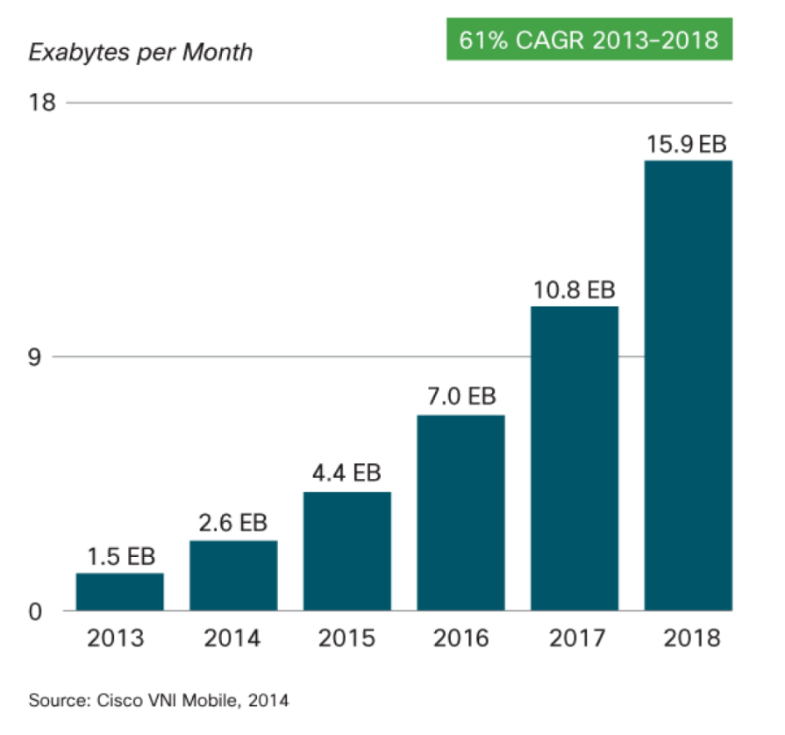
Data is Everywhere
Global Mobile Data Traffic

Slide 4
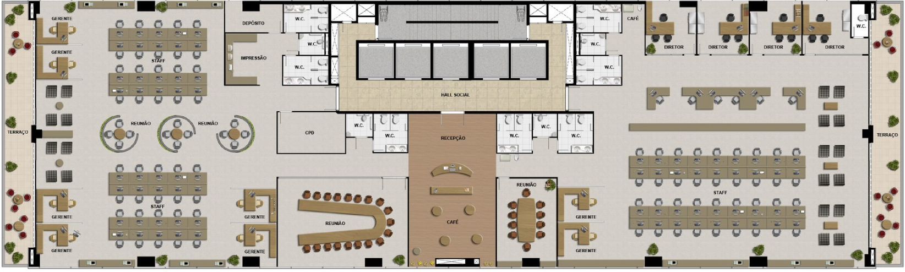
Typical Office

Slide 5
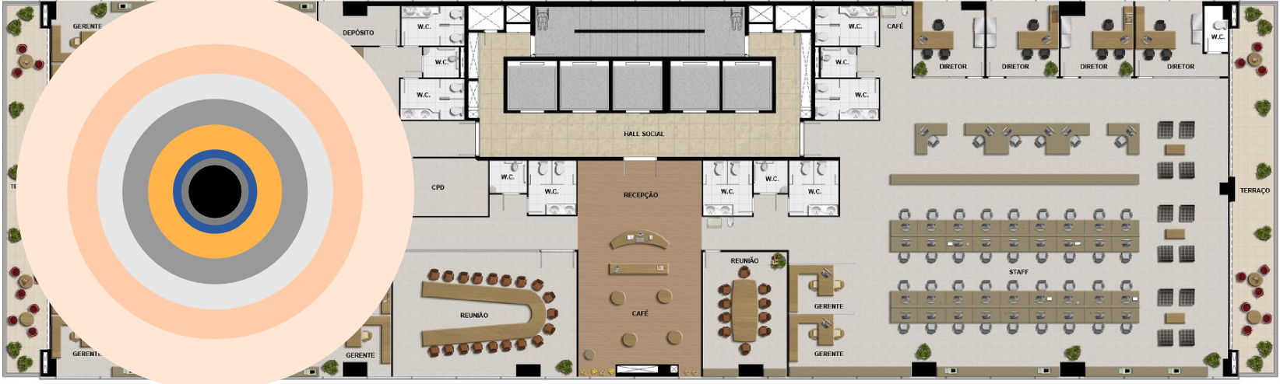
Typical Office – WiFi Coverage
Wi-Fi Router Location

Slide 6
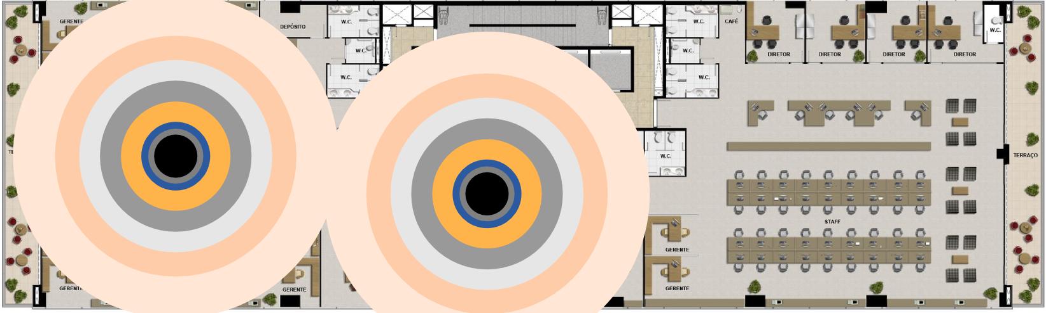
Typical Office – WiFi Coverage
Wi-Fi Router Location

Slide 7
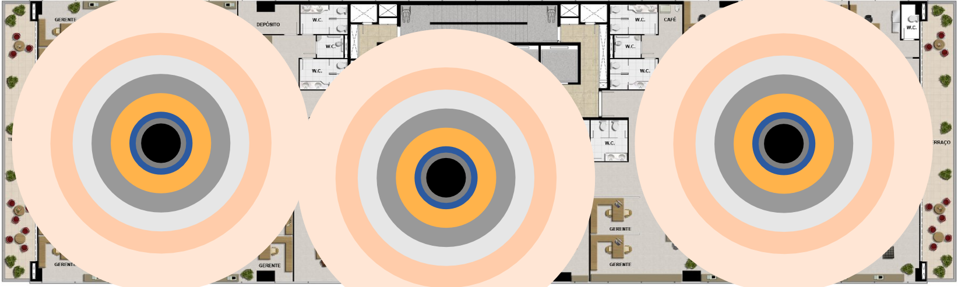
Typical Office – WiFi Coverage
Wi-Fi Router Location

Slide 8
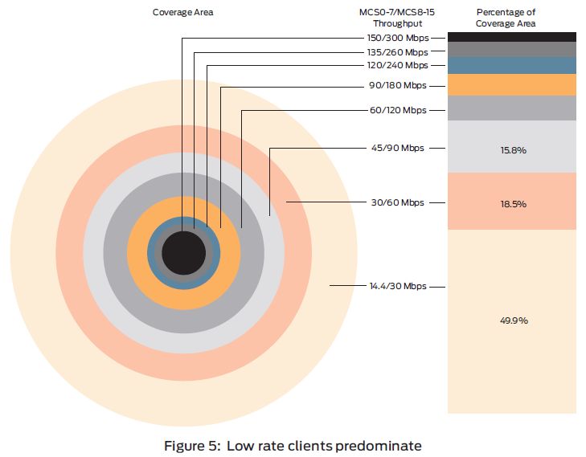
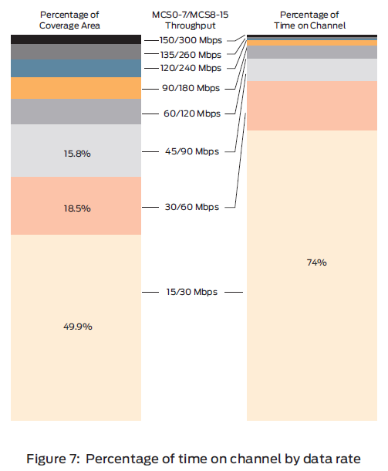
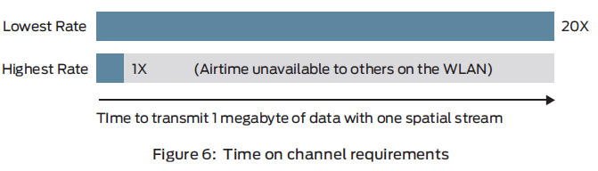
Typical Office – WiFi Coverage

Slide 9
Typical Office

Slide 10
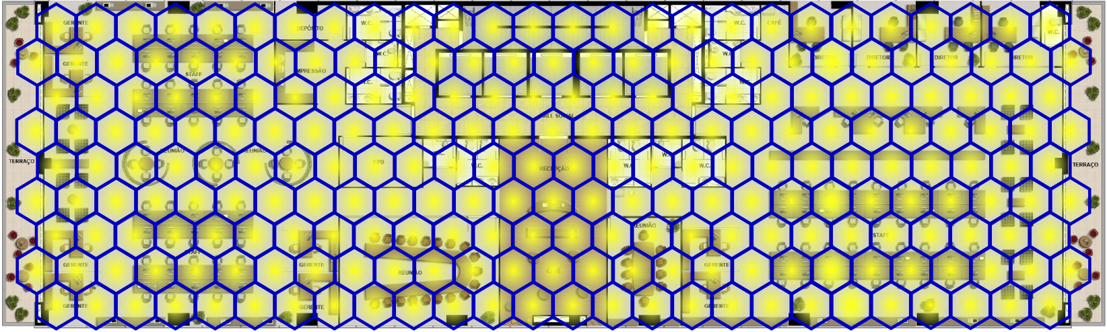
Typical Office – LiFi Coverage
Each Honeycomb is a Li-Fi router

Slide 11
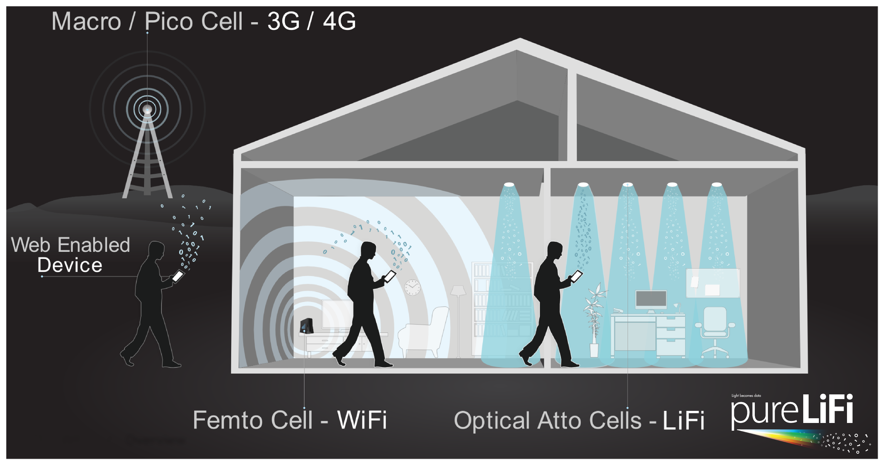
What is LiFi?

Slide 12
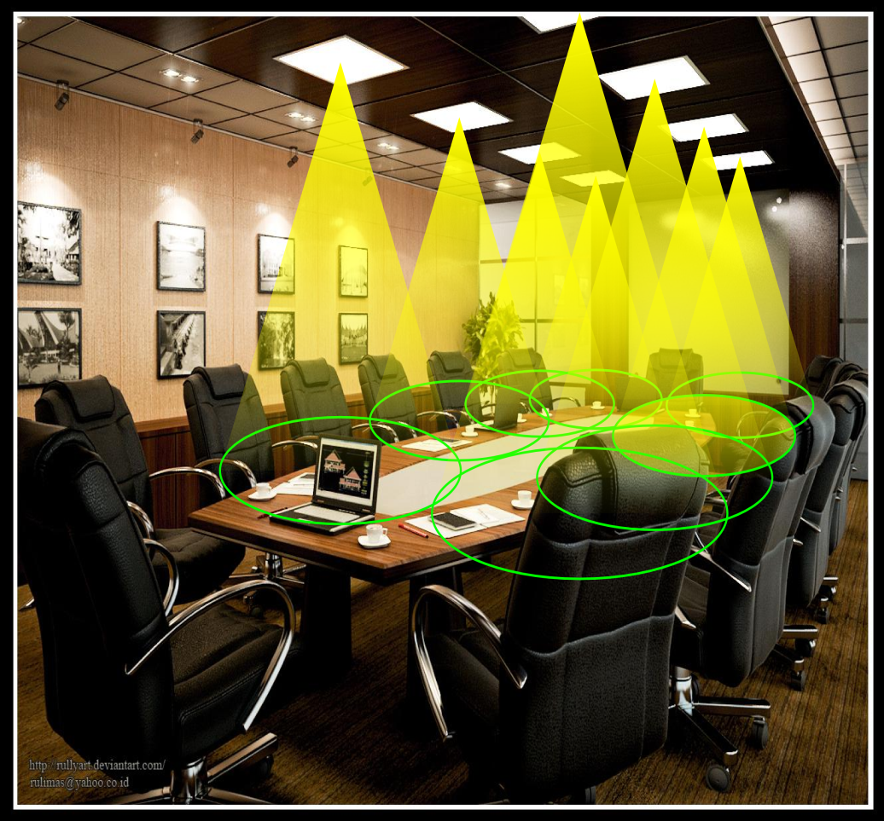
The LiFi Optical Atto-cell Network
Cellular network in a room: optical atto-cell network.
Each light functions as a base station covering a very small area (typically 1-10 m²).
Inherent properties of light reduce interference:
  No signals outside the room
  Easy beamforming with optics
  Enhanced security

Slide 13
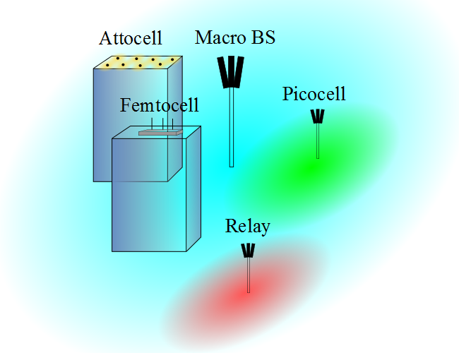
Het. Nets = Small Cells
I. Stefan, H. Burchardt, and H. Haas, “Area spectral efficiency performance comparison between VLC and RF femtocell networks,” ICC, 2013.

Slide 14
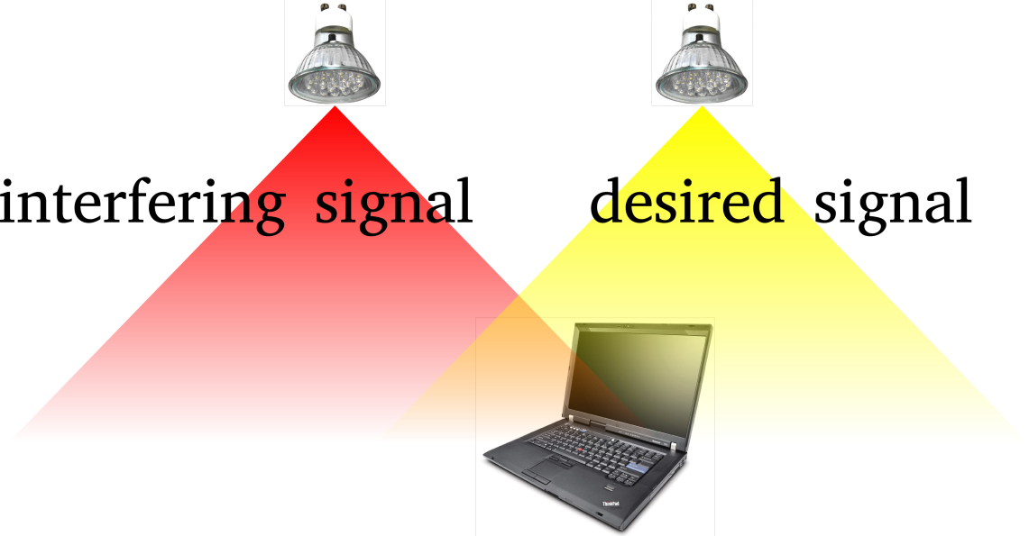
Interference Coordination in VLC
Spectrum reuse leads to co-channel interference (CCI).
Interference coordination techniques in OW:
  Traditional static resource partitioning [2]
  Busy-burst-signalling-based interference-aware resource allocation [3]
  Fractional frequency reuse [4].
[2] G. W. Marsh, J. M. Kahn, “Channel Reuse Strategies for Indoor Infrared Wireless Communications,” IEEE Trans. on Commun., 1997.
[3] B. Ghimire and H. Haas, “Self Organising Interference Coordination in Optical Wireless Networks,” in EURASIP Journal on Wireless Communications and Networking, 2012.
[4] C. Chen, et. al., “ Fractional frequency reuse in optical wireless networks,” in PIMRC, 2013.

Slide 15
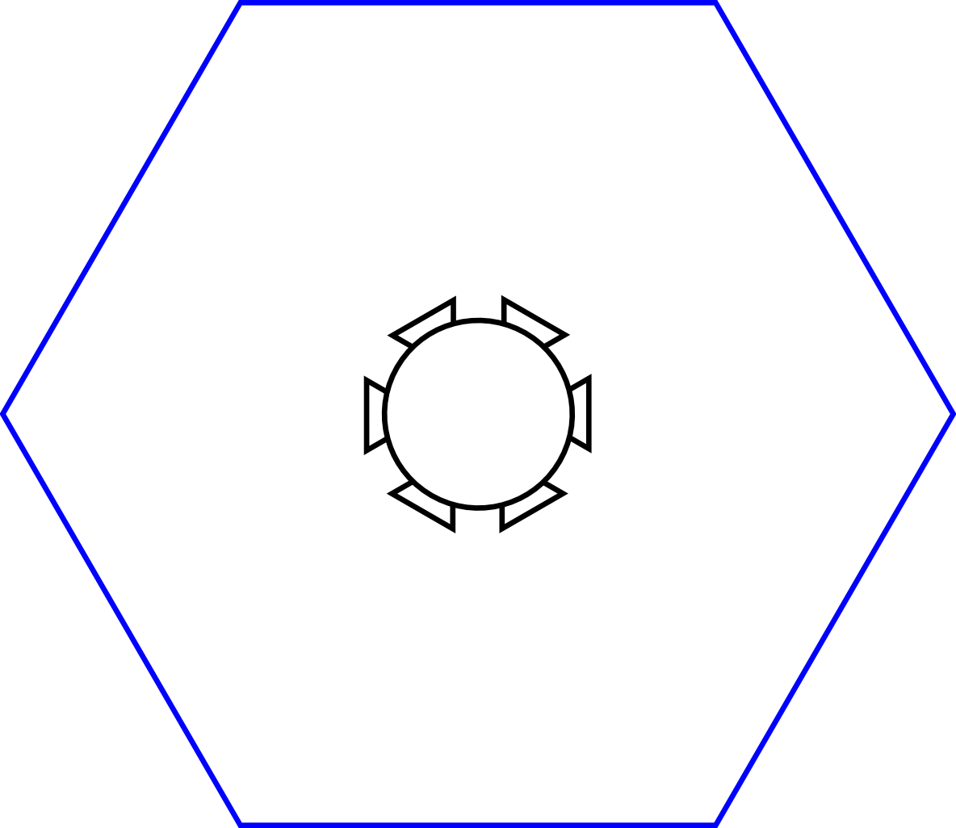
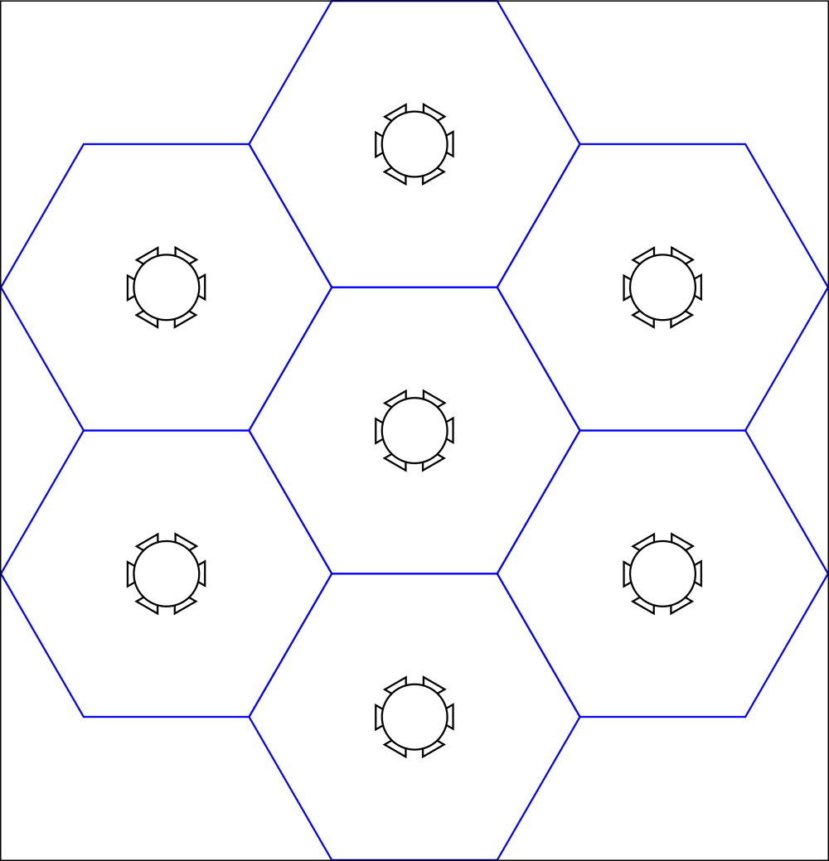
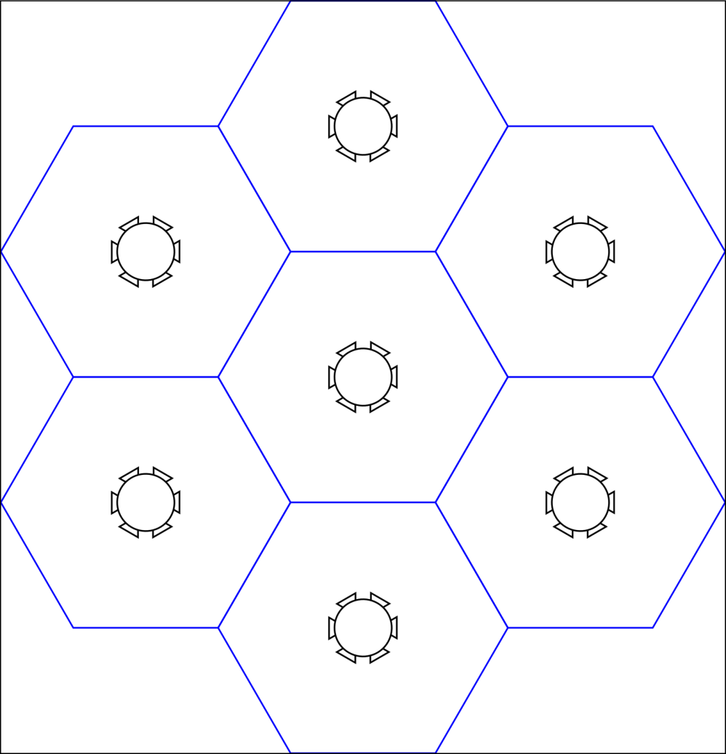
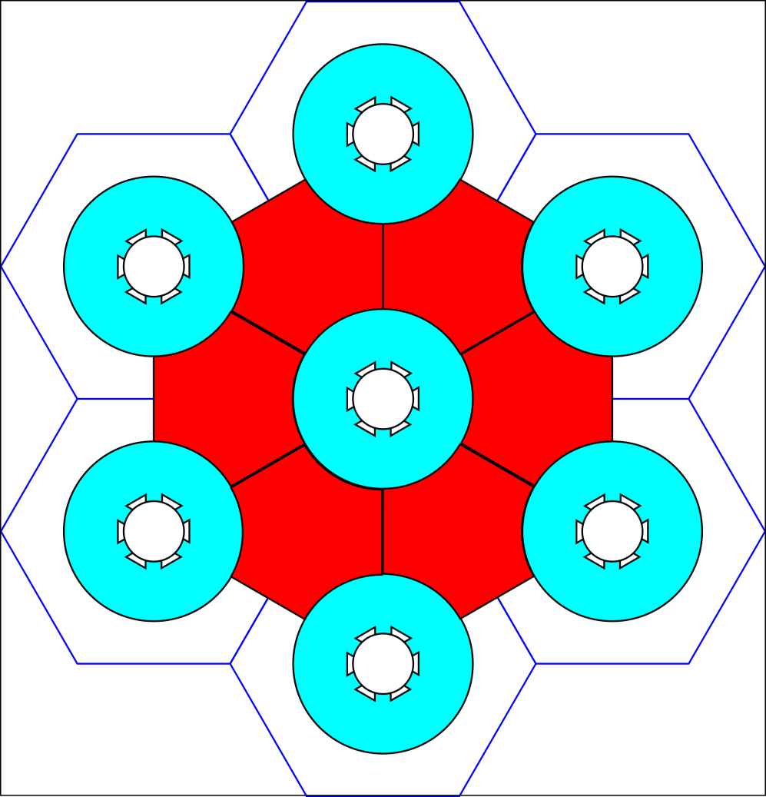
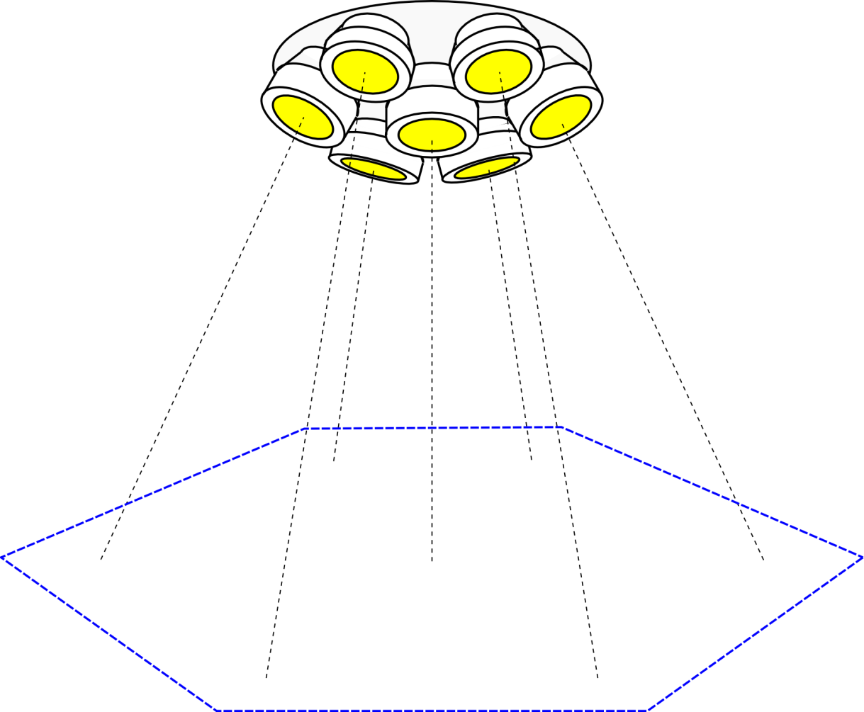
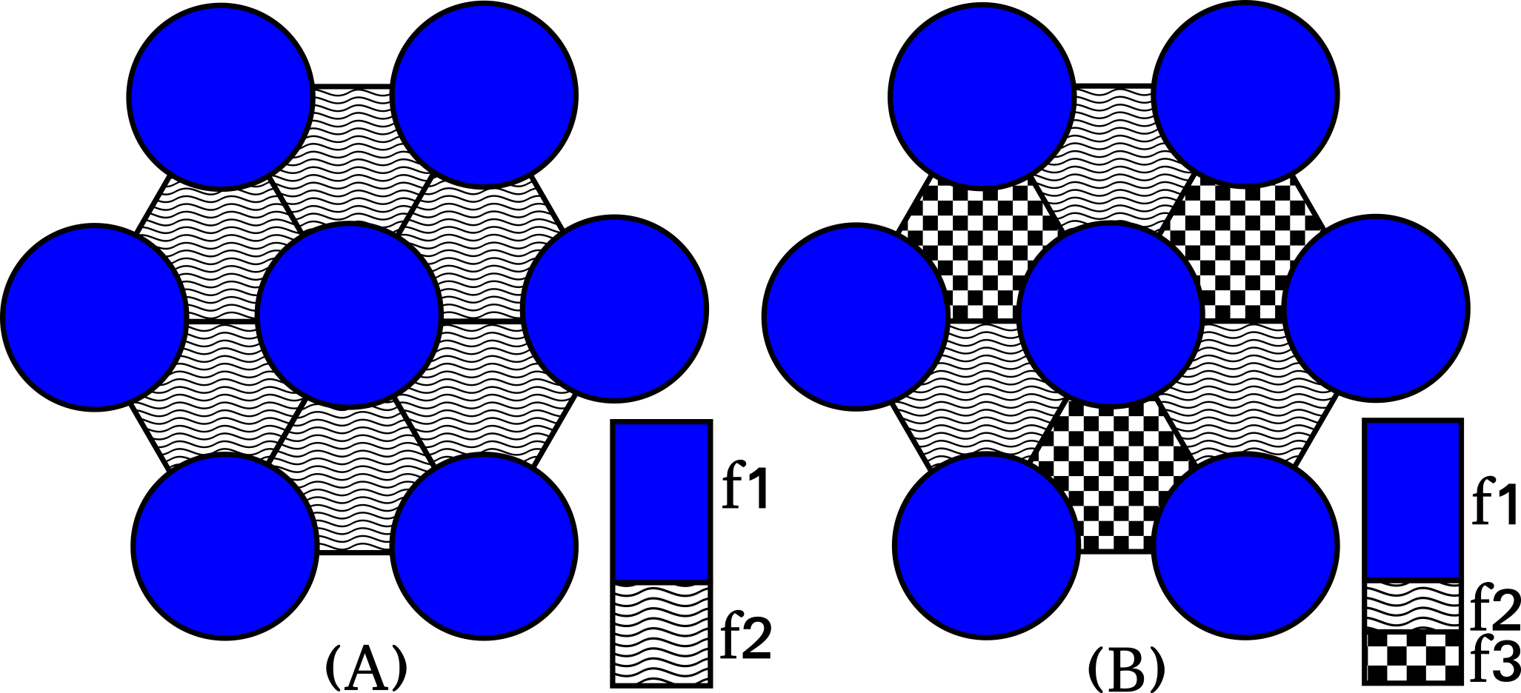
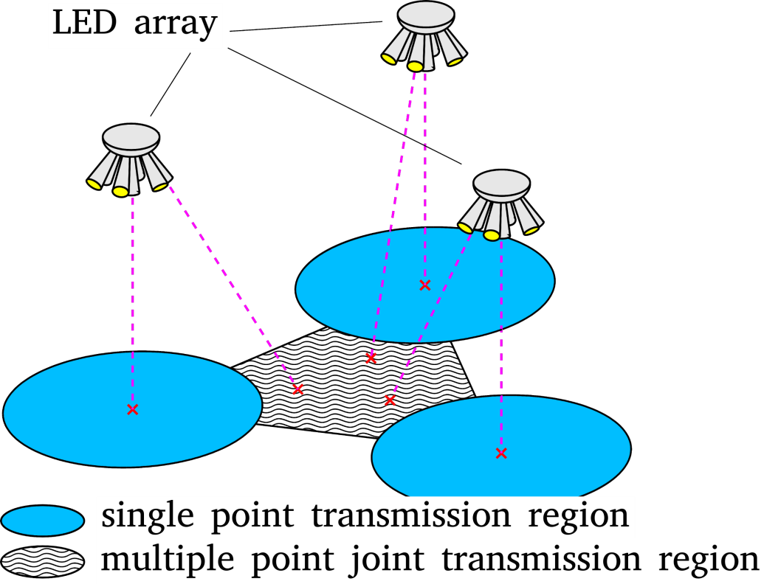
Joint Transmission in VLC
LED array design:
VLC Downlink network:
Transmission region division:
Frequency plan:

Slide 16
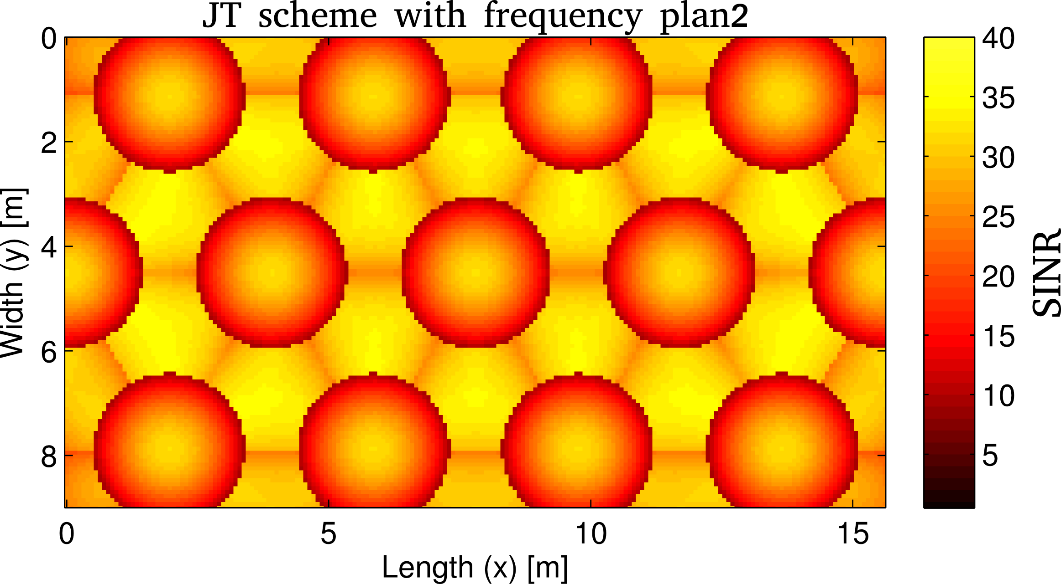
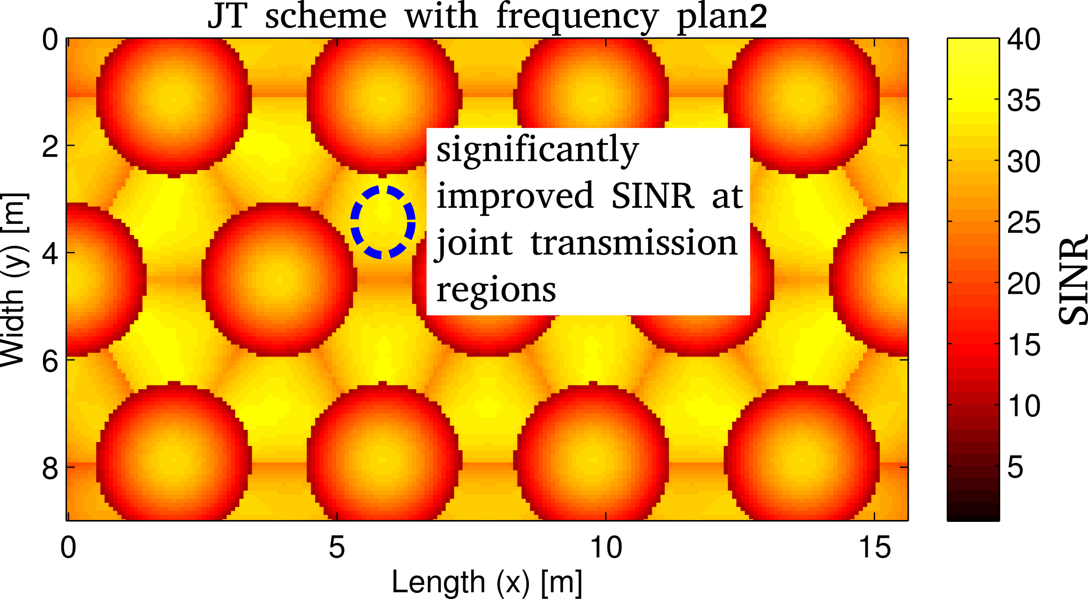
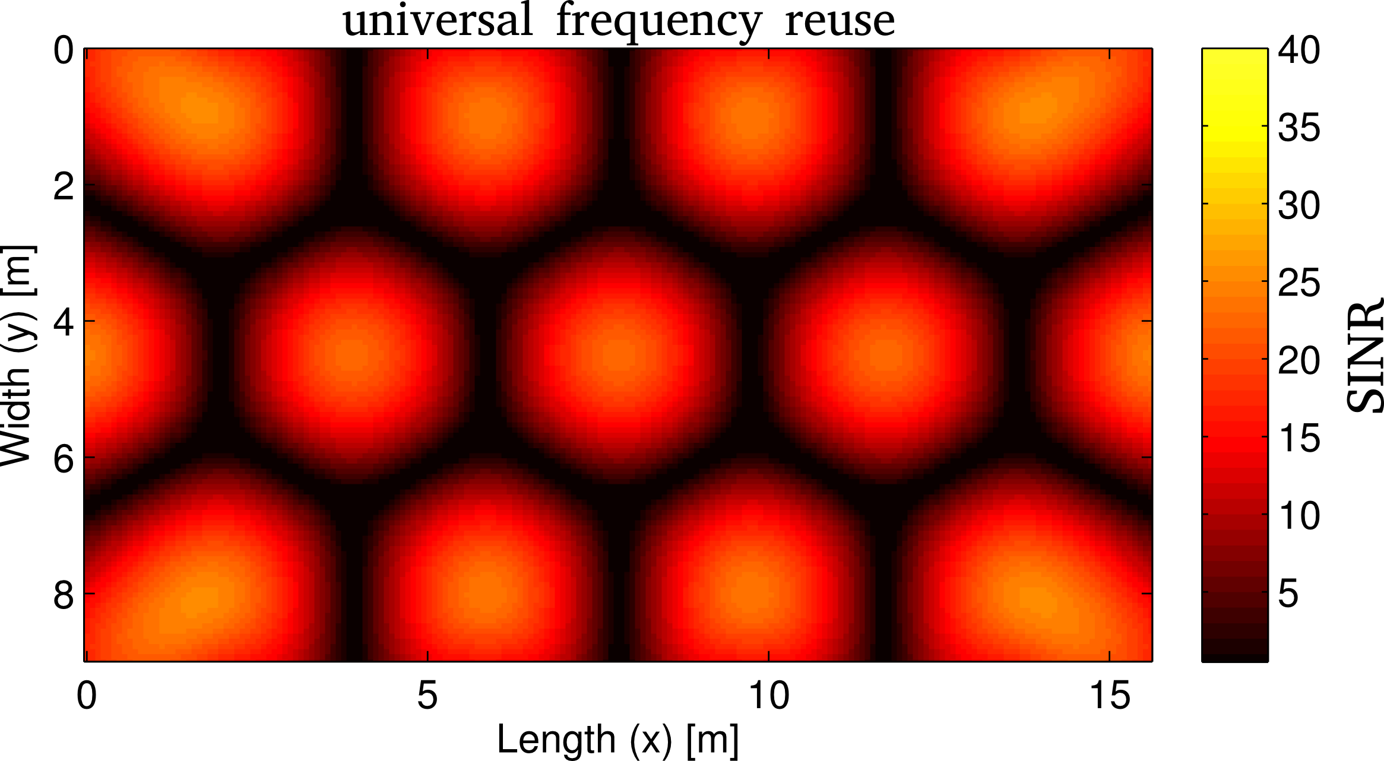
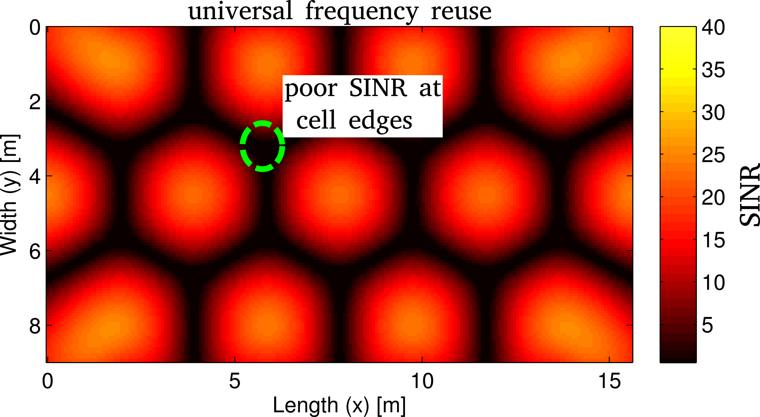
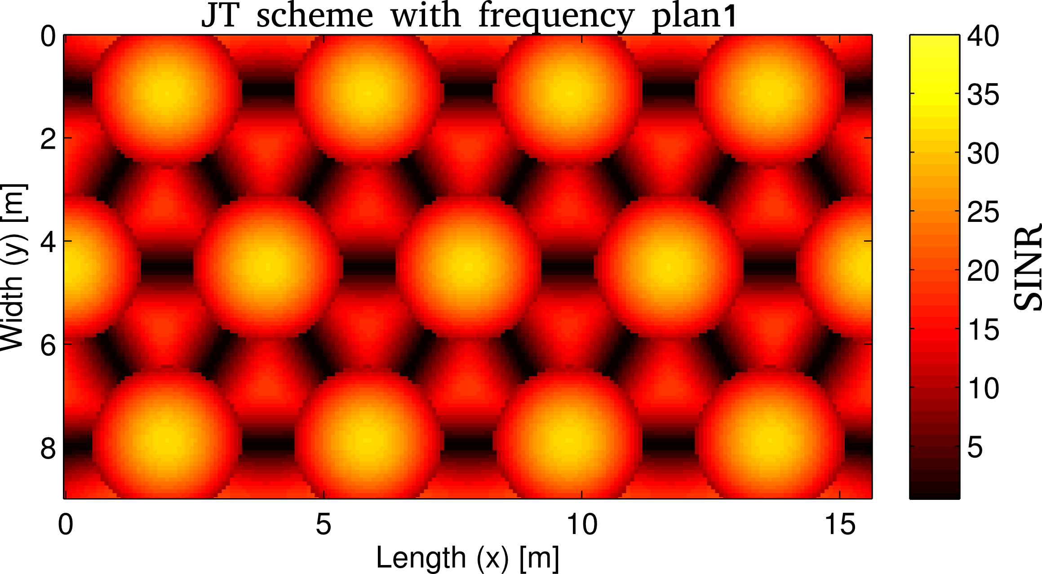
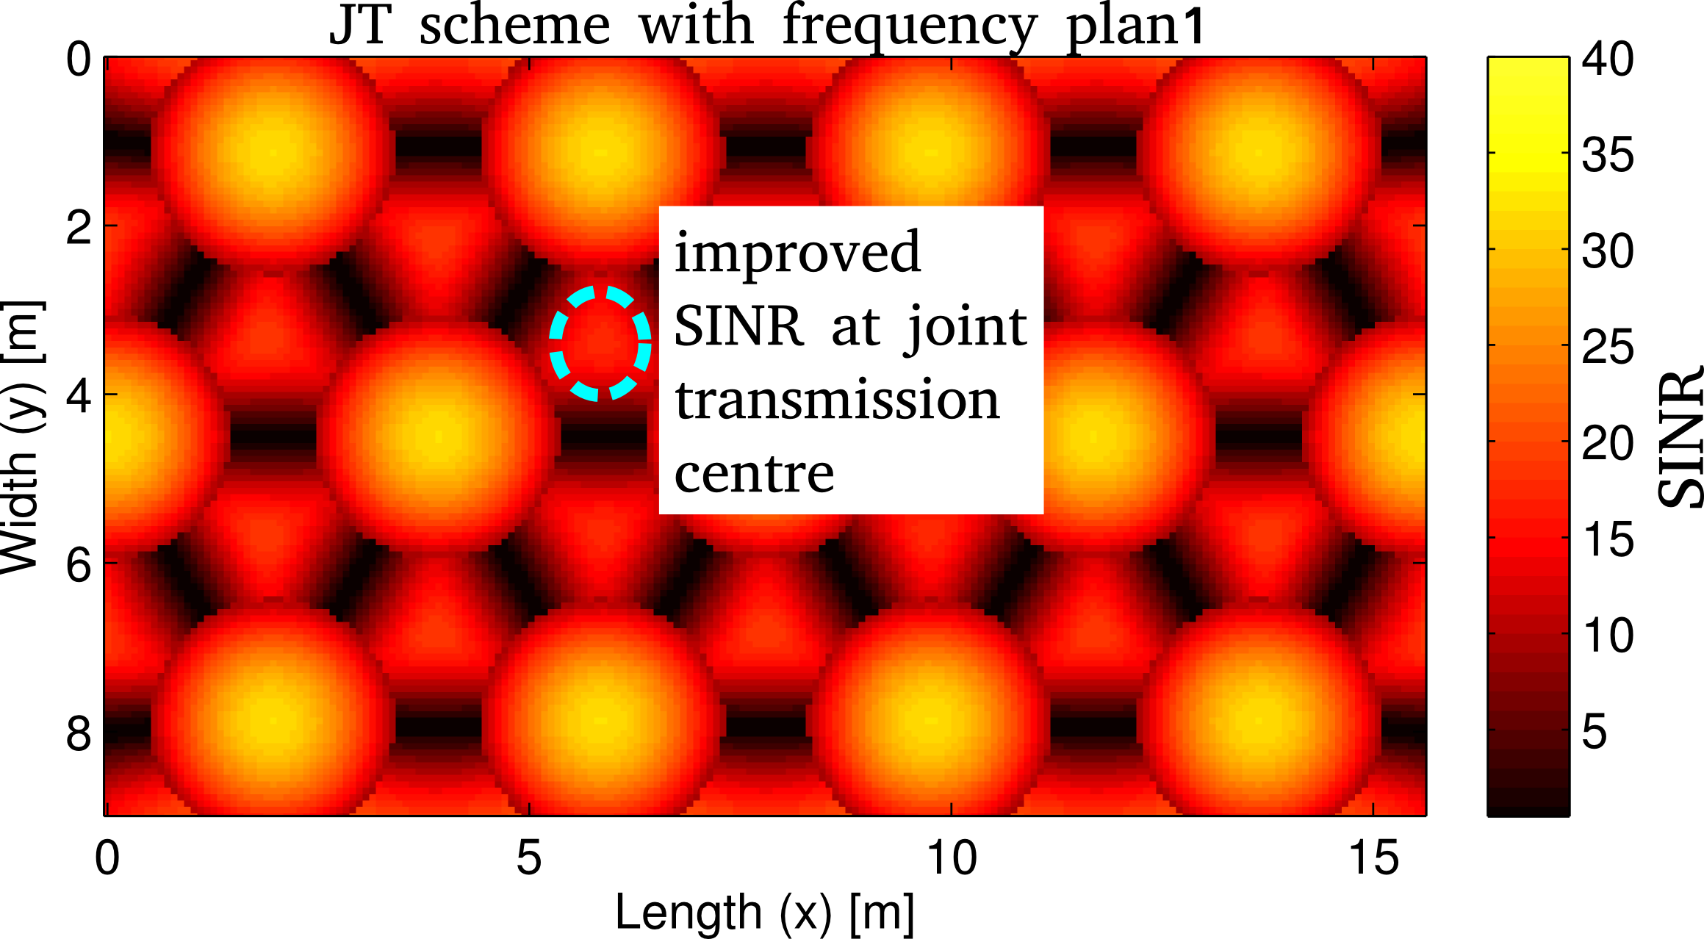
Simulation Results
Signal to Interference plus Noise Ratio (SINR):

Slide 17
Co-existence

Slide 18
Co-existence

Slide 19

LiFi: Competitive Advantages
Security
Safety
Localization
Data density
No Regulatory Constraints – Globally Unlicensed

Slide 20
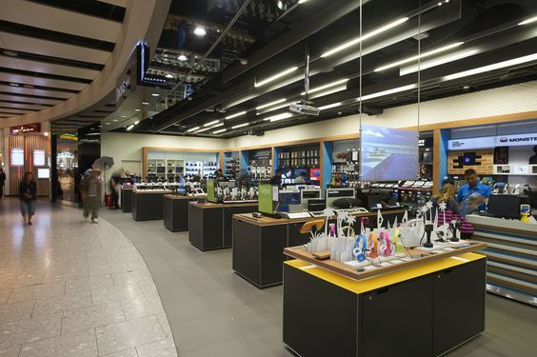
LiFi in Retail: For the Customer
Flexible and Adaptive Retail Space
Delivery of high-bandwidth data at particular points in store requires cabled connection. Makes these rather immobile.
Alteration of retail space to enable new customer experiences a key part of retailer strategy.
High-bandwidth flexible retail space through LiFi enables cost reductions for retailers when modifying or refitting the space.

Slide 21

LiFi in Retail: For the Customer
Location-base Content
Real-time delivery of product-relevant content based on the position of the consumer in the store.
No additional infrastructure for RF comm-unications required to deliver content, can be provided directly over LiFi.
Data density of LiFi enables very-high bandwidth content without fear of lack of wireless resources.

Slide 22
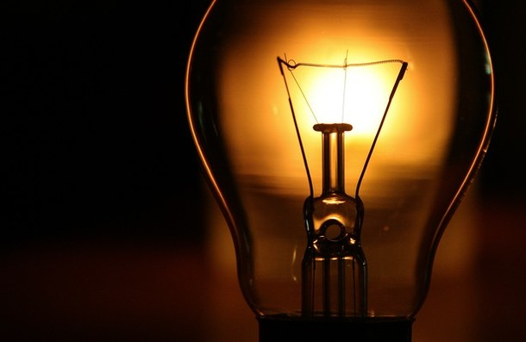
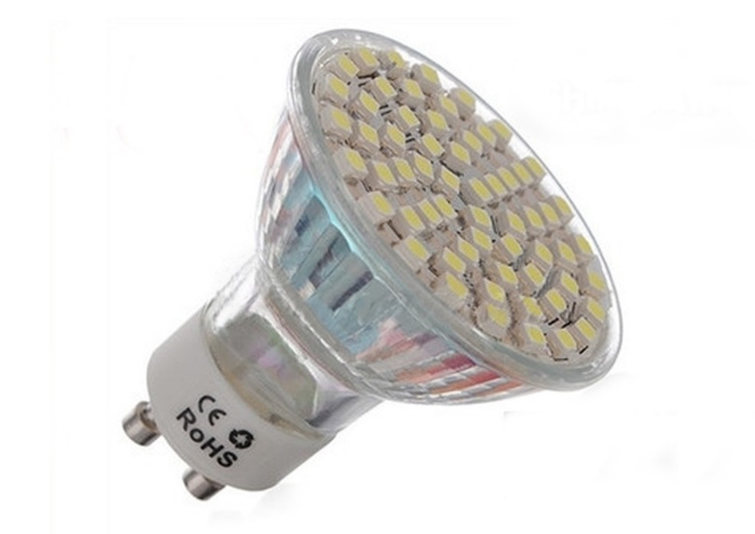
Future Services
Business focus shifts from volume sales to Quality of Service
enabling SMEs to compete with Incumbents

Slide 23
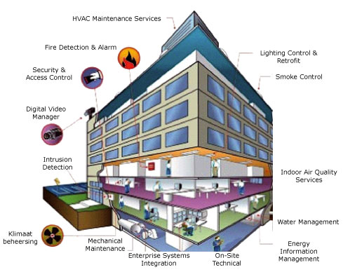

Future Services
Building Management Systems for Smart Building
Smart Buildings and Smart Infrastructure for Smart Cities

Slide 24
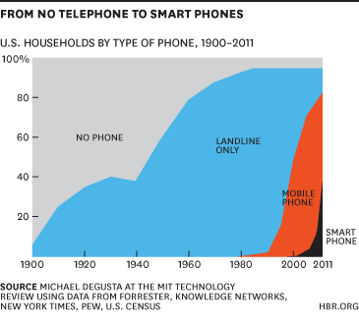
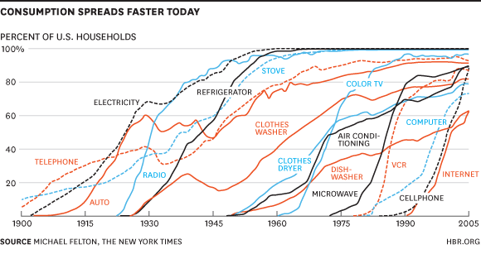
Future Services – When?
Notes:
Technology is accelerating at an Exponential Pace!
The traditional duration of the profitable cycle of a product or business model is shrinking EXPONENTIALLY!
Many people suggest that rates of new product introduction and adoption are speeding up, but is it really, across the board? The answer seems to be yes. An automobile industry trade consultant, for instance, observes that “Today, a typical automotive design cycle is approximately 24 to 36 months, which is much faster than the 60-month life cycle from five years ago.” The chart below, created by Nicholas Felton of the New York Times, shows how long it took various categories of product, from electricity to the Internet, to achieve different penetration levels in US households. It took decades for the telephone to reach 50% of households, beginning before 1900. It took five years or less for cellphones to accomplish the same penetration in 1990. As you can see from the chart, innovations introduced more recently are being adopted more quickly. By analogy, firms with competitive advantages in those areas will need to move faster to capture those opportunities that present themselves.
This second graph, by Michael DeGusta of MIT’s Technology Review, presents similar results. It took 30 years for electricity and 25 years for telephones to reach 10% adoption but less than five years for tablet devices to achieve the 10% rate. It took an additional 39 years for telephones to reach 40% penetration and another 15 before they became ubiquitous. Smart phones, on the other hand, accomplished a 40% penetration rate in just 10 years, if we time the first smart phone’s introduction from the 2002 shipment of the first BlackBerry that could make phone calls and the first Palm-OS-powered Treo model.

Slide 25
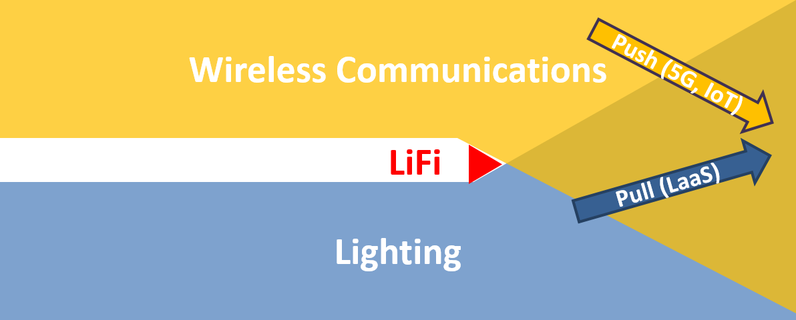
LiFi: The Bridge between…
Desire for new lighting services and the demand for more data
  LiFi as a new service for data provision and generation
LiFi paves the way for new business opportunities in the lighting industry
Notes:
Technology is accelerating at an Exponential Pace!
The traditional duration of the profitable cycle of a product or business model is shrinking EXPONENTIALLY!
Many people suggest that rates of new product introduction and adoption are speeding up, but is it really, across the board? The answer seems to be yes. An automobile industry trade consultant, for instance, observes that “Today, a typical automotive design cycle is approximately 24 to 36 months, which is much faster than the 60-month life cycle from five years ago.” The chart below, created by Nicholas Felton of the New York Times, shows how long it took various categories of product, from electricity to the Internet, to achieve different penetration levels in US households. It took decades for the telephone to reach 50% of households, beginning before 1900. It took five years or less for cellphones to accomplish the same penetration in 1990. As you can see from the chart, innovations introduced more recently are being adopted more quickly. By analogy, firms with competitive advantages in those areas will need to move faster to capture those opportunities that present themselves.
This second graph, by Michael DeGusta of MIT’s Technology Review, presents similar results. It took 30 years for electricity and 25 years for telephones to reach 10% adoption but less than five years for tablet devices to achieve the 10% rate. It took an additional 39 years for telephones to reach 40% penetration and another 15 before they became ubiquitous. Smart phones, on the other hand, accomplished a 40% penetration rate in just 10 years, if we time the first smart phone’s introduction from the 2002 shipment of the first BlackBerry that could make phone calls and the first Palm-OS-powered Treo model.

Slide 26
New Opportunities: Collaboration
LiFi enables the Lighting Industry to collaborate with:
  Infrastructure providers
  Content providers
For wireless data and content provision to businesses and consumers alike, forging new partnerships and entry into new industries
Notes:
Technology is accelerating at an Exponential Pace!
The traditional duration of the profitable cycle of a product or business model is shrinking EXPONENTIALLY!
Many people suggest that rates of new product introduction and adoption are speeding up, but is it really, across the board? The answer seems to be yes. An automobile industry trade consultant, for instance, observes that “Today, a typical automotive design cycle is approximately 24 to 36 months, which is much faster than the 60-month life cycle from five years ago.” The chart below, created by Nicholas Felton of the New York Times, shows how long it took various categories of product, from electricity to the Internet, to achieve different penetration levels in US households. It took decades for the telephone to reach 50% of households, beginning before 1900. It took five years or less for cellphones to accomplish the same penetration in 1990. As you can see from the chart, innovations introduced more recently are being adopted more quickly. By analogy, firms with competitive advantages in those areas will need to move faster to capture those opportunities that present themselves.
This second graph, by Michael DeGusta of MIT’s Technology Review, presents similar results. It took 30 years for electricity and 25 years for telephones to reach 10% adoption but less than five years for tablet devices to achieve the 10% rate. It took an additional 39 years for telephones to reach 40% penetration and another 15 before they became ubiquitous. Smart phones, on the other hand, accomplished a 40% penetration rate in just 10 years, if we time the first smart phone’s introduction from the 2002 shipment of the first BlackBerry that could make phone calls and the first Palm-OS-powered Treo model.

Slide 27

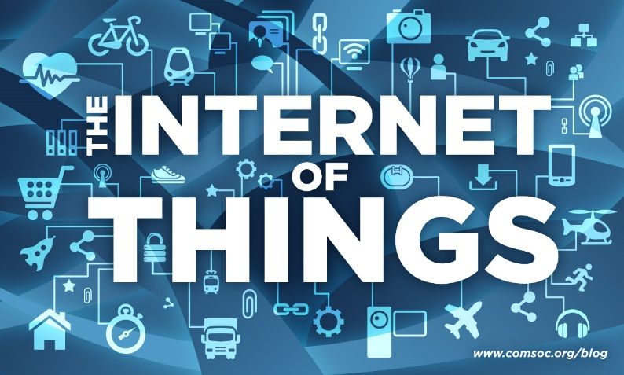
New Opportunities: Integration
LiFi enables lighting-communications integration into existing electronics:
Enabling the industry to drive back to volume sales through original equipment manufacture (OEM)
Notes:
Technology is accelerating at an Exponential Pace!
The traditional duration of the profitable cycle of a product or business model is shrinking EXPONENTIALLY!
Many people suggest that rates of new product introduction and adoption are speeding up, but is it really, across the board? The answer seems to be yes. An automobile industry trade consultant, for instance, observes that “Today, a typical automotive design cycle is approximately 24 to 36 months, which is much faster than the 60-month life cycle from five years ago.” The chart below, created by Nicholas Felton of the New York Times, shows how long it took various categories of product, from electricity to the Internet, to achieve different penetration levels in US households. It took decades for the telephone to reach 50% of households, beginning before 1900. It took five years or less for cellphones to accomplish the same penetration in 1990. As you can see from the chart, innovations introduced more recently are being adopted more quickly. By analogy, firms with competitive advantages in those areas will need to move faster to capture those opportunities that present themselves.
This second graph, by Michael DeGusta of MIT’s Technology Review, presents similar results. It took 30 years for electricity and 25 years for telephones to reach 10% adoption but less than five years for tablet devices to achieve the 10% rate. It took an additional 39 years for telephones to reach 40% penetration and another 15 before they became ubiquitous. Smart phones, on the other hand, accomplished a 40% penetration rate in just 10 years, if we time the first smart phone’s introduction from the 2002 shipment of the first BlackBerry that could make phone calls and the first Palm-OS-powered Treo model.

Slide 28
What is LiFi?
http://purelifi.com
Notes:
Technology is accelerating at an Exponential Pace!
The traditional duration of the profitable cycle of a product or business model is shrinking EXPONENTIALLY!
Many people suggest that rates of new product introduction and adoption are speeding up, but is it really, across the board? The answer seems to be yes. An automobile industry trade consultant, for instance, observes that “Today, a typical automotive design cycle is approximately 24 to 36 months, which is much faster than the 60-month life cycle from five years ago.” The chart below, created by Nicholas Felton of the New York Times, shows how long it took various categories of product, from electricity to the Internet, to achieve different penetration levels in US households. It took decades for the telephone to reach 50% of households, beginning before 1900. It took five years or less for cellphones to accomplish the same penetration in 1990. As you can see from the chart, innovations introduced more recently are being adopted more quickly. By analogy, firms with competitive advantages in those areas will need to move faster to capture those opportunities that present themselves.
This second graph, by Michael DeGusta of MIT’s Technology Review, presents similar results. It took 30 years for electricity and 25 years for telephones to reach 10% adoption but less than five years for tablet devices to achieve the 10% rate. It took an additional 39 years for telephones to reach 40% penetration and another 15 before they became ubiquitous. Smart phones, on the other hand, accomplished a 40% penetration rate in just 10 years, if we time the first smart phone’s introduction from the 2002 shipment of the first BlackBerry that could make phone calls and the first Palm-OS-powered Treo model.

Slide 29
References
I. Stefan, H. Burchardt, and H. Haas, “Area spectral efficiency performance comparison between VLC and RF femtocell networks,” ICC, 2013.
G. W. Marsh, J. M. Kahn, “Channel Reuse Strategies for Indoor Infrared Wireless Communications,” IEEE Trans. on Commun., 1997.
B. Ghimire and H. Haas, “Self Organising Interference Coordination in Optical Wireless Networks,” in EURASIP Journal on Wireless Communications and Networking, 2012.
C. Chen, et. al., “ Fractional frequency reuse in optical wireless networks,” in PIMRC, 2013.
H. Haas, L. Yin, Y. Wang, and C. Chen, "What is LiFi?," in Journal of Lightwave Technology , vol.PP, no.99, 2016
C. Chen, D. A. Basnayaka, and H. Haas, "Downlink Perormance of Optical Attocell Networks," in IEEE Journal of Lightwave Technologies, vol. 34, no. 1, pp. 137-156, Jan. 2016.
Dobroslav Tsonev, Stefan Videv, and Harald Haas, "Towards a 100 Gb/s visible light wireless access network," Opt. Express 23, 1627-1637 (2015)
M. Ayyash, H. Elgala, A. Khreishah, V. Jungnickel, T. Little, S. Shao, M. Rahaim, D. Schulz, Coexistence of WiFi and LiFi towards 5G: Concepts, Opportunities, and Challenges, IEEE Communiations Magazine, Optical Communications Series, vol. 54, no. 2, pp. 64-71, February 2016.
Yunlu Wang and Harald Haas, “Dynamic Load Balancing with Handover in Hybrid Li-Fi and RF Networks”, Journal of Lightwave Technology, vol. 33, no. 22, pp.4671-4682, 2015.

