Slide 1
TGax MU Ad-hoc Agenda March 2016
Date: 2016-03-16

Slide 2
IEEE 802.11 TGax
High Efficiency WLAN
MU Ad Hoc
Co-Chairs:
Kaushik Josiam (Samsung)
Sigurd Schelstraete (Quantenna)
Kiseon Ryu (LG Electronics)

Slide 3
Meeting Protocol
Please announce your affiliation when you first address the group during a meeting slot
Slide 3

Slide 4
Attendance
https://murphy.events.ieee.org/imat/attendance/index
Register
Indicate attendance
See document 11-09-0517r0 for more details
Slide 4

Slide 5
Agenda Items
March 14 2016, 7:30PM – 9:30PM
Call meeting to order
Patent policy, etc. (Call for Potentially Essential Patents)
Set and approve agenda
Ad-hoc rules
Two MU ad hoc sessions this week
  Monday Evening
  Wednesday PM2
Technical Presentations approved by 802.11ax chair for presentation this week, and related straw polls
Any other technical presentations

Slide 6
Agenda Items
March 16 2016, 4:00PM – 6:00PM
Call meeting to order
Patent policy, etc. (Call for Potentially Essential Patents)
Set and approve agenda
Ad-hoc rules
Two MU ad hoc sessions this week
  Monday Evening
  Wednesday PM2
Technical Presentations approved by 802.11ax chair for presentation this week, and related straw polls
Any other technical presentations

Slide 7
Participants, Patents, and Duty to Inform
All participants in this meeting have certain obligations under the IEEE-SA Patent Policy. Participants:
  “Shall inform the IEEE (or cause the IEEE to be informed)” of the identity of each “holder of any potential Essential Patent Claims of which they are personally aware” if the claims are owned or controlled by the participant or the entity the participant is from, employed by, or otherwise represents
    “Personal awareness” means that the participant “is personally aware that the holder may have a potential Essential Patent Claim,” even if the participant is not personally aware of the specific patents or patent claims
  “Should inform the IEEE (or cause the IEEE to be informed)” of the identity of “any other holders of such potential Essential Patent Claims” (that is, third parties that are not affiliated with the participant, with the participant’s employer, or with anyone else that the participant is from or otherwise represents)
  The above does not apply if the patent claim is already the subject of an Accepted Letter of Assurance that applies to the proposed standard(s) under consideration by this group
Quoted text excerpted from IEEE-SA Standards Board Bylaws subclause 6.2
Early identification of holders of potential Essential Patent Claims is strongly encouraged
No duty to perform a patent search
Slide #1

Slide 8
Patent Related Links
  All participants should be familiar with their obligations under the IEEE-SA Policies & Procedures for standards development.
  Patent Policy is stated in these sources:
  IEEE-SA Standards Boards Bylaws
  http://standards.ieee.org/guides/bylaws/sect6-7.html#6
  IEEE-SA Standards Board Operations Manual
  http://standards.ieee.org/guides/opman/sect6.html#6.3
  Material about the patent policy is available at
  http://standards.ieee.org/board/pat/pat-material.html
If you have questions, contact the IEEE-SA Standards Board Patent Committee Administrator at patcom@ieee.org or visit http://standards.ieee.org/board/pat/index.html
This slide set is available at http://standards.ieee.org/board/pat/pat-slideset.ppt
Slide #2

Slide 9
Call for Potentially Essential Patents
If anyone in this meeting is personally aware of the holder of any patent claims that are potentially essential to implementation of the proposed standard(s) under consideration by this group and that are not already the subject of an Accepted Letter of Assurance:
  Either speak up now or
  Provide the chair of this group with the identity of the holder(s) of any and all such claims as soon as possible or
  Cause an LOA to be submitted
Slide #3

Slide 10
Other Guidelines for IEEE WG Meetings
All IEEE-SA standards meetings shall be conducted in compliance with all applicable laws, including antitrust and competition laws.
  Don’t discuss the interpretation, validity, or essentiality of patents/patent claims.
  Don’t discuss specific license rates, terms, or conditions.
    Relative costs, including licensing costs of essential patent claims, of different technical approaches may be discussed in standards development meetings.
      Technical considerations remain primary focus
  Don’t discuss or engage in the fixing of product prices, allocation of customers, or division of sales markets.
  Don’t discuss the status or substance of ongoing or threatened litigation.
  Don’t be silent if inappropriate topics are discussed … do formally object.
---------------------------------------------------------------
See IEEE-SA Standards Board Operations Manual, clause 5.3.10 and “Promoting Competition and Innovation: What You Need to Know about the IEEE Standards Association's Antitrust and Competition Policy” for more details.
Slide #4

Slide 11
Ad-hoc Group Straw poll rules
Document: 15/0075r0
A straw poll needs to achieves at least 75% at the ad-hoc level to be converted to a motion at the TG level.
In the case a consensus can not be reached within an Ad Hoc group (a stalemate that prohibits further progress), the subject is moved to the Task group, if an Ad Hoc straw poll vote to move the subject to the Taskgroup achieves >50% approval.
A straw poll affecting the Spec Framework has to start with,
  Do you agree to add to the TG Specification Frame work document?
  x.y.z. <feature description>
For further details, please see the operating rules for Tgax Ad-hoc groups
  https://mentor.ieee.org/802.11/dcn/15/11-15-0075-00-00ax-operating-rules-for-tgax-ad-hoc-groups.docx

Slide 12
Submissions (MU)
DCN | Title | Author | Ad Hoc
11-16/0331 | Power Control for Multi-User Transmission in 802.11ax | Kome Oteri | MU
11-16/0333 | Issue related to unused UL OFDMA RUs | Stephane Baron | MU
11-16/0340 | Random Access UL MU Resource Allocation and Indication | Leonardo Lanante | MU
11-16/0371 | Further consideration for MU-RTS/CTS | Jing Ma | MU
11-16/0379 | Trigger Frame Format | Simone Merlin | MU
11-16/0413 | Power Control for UL MU | Arjun Bharadwaj | MU
6 MU Submissions

Slide 13
MU Ad hoc Straw Poll 1
Do you agree to add the following to the TGax SFD ?
In an HE trigger-based PPDU transmission, a power pre-correction mechanism is needed.
Y/N/A 32/0/4
Passes
Submission IEEE 802.11-16/0331r1

Slide 14
MU Ad hoc Straw Poll 2
Do you agree to add the following to the TGax SFD ?
The power control mechanism shall be flexible enough to allow for scheduling both class A and class B devices in the same HE trigger-based PPDU transmission.
Y/N/A – 34/0/11
Passes
Submission IEEE 802.11-16/0331r1

Slide 15
MU Ad hoc Straw Poll 3
Do you agree to add the following to the TGax SFD ?
In a DL HE-MU-PPDU, the AP may set different transmit powers for different resource units.
Y/N/A 17 /0/13
Passes
Submission IEEE 802.11-16/0331r1

Slide 16
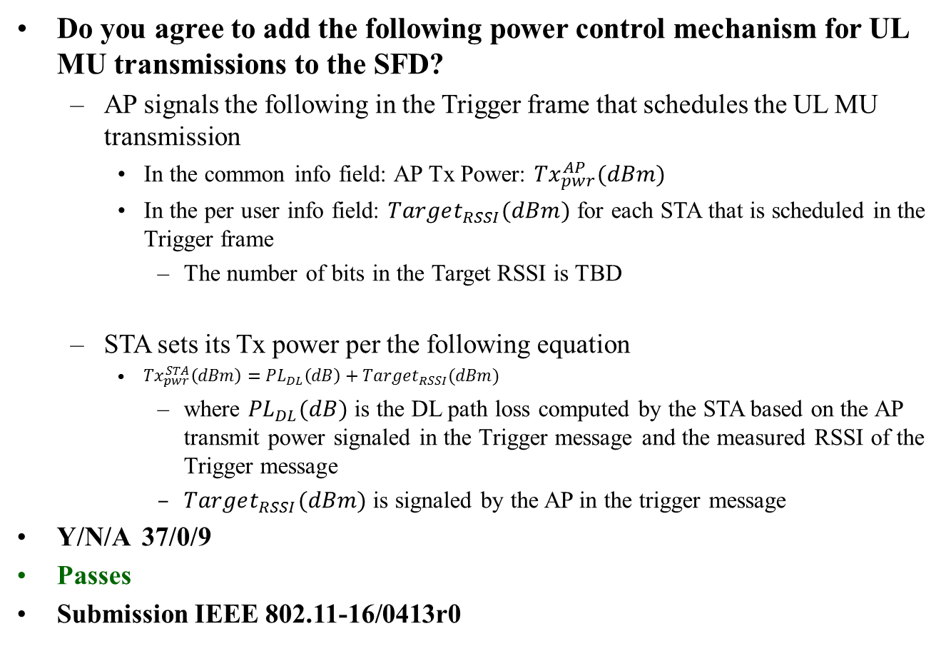
MU Ad hoc Straw Poll 4
Do you agree to add the following power control mechanism for UL MU transmissions to the SFD?
  AP signals the following in the Trigger frame that schedules the UL MU transmission
    In the common info field: AP Tx Power: ${Tx}_{pwr}^{AP}(dBm)$
    In the per user info field: $Target_{RSSI}(dBm)$ for each STA that is scheduled in the Trigger frame
      The number of bits in the Target RSSI is TBD
  STA sets its Tx power per the following equation
    ${Tx}_{pwr}^{STA}\left(dBm\right)={PL}_{DL}\left(dB\right)+Target_{RSSI}(dBm)$
      where ${PL}_{DL}(dB)$ is the DL path loss computed by the STA based on the AP transmit power signaled in the Trigger message and the measured RSSI of the Trigger message
      $Target_{RSSI}(dBm)$ is signaled by the AP in the trigger message
Y/N/A 37/0/9
Passes
Submission IEEE 802.11-16/0413r0

Slide 17
MU Ad hoc Straw Poll 5
Do you agree to add the following text to the SFD?
  STAs that participate in HE trigger-based PPDU transmit the power headroom in triggered UL MU transmissions to assist in the AP’s MCS selection
    Details of STA headroom definition are TBD
Y/N/A 35/0/7
Passes
Submission IEEE 802.11-16/0413r0

Slide 18
MU Ad hoc Straw Poll 6
Do you agree to add the following text to the SFD?
  STAs that participate in HE trigger-based PPDU shall support +/-3dB Relative Tx power requirements for Class B devices.
    Relative Tx power accuracy is defined as the accuracy of the change of the transmit power in consecutive UL MU transmissions
Y/N/A 29/1/7
Passes
Submission IEEE 802.11-16/0413r0

Slide 19
MU Ad hoc Straw Poll 7
Do you agree that some configurations of unused OFDMA RUs are potentially critical for MU OFDMA TXOP, and that a further study is required ?
Y/N/A 11Y/0N/Many A
Submission IEEE 802.11-16/0333r0
NOT FOR MOTION INTO SFD

Slide 20
MU Ad hoc Straw Poll 8
Do you agree to add the following in the SFD
The spec shall support regular UL MU transmission for unassociated STAs.
Y/N/A 2Y/2N/Many
Fails
Submission IEEE 802.11-16/0340r1

Slide 21
MU Ad hoc Straw Poll 9
Do you agree to add the following in the SFD.
For unassociated STAs, a TBD function of the STA’s MAC address shall be used as a user ID in the trigger frame.
Y/N/A 2/9/Many
Fails
Submission IEEE 802.11-16/0340r0

Slide 22
MU Ad hoc Straw Poll 10
Do you agree to add a user ID type in the per User info field of the Trigger frame to distinguish between associated STAs, unassociated STAs, and random access user IDs.
Y/N/A 4/3/Many
Submission IEEE 802.11-16/0340r0
NOT FOR MOTION INTO SFD

Slide 23
MU Ad hoc Straw Poll 11
Do you agree to amend the Trigger Frame format in the SFD, as shown in the document IEEE802.11-16/0379r0?
Y/N/A 27/0/2
Passes
Submission IEEE 802.11-16/0379r0

Slide 24
MU Ad hoc Straw Poll 12
Do you agree to add the following sentence which is marked in blue to the 4.4 of 11ax TG SFD:
  MU-RTS will carry signaling for each STA to indicate the 20 MHz channel(s) for transmitting CTS responses when CTS is sent in (duplicate) non-HT PPDU
    When a STA sends CTS in response to MU-RTS, the CTS response shall be transmitted in the 20 MHz channel(s) indicated in MU-RTS
      provided other transmission conditions TBD are met (e.g. channel idleness)
    The indicated 20 MHz channel(s) can be either Primary20, Primary40, Primary80 or 160/80+80 MHz. For an STA, the one or more secondary 20 MHz channels need not be contiguous to the primary 20 MHz channel. The secondary 40 MHz channel needs not be contiguous to the primary 40MHz channel.
    Other indications are TBD.
    Exact Signaling TBD
Y/N/A 5/3/many
Fails
Submission IEEE 802.11-16/0371r2

