Slide 1
Considerations on LRLP
Date: 2016-03-12
Authors:
Slide 1

Slide 2
Abstract
This submission provides recommended focus of the LRLP use cases and technical features

Slide 3
LRLP Discussions As of Now
According to LRLP Output Report Draft [1], its use cases are enumeration of IoT services
Smart Grid
IoT
At Home
Full Function in STA (LRLP support by mobile device in indoor)
Industrial Connected Worker
Precision Agriculture
Drone for Aerial Imaging
Digital Health

Slide 4
LRLP Discussions As of Now
According to the use cases analysis [2] and technical requirements [1] in comparison, we can locate a couple of issues:
While majority of use cases require Low Power, but NOT Long Range, technical requirements just enumerates something for Low Power here and something for Long Range (see Appendix A)
It is not certain whether the achieving Low Power and Long Range at the same time or supporting any Low Power and any Long Range modes is the main focus for LRLP.
Technological limits some combinations to be extremely challenging (e.g Ultra Long Power (e.g., 50uW) and Long Range (e.g., 2-4km for drone communication)). However, not clear what the direction would be for LRLP.
Lack of focus may damage deployment of LRLP if ratified in IEEE. We have seen something similar during 11n where having too many options resulted in none of the options being inter-operable.

Slide 5
Which Direction LRLP Needs to Go?
LRLP should streamline functional requirements such that allows engineers to focus on specific directions for the 802.11 specification.
Enumeration of all possible IoT use cases and try to address them, may result in too many options for LRLP.
LRLP should have differential factors in usage model compared to the existing WLAN specifications
Rather than just enumerating all the possible IoT services for next-generation (that would be one of fastest way to be killed in the market), LRLP should have apparent differential factor in usage model
Otherwise, we might face at cannibalization of 802.11 in the market between IEEE802.11 specifications while all the Wi-Fi are struggling to survive non-Wi-Fi technology candidates

Slide 6
Usage Model Differential Factor for LRLP
Historically, every WLAN specification has been trying best to define its apparent differential factor in usage model (please see references)
802.11ac [5] compared to 802.11n [3]
Focused on usage models with quite higher data rate than 802.11n
802.11ad [6] compared to 802.11ac [5]. (Note: comparison [7])
Focused on some specific usage models, e.g., uncompressed video
See Appendix B for differentiation between 11ac and 11ad.
802.11ah [8] compared to 802.11ac/n [3,5]
Focused on “long range & relative low power & large number of devices” as a single requirement
802.11ax [9] compared to 802.11ac [5]
Focused on usage models with densely-deployed Wi-Fi devices
802.11ay [10] compared to 802.11ad [6]
Focused on usage model with even higher data rates compared with 802.11ad

Slide 7
Regarding 802.11ah
802.11ah is prepared for the markets with the following typical features:
Long range (up to 1km)
Technical features: 900MHz band, narrow BW(1MHz), PHY repetition, relay
Relative low power
Technical features: TWT, short data/control/mgnegment frames (NDP-type), RAW (time-domain sub-grouping), …
Large number of STAs per AP (up to thousands)
Technical features: Modified TIM grouping, …
Avoid functional overlap between 802.11ah and LRLP
802.11ah is now a mature technology and ready for deployment.

Slide 8
What LRLP Should Focus on?
LRLP should focus on what the previous 802.11 specifications do not cover
Enumerating IoT applications is not enough and too vague.
May need to focus on a specific zone in the range vs. power diagram, or have a very specific direction.
Inter-operability and co-existence is also extremely important.
LRLP should not degrade the existing WLAN networks
It could damage the WLAN networks already deployed as well as LRLP itself (that is a worst scenario)
Because 2.4GHz band which LRLP is trying to mainly use is already severely saturated with billions of Wi-Fi devices all over the world
If LRLP tries to use other bands as well (900MHz or 5GHz), backward compatibility & coexistence with more type of devices is also inevitable

Slide 9
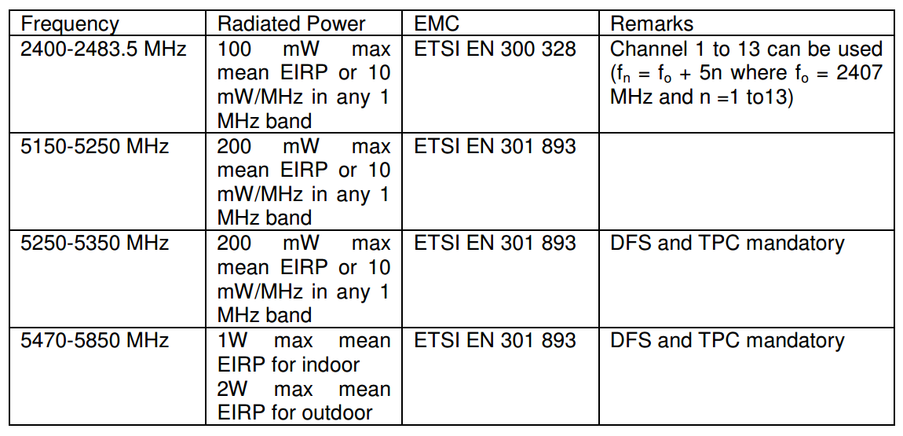
About Long Range?
LRLP may not have large benefit of in range extension
Pathloss characteristic for 2.4GHz: quite worse than 900M band [14]
Nominal TX power: normally up to 100mW. But, in Europe (according to ETSI regulation rule), additional restriction on narrow BW in 2.4GHz band allows only 10mW/MHz in any 1MHz band [11] which is very detrimental to narrowband transmission in 2.4GHz

Slide 10
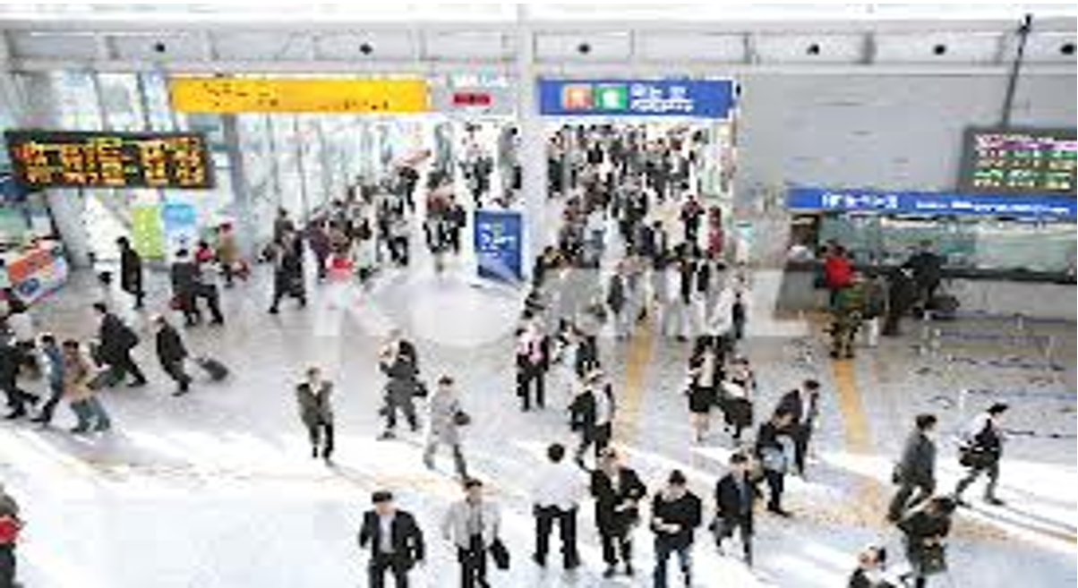
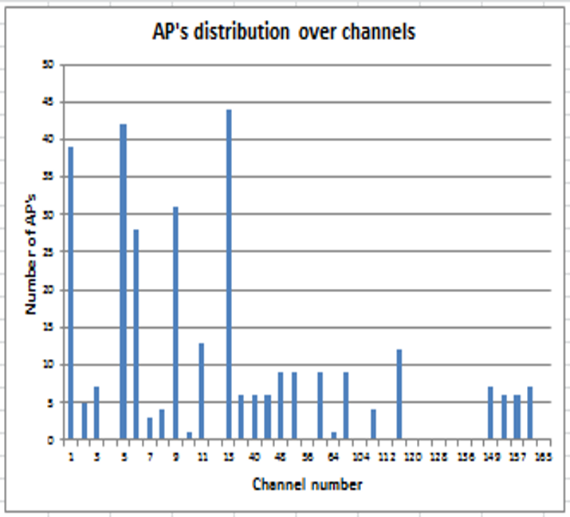
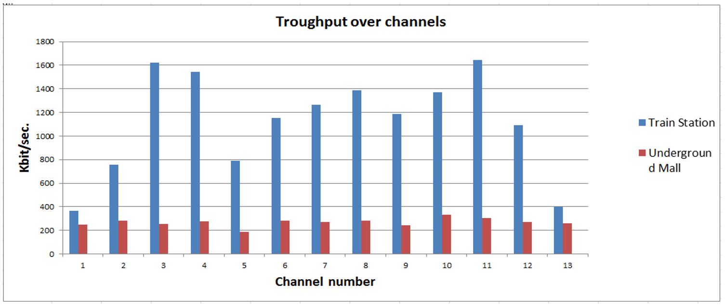
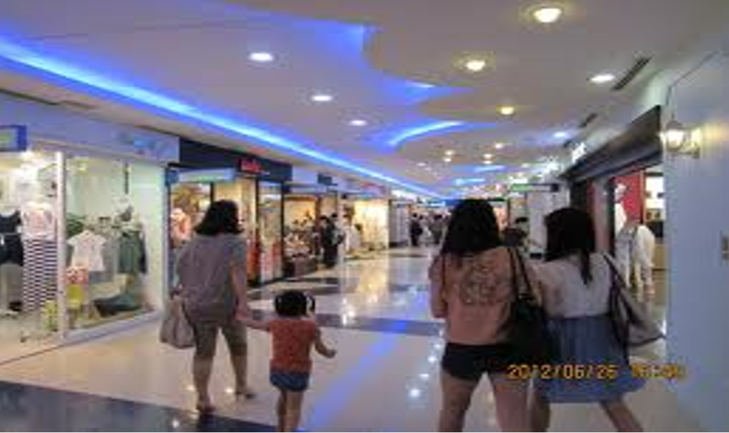
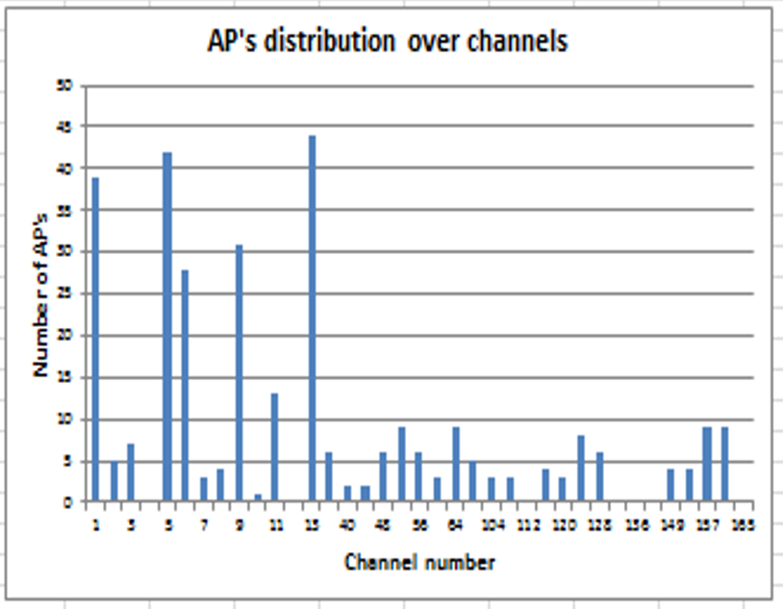
Long Range in 2.4 GHz
Range Extension in 2.4 GHz Band
Saturation of this band is exceptionally high
How much? ▶ According to some measurements done in Seoul, Korea [12], aggregated throughput per BSS is almost 0.01bps/Hz
Train Station & Underground Mall

Slide 11
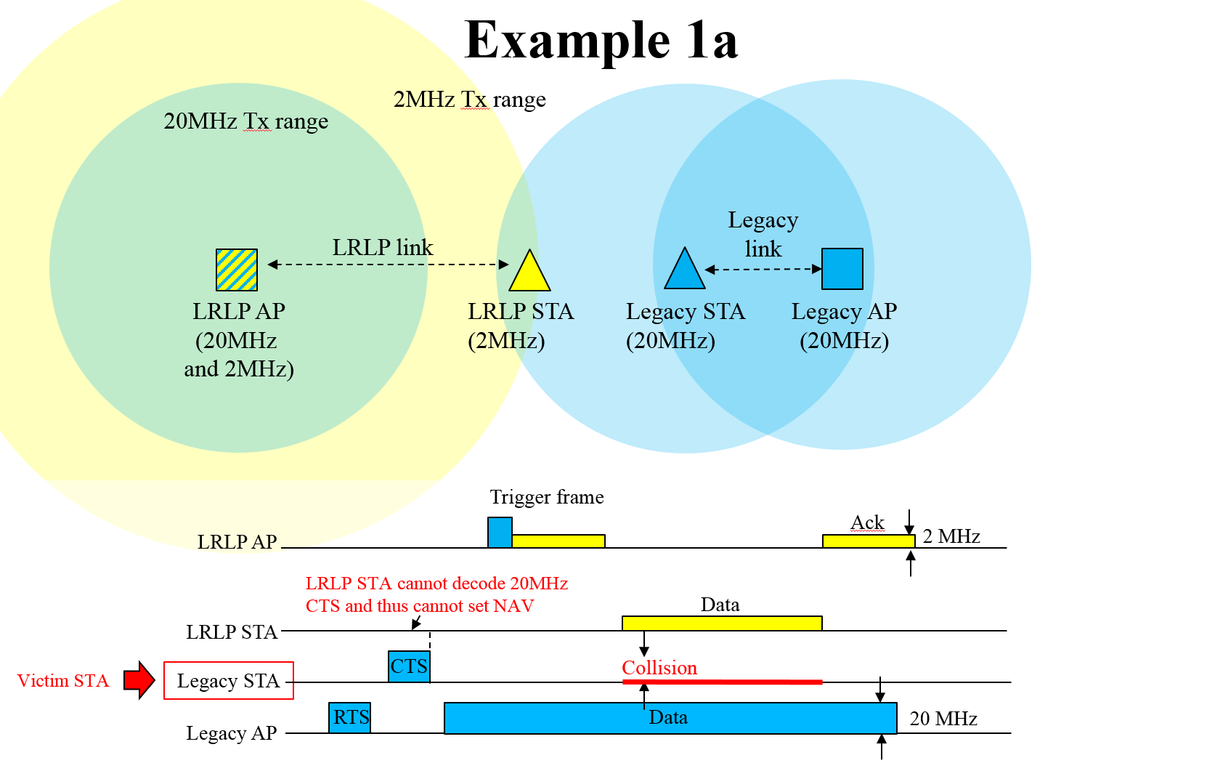
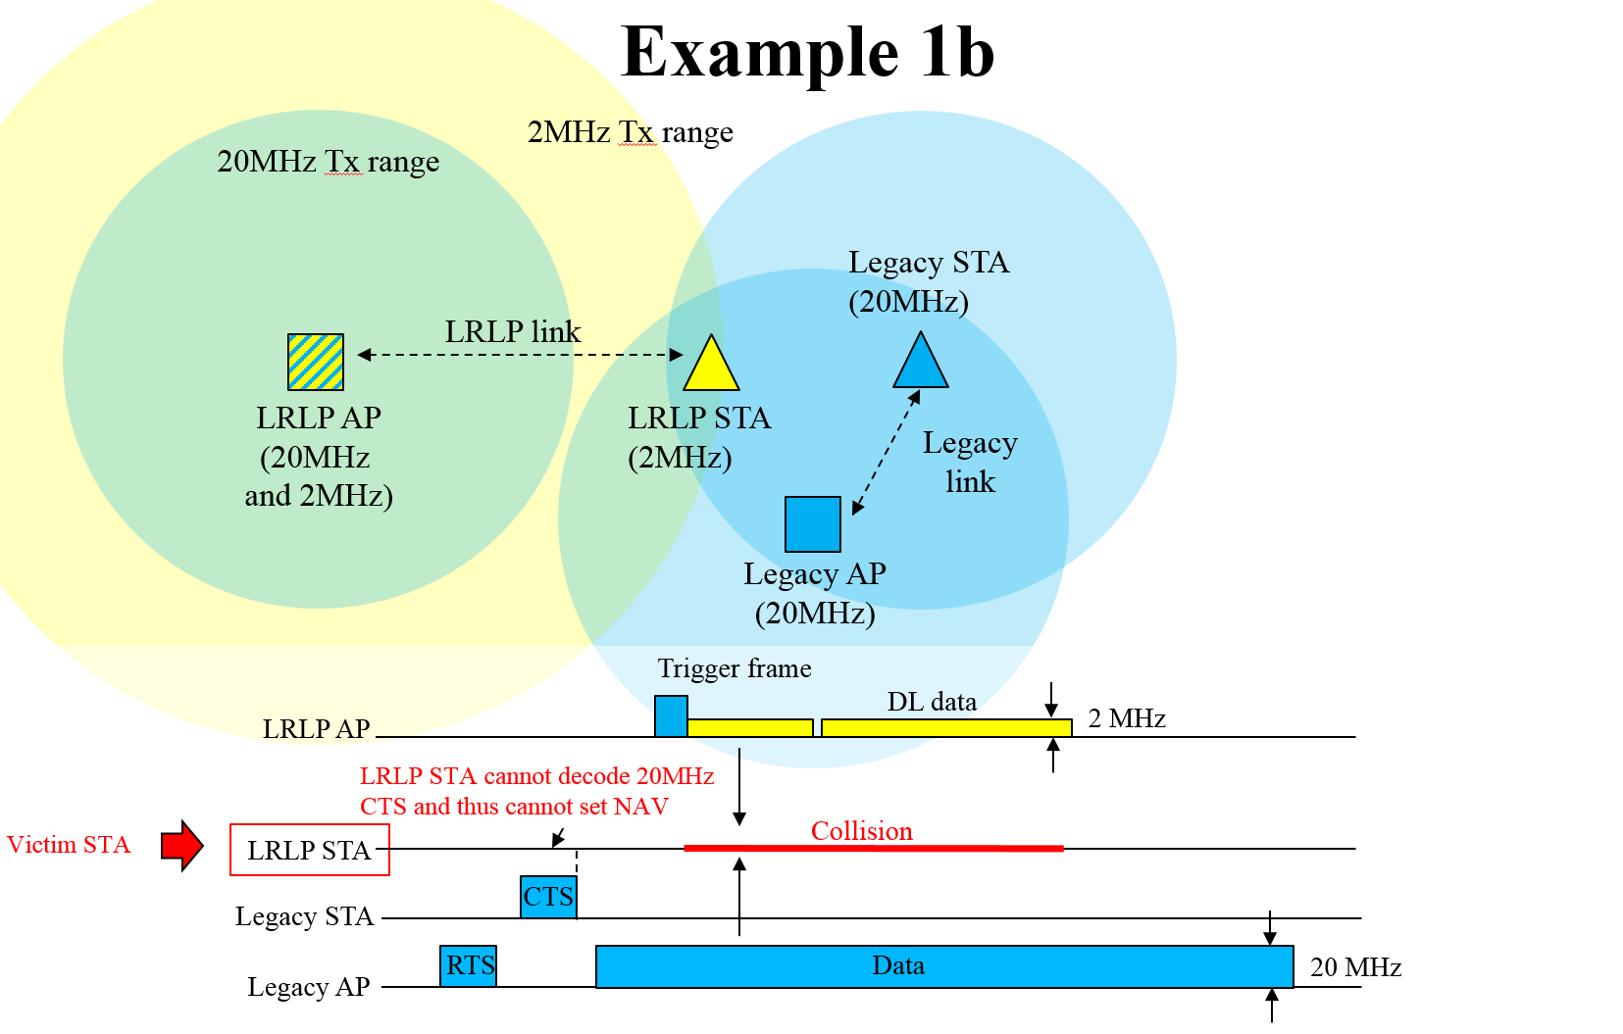
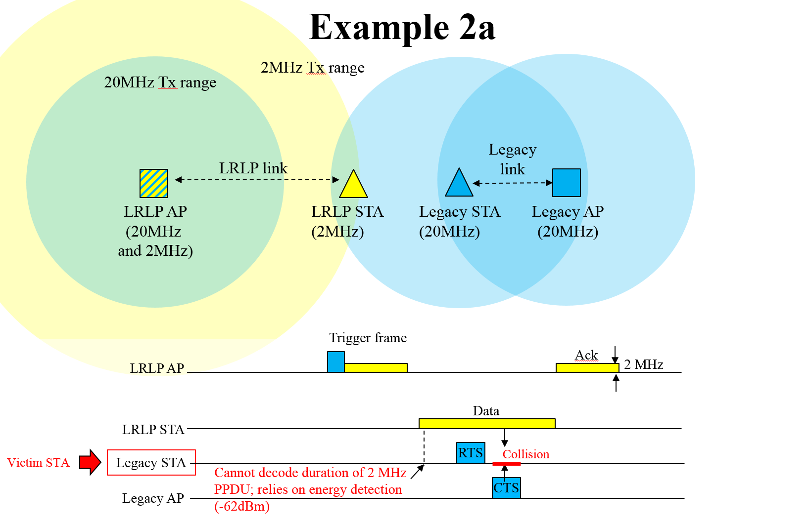
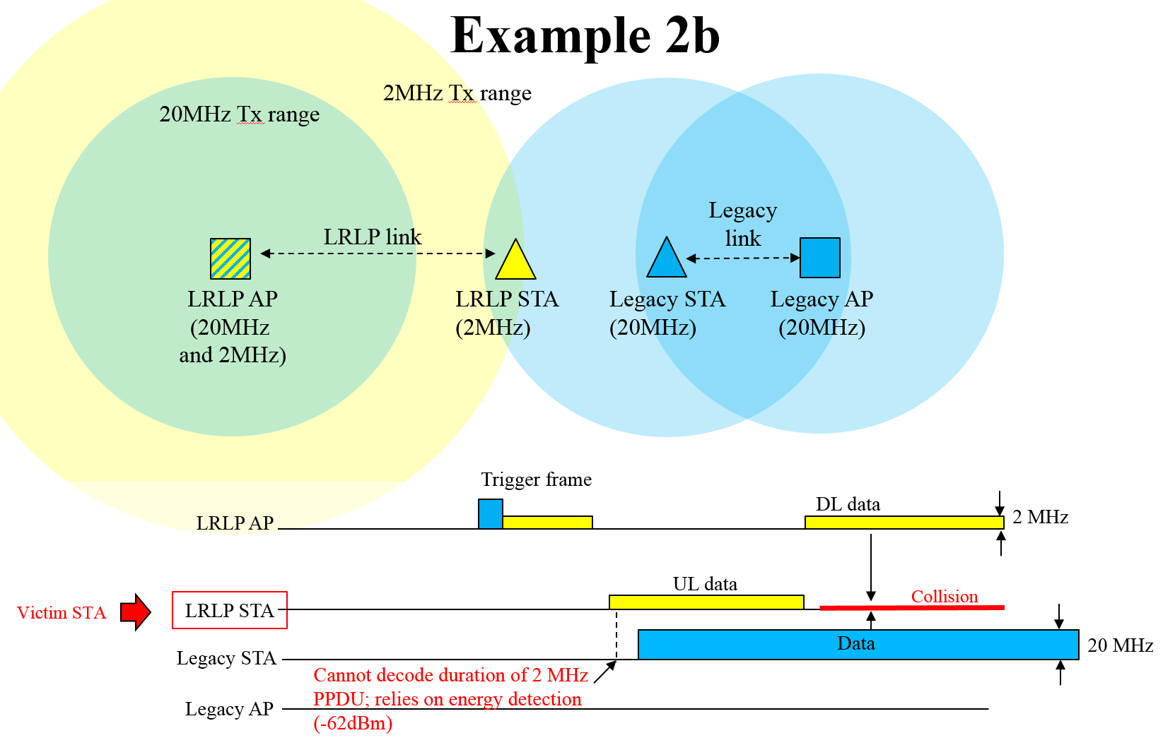
Coexistence Issues with Long Range in 2.4 GHz
Co-existence issues needs to be carefully investigated when supporting long range.
This could result in one of following interference problems very often due to tons of legacy devices near by even in the case of AP-sending Trigger-based protection of STA’s narrowband TX [13]
Assuming the transmission coverage of LRLP devices is not smaller than that of legacy devices, legacy devices can be victim of interference quite often

Slide 12
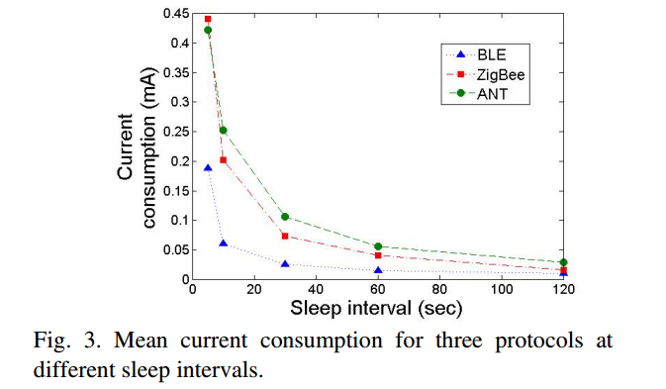
About Low Power?
Differentiating Low Power feature for LRLP
Ultra-low power (e.g., 50uW), which is described in the LRLP output document [1], is stated as one of the key requirements. However, there are already well established technologies in the market that allows low power communications. One example is BLE. According to Microsoft & Univ. of Washington’s measurement analysis [15], (when sleep-interval is 2 min.), avg. power consumption of BLE is measured about 30uW.
A communication protocol which allows lower power consumption may not be enough to differentiate LRLP with BLE or ZigBee and guarantee success in the IoT market. Additional differentiating factors are needed (for example, low power wake up receiver [15])
Under 0dBm TX power
Under 3.3V power voltage

Slide 13
Conclusion
LRLP should have apparent differentiating factors in usage models compared to the existing 802.11 specifications
It is recommended that LRLP should initially focus on ultra low-power feature for Wi-Fi.
Already challenging to get Wi-Fi to ultra low power and will require significant effort from specification perspective.
Support of long range should be determined only after careful co-existence study among existing WLAN specifications.

Slide 14
References
[1] 11-15-1446-09-lrlp-lrlp-output-report-draft
[2] 11-16-0022-01-lrlp-longrange-vs-lowpower-and-coexistence
[3] 11-03-0802-23-000n-usage-models
[4] 11-08-1323-00-0vht-introduction-to-vht-usage-models
[5] 11-09-0161-02-00ac-802-11ac-usage-model-document
[6] 11-09-0583-00-00ad-tgad-usage-model
[7] 11-08-0451-00-0vht-mapping-wfa-usage-models-to-operating-bands
[8] 11-11-0457-00-00ah-potential-compromise-of-802-11ah-use-case-document
[9] 11-13-0657-06-0hew-hew-sg-usage-models-and-requirements-liaison-with-wfa

Slide 15
References
[10] 11-15-0625-03-00ay-ieee-802-11-tgay-usage-scenarios
[11] ETSI EN 300 328 v1.8.1 and ETSI EN 301 893 v1.7.1
[12] 11-13-0556-01-0hew-wi-fi-interference-measurements-in-korea
[13] 11-16-0026-00-lrlp-coexistence-problem
[14] 11-11-0968-03-00ah-channel-model-text
[15] 11-15-1307-00-low-power-wake-up-receiver-for-802.11
[16] Proceedings of IEEE International Wireless Symposium (IWS), April 2013, “Power Consumption Analysis of Bluetooth Low Energy, ZigBee, and ANT Sensor Nodes in a Cyclic Sleep Scenario”
[17] 11-16-0027-00-lrlp-lp-wur-enabling-low-power-low-latency-capability-for-802-11
[18] 11-14-1444-02-00ax-energy-efficiency-evaluation-and-simulation-model

Slide 16
Appendix

Slide 17
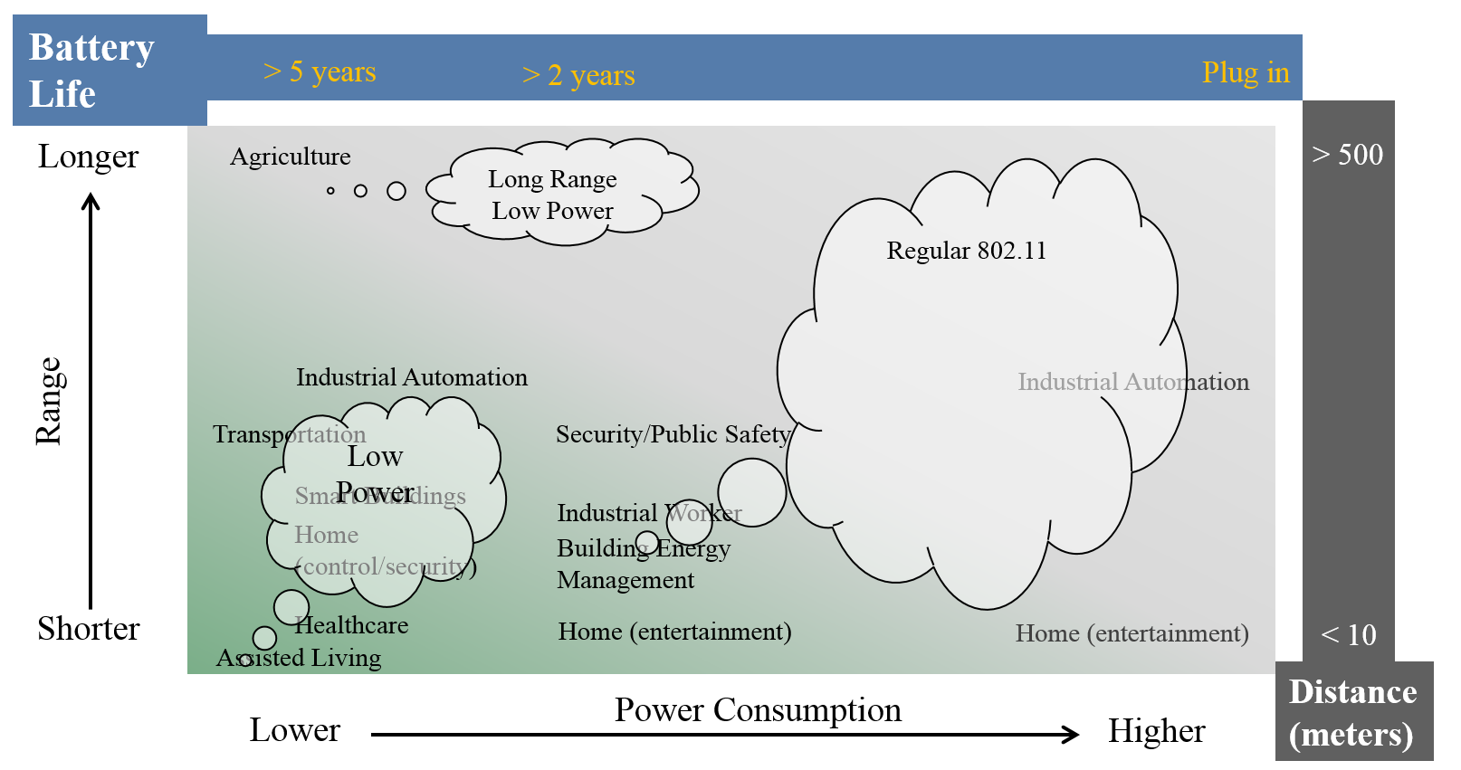
Appendix A
Use cases analysis diagram [2]

Slide 18
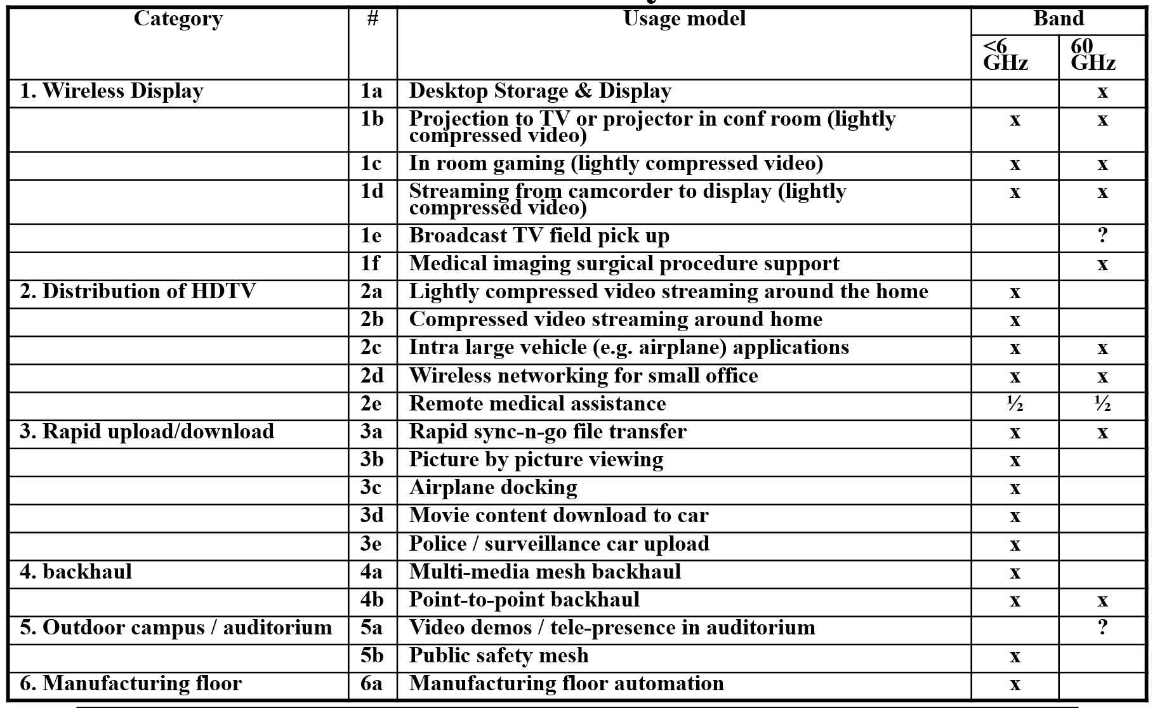
Appendix B
802.11ac (VHT6) & 802.11ad (VHT60) tried to differentiate each other apparently in usage model even though they are operating in the different bands [7]

