Slide 1
11ay DL MU-MIMO BF Training and User Selection
Date: 2016-03-13
Authors:

Slide 2
Introduction
Benefits of DL MU-MIMO
  Aggregation Gain:
    reduced number of channel access, reduced overhead associated with short packets
  Spatial Multiplexing:
    Peak throughput increase: simultaneous transmission of multiple spatial streams.
    Possibility of LOS MU-MIMO transmission: Higher throughput and longer range (no need to overcome path and reflection loss associated with NLOS MIMO)
For 11ay, it is important that DL-MU-MIMO should
  Scalable to large number of STAs
  Supports 20+Gbps or higher throughput (Ericsson demonstrated 25Gbps for LTE MU-MIMO downlink http://www.ericsson.com/news/1987136)
  Minimize overhead (BF training, Sounding and feedbacks)

Slide 3
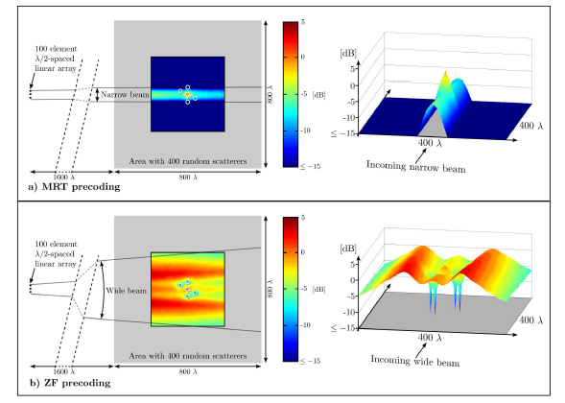
Potential Issues
Hybrid beamforming is the preferred approach for MU-MIMO
Issues with digital processing:
  Data in CSI feedbacks increases with # of antennas and number of STAs
  Zero-forcing (or block orthogonal) types of operation relies on null space operation. Due to short wavelength at 60GHz, it might require very frequent sounding and feedbacks (>250 Hz required per STA for <3 dB degradation) → very significant overhead.
  Maximal ratio combining or equal gain combining (can be implemented in analog domain if channel is flat, due to narrower beam) is less sensitive to channel variability and narrower antenna beam provides cleaner channel
We believe that good analog BF (with limited digital processing) is essential for the reliable MU-MIMO
Digital Processing:
10 Hz S&F @5GHz → 10 dB degradation (DCN11ax.0858).
25 Hz S&F @5GHz → 3dB degradation.
>250 Hz S&F per user @60GHz required for <3 dB degradation

Slide 4
User Grouping and Down-Selection
When there are a large number of users to select from, it is easier to achieve near mutually orthogonal beamforming to a selected set users
Desirable operation for MU-MIMO:
  MU-MIMO BF training with a large user group.
  Divide into smaller sub-groups (with near orthogonal beamforming, similar MCS) for each MU-MIMO transmission.
  DL-MU-MIMO transmission to different sub-groups
Transmission to UG1
Transmission to UG2

Slide 5
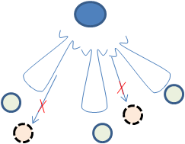
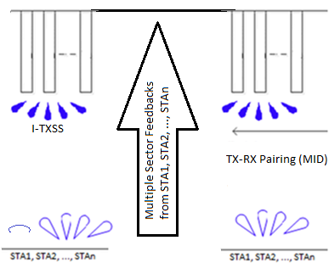

Overall Flow of MU-MIMO
Step 1:
I-TXSS for TX Sector reduction,
Step 2:
Collect multiple TX sector feedbacks from STAs
Step 3:
TX-RX Pairing (MID) (combined TXSS + R-RXSS after TX sector reductin)
Step 4:
Collecting feedbacks from STAs, send MU-MIMO antenna configuration to selected user subgroups
Step 5:
MU-MIMO Transmission to user subgroup
User Group 1
RX typically in Omni

Slide 6
Step 1 I-TXSS
I-TXSS to allow TX sector reduction via collecting multiple TX sector feedbacks from responder STAs
  Multiple TX antennas can transmit simultaneously using orthogonal waveforms
  As number of user in the group becomes large, the benefits of TX sector becomes less significant
    the number of feedback increases - more overhead
    the reduction of TX sector is smaller
  Should only be used when number of user is smaller or number of TX sector/RX sector pairing is large.
  STA can only send feedbacks if the responder TX BF is updated

Slide 7
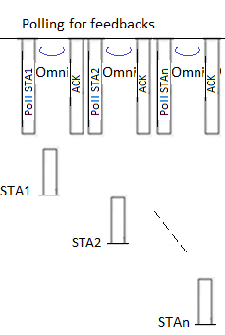
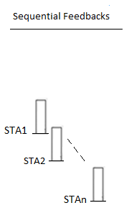
Step 2 Collecting multiple TX sector feedbacks
Option 1: Polling, feedbacks, (and ACK)
  Easier to synchronize with a poll or trigger frame
  ACK needed ?
Option 2: Sequential feedbacks
  Difficult to synchronize
  Less overhead

Slide 8
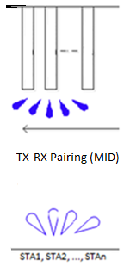
Step 3 TX-RX Pairing (MID)
Initiator sweep through TX-RX pairings (after TX sector reduction from STAs).
Multiple antennas can transmit simultaneously using orthogonal waveform
Responder sweep through RX sectors (multiple antennas receive simultaneously)

Slide 9
Step 4 Collecting feedbacks from STAs
Can we assume that STAs are already trained in TX Sectors/Antennas (SLS still up-to-date) for both I->R and R->I direction before MU-MIMO BF training ?
  If STA are SLS-up-to-date, AP/PCP can poll STAs or use sequential feedbacks to get feedbacks from STAs
If STAs are not trained in TX Sectors/Antennas (SLS-not-up-to-date):
  STAs with antenna pattern reciprocity knows their TX sector/antenna, it can send feedbacks to AP/PCP in specific antenna/sector (AP receives with omni-receive antenna)
  If STAs have no antenna pattern reciprocity, STAs need R-TXSS on one-by-one basis to able to send feedbacks to AP/PCP
After AP/PCP decide on the antenna configuration for MU-MIMO, transmit antenna configuration to the selected users

Slide 10
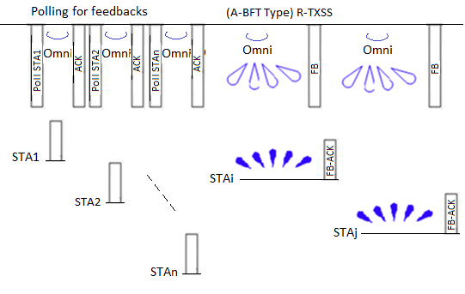
Step 4 Collecting feedbacks from STAs
Two steps for collecting feedbacks from STAs:
  1. Polling (for STAs w up-to-date SLS)
  2. Use A-BFT type to allow R-TXSS contentions for STAs w/o up-to-date SLS
    Multiple channel A-BFT type operation
    AP only needs one antenna in omni-receive, the other antennas can be RXSS for asymmetric link.
    AP specify the duration for A-BFT type of operation
MU-MIMO Antenna Configuration Feedbacks to selected users
Collecting feedbacks from STAs
PCP/AP
Polling or Sequential
A-BFT Type contentions ?
Note: PCP/AP allocates one antenna for omni, other antennas can be RXSS to support asymmetric link

Slide 11
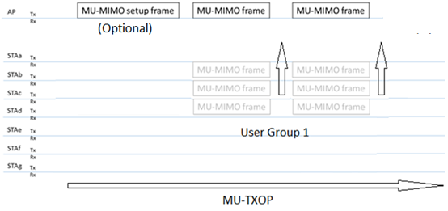
Step 5+ MU-MIMO Transmission
Step 5:
MU-MIMO Transmission to user subgroup

Slide 12
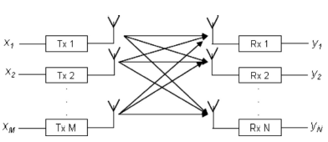
CSI Feedbacks – Option 1 Capacity
MIMO Capacity is the metric used in TX/RX Pairing and Sector Selection for MIMO
  A metric was presented by Panasonic which uses MIMO capacity
Due to CE field waveform, it might be more convenient to deal with spatial temporal channel matrix
h_{i,j}(τ,t) : channel response of j^{th} TX antenna, i^{th} RX antenna pairing
The MIMO capacity is
* Note entry in matrix multiplication is done by correlation.

Slide 13
CSI feedback – Option 2 SINR
During scalable BF training, the TX antenna/sector and RX antenna/sector pairing are observed by STAs. Additionally, potential interference/leakage between antennas/sectors (which determine the required nulling depth) are also observed.
A simplified metric is to feedback SINR from each antenna/sector for SINR computation. This metric is good for predominantly analog beamforming case.

Slide 14
Example of SINR
(Sector Sweep+R-RXSS)
Note: Multiple antennas can transmit simultaneously with orthogonal waveforms
STA1, STA2, STA3 feedbacks the RSSIs of all received antennas/sectors from BF training.
AP selects the Antenna/Sector for each STA based on SINR {=S/(I+I+N)}
Maximize SINR reduce the burden of digital processing (nulling)
Ant 1
Ant 2
Ant 3
AP
A1/S2
Signal
STA 1
RSSIs
Interference
A2/S2
STA 2 RSSIs
A3/S7
STA 3 RSSIs

Slide 15
Group ID and PAID
Proposed to use group ID for initial scalable BF training.
  More scalable, predefined.
  Large group possible – needs new grouping scheme
For subsequent DL-MU-MIMO transmission, either use cascaded PAIDs or group ID
  Accommodate multiple DL_MU-MIMO transmission within a TXOP

Slide 16
Conclusions
MU-MIMO BF training and transmission operation are described.
Two metrics for CSI feedback are proposed.

Slide 17
STRAW POLL 1
Do you support to insert into the SFD "11ay MU-MIMO BF support training of more users (including collecting feedbacks from them) than the number of users transmitted to in each MU-MIMO transmission.“
  Yes
  No
  Abstain

