Slide 1
Spatial Re-Use Adaptive CCA Simulation Results
Date: 2016-03-15
Authors:

Slide 2
Introduction
In this presentation, simulation results of open loop OBSS_PD adjustment and transmit power control (TPC) are presented

Slide 3
Open Loop Methods
When packets are detected from OBSS, the OBSS_PD level should be adjusted and suitable TPC needs to be considered as well
Among IEEE space reuse contributions, there are mainly three types of open loop methods
  Static OBSS_PD adjustment , No TPC
  Static & Balanced OBSS_PD adjustment + TPC
  RSSI-Based & Balanced OBSS_PD adjustment + TPC

Slide 4


BSS 1
BSS 2
Method Summary
Legacy PD
Range
1. Static OBSS_PD adjustment, No TPC
OBSS PD
Range
Increased CCA is fixed
not considerate at all
2. Static & Balanced OBSS_PD adjustment + TPC
Increased CCA = Reduction PWR ( fixed)
considerate
RaiesdCCAmax
DynamicValue
3. RSSI-Based & Balanced OBSS_PD adjustment + TPC
-Increased CCA = Reduction PWR = min(DynamicValue, RaiesdCCAmax)
- DynamicValue is from RSSI – OBSS_PD base
- very considerate

Slide 5
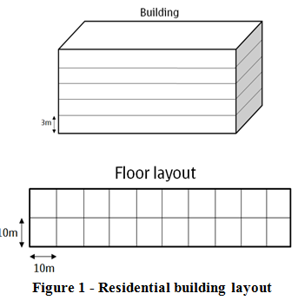
Simulation Parameters
Use a simplified scenario based on 11ax residential scenario
  2 x 5 x 10 = 100 apt. in a building
  One pair of AP/STA in each apt.
Random factor
  Location of AP/STA in each apartment
  Use one channel out of three (0, 1, 2)
  Shadowing effect
Power setting
  TX Power: AP: 20dBm, STA: 15dBm
  Standard CCA in 20MHz: -82dBm
  AP/STA are BW 20 MHz
Other simplification
  Link adaptation: assign best MCS that can sustain 10% PER by looking up SINR-PER table
  No MAC overhead
  No collision

Slide 6
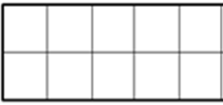
Deployment
Initially:
  Whole building is empty.
Procedure:
  Deploy 11ax SR and legacy devices one by one with specified selection probability p and 1-p at apartments using ch0
  Successfully deployed if interference from all other deployed BSSs is less than adjusted OBSS_PD
  33 AP/STA pairs in ch0
Evaluation Metrics:
  Total system throughput
  System gain
Follow procedure
Legacy or 11ax
Ch0
Ch0
Ch2
Ch1
Ch2
1st RX
1st TX
Ch2
Ch1
Ch0
Ch2
Ch0
1st TX
1st TX
TX
RX
Legacy or 11ax
Legacy or 11ax

Slide 7
Total System Throughput
(mcs0: 1, mcs1: 2, … mcs9: 13.3, PHY rate relative ratio to MCS0)
Relative PHY rate
CCA: Raisd CCA
CCA+TPC: Raised CCA = Reduced TPC
RSSI Based CCA+TPC: RaisedCCAmax

Slide 8
System Gain
“CCA”, “CCA+TPC”, “RSSI-based”:
  The higher chance you deploy SR, the higher system throughput (incentives to use SR)
  Each method can achieve same peak system throughput but at different raised CCA level
“CCA+TPC” behaves like “RSSI-based”
  Similar performance
  Mostly, the raised CCA of RSSI-based method is capped by RaisedCCAmax instead of being affected by the dynamical RSSI
11ax dev. deploy prob. | 25% | 50% | 75% | 100%
Maximum System Gain | 10% | 22% | 33% | 48%

Slide 9
Conclusion
We have summarized three open loop SR methods and have system simulation helping to understand the limitations and potential gain
More devices with OBSS_PD adjustment and TPC, more system gain

