Slide 1
Spatial Re-Use Adaptive CCA Simulation Results
Date: 2016-03-15
Authors:

Slide 2
Open Loop Methods
When packets are detected from OBSS, the carrier sense (CS) CCA level, OBSS_PD, of OBSS packets should be adjusted and suitable transmit power control (TPC) should be considered as well
Among these IEEE contributions, there are mainly three types of open loop methods
  Static OBSS_PD , No TPC
  Static Balanced OBSS_PD + TPC
  RSSI-Based Balanced OBSS_PD + TPC

Slide 3


BSS 1
BSS 2
Method Summary
Increase CCA = fixed
Legacy PD
Range
Static OBSS_PD , No TPC
- not considerate at all
OBSS PD
Range
Increase CCA = Reduction PWR = fixed
Static Balanced OBSS_PD + TPC
- considerate
RaiesdCCAmax
DynamicValue
Increase CCA = Reduction PWR = min(DynamicValue, RaiesdCCAmax)
RSSI-Based Balanced OBSS_PD + TPC
- very considerate

Slide 4
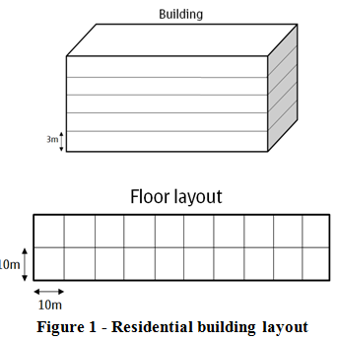
Simulation Parameters
Use simplified 11ax simulation Scenario 1
  2 x 5 x 10 = 100 apt. in a building
  One pair of AP/STA in each apt.
Random factor
  Location of AP/STA in each apartment
  Use one channel out of three (0, 1, 2)
  Shadowing effect
Power setting
  TX Power: AP: 20dBm, STA: 15dBm
  Standard CCA in 20MHz: -82dBm
  BW 20 MHz
Other simplification
  Link adaptation: assign best MCS that can sustain 10% PER by looking up SINR-PER table
  No MAC overhead
  No collision
* Follow 11ax-evaluation-methodology in Box2TestCase3

Slide 5
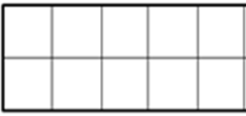
Scenario
Initially:
  Whole building is empty.
Procedure:
  try to deploy 11ax and legacy devices one by one with specified selection probability p and 1-p at apartments using ch0
  Successfully deployed if interference from all other deployed BSS is less than OBSS_PD
  In the end there are 33 AP/STA pairs in ch0
Evaluation Metrics:
  Total system throughput
  System gain
Follow procedure
Legacy or 11ax
Ch0
Ch0
Ch2
Ch1
Ch2
1st RX
1st TX
Ch2
Ch1
Ch0
Ch2
Ch0
1st TX
1st TX
TX
RX
Legacy or 11ax
Legacy or 11ax

Slide 6
Total System Throughput
(mcs0: 1, mcs1: 2, … mcs9: 13.3, PHY rate relative ratio to MCS0)
Relative PHY rate
CCA: Raisd CCA
CCA+TPC: Raised CCA = Reduced TPC
RSSI Based CCA+TPC: RaisedCCAmax

Slide 7
System Gain
“CCA”, “CCA+TPC”, “RSSI-based”:
  The higher chance you deploy 11ax devices instead of legacy ones, the higher system throughput you can get ⬅ incentives to use 11ax
  Each method can achieve same optimal (peak) system throughput (like system capacity) at different raised CCA level ⬅ does it mean simple “CCA” with suitable raised level is good enough?
“CCA+TPC” behaves like “RSSI-based”
  At most of the time, the raised CCA
  (or reduced TX power) of RSSI-based
  method is capped at its RaisedCCAmax instead
  of the true dynamically determined value
11ax dev. deploy prob. | 25% | 50% | 75% | 100%
Maximum System Gain | 10% | 22% | 33% | 48%
CCA+TPC
RaiesdCCAmax
RSSI-based

Slide 8
Conclusion
We have summarized several open loop SR methods/algorithms from IEEE contributions and done a high level system simulation to understand the limitation and potential gain, and also summarized some potential HW related parameters
Simulation results
  Using more 11ax devices can provide some significant system gain
11ax dev. deploy prob. | 25% | 50% | 75% | 100%
Maximum System Gain | 10% | 22% | 33% | 48%

