Slide 1
LP WUR Wake-up Packet Identity Considerations
Date: YYYY-MM-DD
Authors:

Slide 2
Background
In [1], low-power wake-up receiver (LP-WUR) drew a lot of attentions and received strong support in the straw poll
With LP-WUR, it is possible to achieve low-power consumption and low-latency at the same time
In this presentation, wake-up receiver requirements and wake-up packet identity design considerations are discussed

Slide 3
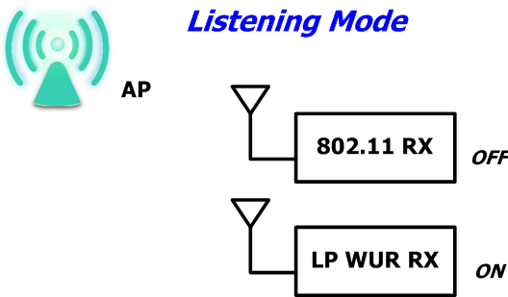
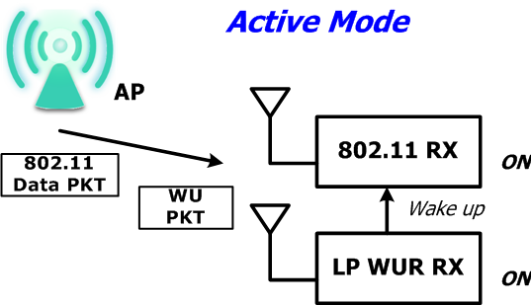
LP WUR Basics [1]
At the station, two receivers exist
  802.11 receiver
  LP-WUR with very low power consumption
At listening mode, only LP-WUR is ON, and the 802.11 receiver is OFF
  The power consumption is very low
When AP needs to communicate with the STA,
  a wake-up packet is sent first to wake up the STA’s 802.11 receiver
  Then, data packets in 802.11 format are sent to the STA

Slide 4
Wake-up Receiver Requirements
Low power consumption is the must
  Simple modulation
    OOK and FSK are used in the literature [2, 3]
  Complicated FEC is NOT preferred
  Required to reduce unnecessary PHY/MAC processing
  Wake-up packet format design is the key
Wake-up packet needs to carry STA specific identify allowing AP to wake up a specific STA

Slide 5
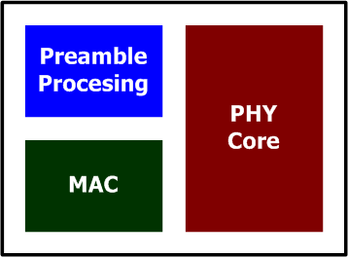
General Receiver Baseband Processing
Consider a general PHY packet with preamble, SIG, and data
Preamble
  RX activities: AGC, packet detection, timing/frequency estimation
  Active hardware: preamble processing
SIG
  RX activities: Decoding packet information
  Active hardware: PHY core
Data
  RX activities: Decoding MPDU data, upper layer information
  Active hardware: PHY core and MAC
For wake-up packets, where to put the identify?

Slide 6
Put Identify in Data/SIG
Wake-up packet needs limited size of data. SIG and data may be combined
Benefit
  High identify design flexibility
  Low false alarm rate with FEC
Drawback & concern
  Decoding complexity
  Power consumption
  All LRLP STAs need processing the whole wake-up packet

Slide 7
Put Identify in Preamble
Benefits
  Easy to decode
  Low power consumption
  Only target LRLP STA needs processing the whole wake-up packet
Drawback & concern
  Limited size of identity pool
  Low identity design flexibility
  False alarm

Slide 8
Summary
We present wake-up receiver requirements and pros/cons analysis of identity design in wake-up packets

Slide 9
References
IEEE 802.11-16/0027r0 LP-WUR (Low-Power Wake-Up Receiver):
Enabling Low-Power and Low-Latency Capability for 802.11
“A 780–950 MHz, 64–146 μW Power-Scalable Synchronized-Switching OOK Receiver for Wireless Event-Driven Applications”, Huang et al., JSSC, May 2014
“High sensitivity wake-up radio using spreading codes: design, evaluation, and applications”, Shih et al., EURASIP Journal on Wireless Communications and Networking 2011

