Slide 1
Multi-Channel Operation in 11ay
Date: 2016-03-14
Authors:

Slide 2
Introduction
In 11ad DTI is coordinated as CBAP and SP using a schedule by PCP/AP.
Scheduling allocation of CBAP and SP can occur every BI by beacon or announce frame.
In 11ay channel utilization can be improved by extending the allocation into the multi-channel operation.

Slide 3
Consideration point: STA’s capability
The operation using multiple channels like channel boning is considered in 11ay.
Each of STAs has different capability of channel bonding in a BSS.
DMG STAs do not have capability of channel bonding.
EDMG STAs have different capability of channel bonding.
When the CBAP and SP are allocated over multiple channels, the STA’s capability of channel bonding should be considered.

Slide 4
Motivation: Allocation over multiple channels
Flexible channel allocation enables the channel utilization to be improved.
PCP/AP allocates multiple channels to STAs in a BSS depending on channel status or STA’s request by beacon or announce frame.

Slide 5
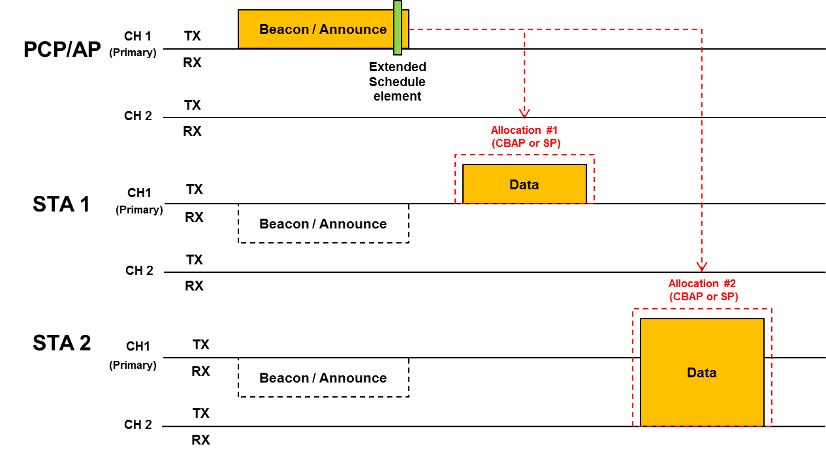
General procedure
PCP/AP has capability of 2 channels operation. PCP/AP schedules allocation #1, #2 by Extended Schedule element within beacon or announce frame transmitted through primary channel.
During Beacon interval, using two allocation fields in Extended Schedule element, channel 1 is allocated to STA 1 and channel 1&2 are allocated to STA 2 which has capability of two channel bonding or channel aggregation.

Slide 6
Signaling allocation by Beacon or Announce frame
Multi-channel allocation can be supported by modifying Extended Schedule element that already exists in 11ad.
There are reserved bits (4 bits) to be used for signaling to EDMG STAs.
Bandwidth(2bits): indication of the allocated bandwidth.

Slide 7
Conclusion
In 11ay channel utilization can be improved by extending the allocation defined in 11ad into the multi-channel operation.
When the CBAP and SP are allocated over multiple channels, the STA’s capability of channel bonding should be considered.
The allocation of CBAP and SP over multiple channels can be supported by simple modification of 11ad.

Slide 8
Straw poll #1
Do you agree to add the following text to the SFD ?
11ay shall support allocation of SP(s) and scheduled CBAP(s) over more than one channel and/or over a bonded channel.
Yes / No / Abstain

Slide 9
Motion #1
Do you agree to add the following text to the SFD ?
11ay shall support allocation of SP(s) and scheduled CBAP(s) over more than one channel and/or over a bonded channel.
Yes / No / Abstain

