Slide 1
Generalized Multi-Beamforming for 11ay
Date: 2016-03-17
Authors:
Name | Company | Address | Phone | Email
Kyungtae Jo | LG Electronics |  |  | kyungtae.jo@lge.com
SungJin Park |  |  |  | allean.park@lge.com
HanGyu Cho |  |  |  | hg.cho@lge.com
JinMin Kim |  |  |  | jinmin1230.kim@lge.com
Saehee Bang |  |  |  | saehee.bang@lge.com
Sang G. Kim |  |  |  | sanggook.kim@lge.com

Slide 2
Introduction
Motion related to multi-beamforming was passed in IEEE meeting, Jan. :
  “The 11ay beamforming protocol supports multi-beamforming for multiple array antennas. Multi-beamforming means that a transmitter simultaneously sends SSW frames in multiple polarized directions”
This contribution intends to investigate how the BF training procedures in 11ad is modified to support the simultaneous refinement of the beams for multiple stations/multiple channels using dual-polarization for 11ay.

Slide 3
Background
For channel modeling in 11ay, polarization characteristics based on antenna sector operation in 11ad is considered.
Exhaustive search in each phase of the 11ad beamforming is not practical in SU/MU-MIMO BF.
In order to reduce BF time as well as to support BF for multi-station/channel, BF protocols using the multiple sectors in parallel can be considered.

Slide 4
Proposed multi-beamforming for 11ay
Before entering DTI, Multi-BF capability exchange may be done, in which the initiator and responders exchange the information about BF and MIMO capabilities including ‘Multi-BF capability indication bit’.
According to the indicators, BRP phase is set up and proceeded through dual-polarized channels in parallel.

Slide 5
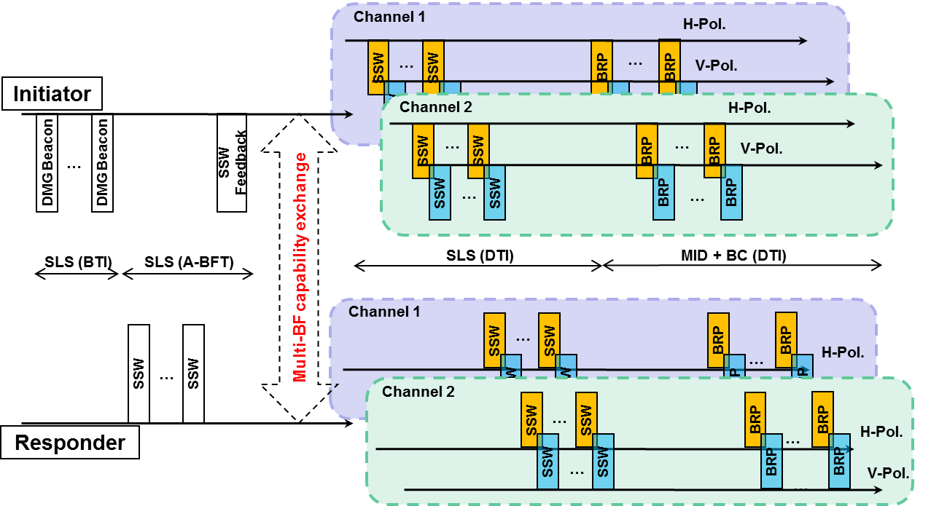
Proposed multi-beamforming for 11ay
In multi-channel operation, we propose the multi-BF scheme to extend into secondary channel since sector selection in only one channel will be less optimal than sector selection performed on whole channel.

Slide 6
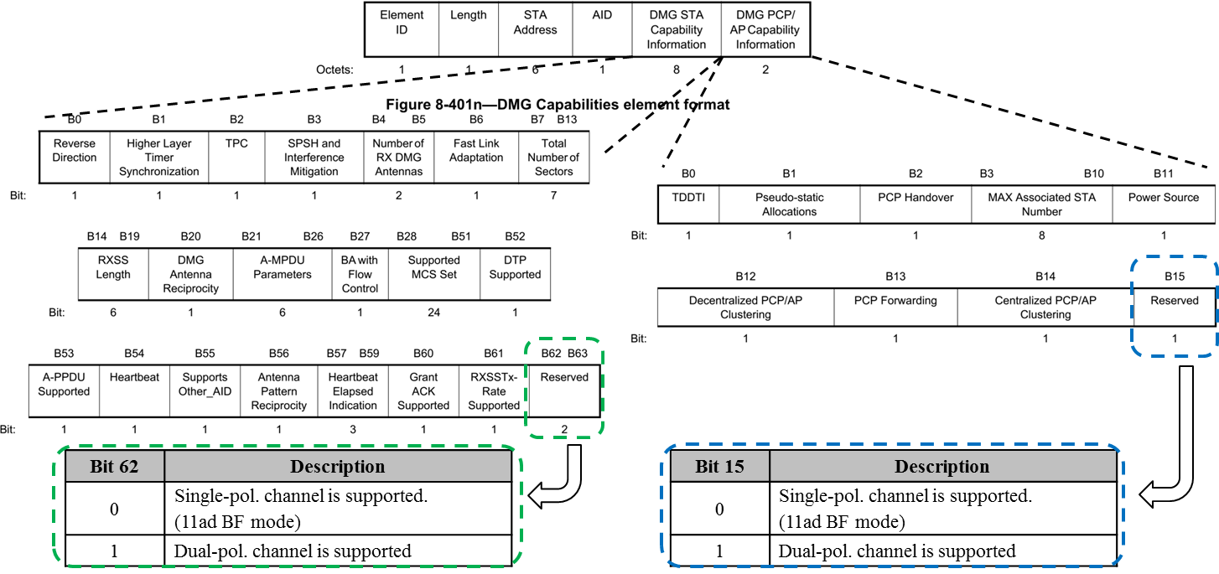
e.g. Multi-BF Capability Exchange (1/2)
New field design for polarization indicator in DMG Capabilities element format that already exists in 11ad.
  There are 2 bits in DMG STA Capability Information field, 1bit in DMG PCP/AP Capability Information field.

Slide 7
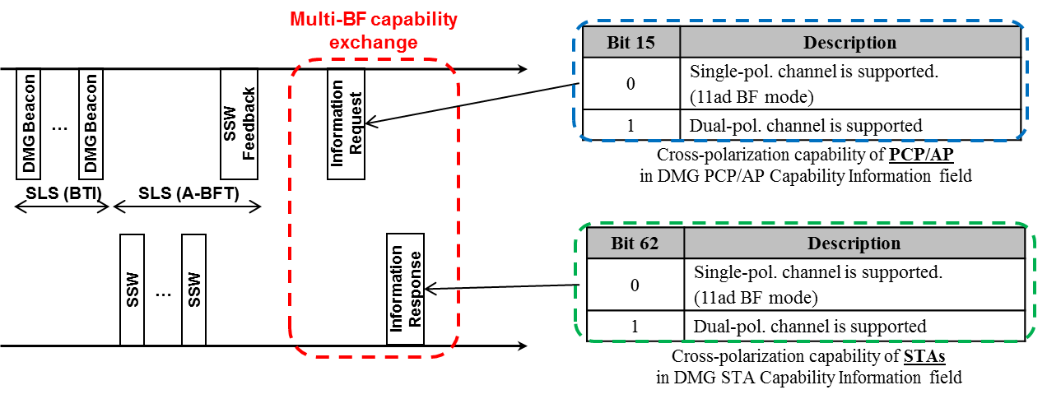
e.g. Multi-BF Capability Exchange (2/2)
Information Request/Response frames exchange including Multi-BF capability
  First, PCP/AP transmits Information Request frames to STAs.
  The Information Request frame includes the information whether PCP/AP can support the dual-polarization.
  The responders transmit Information Response frames with multi-BF capability of STAs to PCP/AP after they received the Information Request frames.
  Beam refinement procedures between PCP/AP and STAs proceed through cross-polarized channels allocated by multi-BF capability exchanges.

Slide 8
Summary
This contribution details the proposed BF procedures based on multi-beam refinement in dual-polarized channels to support beamformed communications for 11ay.
  Generalized multi-beamforming procedure in DTI
Further works : New elements design of Generalized multi-beamforming indicators

Slide 9
Straw poll/motion
Insert the following in the SFD:
“11ay provides the means of Multi-BF capability exchange in which the initiator and responders exchange the information on whether they have the capability of multi-BF”

Slide 10
References
1. K. Jo, et al., “Multi-Beamforming in Polarized Channels for 11ay,” IEEE 11-16/ 0092r1.

