Slide 1
Characterization of Polarimetric Scattering Effects for 802.11ay Channel Modelling
Date: 2016-03-17
Authors:
Name | Affiliation | Address | Phone | Email
Jian Luo, Yan Xin, George Calcev | HUAWEI Technologies |  | +49-89-158834 | Jianluo@Huawei.com Yan.xin@Huawei.com George.Calcev@huawei.com
Robert Müller, Stephan Häfner, Diego Dupleich, Reiner Thomä | Technische Universität Ilmenau |  |  | Mueller.Robert@tu-Ilmenau.de Reiner.thomae@tu-ilmrnau.de

Slide 2
Abstract
In this presentation, we like to show the difference between the 60 GHz and 70 GHz measurements in the entrance hall scenario. Here, we like to discuss the impact of the antenna pattern on the PDP and the channel modeling. Another point of this presentation is the characterization of polarimetric scatters for the 802.11ay channel model. To identify the most important scatters for the 60 GHz broadband channels we use the results from the previous entrance hall measurement to figure out the most significant scatters for the next measurement campaign.

Slide 3
Outline
Motivation
Requirements for the 802.11ay channel model
60 GHz entrance hall measurement
70 GHz vs. 60 GHz entrance hall measurement and the impact of the antenna pattern on the measurements
Discussion of 60 GHz dual polarimertic scattering measurements in the entrance hall
Conclusion

Slide 4
Motivation
ISM-band at 60 GHz
  Unlicensed and wide bandwidth available (up to 7 GHz)
  WLAN/WiGig (802.11ad) and WPAN (802.15.3c)
Advanced system concepts → define measurement and modelling requirements
  Massive MIMO/pencil beamforming → large spatial bandwidth
  Adaptive or switched selection beamforming to mitigate shadowing
  Channel bonding → large bandwidth
Propagation channel
  Double directional measurements are needed to characterized the full channel
  Polarization is an important aspect
  High dynamic range are essential to measure the different propagation effects
Channel characterization for different usage cases

Slide 5
Requirements for the TG.ay channel model
High bandwidth up to 4 GHz
Full polarimetric description
Full 3D channel model description
Antenna independent model
  DoA and DoD
  Beamforming capability
  MIMO capability
Time evolution
  Beam Tracking
Spatial consistency
  Multi user capability
Proper distinction between deterministic and stochastic channel contributions

Slide 6
60 GHz Entrance Hall Measurements

Slide 7
Dual Polarimetric Ultra-Wideband Channel Sounder (DP-UMCS)
TX Module
PA min. 27 dBm
RX Module
Step
Attenuator
LNA
Gain : 35 dB
H Pol.
CH 1
UWB Sounder TX
0 – 3.5 GHz
3.5 GHz - 10.5 GHz
H Pol.
Switch
56 - 66 GHz
UWB Sounder RX
0 – 3.5 GHz
3.5 GHz - 10.5 GHz
71 - 77 GHz
56 - 66 GHz
V Pol.
Step
Attenuator
CH 2
LNA
Gain : 35 dB
V Pol.
PA min.
27 dBm
Multiplier
X8
Multiplier
X8
Optical link
7 GHz
Oscillator
Optical link
7 GHz BW up to 10 GHz measurable bandwidth
Maximum excess delay of 606 ns (180 m) in CS version 1
Dual polarization measurement capability
25 dB AGC (Automatic Gain Control) with 3.5 dB steps
High instantaneous dynamic range: up to 75 dB
Multi-Link and Massive MIMO capabilities
Double directional measurements (with 1 TX and 2 RX)

Slide 8
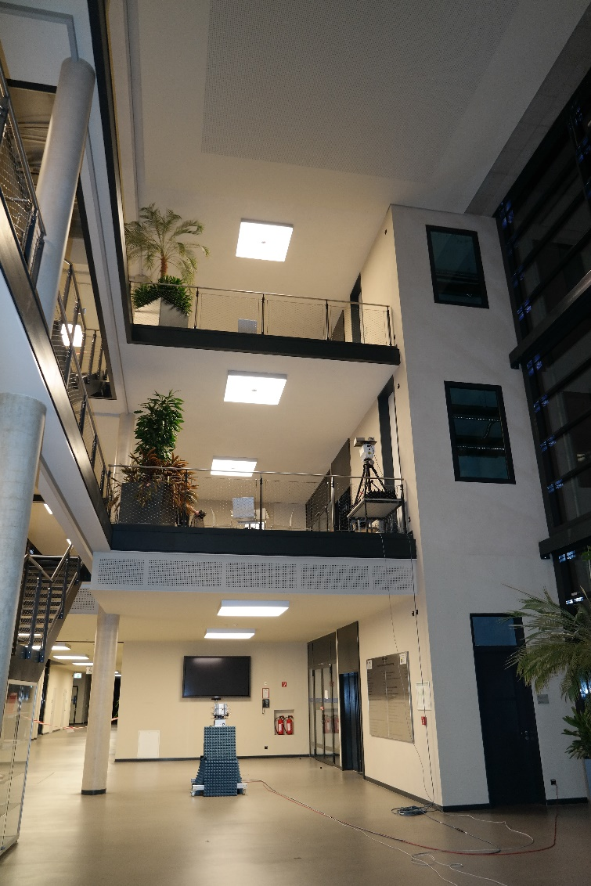
Entrance Hall Scenario
Dimensions:
7 x 25m x 9m
Glass, concrete and metal
3 different floors

Slide 9
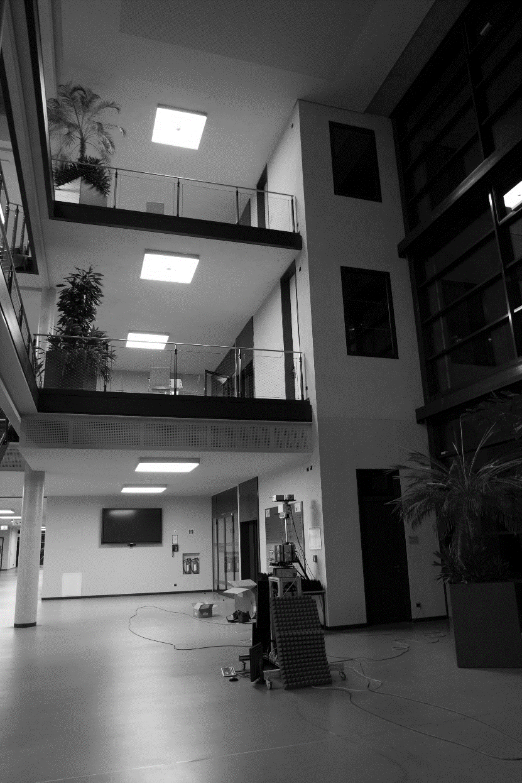
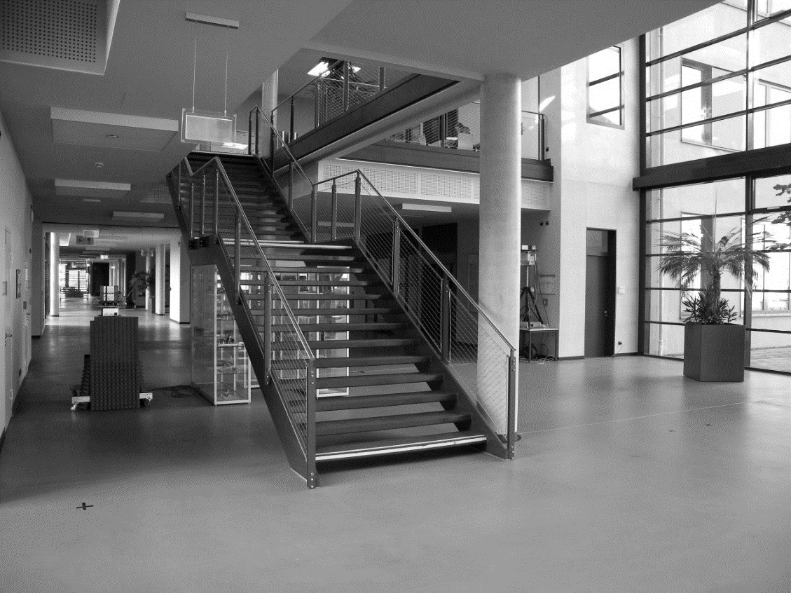
Entrance Hall Scenario
Entrance Hall of Zuse – Bau at TU Ilmenau
3 Tx Positions (1 Tx in the ground floor)
9 Rx Positions (all in the ground floor)
Tx 3
Tx 2
Tx 1
Rx 14
Rx 10
Rx 4
Rx 9
Rx 2
Rx 3
Rx 1
Rx 2
Rx 1

Slide 10
Measurement Set-Up
Static access point scenario
Tx:
  Located at a wall
  Height from ground 2.5 m/ 7.5m/ 12.5m
  30°HPBW@70 GHz of the antenna
  60°HPBW@60 GHz of the antenna
Rx:
  Located at several points in the hall
  Height 1.4m
  30°HPBW@70 GHz of the antenna
  60°HPBW@60 GHz of the antenna
Scanning at Tx and Rx stage via positioners
Tx: Azimuth -90°... 15°/30° 90° Elevation -90°…15°/30°…90°
Rx: Azimuth -180°…15°/30°…150°
-
2.8m
5m
Rx 1
+
Azimuth 0°
C
Rx 9
Rx 2
5m
Rx 3
A
-
Rx 10
5m
Tx X
Azimuth 0°
+
B
Rx 4
Rx 14
Rx 12
Rx 13

Slide 11

Data Pre-processing
Noise floor estimation and removal
Samples lower than the noise floor + 10dB are set to zero
$$h_{i,j,k,l}^{x,y}\left\{\begin{aligned}h_{i,j,k,l}^{x,y} if 10\log_{10}{{\left(\left|h_{i,j,k,l}^{x,y}\right|\right)}^{2}>NF_{dB}+10 dB } \\ 0 a.o.c.\end{aligned}\right.$$

Slide 12
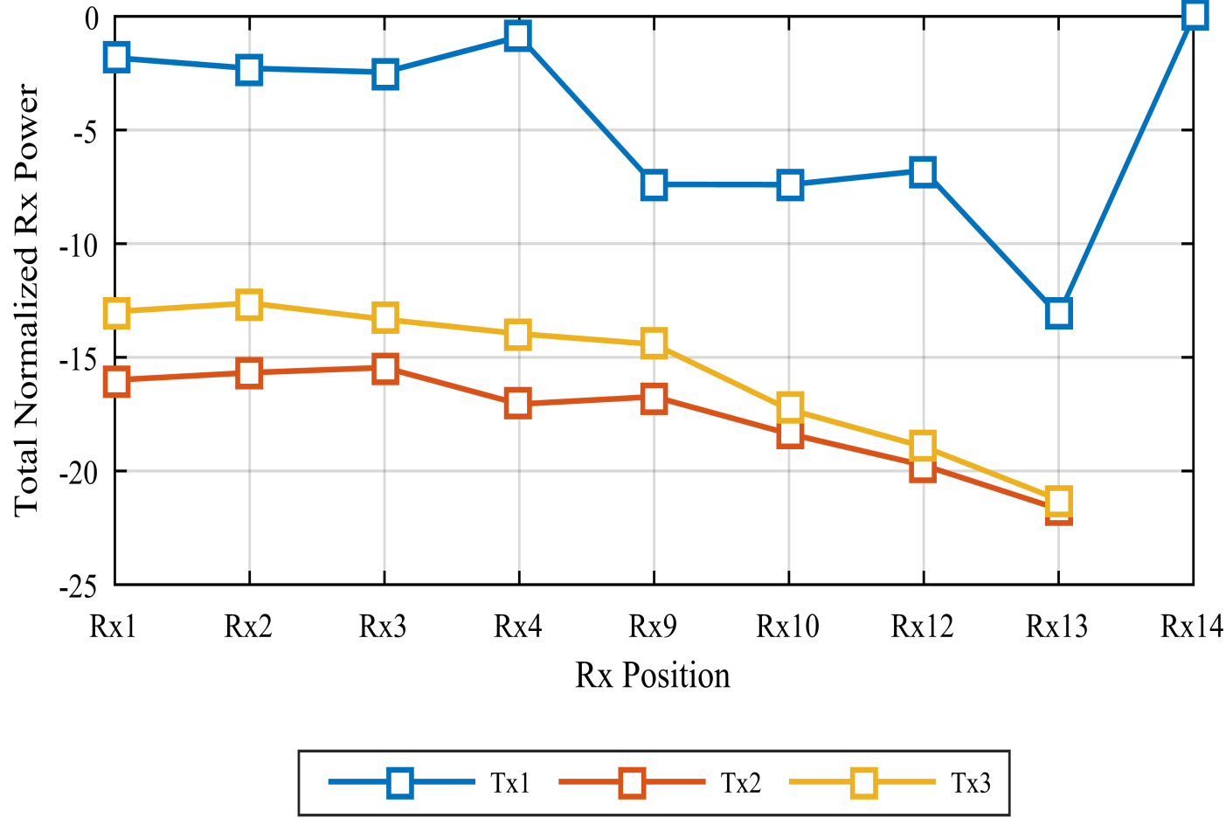
Synthetic omni-directional total received energy per Rx position
Rx Position vs. Tx Height at 60 GHz (1)
-
Rx 1
+
Azimuth 0°
C
Rx 9
Rx 2
Rx 3
A
-
Rx 10
Tx X
Azimuth 0°
+
B
Rx 4
Rx 14
Rx 12
Rx 13

Slide 13
List of channel parameters of the Zusebau Entrance Hall scenario at 60 GHz (1)
Tx | Rx | Visibility | DS [ns] | ED [ns] | Tx Az [°] | Tx El [°] | Rx Az [°] | Prx [dB]
1 | 1 | NaLOS | 25,99 | 161,72 | 71,59 | 56,07 | 85,69 | -1,81
1 | 2 | NaLOS | 32,66 | 207,45 | 67,52 | 55,09 | 79,99 | -2,27
1 | 3 | NaLOS | 39,82 | 142,15 | 65,09 | 49,19 | 83,05 | -2,44
1 | 4 | NaLOS | 40,03 | 155,09 | 65,66 | 49,51 | 77,27 | -0,88
1 | 9 | NLOS | 27,58 | 116,07 | 53,72 | 41,90 | 73,46 | -7,38
1 | 10 | NLOS | 42,51 | 213,33 | 69,15 | 46,17 | 80,95 | -7,39
1 | 12 | NLOS | 33,28 | 159,60 | 53,22 | 43,71 | 36,22 | -6,77
1 | 13 | NLOS | 59,02 | 200,39 | 70,16 | 51,07 | 34,60 | -13,13
1 | 14 | NLOS | 23,00 | 114,11 | 49,35 | 58,83 | 73,70 | 0
2 | 1 | NaLOS | 34,08 | 199,21 | 62,03 | 55,2 | 99,51 | -15,99
2 | 2 | NaLOS | 49,30 | 292,54 | 62,64 | 55,89 | 99,79 | -15,67
2 | 3 | NaLOS | 51,58 | 283,92 | 59,18 | 58,23 | 85,06 | -15,44
2 | 4 | NLOS | 35,55 | 196,07 | 64,01 | 54,79 | 82,75 | -17,05

Slide 14
List of channel parameters of the Zusebau Entrance Hall scenario at 60 GHz (2)
Tx | Rx | Visibility | DS [ns] | ED [ns] | Tx Az [°] | Tx El [°] | Rx Az [°] | Prx [dB]
2 | 9 | NLOS | 41,10 | 200,79 | 60,13 | 56,32 | 97,00 | -16,73
2 | 10 | NLOS | 46,54 | 242,15 | 57,19 | 53,05 | 73,85 | -18,36
2 | 12 | NLOS | 28,01 | 131,76 | 67,54 | 53,05 | 58,43 | -19,75
2 | 13 | NLOS | 36,43 | 325,09 | 73,56 | 56,83 | 45,67 | -21,67
3 | 1 | NaLOS | 49,83 | 203,13 | 50,89 | 58,64 | 92,61 | -12,98
3 | 2 | NaLOS | 46,07 | 281,56 | 40,15 | 59,03 | 93,54 | -12,61
3 | 3 | NaLOS | 37,65 | 270,39 | 54,58 | 60,41 | 73,94 | -13,32
3 | 4 | NLOS | 25,30 | 247,84 | 61,78 | 59,72 | 67,77 | -13,96
3 | 9 | NLOS | 42,62 | 183,13 | 38,32 | 56,15 | 83,87 | -14,42
3 | 10 | NLOS | 47,63 | 279,80 | 33.23 | 47,92 | 69,43 | -17,29
3 | 12 | NLOS | 24,31 | 190,58 | 52,96 | 60,75 | 32,20 | -18,93
3 | 13 | NLOS | 37,17 | 155,88 | 60,04 | 62,27 | 25,67 | -21,25

Slide 15
Conclusion of the Measurements
Propagation at 60 GHz occurs over several floors in a large entrance area
Values extracted from the measurements
  Delay spread for the 20 dB threshold is max. 59,02 ns
  The access delay with a 20 dB threshold is 325,09 ns
  The maximum azimuth spread at Tx is here around 70 °
  The maximum elevation spread at Tx is here around 62 °
  The maximum azimuth spread at Rx is here around 97 °

Slide 16
60 GHz vs. 70 GHz Entrance Hall Measurements
(Analysis of the Antenna Pattern)

Slide 17
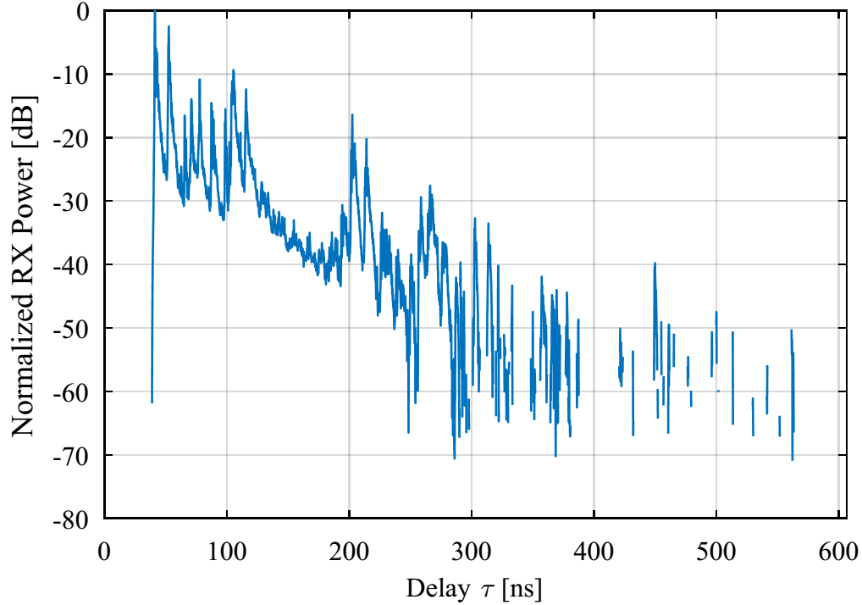
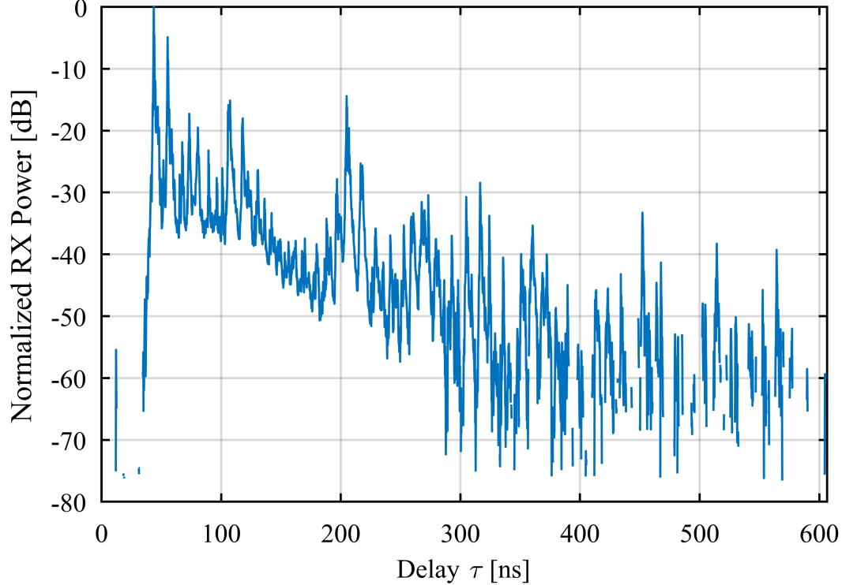
Impact of the Antenna Pattern (1)
Synthetic omni-directional PDP at
Tx1-Rx1 at 60 GHz
Synthetic omni-directional PDP at
Tx1-Rx1 at 70 GHz
Channel impulse responses are very similar
60 GHz antenna have an opening angle of 60 → captures more paths!!

Slide 18
Impact of the Antenna Pattern (2)
Synthetic omni-directional PEAP at
Tx1-Rx1 at 60 GHz
Synthetic omni-directional PEAP at
Tx1-Rx1 at 70 GHz
The channel impulse responses seem very identical

Slide 19
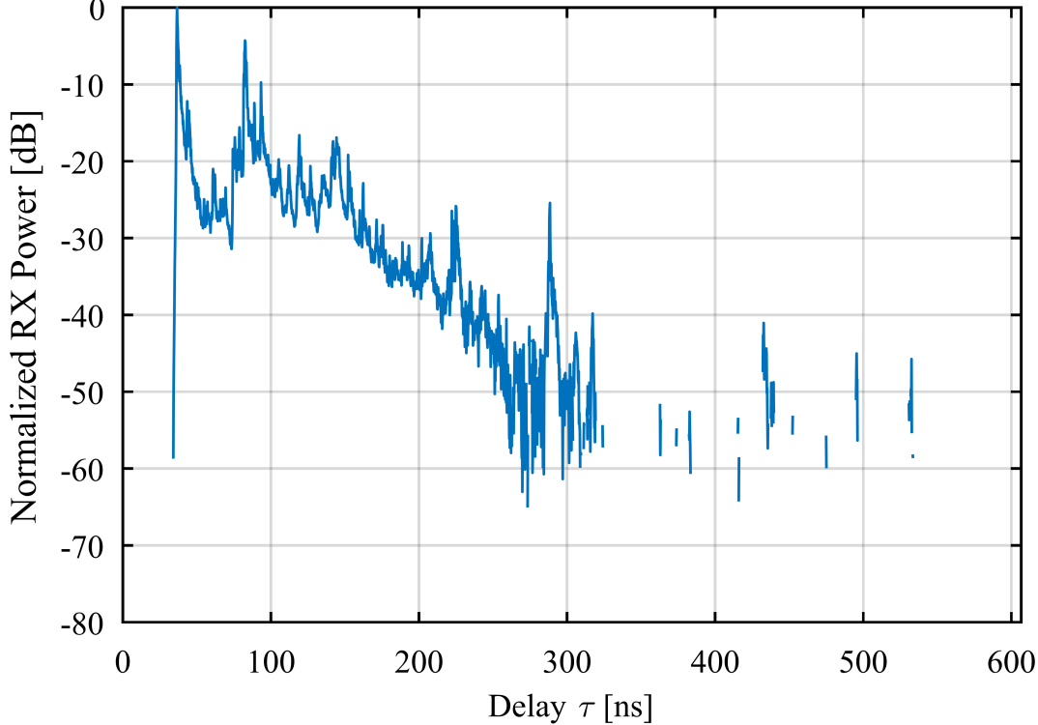
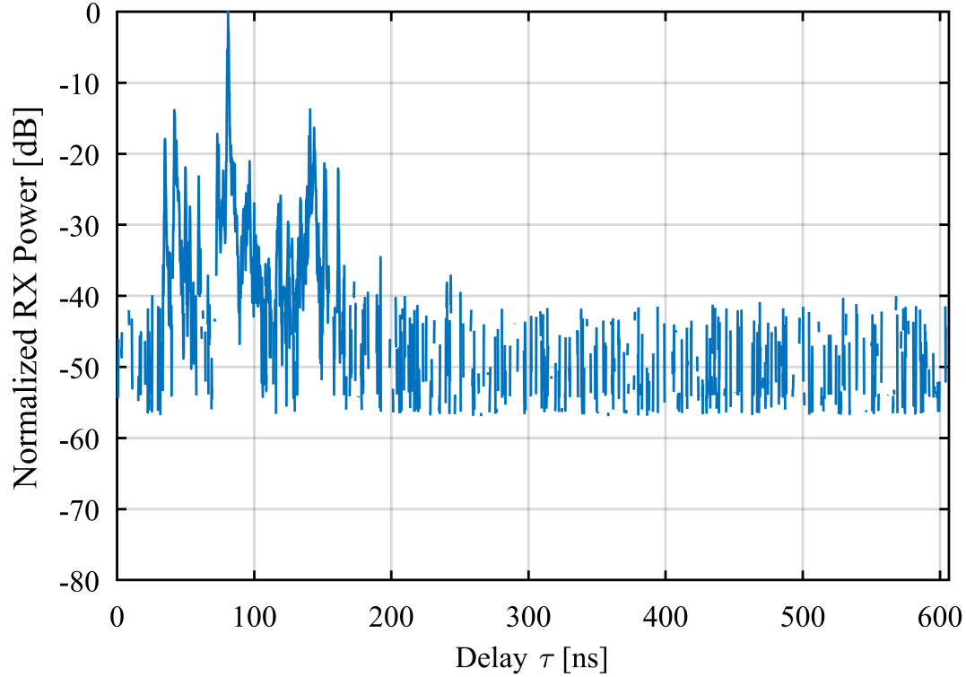
Impact of the Antenna Pattern (3)
Synthetic omni-directional PDP at
Tx1-Rx10 at 60 GHz
Synthetic omni-directional PDP at
Tx1-Rx10 at 70 GHz
Antenna pattern changes the channel characteristic a lot → depends on the position
Antenna pattern can only be removed by using parametric deconvolution techniques

Slide 20
Impact of the Antenna Pattern (4)
Synthetic omni-directional PEAP at
Tx1-Rx10 at 60 GHz
Synthetic omni-directional PEAP at
Tx1-Rx10 at 70 GHz
For 70 GHz cannot detect any preference polarization
For 60 GHz the vertical pol. transmits more power

Slide 21
Conclusion 60 GHz vs. 70 GHz
We can identify the same scatters at 60 GHz and 70 GHz
The antenna pattern highly influences the measurements and the channel parameters
We can see that the reflections from the ceiling at position Rx10 increase the diffuse multipath components
We need a method to compare measurements with different antennas

Slide 22
Discussion of 60 GHz dual polarimertic scattering measurements in the entrance hall

Slide 23
Measurement Goals
3D characterization of scatters at 60 GHz
  Polarimeric, broadband and spatial measurements
Analysis and modelling of scatters
  Parameterization of scatters for the 802.11ay channel model
  Analysis of the spatial consistency of different scatters

Slide 24
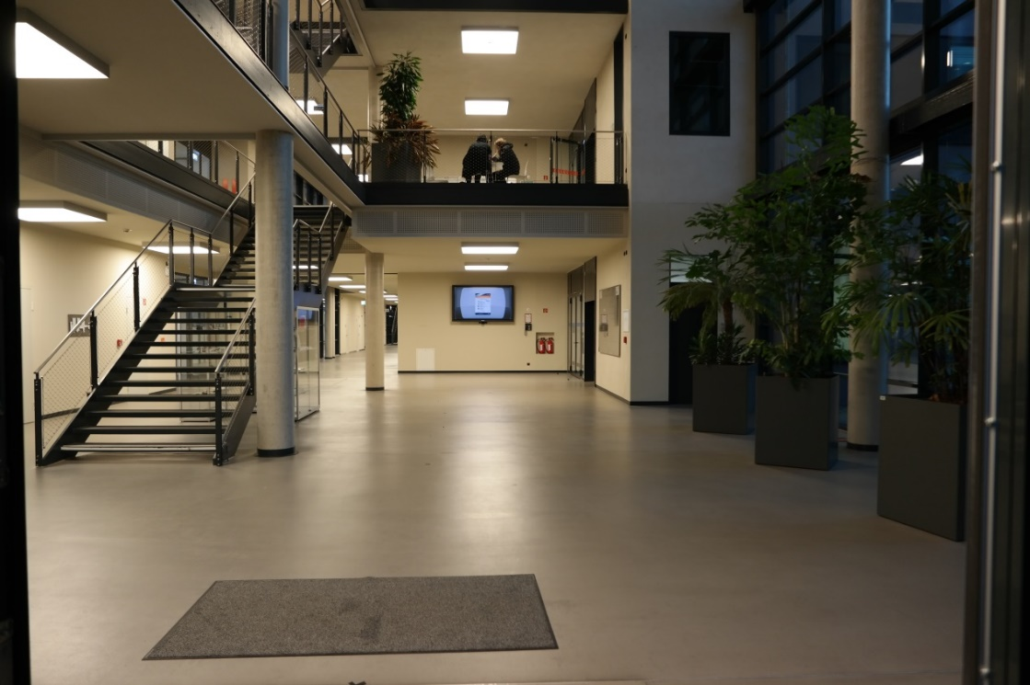
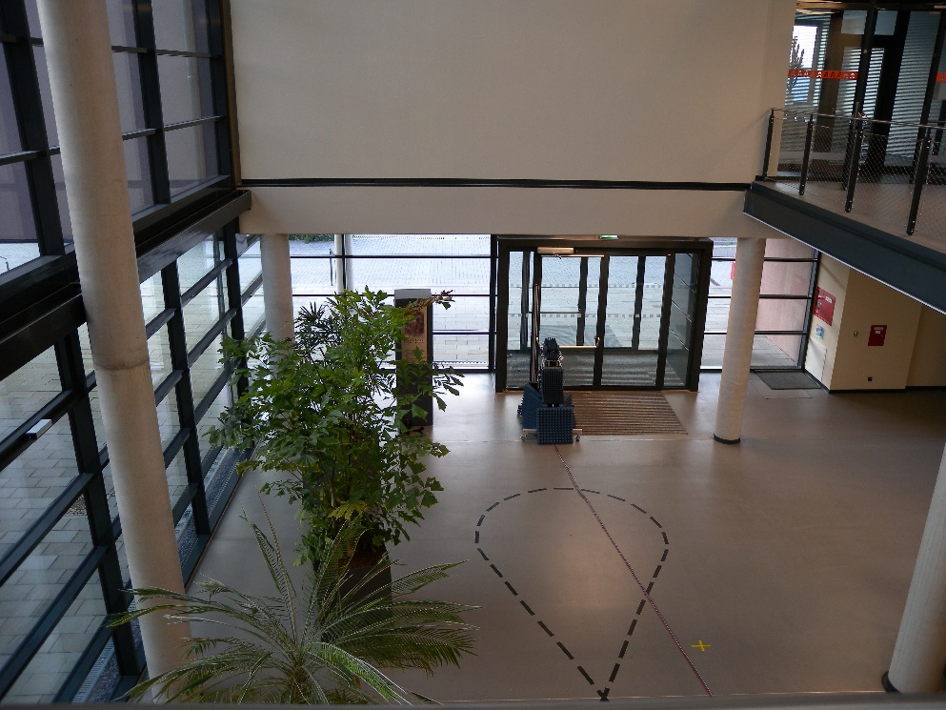
Measurement Objects of Interest
concrete pillar
Corner wall
Wall and big screen
Entrance door

Slide 25
Measurement Setup
Dual-pol antennas with 2.5 ° 3 dB beam width
Frequency band: 60 - 67 GHz
2 automatic rails with a length of 3 m
  Small and large scale grids are possible (min. step size 2 mm)
2 positioners to change the illumination angle in azimuth and elevation
Different heights at Rx and Tx also possible → useful?

Slide 26

60 GHz dual pol. Scattering Measurements Setup
$$α$$
h₁
h₂
rail positioner 1
rail positioner 2
3m
3m

Slide 27
Conclusion/Discussion
We present channel parameters for the 60 GHz entrance hall scenario
We show that the antenna pattern have a big influence on the measurement results
  Here we need a broadband parameter estimator to sto deconvolve the antenna from the measurements
Next Steps
  We present the next measurements for the broadband and polarimertic characterization of scatters at 60 GHz
  Outdoor measurements at 60 GHz
  Large indoor scenarios with distances larger than 40 m
  Dynamic measurements of human scattering inclusive Doppler shift up to 50 km/h
Notes:
5G systems at mm-wave require SNR optimisation → and this will be only done with dual polarisation

