Slide 1
Antenna Pattern Decoupling Operation in 802.11ay Channel Modeling
Date: 2016-03-17
Authors:

Slide 2
Motivation
The effects of antenna pattern should be carefully considered in high frequency channel modeling,
  Measurements in low frequency bands (<6GHz) have used omni-directional/sector antennas, while the same antenna configuration is also applied for operating environment.
  However, in the higher frequency bands, antenna pattern should be taken into account in system design. If different antenna patterns are applied to channel measurements and system operations, the channel model obtained may not be fully helpful for system design.
Quasi-Deterministic (Q-D) approach [1] has been proposed in 802.11ay channel modeling. In this approach, channel models consist of two folds: deterministic components (i.e., D-rays) and random components (i.e., R-/F- rays). D-rays are simulated by ray-tracing method and R-/F- rays are extracted from channel measurements.
This presentation addresses the impact of antenna patterns on channel measurement and proposes decoupling the channel modeling from antenna patterns, which we think to be essential in Q-D channel modeling.

Slide 3
Outline
An example of the effects of antenna patterns
Antenna pattern decoupling operation in Q-D model
Summary

Slide 4
An Example of the Effects of Antenna Patterns

Slide 5

Measurement Campaign for Indoor Scenario @73GHz*
Picture
(Open office at U2 building of Chengdu Huawei Research Center)
Floor plan
* Here the results@73GHz is presented as a reference to illustrate the effects of antenna pattern in channel measurement.

Slide 6
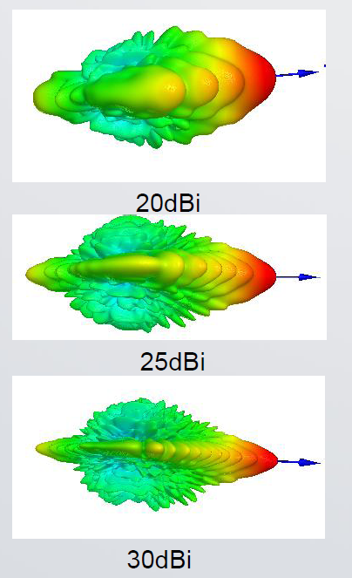
Measurement Campaign for Indoor Scenario @73GHz (2)
LOS and NLOS are both considered.
Main measurement parameters
Tx height (m) | 2.16 |  | Rx elevation sweep | N/A
Rx height (m) | 1.8 |  | Central frequency (GHz) | 73
Tx azimuth (deg) | 0 |  | Bandwidth (GHz) | 1
Tx elevation (deg) | 0 |  | Freq. sweep points | 1001
Tx location | Static |  | Tx antenna | Waveguide/ 10dBi
Rx location | Static |  | Rx antenna | Horn/ 20dBi, 25dBi, 30dBi
 |  |  | Polarization | Vertical
Rx azimuth sweep (deg) | 0~359 |  | Tx-Rx distance (m) | LOS | 15.4
Rx azimuth sweep step (deg) | 1 |  |  | NLOS | 12.4
Measurement antenna patterns

Slide 7
Power Angular Spectrum (PAS)
LOS
NLOS
Lobe 1
Lobe 1
Lobe 3
Lobe 2
Lobe 3
Lobe 2
Power (dB)
Power (dB)
Azimuth angle (deg)
Azimuth angle (deg)
Observations:
    Three lobes are presented;
    For different antenna patterns, the measured PAS are different;

Slide 8
Angular Spread (AS)
AS are estimated from the measured PAS and based on the extraction procedure presented in WINNER II channel models [2].
Cases | Rx antennas | AS (deg)
 |  | Lobe 1 | Lobe 2 | Lobe 3 | Global
LOS | 30dBi | 2.9 | 2.7 | 4.5 | 26.2
 | 25dBi | 5.6 | 5.5 | 7.0 | 34.9
 | 20dBi | 5.6 | 6.0 | 14.3 | 40.9
NLOS | 30dBi | 3.2 | 3.2 | 5.7 | 46.3
 | 25dBi | 9.7 | 6.6 | 5.7 | 50.4
 | 20dBi | 11.6 | 6.7 | 5.7 | 41.8
From the table, it is observed that the values of AS with different Rx antenna patterns are different.
It implies a necessity that the effect of antenna patterns on the extracted parameters for channel modeling be removed.

Slide 9
Antenna Pattern Decoupling Operation in Q-D Channel Modeling

Slide 10
Relationship between Ideal and Measured Channel
In general, the relationship between ideal (pure propagation) channel and measured channel can be expressed as
Ideal channel, eq.(3.1) in [1]
Measured channel
Tx antenna pattern
Rx antenna pattern
Measured_Channel = Ideal_Channel Antenna_Pattern
    -- convolution operation;
    L, M -- the antenna pattern resolution in the azimuth and elevation plane, respectively;
    p , Ω -- the amplitude and phase of the (l, m)antenna pattern resolution unit, respectively.

Slide 11
Relationship between Ideal and Measured Channel (2)
In Q-D approach, the channel model consists of two parts,
  where
  Deterministic_channel_components are simulated by ray-tracing;
  Random_channel_components are obtained from channel measurements;
Channel = Deterministic_channel_components + Random_channel_components
Antenna pattern can be set to the isotropic configuration in ray-tracing.
Therefore, the effects of antenna pattern mainly occur in random components modeling in Q-D.

Slide 12
Antenna Pattern Decoupling
Basically, “antenna pattern decoupling” can be defined as the operation of decoupling the channel model from the measurement antenna patterns, which can be expressed as
Ideal_Channel = Measured_Channel Antenna_Pattern
Measured PAS
Measured PAS
Power
Antenna Pattern Decoupling
Power
θ
Antenna pattern info.
θ₁
θ₂
θ₃
θ₄
θ₅
θ₆
θ₇
θ
Antenna pattern-independent channel/Angular distribution in the actual channel

Slide 13
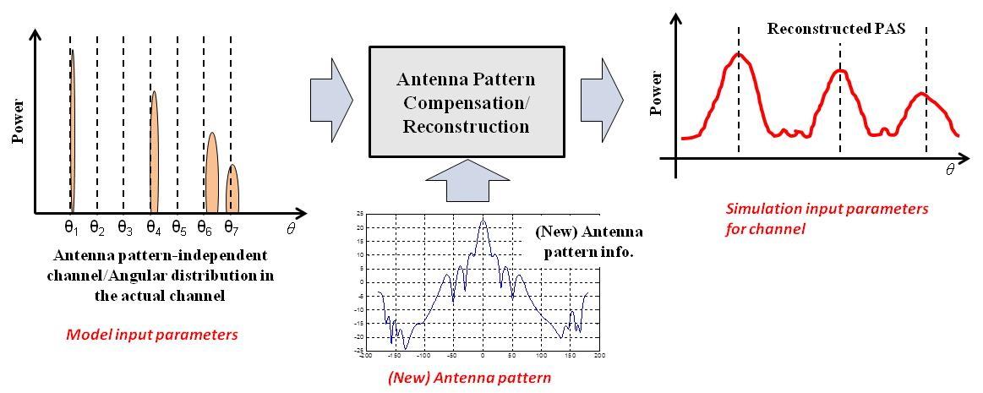
How to Generate the Simulation Channel
Since the channel model is ideal and should be independent of antenna patterns, in simulations, the effect of antenna patterns should be compensated/reconstructed.
Simulation_Channel = (Deterministic_channel_components + Random_channel_components ) Antenna_Pattern

Slide 14
Procedure of Antenna Pattern Decoupling Operation
The general procedure of antenna pattern decoupling should include the following steps:
  Step 1: estimate the path of propagation (angular domain/delay domain/both);
  Step 2: remove the measurement antenna pattern**;
  Step 3: reconstruct/compensate the extracted data with measured/new antenna pattern;
  Step 4 (optional): evaluate the effect of reconstruction and antenna decoupling
Antenna Decoupling
Application/Verification
** There are couples of methods to achieve Step 2, such as MUSIC[Schmidt], CLEAN[Clarke] or SAGE[Fessler] algorithm in the field of signal processing, and so on. This step can be treated as an inverse problem.

Slide 15
General Criterion for Antenna Pattern Decoupling
To guarantee the performance of antenna pattern decoupling operation, we suggest the following criterion to evaluate the effectiveness of specific decoupling algorithm.
Min │Reconstructed_Channel – Orignal_Measured_Channel│²
MSE – Minimum Squared Error

Slide 16
Summary
The effect of antenna patterns should be considered in 802.11ay channel modeling.
This effect mainly affects the random components modeling in the Q-D channel modeling method.
In this presentation, we propose considering antenna pattern decoupling operations as an essential processing step in Q-D channel modeling.
In addition, we propose a general criterion to evaluate the effectiveness of antenna pattern decoupling.

Slide 17
References
[1] IEEE 802.11-15/1150r2, “Channel Models for IEEE 802.11ay”
[2] IST-4-027756 WINNER II D1.1.2 v1.0, “WINNER II Channel Models, Part II- Radio Channel Measurement and Analysis Results”

Slide 18
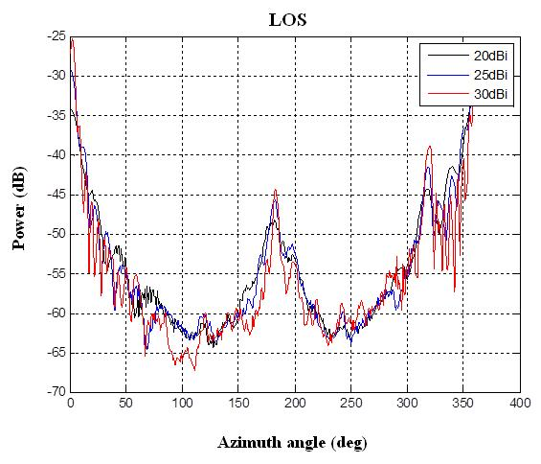
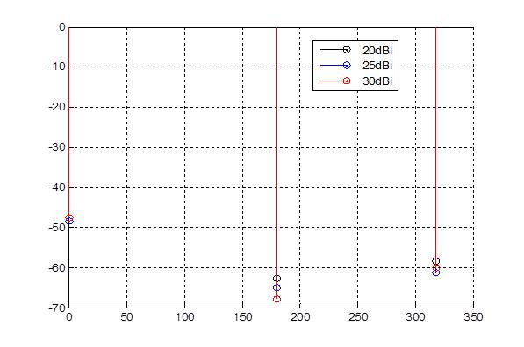
Backup: Preliminary Results for Antenna Pattern Decoupling Operation (LOS case)
Original PAS before antenna pattern decoupling
Extracted Angular distribution after antenna pattern decoupling

Slide 19
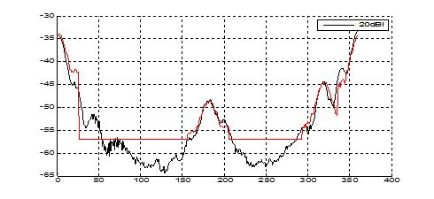
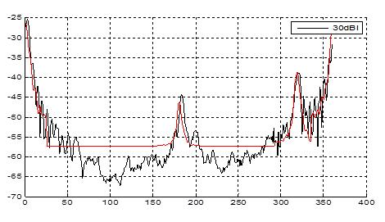
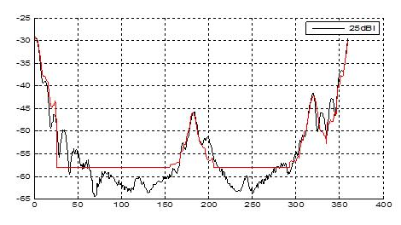
Backup: Preliminary Results for Antenna Pattern Decoupling Operation (LOS case)
Reconstructed PAS
(black: original ; red: reconstructed)
Cases | Rx antennas | Deviation btw O&R (dB)
LOS | 30dBi | 0.1
 | 25dBi | 0.1
 | 20dBi | 0.1

Slide 20
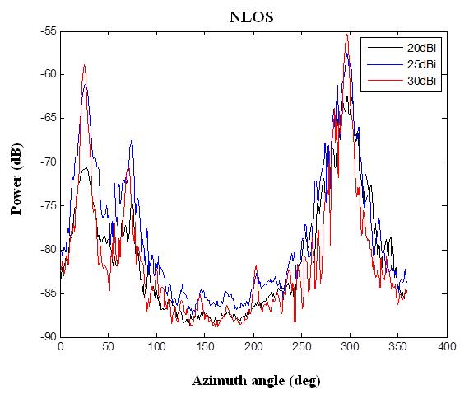
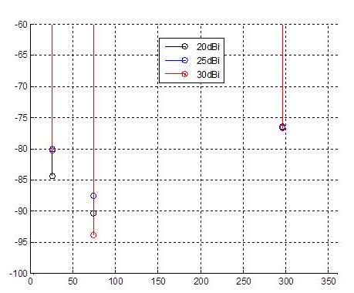
Backup: Preliminary Results for Antenna Pattern Decoupling Operation (NLOS case)
Original PAS before antenna pattern decoupling
Extracted Angular distribution after antenna pattern decoupling

Slide 21
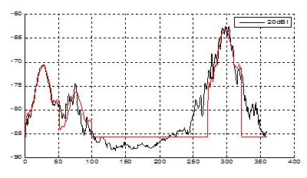
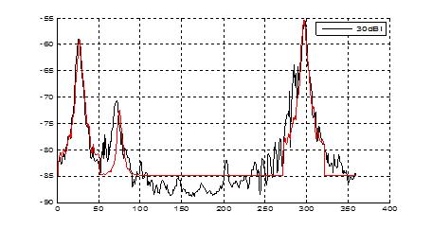
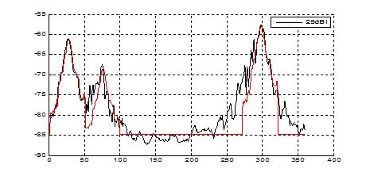
Backup: Preliminary Results for Antenna Pattern Decoupling Operation (NLOS case)
Reconstructed PAS
(black: original ; red: reconstructed)
Cases | Rx antennas | Deviation btw O&R (dB)
LOS | 30dBi | 0.5
 | 25dBi | 0.5
 | 20dBi | 0.3

Slide 22
Straw Poll 1
Would you agree to consider the operation of antenna pattern decoupling in 11ay channel modeling?
Y-N-A

