Slide 1
A Multi-Zone Q-D Propagation Model for IEEE 802.11ay Large Scale Environments
Date: 2016-03-15
Authors:

Slide 2
Motivation
802.11ay introduces new large scale scenarios [1], such as open area, street canyon, etc..
Due to the fact that 802.11ay operates in the 60 GHz band, if the propagation distance is up to several hundred meters, signal propagation may experience multiple significantly different physical effects during its journey.
In order to accurately reflect these effects, this presentation shows a multi-zone propagation model* for 802.11ay new large-scale scenarios.
* The model could be complementary with the Q-D channel model in 11ay.

Slide 3
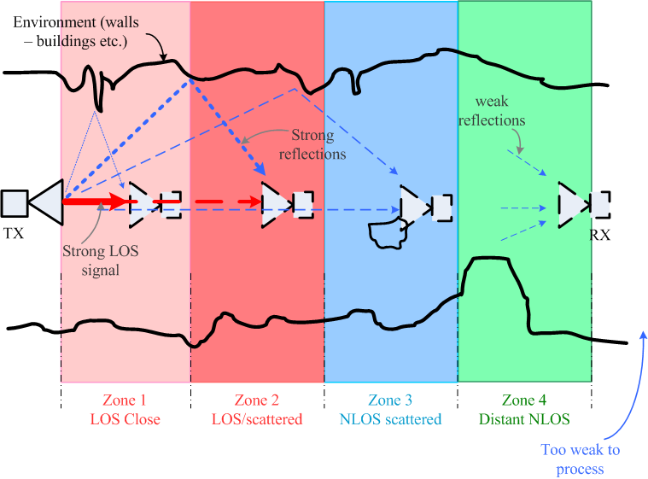
An Illustration of Physical Propagation Effects
Zone 1 (close range free space)
direct path with few reflections
Zone 2 (LOS/scattered/waveguide)
direct path with significant close reflections
Zone 3 (NLOS scattered)
strong reflections with some weak direct path energy
Zone 4 (distant NLOS)
both direct and reflected signals are weak
** The thicknesses of lines stand for the strengths of signal.

Slide 4
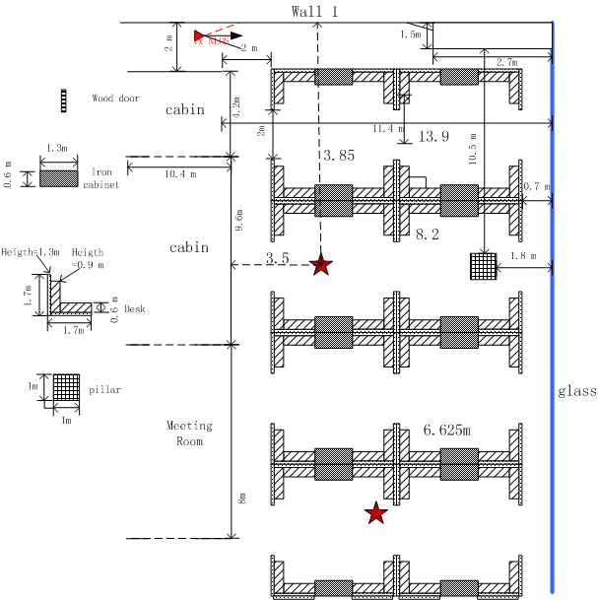
Preliminary Results of Propagation Effects in Different Transmission Zones
TX
73GHz measurement campaign;
Open office scenario;
RX position A is 6.03m away from TX;
RX position B is 12.79m away from TX;
RX
position A
RX
position B

Slide 5
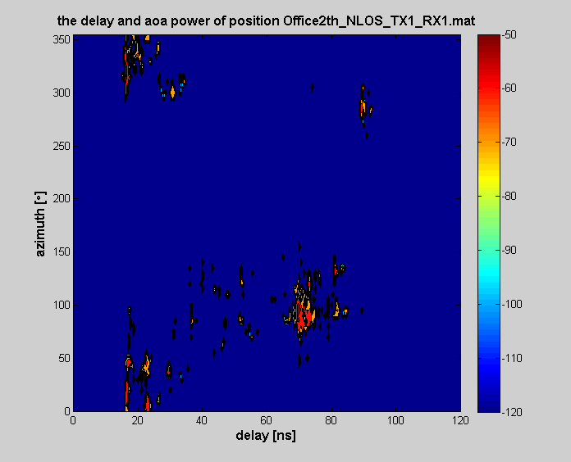
Preliminary Results of Propagation Effects in Different Transmission Zones (2)
TX
Joint domain spectrum @ position A
A
A
B
Main lobe LOS
RX
position A
Glass reflections
B
RX
position B
Position A (near-end): narrow delay spread & angular spread;

Slide 6
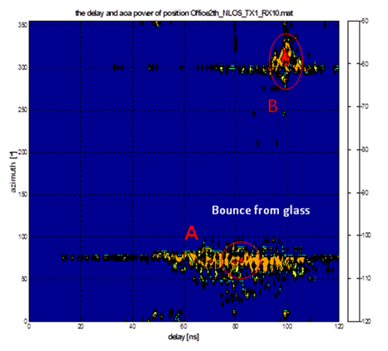
Preliminary Results of Propagation Effects in Different Transmission Zones (3)
TX
2 order reflections
RX
position A
Joint domain spectrum @ position B
Glass reflections
B
A
RX
position B
Position B (far-end): wide delay spread & narrow angular spread;

Slide 7
It looks like that we need more than one set of parameters to reflect the characteristics of channel…

Slide 8
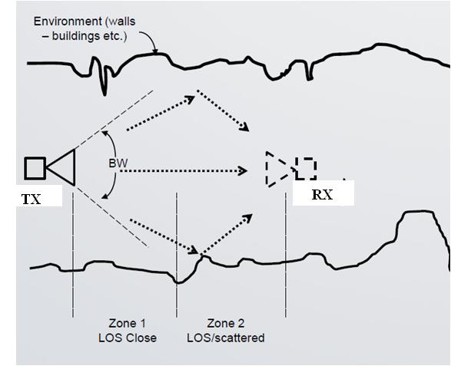
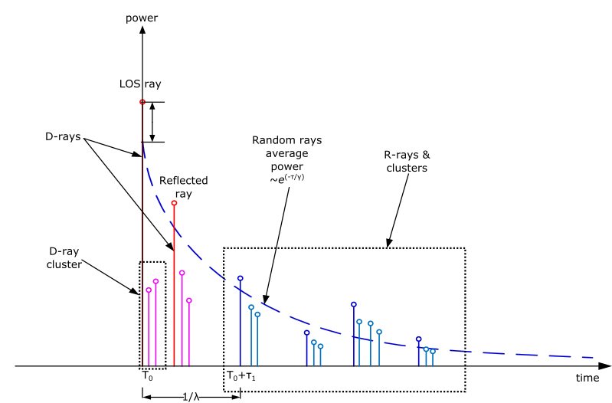
CIR Structure of Different Zones based on Q-D Channel Modeling Approach
Copy from [1]
RX locates in the zone that the propagation is dominated by the direct path and significant close reflections

Slide 9
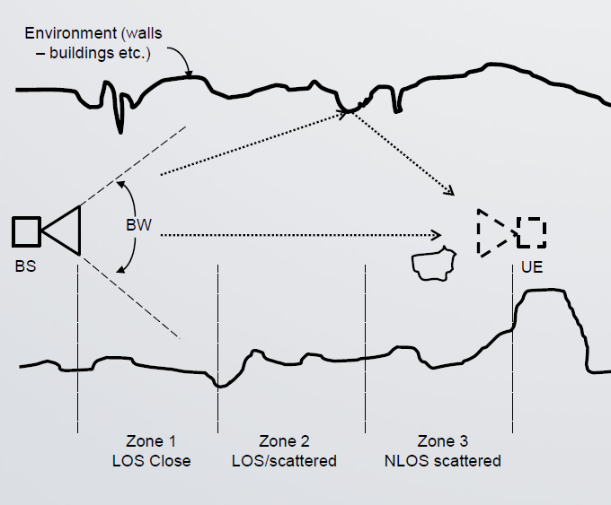
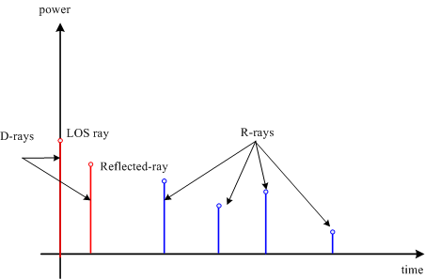
CIR Structure of Different Zones based on Q-D Channel Modeling Approach (2)
Power, angular spread (AS), or delay spread (DS) may change
TX
RX
RX locates in the zone that the propagation is mainly by the reflections with some direct path energy but these are attenuated by distance.

Slide 10
Zones for 11ay New Large-Scale Environments
The typical deployment “scenario” may overlap multiple propagation zones depending on the details of the environments.
Therefore, for example for 11ay new large-scale scenarios,
Open area – Zones 1 and 2;
Street canyon – Zone 2 and 3;
Hotel lobby – Zone 1, 2 and 3;

Slide 11
Zone Determination Criteria
Option 1 -- Distance Criterion
According to prior information, a distance within d₁ could be classified into Zone 1, and a distance with d₂ to d₃ could be considered as Zone 2, etc..
Option 2 – Power Criterion based on D-rays ray tracing
According to the strength of D-rays, e.g., if the LOS ray is significantly larger than the 1st order reflection ray, then Zone 1 is determined;
After that, R-rays are modeled in each zone.
Option 3 – Clustering Criterion based on R-rays statistical measurements
Clustering of the joint domain spectrum, and then zones are determined based on the characteristics of the clusters, e.g., narrow delay spread and angular spread corresponds to Zone 2.
After that, D-rays are calculated in each zone.

Slide 12
References
[1] IEEE 802.11-15/1150r2, “Channel Models for IEEE 802.11ay”

