Slide 1
Considerations on Phase Noise Model for 802.11ay
Date: 2016-03-17
Authors:

Slide 2
Motivation
Mar. 2016
Phase noise (PN) is one of the critical impairments in 60GHz band. It may significantly impact on the bit error rate, and yield synchronization problems.
In IEEE 802.11ad [1], PN characteristic is modeled as a one-pole-one- zero model, and applied in SYS/PHY simulations.
802.11ay introduces new use cases (e.g., wireless backhauling) and new features (e.g., MIMO), which will generate additional requirements on PN modeling.
This submission addresses this problem and proposes a new complementary PN model which may be better suitable for the 802.11ay simulation for these new cases or features.

Slide 3
Phase Noise and its Effects
Mar. 2016
I/Q demod.
Phase-noise from VCO/PLL
ADC
0
90
BPF
VGA
LNA
VGA
ADC
PLL (Osc.)
BPF
VGA
DAC
0
90
BPF
PA
PA drive
DAC
I/Q mod.
PN is a critical RF impairment, mainly occurred in oscillator.
  Even small amount of noise caused by an oscillator will lead to significant changes in its frequency spectrum and timing properties (timing jitter).
It may significantly affect system performance.

Slide 4
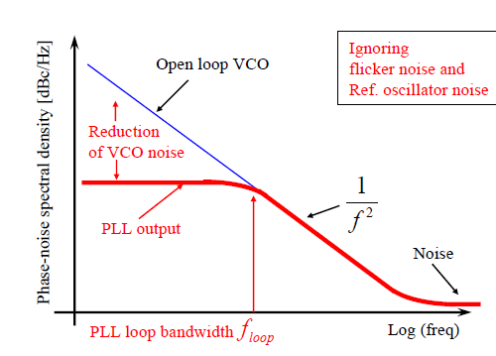
PLL Output Phase Noise Model
Mar. 2016
PLL (Phase-Locked-Loop) output model [2] is a typical PN model, and widely applied for carrier synchronization in communication system.
Its PN output is the synthesis of the noise in each building block.
Dominated Noise
noise
noise
noise
noise
Phase Detection
x N
Ref. Oscillator
LPF
VCO
Freq. Multiplier
(Optional)
noise
1/N
Freq. Divider
Phase noise contributions for a normal PLL (termed Single Local Oscillator Structure)
Phase noise characteristics for VCO and PLL [3]

Slide 5
802.11ad Phase Noise Model [1]
Mar. 2016
PN model in 802.11ad is a typical PLL output model that,
      PSD(0) = −90 dBc/Hz
      Pole frequency f_{p} = 1 MHz
      Zero frequency f_{z} = 100 MHz
      PSD (infinity) = −130 dBc/Hz
pole freq.
11ad theoretical result
zero freq.

Slide 6
New Requirements on PN model for 802.11ay
Mar. 2016
Outdoor scenario and MIMO transmission in 11ay, which will pose changes on current Single LO Structure of 11ad.
      Wireless Backhauling: To compensate significant propagation losses, a feasible and economical approach is by composing a larger array with higher antenna gain based on several small arrays (left-handed figure);
      MIMO: Multi-stream is supported by multiple RF paths (right-handed figure);
It is necessary to implement Multiple LOs Structure in 802.11ay.

Slide 7
Possible Multiple LOs Structures
Mar. 2016
Option A
Option B
Option C
A | Independent LO for each path/ no freq. multiplier
B | Independent LO & freq. multiplier for each path
C | Common oscillator/no freq. multiplier
D | Common oscillator & independent freq. multiplier for each path
Option D

Slide 8
Partially Coherent Common LO Structure (1/2)
Mar. 2016
Among these multiple LOs structures, we prefer Option D “partially coherent common LO structure” for its advantages,
      Compared with Option A & B, less oscillators are used, which will reduce RF circuit cost;
      In addition, for MIMO transmission, maintaining some correlation characteristic of PN between each path will be helpful in MIMO detection (since advanced PN compensation/ immunity schemes are feasible);
PNs between these paths are partially correlated

Slide 9
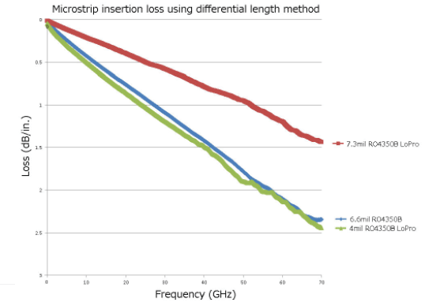
Partially Coherent Common LO Structure (2/2)
Mar. 2016
Among these multiple LOs structures, we prefer Option D “partially coherent common LO structure” for its advantages,
      Compared with Option A & C, reference source is first carried on fundamental frequency via common LO, and then carried to harmonical frequency. This procedure will reduce the feeder loss (since the feeder loss for the lower frequency signals is less);
Lower fundamental frequency signal
1.4 dB/in. @60GHz
2.2 dB/in. @60GHz
Measurements by Rogers Corp. [4]
Notes:
Harmonical
Fundamental

Slide 10
Proposed Phase Noise Model for 802.11ay
Mar. 2016
In this submission, we propose the following model for this partially coherent common LO structure, which is complementary to the PN model in 802.11ad
(treated as a Behavior Model)
Ideal Freq. Multiplier
Ref. Oscillator
LO ₁
    where,
    PN^{(m)} the output of phase noise in m^{th} path LO, LO_{m}
    PN₀ the output of LO signal after ideal frequency multiplier, i.e.,
    the independent noise caused by frequency multiplier, and can be simplified as white noise which PSD = − 130 dBc/Hz
x N
Shared LO₀
Freq. Multiplier Noise
LO ₂
x N
…
Freq. Multiplier Noise
…
…
LO _{M}
x N
Freq. Multiplier Noise

Slide 11
How to Generate the Proposed Phase Noise for 802.11ay
Mar. 2016
time
freq.
AWGN
FFT
IFFT
time
Phase-noise @ path 1
(N-point)
(N-point)
PSD
WGN₁
freq.
Phase-noise @ path 2
p₀
f_{p}
f_{z}
WGN₂
11ad Phase-noise characteristics
(red: original ; blue : omit background noise)
…
Phase-noise @ path M
WGN_{M}
      In the figure above, WGN_{i} is the independent white noise with PSD p₀ = − 130 dBc/Hz

Slide 12
Summary
Mar. 2016
New use cases and features in 802.11ay suggest new requirements on PN modeling.
For better performance evaluations, in this submission, possible multiple LOs structures are presented.
Partially coherent common LO structure is suggested for 802.11ay, and a complementary PN model is proposed accordingly .

Slide 13
Backup: the relationship between the proposed model and 11ad PN model
Mar. 2016
LO₀
PN₀
Ideal Freq. Multiplier
noise
noise
noise
noise
noise
Ref. Oscillator
LO ₁
Phase Detection
x N
x N
Ref. Oscillator
LPF
VCO
Freq. Multiplier
Shared LO₀
Freq. Multiplier Noise
noise
LO ₂
x N
1/N
Ideal Freq. Multiplier + Noise
Freq. Divider
…
Freq. Multiplier Noise
…
…
LO _{M}
x N
Freq. Multiplier Noise
Each path in the partially coherent common LO can be equivalent to a single LO in11ad, with independent frequency multiplier noise.

Slide 14
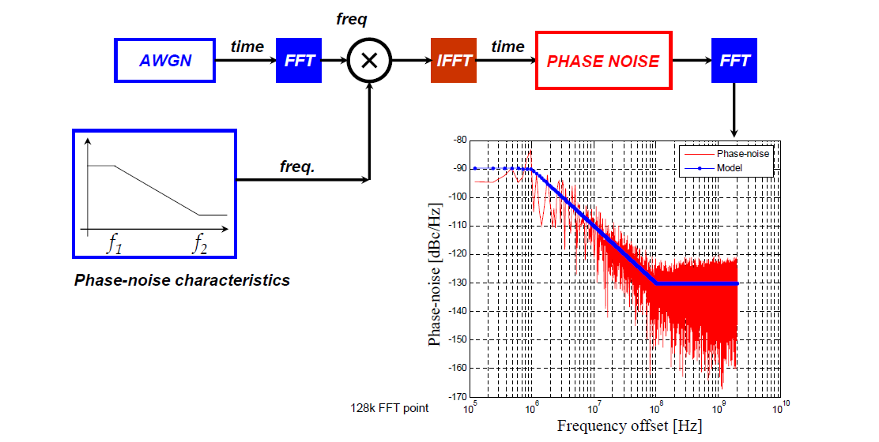
Backup: how to generate phase noise for 802.11ad
Mar. 2016
Source: IEEE802.15-06-0477-01-003c, “RF Impairment models for 60GHz-band SYS/PHY simulation”

Slide 15
References
Mar. 2016
[1] IEEE802.11-09/1213r1, “60 GHz Impairments Modeling”
[2] W. Rosenkranz, “Phase-Locked Loops with Limiter Phase Detectors in the Presence of Noise”, IEEE Tran. Communications, vol.30, no.10, Oct. 1982
[3] IEEE802.15-06-0477-01-003c, “RF Impairment models for 60GHz-band SYS/PHY simulation”
[4] Rogers Corporation, “RO4000® Series High Frequency Circuit Materials”

